Slide 1

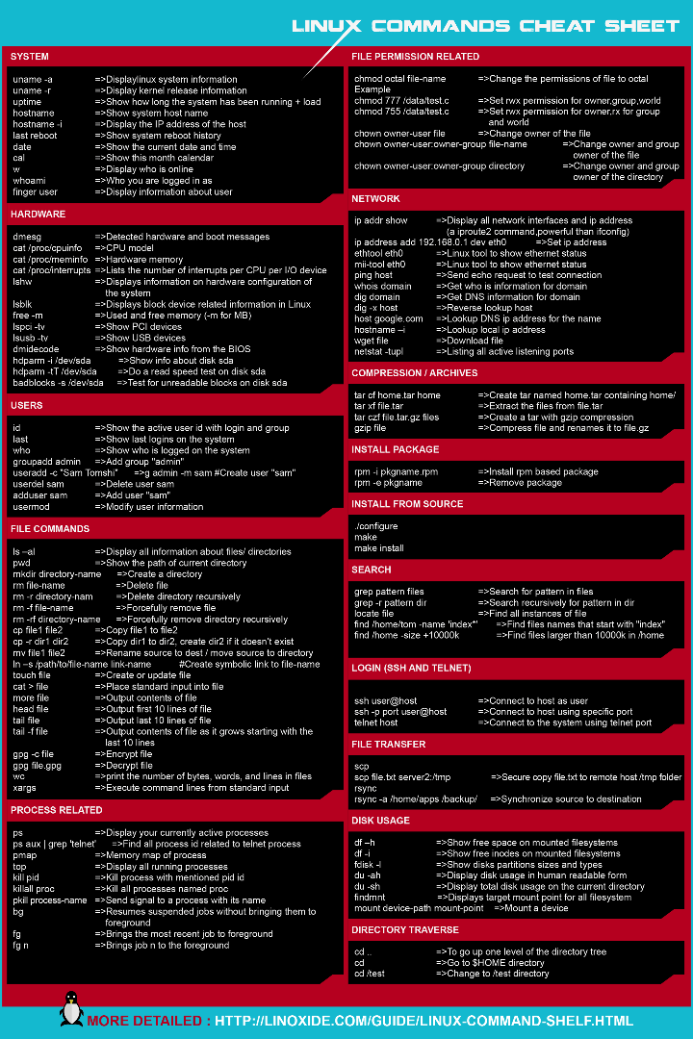


Introduction to Basic Process Utility Commands
Managing and monitoring processes is an important aspect of system administration. This presentation provides an overview of commonly used process utility commands in Linux. Learn how to list, view, and terminate processes, as well as change their priority to optimize system performance.
by dummy

Slide 2

Viewing Running Processes using 'ps'
Syntax
Description
Example
ps [options]
The 'ps' command lists all currently running processes. Use the option 'aux' to provide a detailed list of all running processes on the system. The '-ef' option allows you to see all processes in a slightly different format.
To list all running processes with more comprehensive information use 'ps aux'.

Slide 3
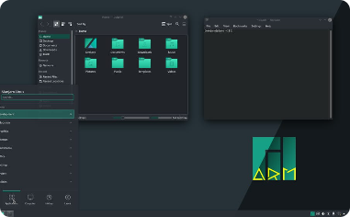
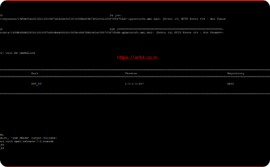
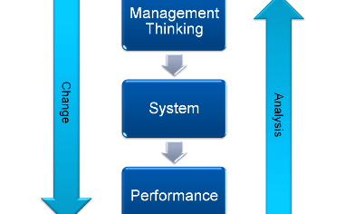
Real-time Monitoring with 'top'
Description
User-friendly Interface with 'htop'
Optimizing System Performance
The 'top' command provides real-time dynamic monitoring of system processes. Use this command to view running processes, CPU usage, memory usage, and other system statistics.
'htop' is an interactive process viewer that provides a more user-friendly interface. It allows you to scroll through the process list, sort processes, and send signals to them.
Monitoring processes with 'top' helps to identify resource-intensive processes that may be slowing down your system. Close or terminate these processes to optimize system performance.

Slide 4
Terminating Processes with 'kill' and 'killall'
1
'kill' Command
The 'kill' command is used to terminate or send signals to processes, providing a way to gracefully stop a running process. Use the 'kill [signal] [process_id]' syntax to send a signal to a specific process or terminate the process.
2
'killall' Command
Use the 'killall' command to terminate processes by name rather than by process ID. This command is useful when multiple instances of a process are running.

Slide 5
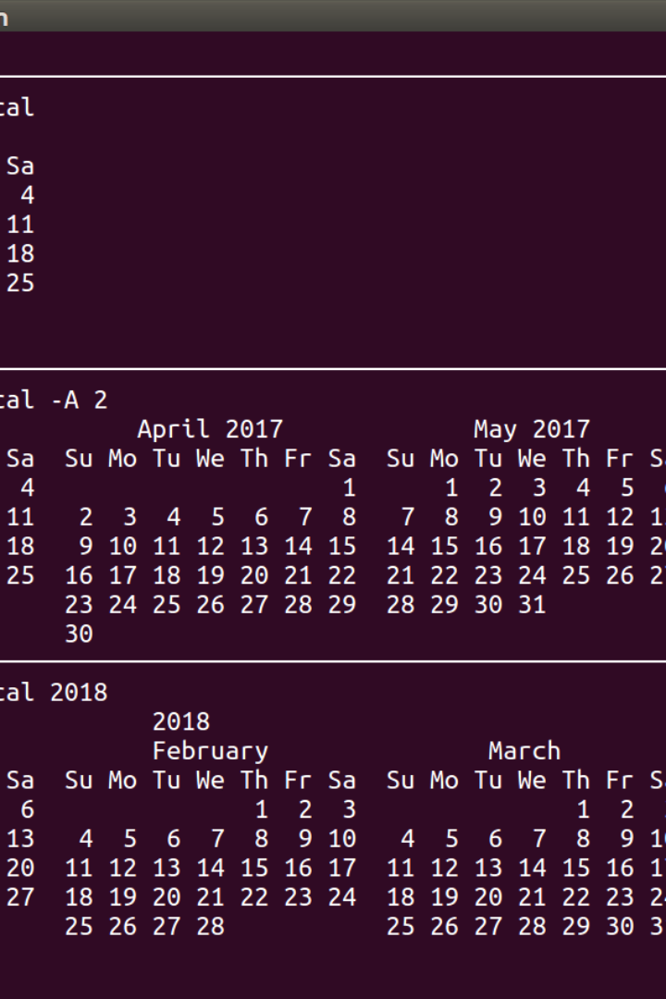
Killing Processes by Name with 'pgrep' and 'pkill'
1
'pgrep' Command
2
'pkill' Command
The 'pgrep' command is used to find the process IDs of processes that match a specified pattern or name. Use this command when you want to identify a specific running process.
Use the 'pkill' command to signal or terminate processes by name. This command offers an alternative to 'kill' when you don't know the process ID.
3
'Signal' a Running Process
You can also use 'pkill' to send signals to running processes. Use the '-SIGTERM' option to terminate the named process gracefully.

Slide 6
Managing Background Jobs with 'jobs'
Syntax
Description
jobs [-lnprs] [%job_id]
The 'jobs' command is used to list all currently running background jobs associated with the current terminal session. It's often used together with the 'bg' and 'fg' commands to manipulate background and foreground processes.

Slide 7
Changing Process Priority with 'nice' and 'renice'
Syntax
Description
nice [-n increment] [command [argument...]]
The 'nice' command is used to launch processes with a specified niceness level, which is a measure of priority given to the running processes. Use this command to give lower or higher priority to a process when it starts.
Syntax
Description
renice [-n increment] -p [process_id]
The 'renice' command is used to change the priority (niceness level) of running processes. Use this command to adjust the priority of running processes based on system performance.

Slide 8
Conclusion
Improved System Management and Optimization
Efficient Workflow
Knowing how to effectively use process-related commands streamlines your workflow and makes you more productive. Many of these commands can be executed in a matter of seconds, allowing you to quickly manage and troubleshoot your system.
Understanding and using these basic process utility commands in Linux are valuable skills for system administration, troubleshooting, and performance tuning. With these commands at your disposal, you can monitor and manage running processes to optimize system performance and improve system management.

