Slide 1
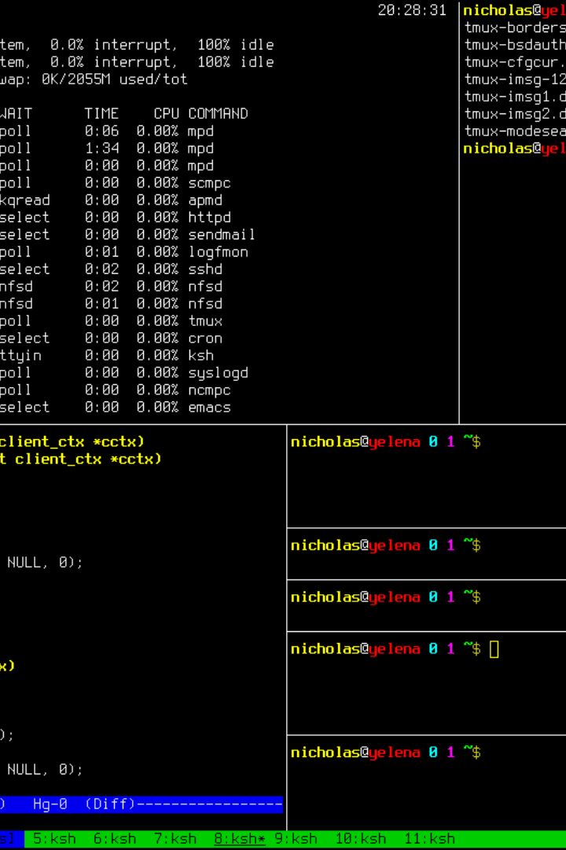


The Power of Chmod: Mastering File Permissions in Linux
Welcome to the world of Linux file permissions! In this presentation, we will explore the mighty chmod command and its role in controlling access to files and directories. Get ready to unleash your inner Linux wizard!
by THRISHALI KOTAGIRI

Slide 2
Understanding File Permissions
Owner
Group
Others
The owner has full control over the file and can modify permissions.
The group has a specified level of access defined by the owner.
All other users who are not the owner or part of the group.

Slide 3

Chmod Basics
1
Symbolic Mode
2
Numeric Mode
Use letters such as "u" for user, "g" for group, and "o" for others along with "+" (add), "-" (remove), and "=" (set).
Represent permissions using numerical values: 4 (read), 2 (write), 1 (execute). Add the values to get the desired permission level.
3
Common Examples
For instance, "chmod u+rwx file.txt" gives the owner read, write, and execute permissions on "file.txt".

Slide 4
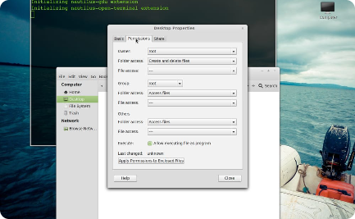
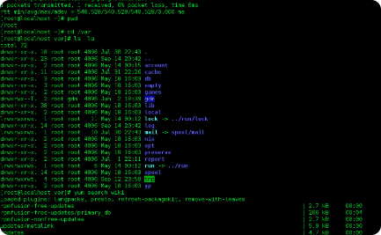
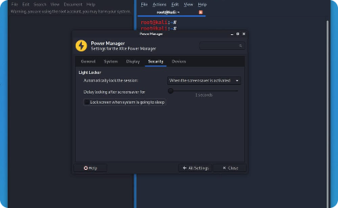
Advanced File Permission Manipulation
Octal Notation
Recursively Modifying Permissions
SUID, SGID, and Sticky Bit
Assign permissions at once using 3-digit octal numbers. For example, "chmod 755 script.sh" grants the owner full control, group read and execute access, and others read and execute permissions.
Learn about special file permissions that can elevate privileges or enforce specific behaviors.
Apply chmod command to a directory and its contents with the "-R" flag. Be cautious when using this option.

Slide 5
File Permission Best Practices
1
Principle of Least Privilege
Grant only the necessary permissions to ensure security and minimize potential risks.
2
Regular Auditing
Periodically review and audit file permissions to identify any unauthorized access or changes.
3
Delegation
Assign appropriate permissions to different user groups for collaborative workflows.

Slide 6
Security Considerations
Protecting Sensitive Data
Avoiding Recursive Mistakes
Combining with Other Security Measures
Ensure confidential information is accessible only to authorized individuals with strict permission settings.
Double-check the target when using recursive chmod commands to prevent unintended permission changes.
File permissions should be part of a comprehensive security strategy, including encryption and user access controls.

Slide 7

Common Mistakes to Avoid
1
Unnecessary 777 Permissions
2
Using Wildcards Carelessly
Avoid granting full read, write, and execute access to everyone for files and directories. Stick to the principle of least privilege.
Be careful when using wildcards with the chmod command, as it may result in unintended changes affecting multiple files.
3
Ignoring File Ownership
File permissions combined with correct ownership ensure both security and accountability. Always consider both factors.

Slide 8
Troubleshooting and Tips
1
Error Messages
Understanding common error messages like "Permission denied" and their troubleshooting methods.
Effective Use of Wildcards
2
Master the art of using wildcards like "*", "?" to select multiple files or directories for permission modification.
3
Undoing Permission Changes
Learn how to revert permission changes using the "chmod" command with appropriate options.

Slide 9
Conclusion
Congratulations! You now possess the knowledge to wield the mighty chmod command and exercise fine-grained control over file permissions in Linux. Embrace your newfound power and keep exploring the vast possibilities of the Linux operating system!

