Slide 1
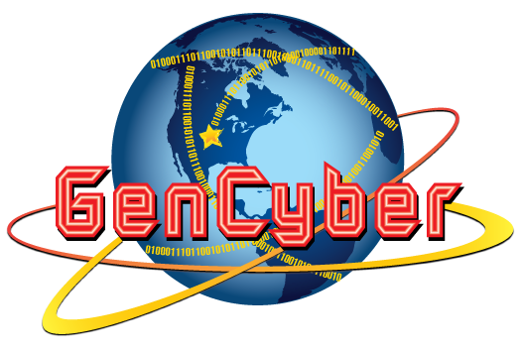

Silicon Prairie Gencyber
Computer Hardware

Slide 2
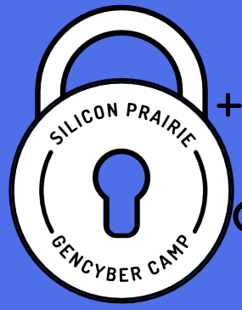
Cybersecurity First Principles
Domain Separation
Process Isolation
Resource Encapsulation
Least Privilege
Layering
Abstraction
Information Hiding
Modularity
Simplicity of Design

Slide 3
Overview
Defining a computer
Types of computers
Component Identification
Input/Output Devices
Preparing to open the System Unit
Internal component Identification
Storage types
Software types

Slide 4
Defining a Computer
A computer is a device that accepts data input from several sources, processes the data and then produces an output to answer a question, solve a problem or carry out a task.

Slide 5
Types of Computers
PC (Personal Computer)
Mac
Netbook
Tablets
Supercomputer
Laptop
Mainframe
Smartphone
Wearable

Slide 6
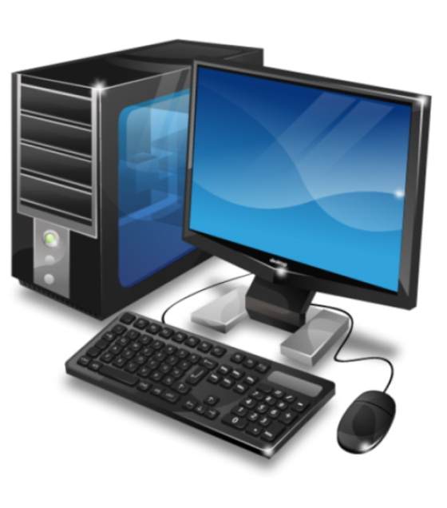
PC
Based on the IBM PC
Uses OS (Operating Systems)
DOS (Disk Operating System)
Windows
Most popular for business
Form factors
Desktop
Laptop
Servers

Slide 7
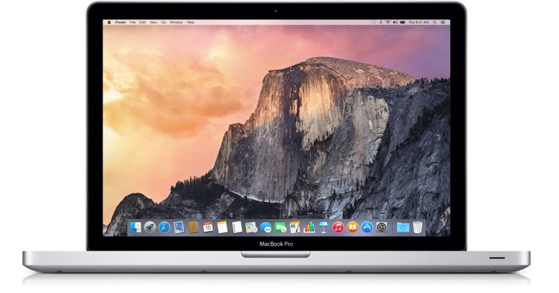
Mac
Released in mid 80’s
More expensive
Desired for graphics and video
Introduced using the i86 processor in 05
Uses the OSx operating system
Form factors
Desktop
Laptop

Slide 8
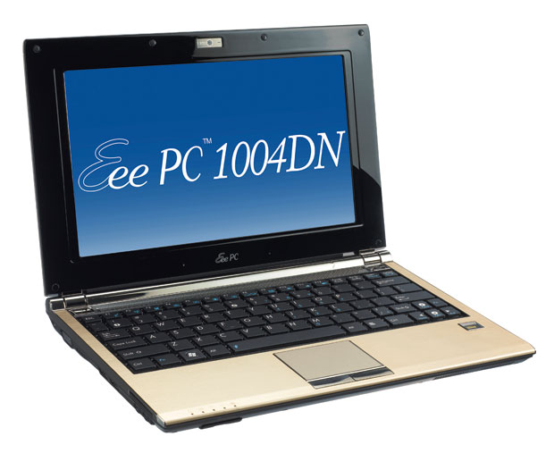
Netbook
Introduced in 2007
Smaller that a laptop
Light weight
Many used Linux OS
Introduced the us of Solid State Drives (SSD)
Predecessor to the Unltrabooks and Chromebooks

Slide 9
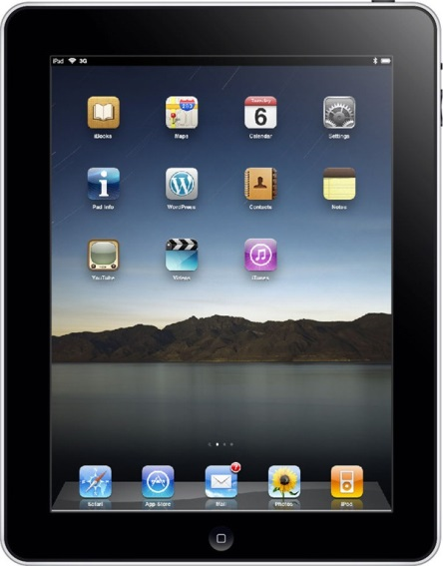
Tablets
Apple introduced the iPad in 2010
Uses touch screen for input from user
All solid state components
Forms
iPad series
Surface
Galaxy

Slide 10
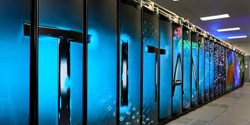
Supercomputer
Operate at the highest rate
Used in
Science
Engineering
Used to help solve complex problems
Simulates environments
Types
Cray
IBM
Fujitsu

Slide 11
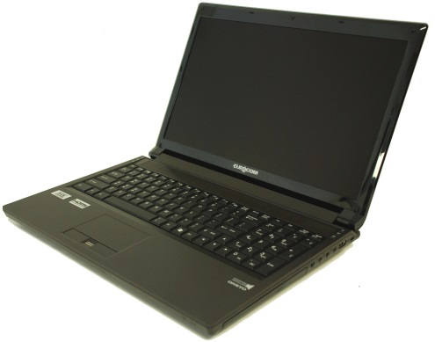
Laptop
Portable
Used for
Students
Travelers
Instructors
Because of battery powered, can be moved to different locations
Can use
Wired communications
WiFi (Wireless Fidelity)

Slide 12
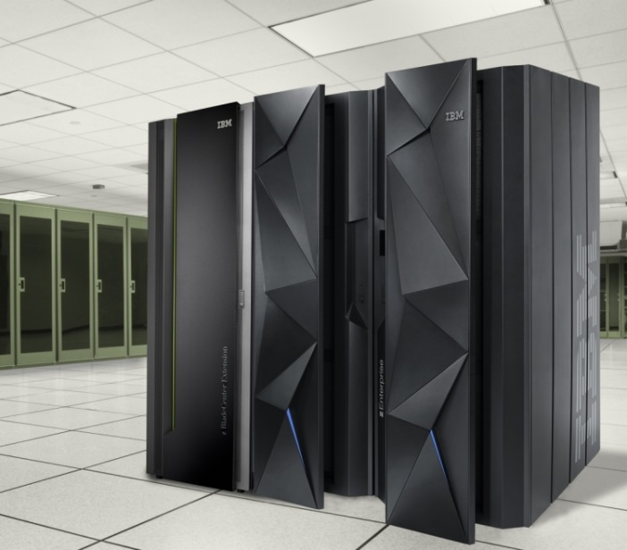
Mainframe
Large expensive computers
Processes large amounts of data
Supports hundreds or thousands of users
Commonly seen in banking, airlines and corporate environments
Walmart
First National Bank
Werner Trucking

Slide 13
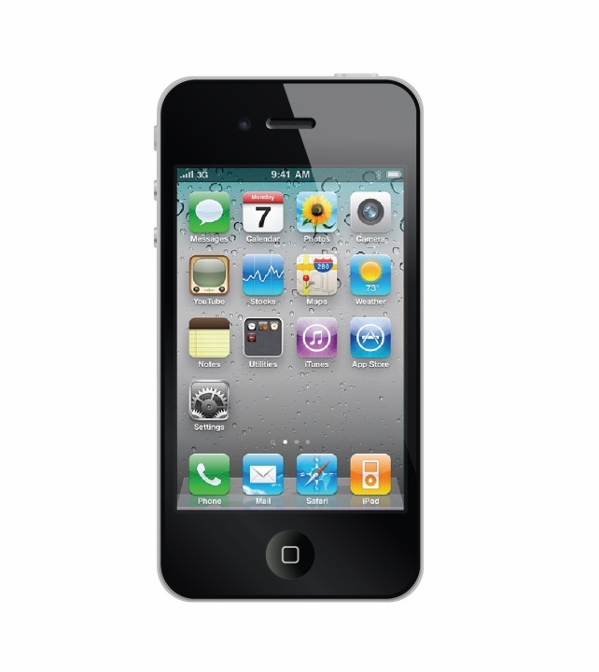
Smartphone
A combined phone and computer
Replaced the PDA (Personal Digital Assistant)
Gives the user the power of a computer in the palm of their hand
Can accomplish just about any task a computer can accomplish

Slide 14
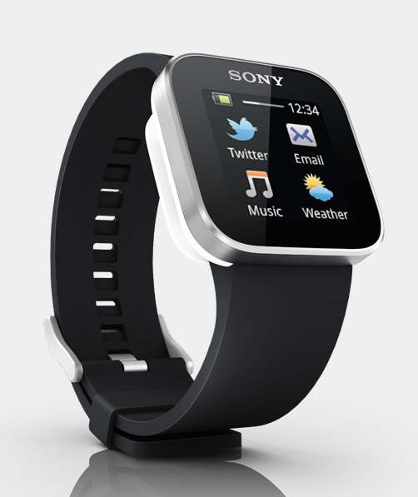
Wearables
Beginning to trend
iWatch – Apple
Moto 360 - Motorola
Samsung Gear
Fitbit – fitness tracker
Pebble – smart watch

Slide 15
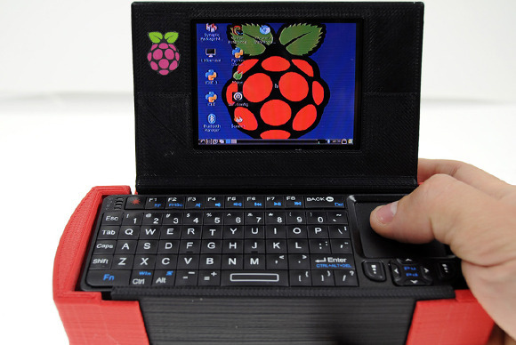
Raspberry Pi
A low cost credit-card sized computer
Uses Linux OS
Things you can do
Home server
Media hub
Pi glasses
Smartphone

Slide 16
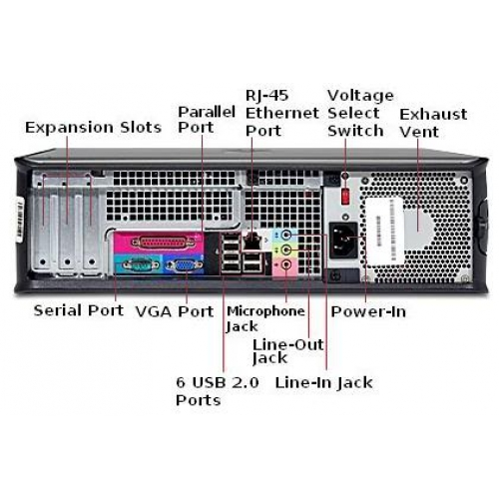
Connection Identification

Slide 17
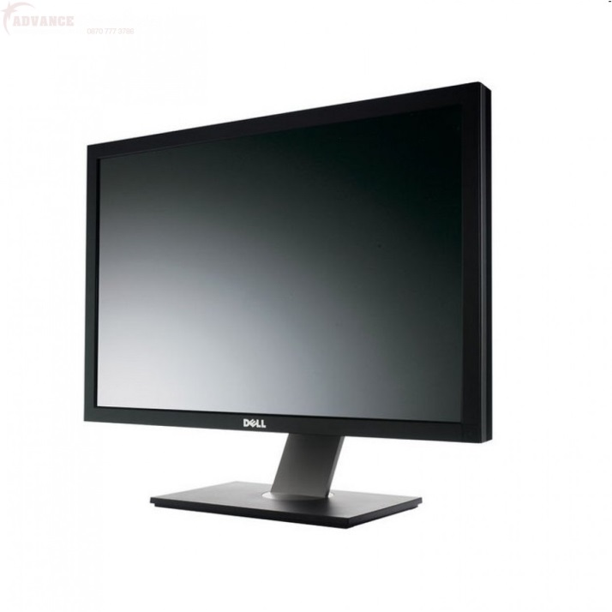
Input/Output Devices
Input Devices
Mouse
Keyboard
Microphone
Output Devices
Speakers
Monitor
Printer

Slide 18
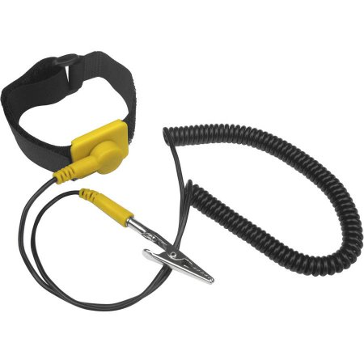
Preparation to open System Unit
Remove jewelry
Place computer on an antistatic mat
Use grounding strap
Have the proper tools available for the task

Slide 19
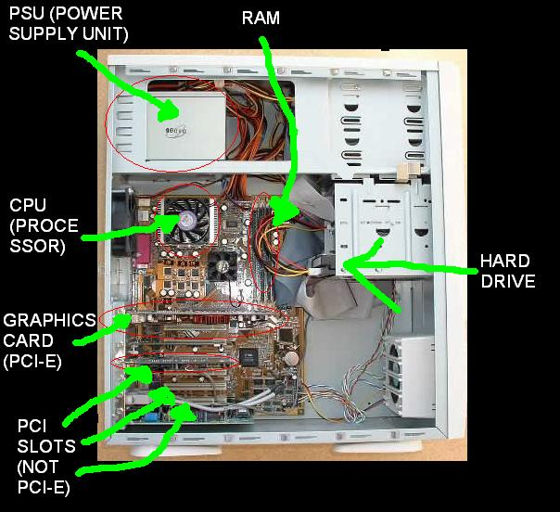
Domain Separation
Least Privilege
Layering
Modularity
Minimization
Notes:
- Inside a computer system, there are also domains. For example, most hardware
microprocessors have a supervisor domain (sometimes referred to as a
supervisor state or privileged state) and a user domain. In supervisor state,
privileged hardware instructions can be executed. An operating system uses
these hardware domains to implement mechanisms that protect it from
interference by user written programs and purchased applications. The
operating system code runs in supervisor state, while the user programs run in
the user domain.
- When a person gets a new computer, s/he installs or logs onto the computer
using an administrative account. This account has privileges to install software,
add users, add hardware, and add and delete almost any program or file. The
account is all powerful and must be used wisely. If a person uses a browser to
access a website that contains malware and they are running as administrator, it
is more likely that malware could be installed. If the person was running as a
regular user with minimal privileges, the malware would not have been installed.
- The goal of minimization is to simplify and decerase the number of ways that
software can be exploited. This can include turning off ports that are not
needed, reduce the amount of code running, use the concept of least privilege
and turn off unneeded features.

Slide 20
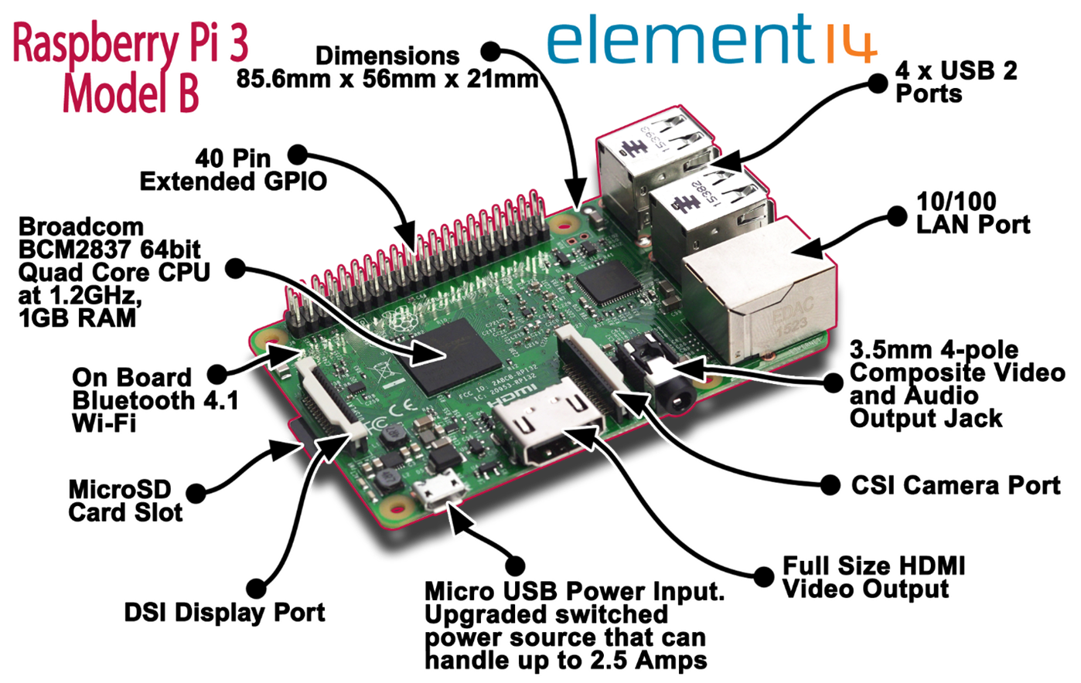
Raspberry Pi

Slide 21
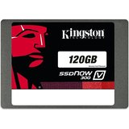
Storage Types
RAM (Random Access Memory)
Volatile
Measured in
Megabytes
Gigabytes
Hard Disk Drive
Electrical/mechanical
Uses platters to read/write data
Solid State Drive
Uses chips instead of platters
Faster in accessing data

Slide 22
Software Types
Domain Separation
Least Privilege
Layering
Modularity
Minimization
Systems software
Designed to run and interface the hardware
Used to manage the computer and software
Windows
Linux
OSx
Application Software
Used to carry out a task
Word-processing
Spreadsheet
Presentations

Slide 23
Summary
Understand hardware and how it relates to the first principles
They types of computers
Identify hardware components
Identify major software types

