Slide 1


Silicon Prairie Gencyber
Wireless

Slide 2

Cybersecurity First Principles
Least Privilege
Layering
Information Hiding
Modularity
Simplicity of Design

Slide 3
Silicon Prairie Gencyber
Define wireless
Cellular
Wi-Fi (Wireless Fidelity)
Issues
Tools

Slide 4
Defining Wireless
Sending and receiving data using radio waves

Slide 5
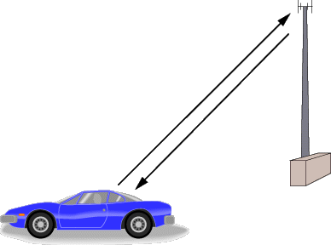
Cellular
A radio network distributed across the area in cells
Uses two frequencies to give full duplex communications
Transmit
Receive
Typical cell covers between 9 and 21 miles

Slide 6
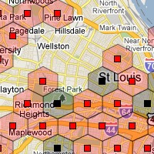
Cellular
The device is handed off to the next cell when the signal on one becomes weak
Divided into generations
1st – Analog
2nd – GSM, TDMA, CDMA, PDC
3rd – CDMA, UMTS, EDGE
4th – CDMA, HSDPA, LTE
5th – Used for VR and driverless cars

Slide 7
Wi-Fi (Wireless Fidelity)
Short range wireless broadband
Standards
Established by the IEEE (Institute of Electrical and Electronic Engineers)
Base standard 802.11

Slide 8
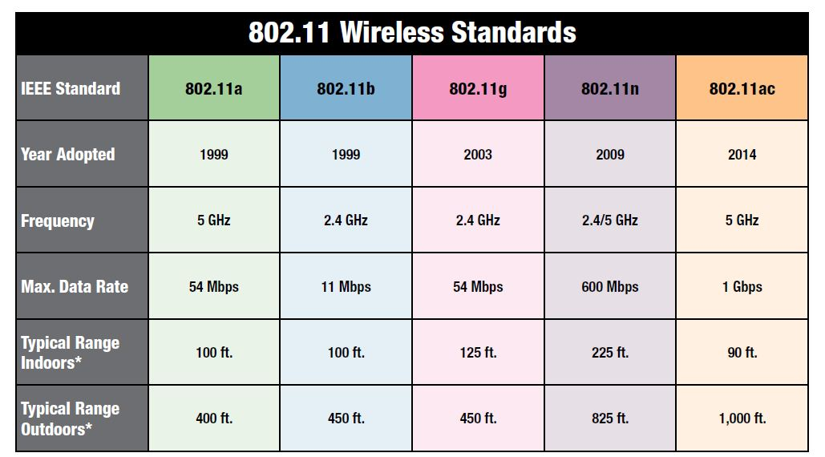
Wi-Fi (Wireless Fidelity)

Slide 9
Issues
Cellular
Congestion
Interference
Fading
Tower coverage
Wi-Fi
Interference
Channels
Fading
Firmware
Location of AP
War Driving

Slide 10
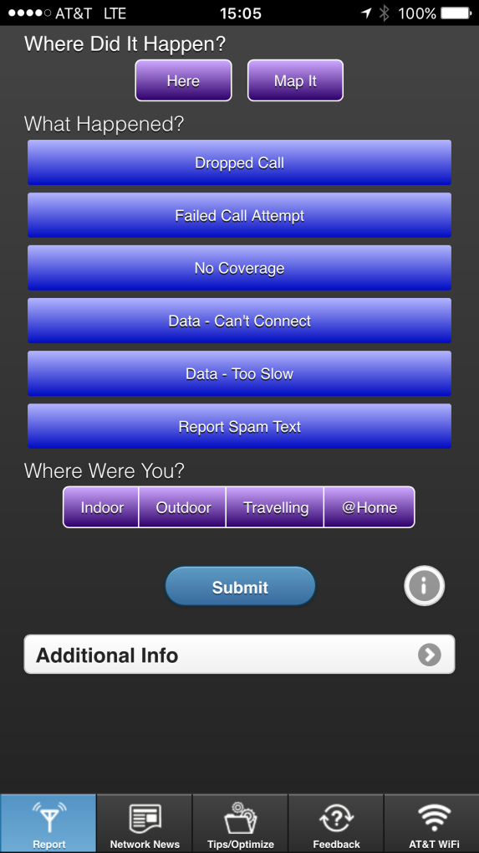
Tools
Cellular
Mark the spot (AT&T)
Field Test connection
iPhone (*3001#12345#*)
Each device will have a different process
Wi-Fi
Fing
Wi-Fi Scanner
Wi-Fi Analyzer
Wi-Fi Signal App
Visstumbler

Slide 11
Wi-Fi PineApple
Used for penetration testing
Used for man-in-the middle attacks
Can be setup as a Evil Twin

Slide 12
Countermeasures
Use MAC (Media Access Control) filtering
Use encryption
Disable SSID (Service Set Identifier) broadcast
Change default passwords and SSID
Limit range
Keep firmware current
Limit access times

Slide 13
Summary
Basics of wireless connectivity
Know the differences between cellular and Wi-Fi
Issues of using wireless
Tools for security and administrators
Countermeasures

