Slide 1


Silicon Prairie Gencyber
Cryptography

Slide 2
Objectives
Why is cryptography important to cybersecurity
Early example of cryptography: Caesar cipher
Weaknesses of cryptography
Using Python to break a code

Slide 3

Cybersecurity First Principles
Domain Separation
Process Isolation
Resource Encapsulation
Least Privilege
Layering
Abstraction
Information Hiding
Modularity
Simplicity of Design
Minimization

Slide 4

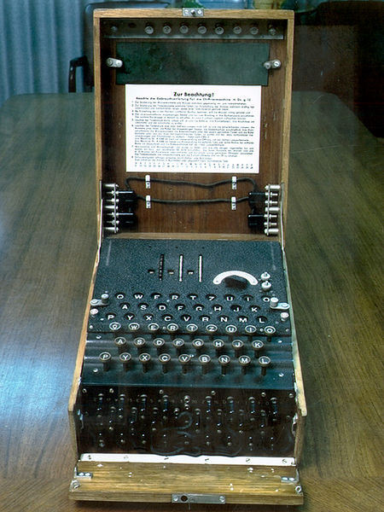
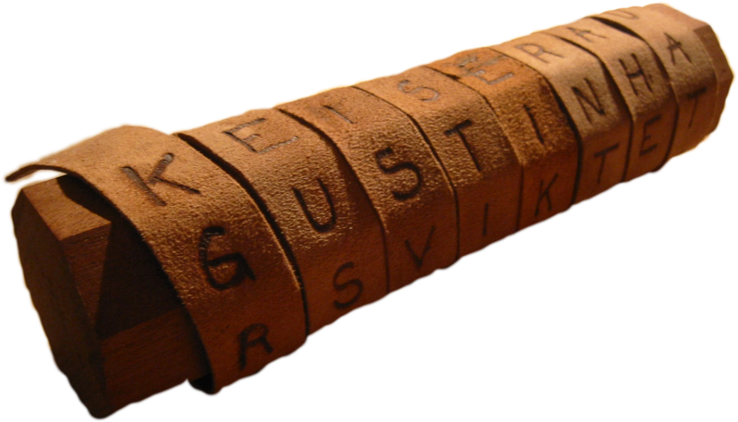
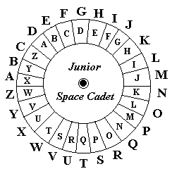
What is Cryptography?

Slide 5
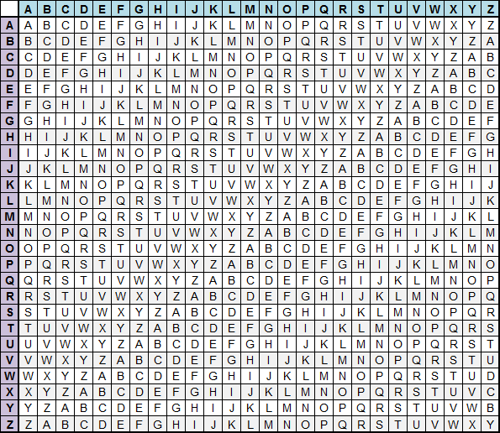
Early Cryptography Caesar Cipher
How are you?
Pwe izm gwc?
What’s the key?
I

Slide 6
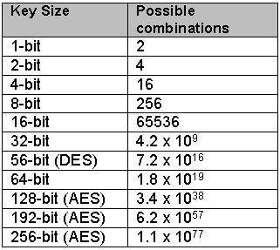
What’s wrong with Caesar?
Keyspace
Cryptanalysis
___is the most common first letter of a word
___ is the most common last letter of a word
___ is them most common word
Common two-letter combos: _______________
Common three-letter combos: ______________
T
E
The
he, re, an, th, er, in
ent, ing, ion, and

Slide 7

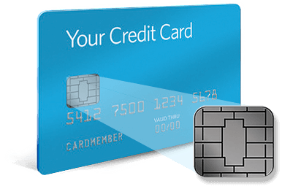
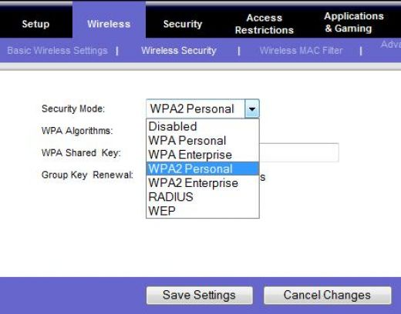
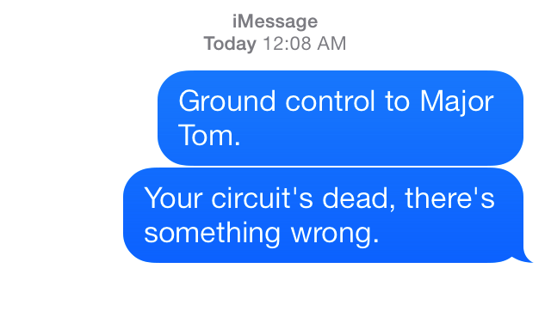

Where is Cryptography Used?

Slide 8
HELP!!!!
Just when you thought it was safe to take a break you've found out that Claire, Elf Corp's lead programmer got lost on the way to work playing Pokemon GO. She developed a program to encrypt the company's lunch menu with a Caesar cipher. Unfortunately, she never completed the decrypting program and the cafeteria is serving blanched brussels sprouts today, no one wants to get in that line. You've been recruited to write a decrypting algorithm, and…oh yea, no one knows the key.

Slide 9
Found Code
#! /usr/bin/env python3
ALPHABET = "abcdefghijklmnopqrstuvwxyz"
def caesar (word, key):
encoded = ""
for ch in word:
if ch in ALPHABET:
index = ALPHABET.find(ch)
nextIndex = (index + key) % 26
encoded += ALPHABET[nextIndex]
else:
encoded += ch
return encoded
pfiggszg gdfcihg cb zwbs gwl.

Slide 10
Silicon Prairie Gencyber
pfiggszg gdfcihg cb zwbs gwl.

