Slide 1
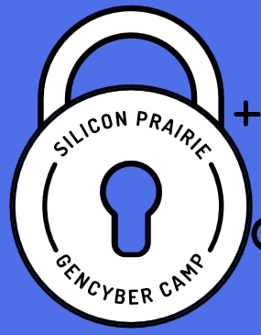



Computer Forensics

Slide 2
Cybersecurity First Principles
Domain Separation
Process Isolation
Resource Encapsulation
Least Privilege
Layering
Abstraction
Information Hiding
Modularity
Simplicity of Design
Minimization

Slide 3
Objectives
Describe the field of digital forensics
Explain how to prepare computer investigations and summarize the difference between public-sector and private-sector investigations
Explain the importance of maintaining professional conduct
Describe how to prepare a digital forensics investigation by taking a systematic approach
Notes:
Objectives
Describe the field of digital forensics
Explain how to prepare computer investigations and summarize the difference between public-sector and private-sector investigations
Explain the importance of maintaining professional conduct
Describe how to prepare a digital forensics investigation by taking a systematic approach

Slide 4
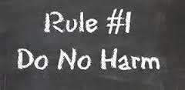
If you don’t know what your doing, it’s often better not to do anything.

Slide 5
An Overview of Digital Forensics
Digital forensics
The application of computer science and investigative procedures for a legal purpose involving the analysis of digital evidence after proper search authority, chain of custody, validation with mathematics, use of validated tools, repeatability, reporting, and possible expert presentation.
In October 2012, an ISO standard for digital forensics was ratified - ISO 27037 Information technology - Security techniques
Notes:
An Overview of Digital Forensics
Digital forensics
The application of computer science and investigative procedures for a legal purpose involving the analysis of digital evidence after proper search authority, chain of custody, validation with mathematics, use of validated tools, repeatability, reporting, and possible expert presentation.
In October 2012, an ISO standard for digital forensics was ratified - ISO 27037 Information technology - Security techniques

Slide 6
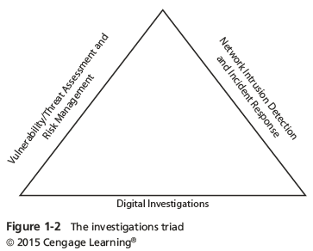
Digital Forensics and Other Related Disciplines
Forensics investigators often work as part of a team, known as the investigations triad
Notes:
Digital Forensics and Other Related Disciplines
Forensics investigators often work as part of a team, known as the investigations triad
Figure 1-2 The investigation triad

Slide 7
Understanding Private-Sector Investigations
During private investigations, you search for evidence to support allegations of violations of a company’s rules or an attack on its assets
Three types of situations are common:
Abuse or misuse of computing assets
E-mail abuse
Internet abuse
A private-sector investigator’s job is to minimize risk to the company
Notes:
Understanding Private-Sector Investigations
During private investigations, you search for evidence to support allegations of violations of a company’s rules or an attack on its assets
Three types of situations are common:
Abuse or misuse of computing assets
E-mail abuse
Internet abuse
A private-sector investigator’s job is to minimize risk to the company

Slide 8
Maintaining Professional Conduct
Professional conduct - includes ethics, morals, and standards of behavior
An investigator must exhibit the highest level of professional behavior at all times
Maintain objectivity
Maintain credibility by maintaining confidentiality
Investigators should also attend training to stay current with the latest technical changes in computer hardware and software, networking, and forensic tools
Notes:
Maintaining Professional Conduct
Professional conduct - includes ethics, morals, and standards of behavior
An investigator must exhibit the highest level of professional behavior at all times
Maintain objectivity
Maintain credibility by maintaining confidentiality
Investigators should also attend training to stay current with the latest technical changes in computer hardware and software, networking, and forensic tools

Slide 9
Taking a Systematic Approach
Steps for problem solving
Make an initial assessment about the type of case you are investigating
Determine a preliminary design or approach to the case
Create a detailed checklist
Determine the resources you need
Obtain and copy an evidence drive
Notes:
Taking a Systematic Approach
Steps for problem solving
Make an initial assessment about the type of case you are investigating
Determine a preliminary design or approach to the case
Create a detailed checklist
Determine the resources you need
Obtain and copy an evidence drive

Slide 10
Taking a Systematic Approach
Steps for problem solving (cont’d)
Identify the risks
Mitigate or minimize the risks
Test the design
Analyze and recover the digital evidence
Investigate the data you recover
Complete the case report
Critique the case
Notes:
Taking a Systematic Approach
Steps for problem solving (cont’d)
Identify the risks
Mitigate or minimize the risks
Test the design
Analyze and recover the digital evidence
Investigate the data you recover
Complete the case report
Critique the case

Slide 11
Assessing the Case
Systematically outline the case details
Situation
Nature of the case
Specifics of the case
Type of evidence
Known disk format
Location of evidence
Based on these details, you can determine the case requirements
Notes:
Assessing the Case
Systematically outline the case details
Situation
Nature of the case
Specifics of the case
Type of evidence
Known disk format
Location of evidence
Based on these details, you can determine the case requirements

Slide 12
Planning Your Investigation
A basic investigation plan (cont’d):
Prepare your forensics workstation
Retrieve the evidence from the secure container
Make a forensic copy of the evidence
Return the evidence to the secure container
Process the copied evidence with computer forensics tools
Notes:
Planning Your Investigation
A basic investigation plan (cont’d):
Prepare your forensics workstation
Retrieve the evidence from the secure container
Make a forensic copy of the evidence
Return the evidence to the secure container
Process the copied evidence with computer forensics tools

Slide 13
Conducting an Investigation
Gather resources identified in investigation plan
Items needed
Original storage media
Evidence custody form
Evidence container for the storage media
Bit-stream imaging tool
Forensic workstation to copy and examine your evidence
Securable evidence locker, cabinet, or safe
Notes:
Conducting an Investigation
Gather resources identified in investigation plan
Items needed
Original storage media
Evidence custody form
Evidence container for the storage media
Bit-stream imaging tool
Forensic workstation to copy and examine your evidence
Securable evidence locker, cabinet, or safe

Slide 14
Gathering the Evidence
Avoid damaging the evidence
Steps
Fill out the evidence form, have the manager sign
Place the evidence in a secure container
Carry the evidence to the computer forensics lab
Make bit-stream copies of the evidence
Complete the evidence custody form
Secure evidence by locking the container
Notes:
Gathering the Evidence
Avoid damaging the evidence
Steps
Meet the IT manager to interview him
Fill out the evidence form, have the IT manager sign
Place the evidence in a secure container
Carry the evidence to the computer forensics lab
Complete the evidence custody form
Secure evidence by locking the container

Slide 15
Hashing / Checksum
Unique identifiers
Used for
Passwords
Forensics
File Integrity checking

Slide 16
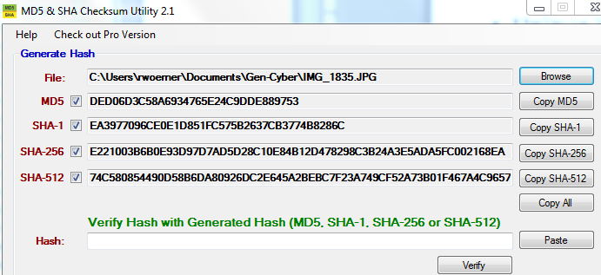
Hashing / Checksum
Algorithms:
MD5
SHA-256

Slide 17
Forensics Tools
OS Forensics
Forensics ToolKit (FTK)
EnCase

Slide 18

Email Headers
Notes:
https://mxtoolbox.com/Public/Content/EmailHeaders/

Slide 19
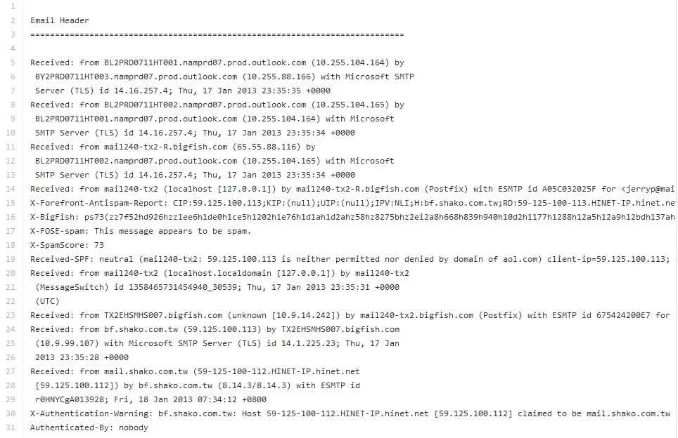
Email Headers
https://github.com/MLHale/GenCyber-web-content/tree/master/day3/email-headers

Slide 20
Viewing Browser History & Cookies
How to view cookies
https://kb.iu.edu/d/ajfi
http://www.wikihow.com/View-Cookies
How to view browsing history
http://www.wikihow.com/View-Browsing-History

Slide 21
Links and Resources
Phishing
Anti-Phishing Working Group (http://apwg.org/)
Tracing
www.arin.net
www.internic.com
Social Networking forensics
http://www.x1.com/products/x1_social_discovery/
http://afentis.com/expert-witness/forensic-software

Slide 22
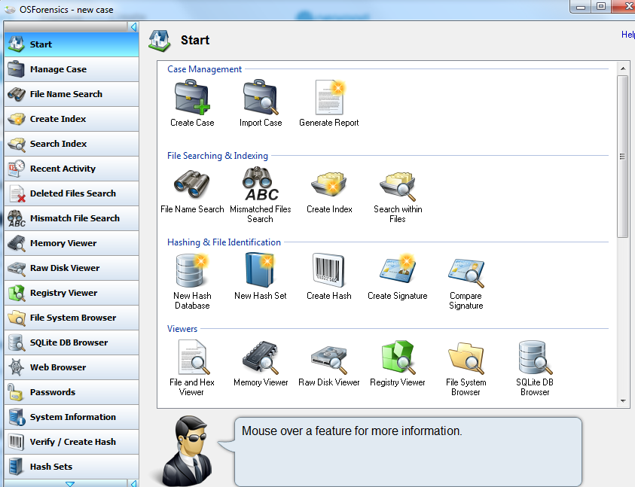
Let’s Try It - OSForensics

Slide 23
Exercise
On the Gen-Cyber Windows image
Find the hidden folder / file
Why can’t you open the file?
How do you view the file?
Identify
What (type of file)
Where (geo coordinates)
When (exact date/time)
How (device used)

Slide 24
Shortcuts & Cheat Sheets
Computer Shortcut Keys
Windows 7 Keyboard Shortcuts (also found at Microsoft eBooks & Resources)
Web Apps Have Keyboard Shortcuts, Too — And Many Work Almost Everywhere
SANS Digital Forensics Cheat Sheets - http://digital-forensics.sans.org/community/cheat-sheets
Linux - http://www.cheat-sheets.org/saved-copy/fwunixref.pdf

Slide 25
Internet Security Principles
Domain Separation
Resource Encapsulation
Layering
Abstraction
Information Hiding
Modularity
Minimization

