Slide 1
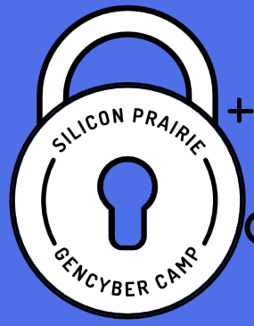



Computer Networking

Slide 2
Cybersecurity First Principles
Domain Separation
Process Isolation
Resource Encapsulation
Least Privilege
Layering
Abstraction
Information Hiding
Modularity
Simplicity of Design
Minimization

Slide 3
What is a “Network”?
A network is a way to get “stuff” between 2 or more “things”
Examples: Mail, phone system, conversations, railroad system, highways and roads.

Slide 4


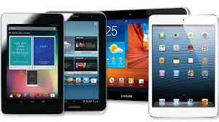
Home Network
Wall Jack
Switch/Router
Ethernet Cable
DSL/Cable Modem
Ethernet Cable

Slide 5
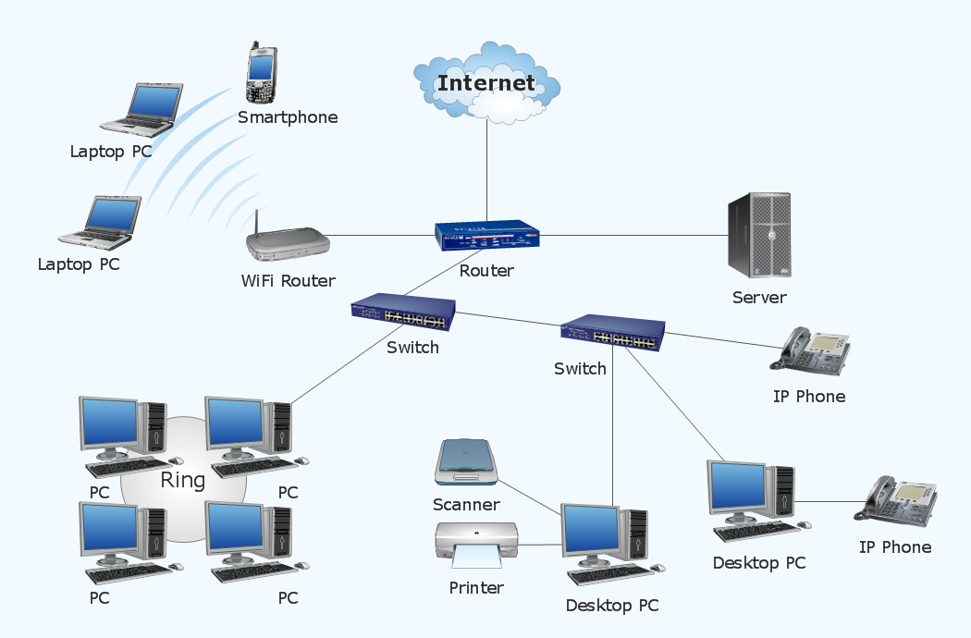
School / Business Network
WiFi
WAN
LAN

Slide 6
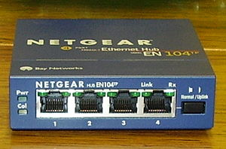

Hub/Switch/Router
To connect multiple segments of networks into a larger one
Hub
A multiport repeater to enhance signal within the same LAN
Switch
Like hub but with intelligent
Better performance
Router
Forward packets from one LAN to another

Slide 7
Protocol Concepts
Protocols are sets of rules.
What do you want to do? (Application)
Where are you going? (Addressing)
How do you get there? (Media types)
Did you get there? (Acknowledgments, Error checking)

Slide 8
Types of addresses
Host names (e.g., www.cnn.com)
Human readable
IP addresses (e.g., 64.236.16.20)
Numerical address used by routers
Related to hosts current location in the network
MAC addresses (e.g., 00-15-C5-49-04-A9)
Numerical address appreciated within local area network
Unique, hard-coded in the adapter when it is built

Slide 9
Network Routing
Application Layer Eg. WWW, FTP, IRC, Email, telnet, …
Transport Layer Eg. TCP, UDP
Network Layer Eg. IP
Link Layer Eg. Ethernet, WiFi
Physical Layer Eg. Ethernet Cable, fiber-optics
Data
Segments
Packets
Frames
Bits

Slide 10
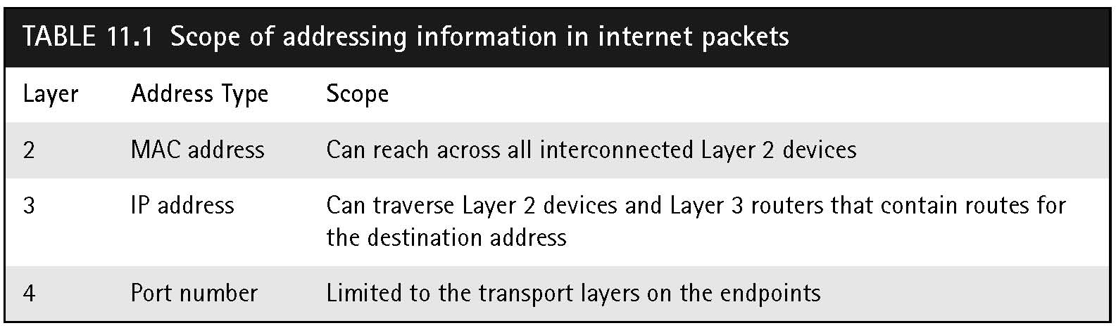
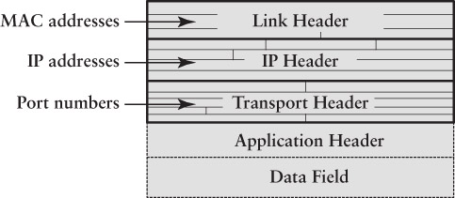
IP Packet Addressing

Slide 11
IP Packet Addressing
Contains pair of IP addresses and port numbers
Port number selects a client or server process
Sender Information
Source port number – chosen randomly by client
Source host’s IP address
Recipient information
Destination port number – preassigned for well known Internet services
Destination host’s IP address

Slide 12
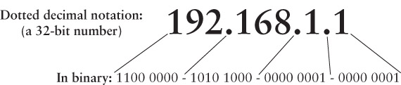
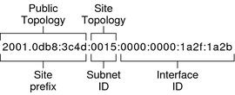
IP Address Format
IPv4
IPv6

Slide 13
Network Names and IP Addresses
Names are easier (for us!) to remember
www.cnn.com vs. 64.236.16.20
IP addresses can change underneath
Move www.cnn.com to 173.15.201.39
E.g., renumbering when changing providers
Name could map to multiple IP addresses
www.cnn.com to multiple replicas of the Web site
Multiple names for the same address
E.g., aliases like ee.mit.edu and cs.mit.edu

Slide 14
Transport Layer (layer 4)
The protocols of the layer provide host-to-host communication services for applications.
Uses in-coming and out-going ports to/from a server.
Http: port 80
Https: port 443
Major types:
Transmission Control Protocol (TCP) is connection-oriented and provides error checking
User Datagram Protocol (UDP) is connectionless. Used for streaming

Slide 15
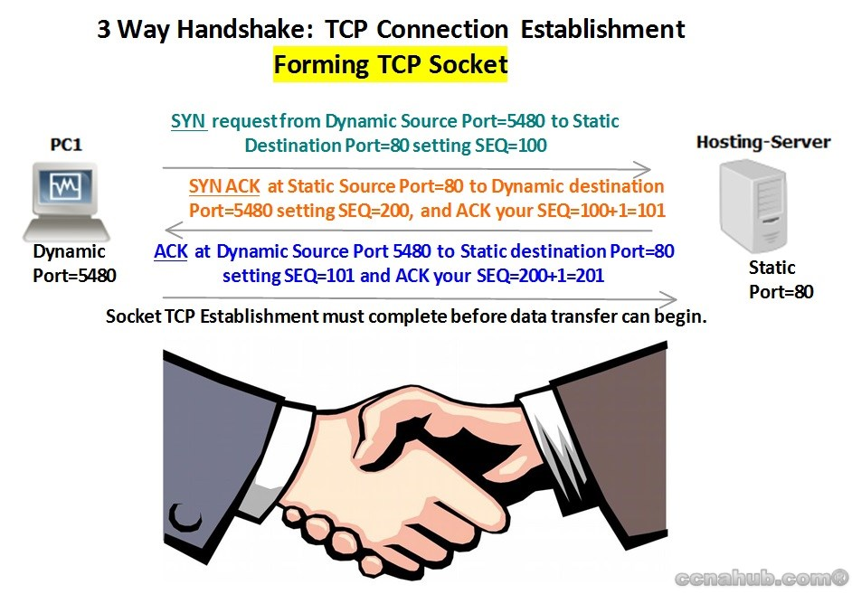
TCP Connections

Slide 16
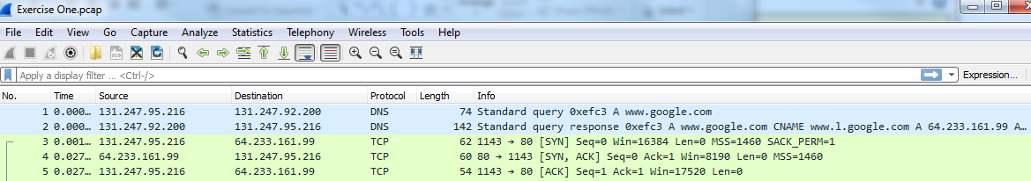
Example
Wireshark

Slide 17
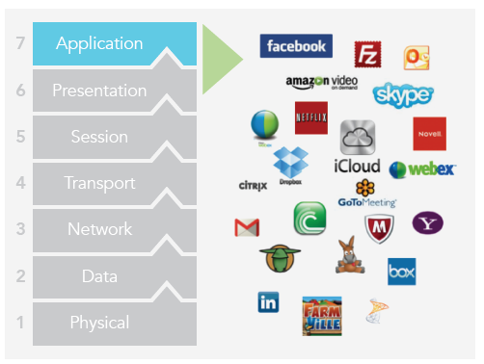
Application Layer (Layer 7)
Interfaces with the operating system and other applications and communicates data between files, messages, and other network activities.
Examples: Email (smtp), Web (http), file transfer (ftp), time (ntp)

Slide 18
Protocols
Protocols for translating between addresses
Address Resolution Protocol (ARP)
Domain Name System (DNS)
Dynamic Host Configuration Protocol (DHCP)
Network Address Translation (NAT)

Slide 19
Address Resolution Protocol
Given an IP address, provide the MAC address
To enable communication within the Local Area Network
“ARP” – looks up MAC or IP addresses on a LAN by asking other hosts for answers
Uses Ethernet “broadcast” feature
Asks “Who is 12.34.56.77?” for example
The hosts with answers send responses
Hosts save answers in their ARP cache
“arp” keyboard command prints the cache

Slide 20
Mapping Between Identifiers
Domain Name System (DNS)
Given a host name, provide the IP address
Given an IP address, provide the host name
Dynamic Host Configuration Protocol (DHCP)
Given a MAC address, assign a unique, temporary IP address
Network Address Translation
Separates internal & external networks
Used when IPv4 ran out of Internet addresses

Slide 21
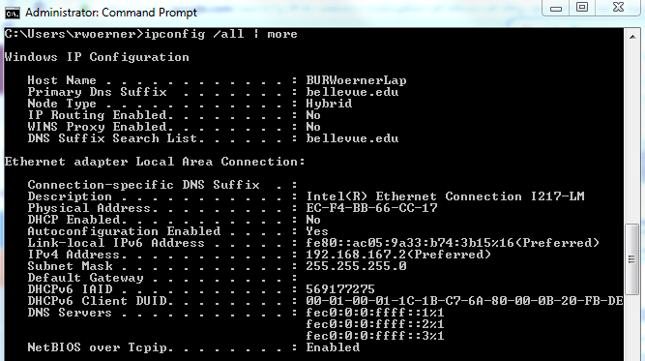
Let’s Try It
Windows: ipconfig

Slide 22
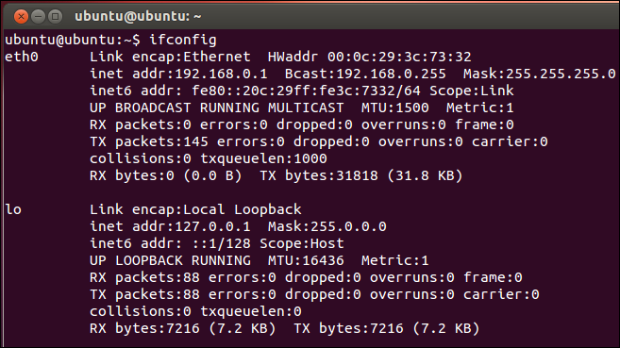
Let’s Try It
Linux: ifconfig

Slide 23
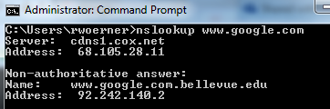
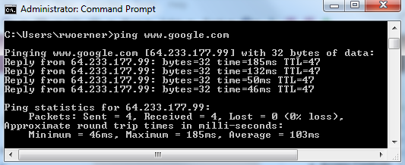
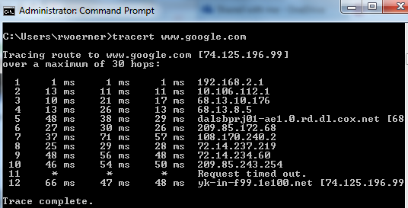
Native network commands
nslookup
ping
Tracert / traceroute
Notes:
Have students try this

Slide 24
Network Security
Firewalls
A firewall is a device (or software feature) designed to control the flow of traffic into and out-of a network.
In general, firewalls are installed to prevent attacks.
Blocks packets based on:
Source IP Address or range of addresses.
Source IP Port
Destination IP Address or range of addresses.
Destination IP Port
Some allow higher layers up the OSI model (applications)

Slide 25
Types of Firewalls
Stateful
Firewall
Router / packet filter
Internet
Application
Proxy
Corporate
Network
Host-based
Firewall

Slide 26
Network Firewalls
Appliance
Router/Bridge based Firewall
A firewall running on a bridge or a router protects from a group of devices to an entire network. Cisco has firewall feature sets in their IOS operating system.
Next-Generation Firewall
Computer-based Network Firewall
A network firewall runs on a computer (such as a PC or Unix / Linux computer). These firewalls are some of the most flexible. Many free products are available including IPFilter (the first package we tried), PF (the current package we are using found on OpenBSD 3.0 and later) and IPTables (found on Linux). Commercial products include: Checkpoint Firewall-1. Apple OSX includes IPFW (included in an operating system you gotta purchase).

Slide 27
Connect Pi to the WiFi
Notes:
Have students connect their Raspberry Pi’s to the WiFi

Slide 28
Network Inspection Tools
Wireshark
Can monitor network traffic in real time
Interprets frame and packet contents
Recognizes standard Internet protocols
Network gateway – lists devices on the LAN
nmap
Can “map” a network
Scans the network address range to locate hosts and the open ports on each host
Caution: may violate an ISP’s use policy

Slide 29
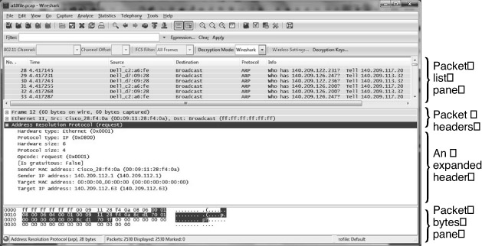
Wireshark Main Window
© Wireshark Foundation

Slide 30
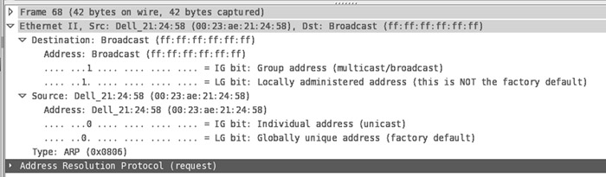
Wireshark: Ethernet Header
© Wireshark Foundation

Slide 31
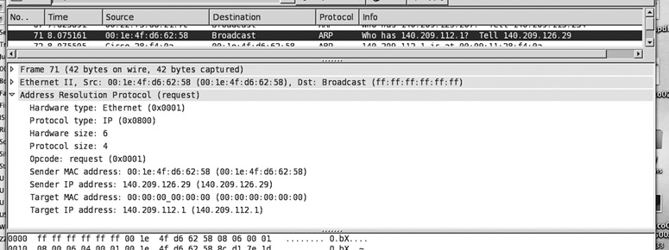
Wireshark: ARP Request
© Wireshark Foundation

Slide 32
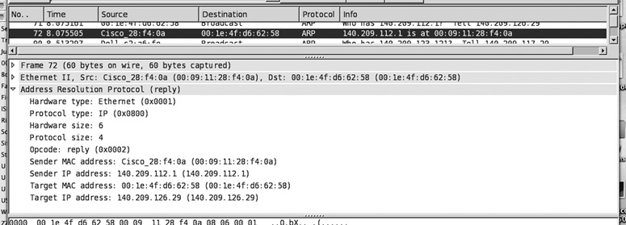
Wireshark: ARP Response
© Wireshark Foundation

Slide 33
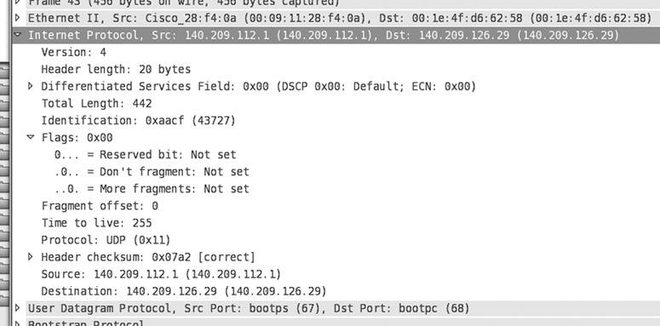
Wireshark: IP header
© Wireshark Foundation

Slide 34
Let’s Try It
Wireshark Exercise

Slide 35
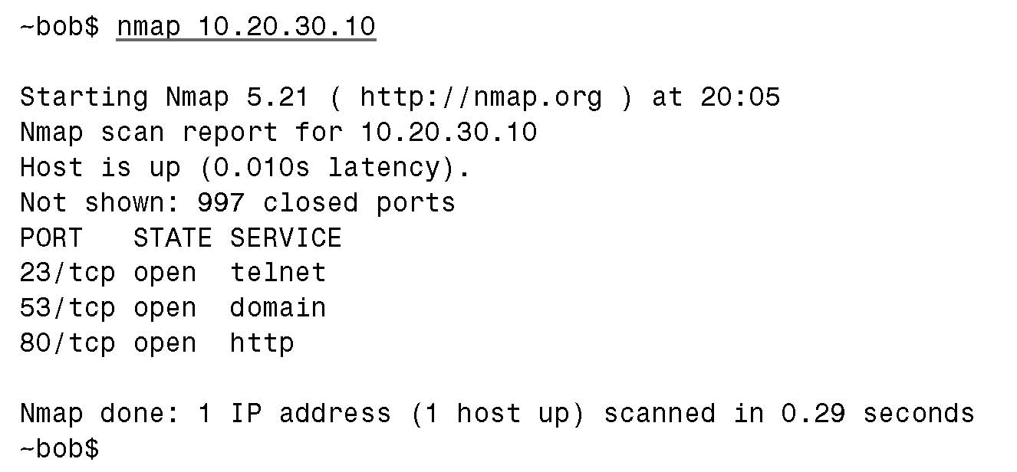
nmap: Scan a host’s services

Slide 36
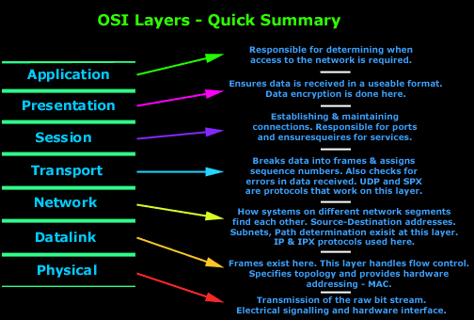
Review

Slide 37
Internet Routing Principles
Domain Separation
Resource Encapsulation
Layering
Abstraction
Information Hiding
Modularity

