Slide 1

Golang Warsaw #54
26 October 2023 – 18:30 7N, Puławska 182, Warszawa

Slide 2

Host

Slide 3


Sponsors

Slide 4
Agenda
Go-first End to End Tests for Highly Stateful Features - Kuba Martin
Break / Your announcements (OpenSource, event etc.); Developer, engineer, lead lost & found || Grab coffee/beer/food;
Discussion Panel on Engineering Principles - Jakub Daliga, Lukasz Gut
Afterparty, slowly moving to a place close by
Notes:
Go-first End to End Tests for Highly Stateful Features
Kuba is an interim lead of OpenTofu and Software Engineering Team Lead at Spacelift. Maintainer of open source projects OctoSQL and jql. Passionate about the architecture and development of scalable, observable distributed systems.
Discussion Panel on Engineering Principles
Open debate

Slide 5
Looking for speakers!
Golang specifics
Software engineering (implement/use/best practices)
Tech leadership and/or management
Your experience building X

Slide 6
Where to find us?
Email: lukasz@lukaszgut.com, jakubdal@gmail.com, wbarczynski@gmail.com
Twitter/X: @golangwaw
Slides: github.com/golangpoland/meetup_golang_warsaw
Job Board: facebook.com/groups/golangpolandjobs

Slide 7
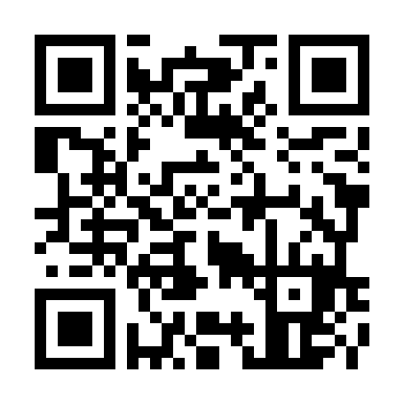
Questions?
Join channel #poland on gophers.slack.com.
https://invite.slack.golangbridge.org/

