Slide 1


Winter 2020 / #GoTurn10
Golang Warsaw #32

Slide 2
About today’s Meetup

Slide 3

Our’s sponsors

Slide 4

JetBrains User Group Support Program
Activity = GoLand

Slide 5
Meetup agenda:
A bit faster logging in GKE, patching fluent-bit – Paweł Pierścionek – [Cludo]
10 minutes break
Accessing custom Kubernetes resources from Golang – Daniel Pacak – [Aqua Security]
Pizza, Beer, Networking

Slide 6
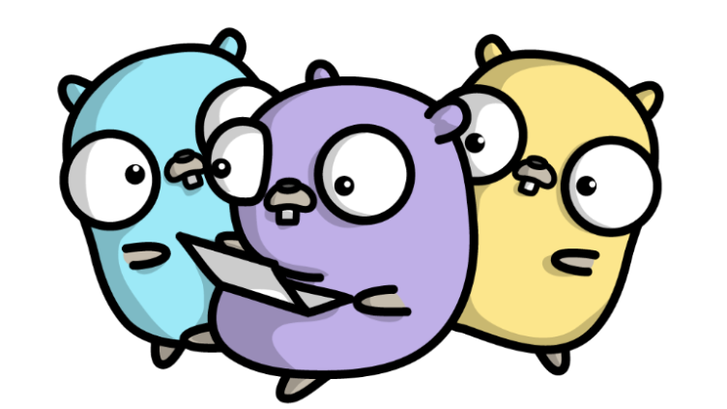
Speakers wanted!

Slide 7
Let’s broden the scope!
Docker, Kubernetes, CloudNative, Serverless
Best practises
Remote team, opensource contributions
CAP, Resiliance, new databases

Slide 8
Pick most suitable format
Formats: 10, 15, 30, 45
Contact us on social media or talk to the organizers:
- Wojciech Barczyński
- Arek Noster
- Kamil Pyrkosz

Slide 9




#GolangWarsaw

