Slide 1

Golang Warsaw #53
20 September 2023 – 18:30 Connectis_ (Varso Place), Chmielna 71, Warszawa

Slide 2

Host

Slide 3


Sponsors

Slide 4
Agenda
Transitioning to Go - Robert Pajak
Break / Your announcements (OpenSource, event etc.); Developer, engineer, lead lost & found || Grab coffee/beer/food;
Hedged requests in Go - Oleg Kovalov
Afterparty, slowly moving to a place close by

Slide 5
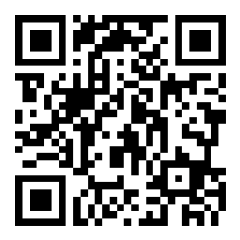
Join Slido for Q&A

Slide 6
Looking for speakers!
Golang specifics
Software engineering (implement/use/best practices)
Tech leadership and/or management
Your experience building X

Slide 7
Where to find us?
Email: lukasz@lukaszgut.com, jakubdal@gmail.com, wbarczynski@gmail.com
Twitter/X: @golangwaw
Slides: github.com/golangpoland/meetup_golang_warsaw
Job Board: facebook.com/groups/golangpolandjobs

Slide 8
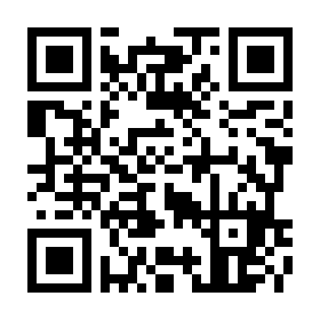
Questions?
Join channel #poland on gophers.slack.com.
https://invite.slack.golangbridge.org/

