Slide 1


AEROSPACE & SPACE TECHNOLOGY
Anjanisutah 3Space PVT. LTD.
India's Next-Generation Space Technology — Building indigenous, reusable launch systems for the future of Indian aerospace.

Slide 2
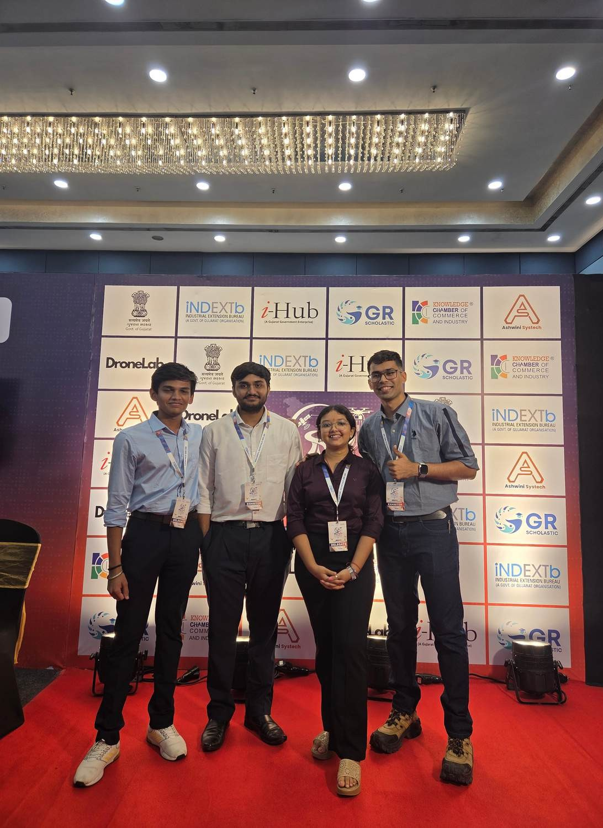
Who We Are
3Space is a pioneering Indian aerospace and space-technology company, dedicated to developing indigenous propulsion systems and fully reusable launch vehicles.
Established in 2025 and incubated at PDEU IIC, our mission begins with an engine-first approach, laying the foundation for a sustainable and cost-effective future in space access.
Founded
2025
Industry
Aerospace & Space Technology
Focus
Reusable Launch Vehicle Ecosystem
Our vision is to build a scalable Indian reusable launch-vehicle ecosystem, ensuring cost-effective and high-frequency access to space.

Slide 3
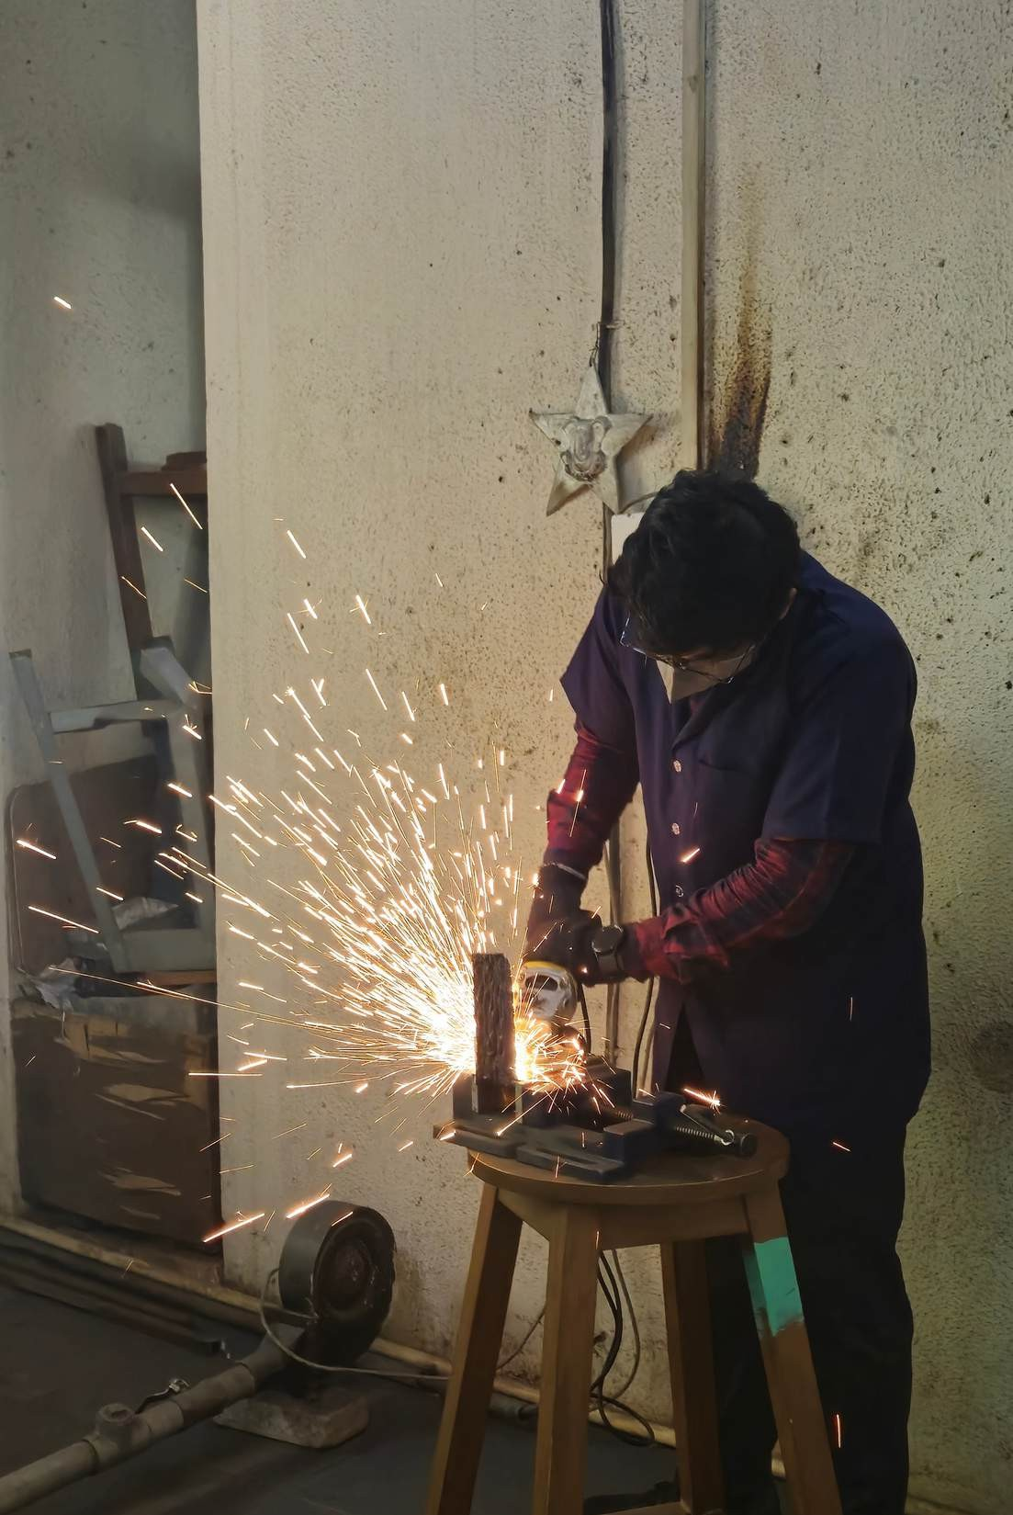
Engine-First Approach
OUR STRATEGY & VISION
3Space is pursuing an engine-first development approach, building propulsion technology as the foundation for a future reusable launch-vehicle ecosystem.
Our current core technology is FFSC MethaLOX propulsion, designed for efficiency and reusability.
Our Vision
To build a scalable Indian reusable launch-vehicle ecosystem capable of providing cost-effective and high-frequency access to space.

Slide 4

The Challenge We Are Solving
Our Solution
Expensive
Small payloads often face disproportionately high launch costs, creating significant barriers to space access for many.
Reusable Architecture
Advanced Propulsion
Infrequent
Limited launch windows and opportunities can severely delay critical research, defence, and commercial missions.
Cost Optimization
Accessible Launch
Our strategy is to first develop indigenous propulsion technology, validate it thoroughly, and then progressively integrate it into a reusable launch vehicle. This integrated approach will culminate in providing highly accessible, cost-effective, and frequent launch services.
Limited Reusability
Developing and implementing high-performance, reusable propulsion systems is inherently complex and capital intensive.

Slide 5
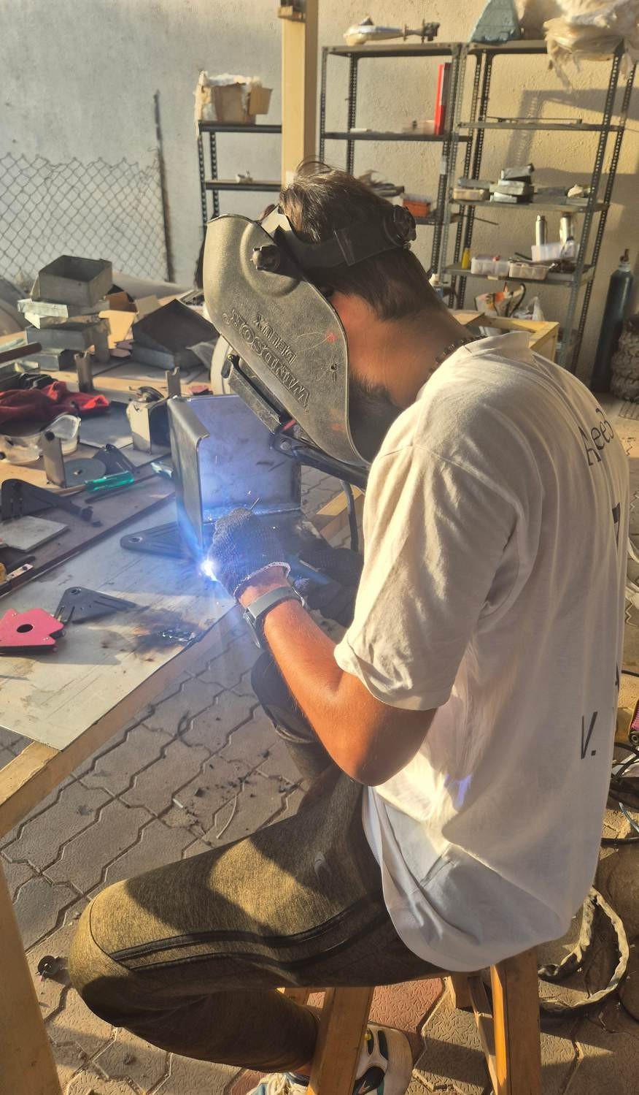
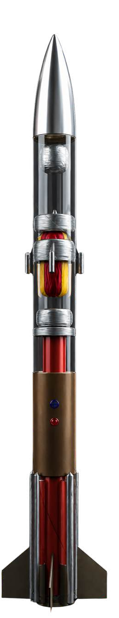
ANJANI-MK1
3SPACE
LAUNCH PROGRAM
OUR FIRST LAUNCH-ORIENTED PROJECT
Objective
To demonstrate and validate technologies forming the foundation of 3Space’s future reusable launch-vehicle programme.
Current Focus
Vehicle development Propulsion integration Flight-system development
Recovery/reusability technologies System-level validation
Target Launch Window
DECEMBER 2026 — FEBRUARY 2027
Development → Integration → Testing → Launch

Slide 6
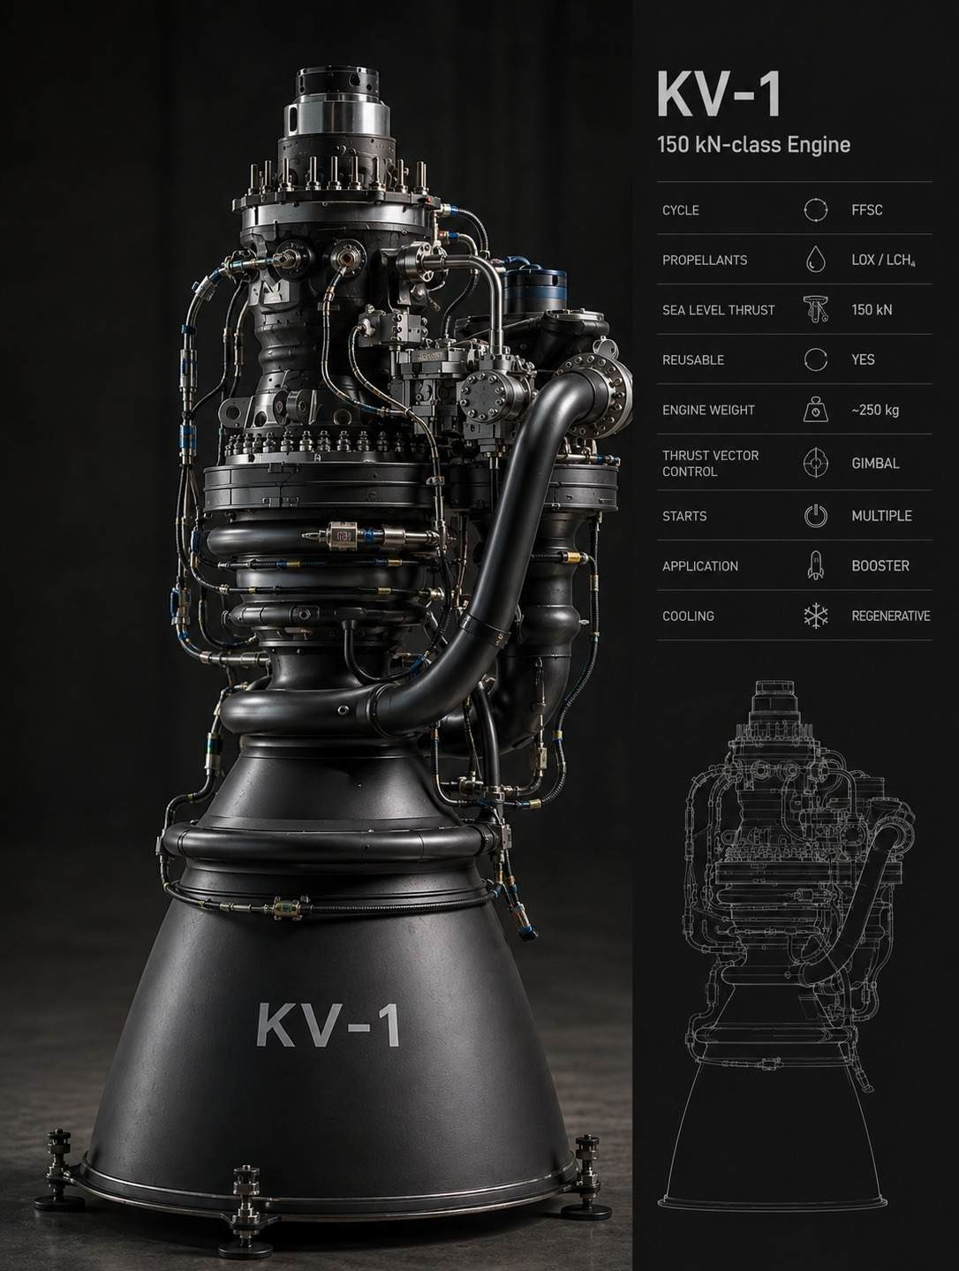

KARN-V1
DEVELOPING THE PROPULSION CORE FOR OUR FUTURE REUSABLE ROCKET
KARN-V1 represents 3Space’s propulsion-development program, focused on creating the advanced engine technology that will form the core of our future reusable orbital launch vehicle.
Development Focus
Design
Propulsion architecture & subsystem development
Build
Engine hardware & component development
Test
Cold-flow, hot-fire & performance testing
Validate
Reliability, endurance & performance characterization
Long-Term Role
KARN-V1 → Validated Propulsion Core → Reusable Orbital Launch Vehicle

Slide 7




Building With the Space & Innovation Ecosystem
INCUBATED AT
PDEU IIC
Our incubation and entrepreneurship ecosystem supporting 3Space’s growth and development.
SUPPORTED BY
iHUB • GOVERNMENT OF GUJARAT • IN-SPACe
Institutional support helping us advance our technology, innovation and participation in India’s growing space ecosystem.
GRANTS & FUNDING SUPPORT SSIP • iHUB Grant support enabling technology development, prototyping and innovation activities.
ACTIVE PARTICIPATION
IN-SPACe ROCKETRY COMPETITION
Active participation in the IN-SPACe rocketry ecosystem, gaining practical experience in rocketry, engineering and collaborative technology development.

Slide 8





The People Behind 3Space
TEAM OVERVIEW
Yashraj Patel Founder, CEO & CTO
Khushi Piparva Chief Propulsion Engineer
Priyank Patel Chief Design & Structures Engineer
Aishwarya Raj Public Relations Lead
Megha Krishna HR Lead
15+ Member Team — Comprising 10+ Technical experts and 5+ Management professionals, our team brings a wealth of experience and innovation.

Slide 9
📧 General Enquiries:
BUILD THE FUTURE OF SPACE WITH US
At 3Space, we believe the future of space
technology is built through collaboration, innovation, and people who are willing to build what has never been built before.
HAVE AN IDEA, OPPORTUNITY OR WANT TO BE PART OF THE JOURNEY?
Let’s connect.
contactus@ a3spacetech.com
📧 Careers & Opportunities:
careers@ a3spacetech.com
🌐 Website:
www.a3spacetech.com

Slide 10
