Slide 1

Analyzing and Manipulating Data with Pandas
July 12th, 2016
Jonathan Rocher (@jonrocher) Principal Software Architect, KBI-Biopharma

Slide 2


Thanks!

Slide 3
Pandas
Started by Wes McKinney in 2009.
Emerged from the finance industry. Motivated by the toolbox in R for manipulating data easily. But Python is a better language…
First public release is 0.3 in Feb 2011.
Grown and maintained by a huge community now, headed by Jeff Reback.
Last release is 0.18.1 in May 2016.
Open source (BSD).
Has become a corner stone of the SciPy ecosystem for all things data!

Slide 4
Pandas’ mission
“To provide high-performance, easy-to-use data structures and data analysis tools [in Python].”
Easy-to-use and performant:
Self-describing data structures to understand, explore and clean the data : 1D, 2D, 3D.
Data loaders to/from common file formats (CSV, Excel json, SQL, SAS, Stata, …).
Plotting functions to visualize the data. See Seaborn, Bokeh… for more.
Basic statistical analysis tools. See statsmodels and sklearn+sklean-pandas for more.

Slide 5


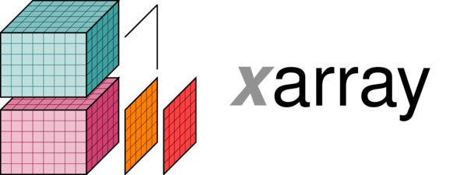








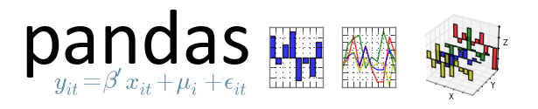
Pandas’ ecosystem growing quickly

Slide 6
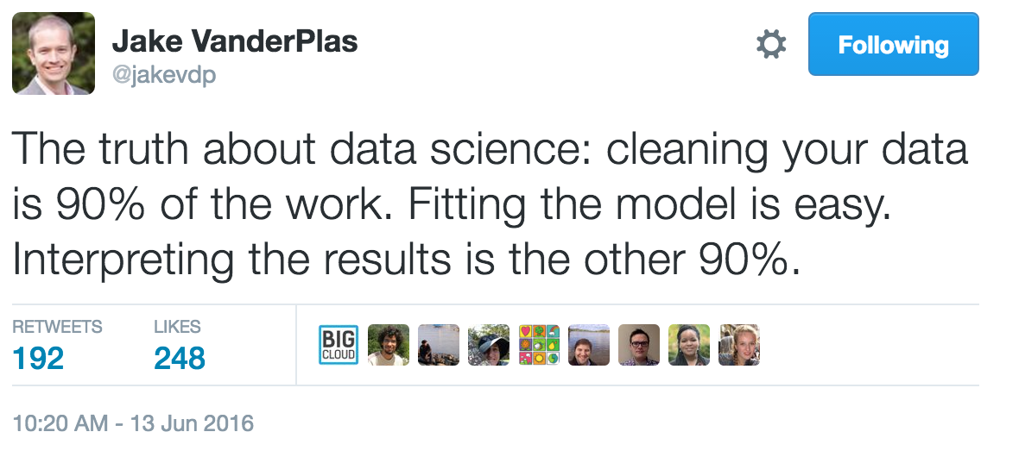
This tutorial’s mission

Slide 7
The story we will follow
To learn about Pandas, we will explore some climate data, mostly timeseries.
Goal: become better-informed citizens explore data on global temperatures, greenhouse gas and sea-level: load, clean, plot, correlate, search, resample, and model.
Full disclosure: I am not a climate scientist ! (if you are, come talk to me…)

