Slide 1

Analyzing and Manipulating Data with Pandas
July 12th, 2016
Jonathan Rocher
jrocher@kbibiopharma.com
Gihub: jonathanrocher
Twitter: @jonrocher

Slide 2
Pandas
Started by Wes McKinney circa 2009-2010.
Emerged from the finance industry. Motivated by the toolbox in R for manipulating data easily. But Python is a better language…
First public release is 0.3 in Feb 2011.
Maintained by a huge community now, headed by Jeff Reback.
Last release is 0.18.1 in May 2016.
Open source (BSD).
Has become a corner stone of the SciPy ecosystem for all things data!

Slide 3
Pandas’ mission
“To provide high-performance, easy-to-use data structures and data analysis tools [in Python].”
Easy-to-use and performant:
Self-describing data structures to understand, explore and clean the data.
Data loaders to/from common file formats (CSV, Excel json, SQL, SAS, Stata, …).
Plotting functions to visualize the data. See Seaborn, Bokeh… for more.
Basic statistical analysis tools. See statsmodels and sklearn+sklean-pandas for more

Slide 4











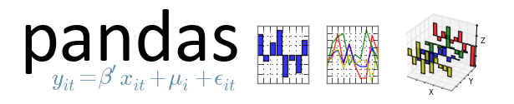
Pandas’ ecosystem growing quickly

Slide 5
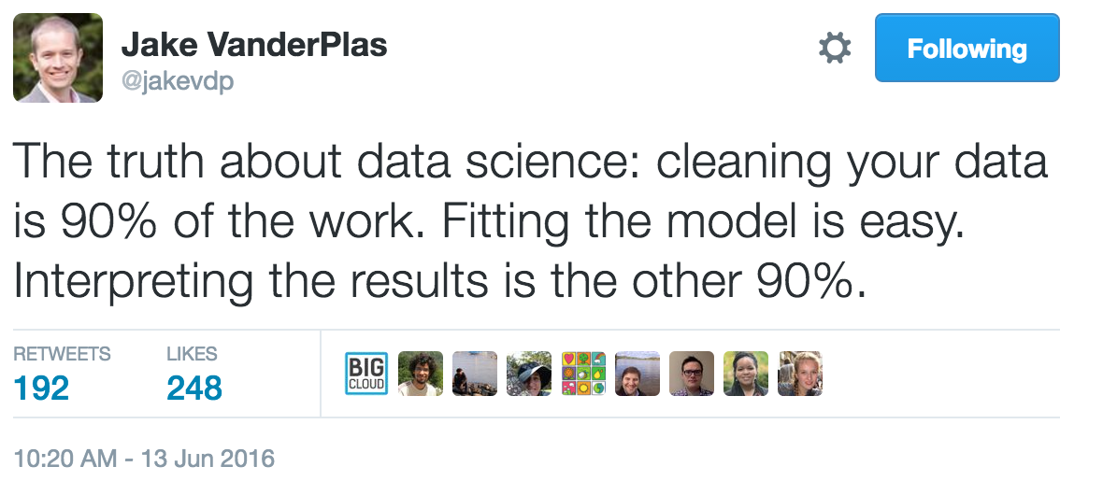
This tutorial’s mission
To provide an beginner introduction to data management, data cleaning, and a bit of data modeling using Pandas (mostly).

Slide 6


Thanks!

Slide 7
The story we will follow
To learn about Pandas, we will explore some climate data, mostly timeseries.
Goal: become better-informed citizens explore data on global temperatures, greenhouse gaz and sea-level: load, clean, plot, correlate, search, resample (and model).
Full disclosure: I am not a climate scientist ! (if you are, come talk to me…)

