Slide 1


+

Slide 2
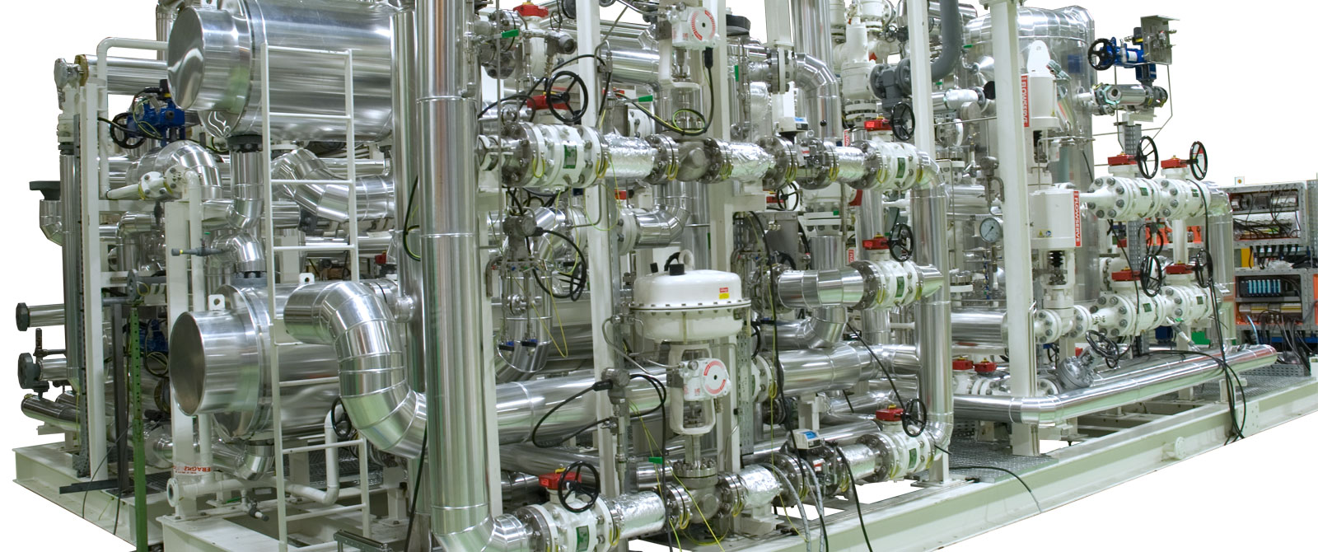
How to model any ecosystem:
the 3Worlds simulation platform
Jacques Gignoux
Ian D. Davies
Shayne R. Flint
https://www.fiorentini.com/ww/en/product/completesolutions/gas-power-plant/gpp_final_gas_conditioning_unit

Slide 3
Three difficulties of Ecology
Ecology:
studies very different objects
addresses very difficult questions
uses many different methods

Slide 4
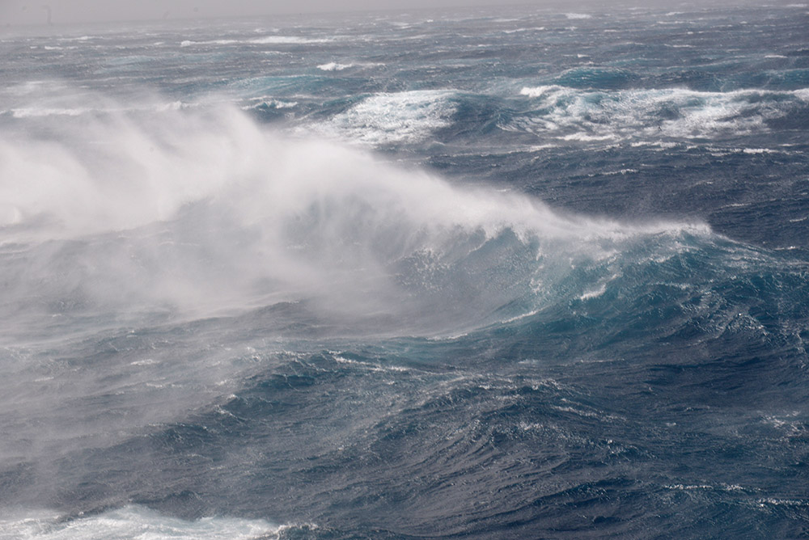
Ecology looks at incredibly different objects
Southern Ocean
photo Michel de Saint Blanquat

Slide 5
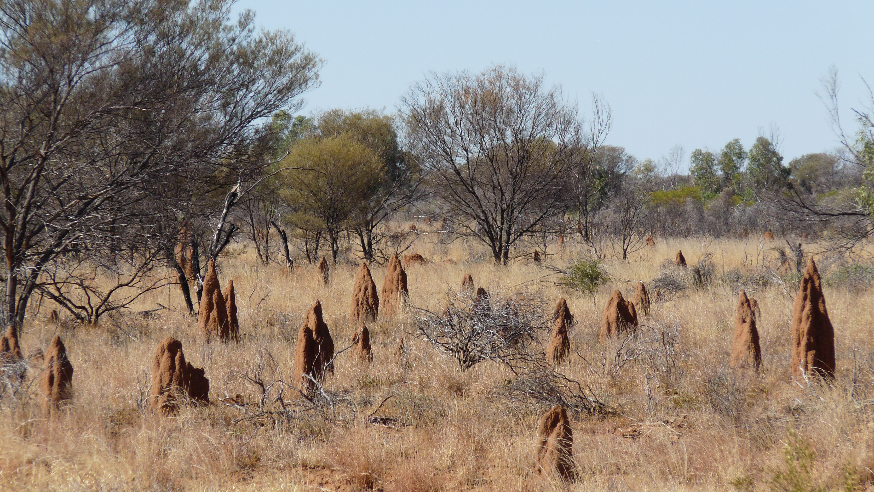
Central Australia
photo Michel de Saint Blanquat
photo Jacques Gignoux

Slide 6
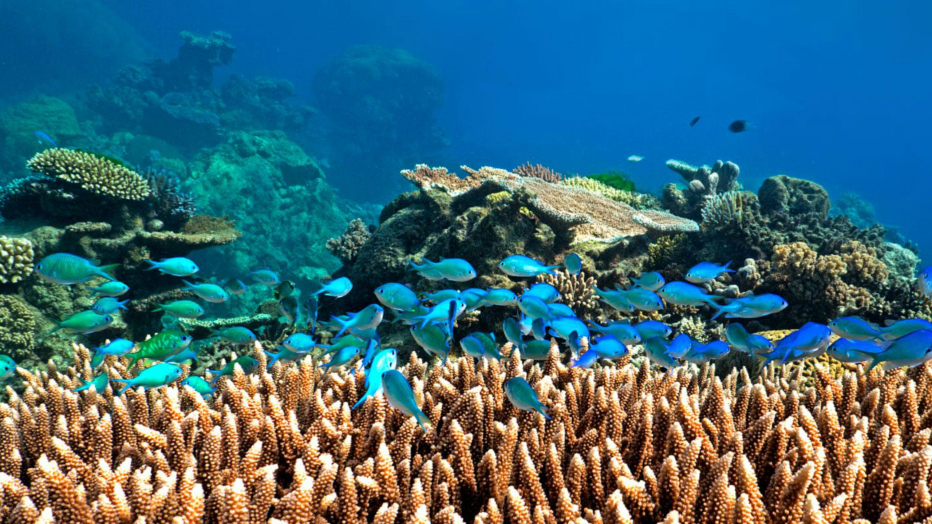
Indonesia
https://www.checkyeti.com/fr/d/1994/15142

Slide 7
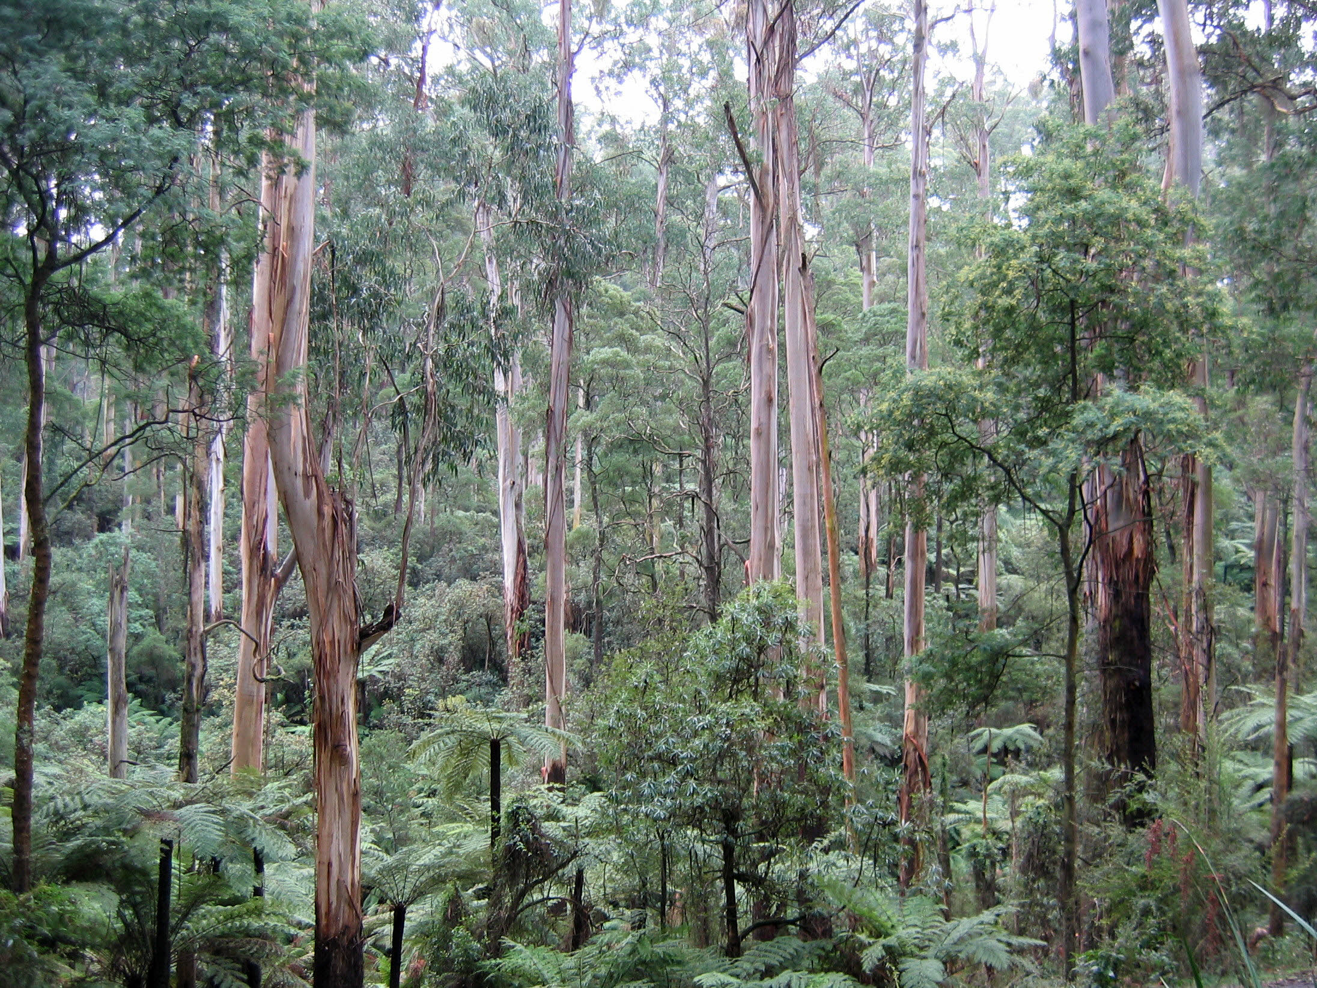
Southern Australia
photo Jacques Gignoux

Slide 8
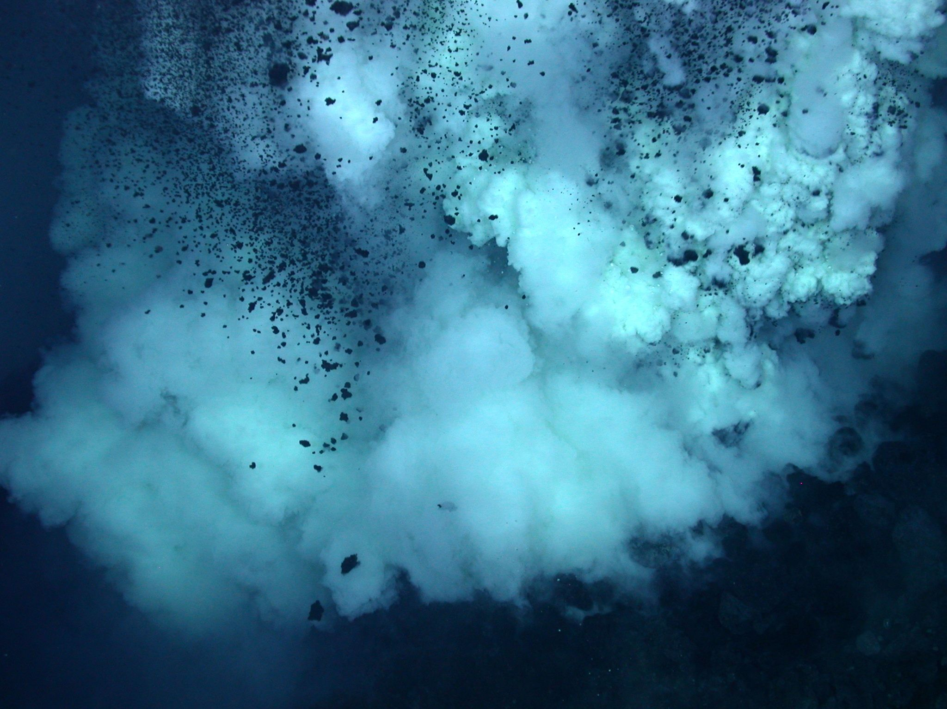
Deep in some ocean
photo Michel de Saint Blanquat
https://www.science-et-vie.com/questions-reponses/d-ou-viennent-les-fumeurs-noirs-9787

Slide 9
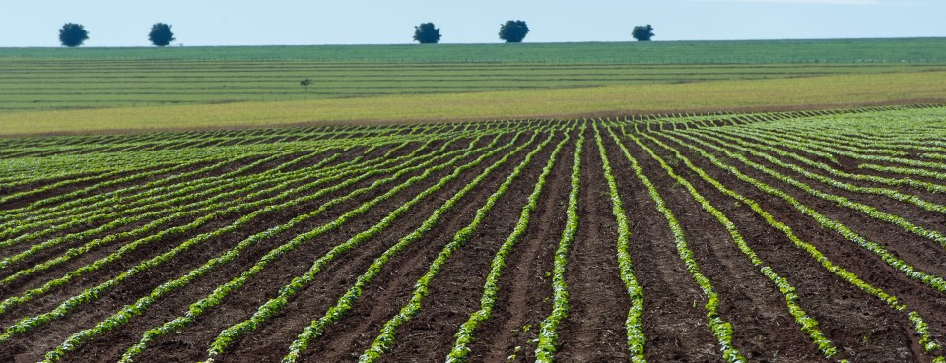
Brazil
https://news.bloomberglaw.com/environment-and-energy/soy-and-the-cerrado-exports-ecology-collide-in-brazils-savanna

Slide 10
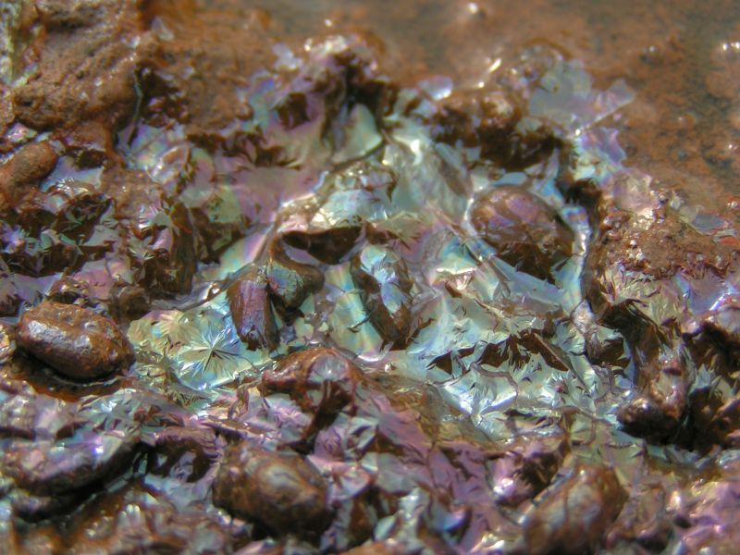
a puddle in Germany
https://atoptics.wordpress.com/tag/bacteria-colours/

Slide 11
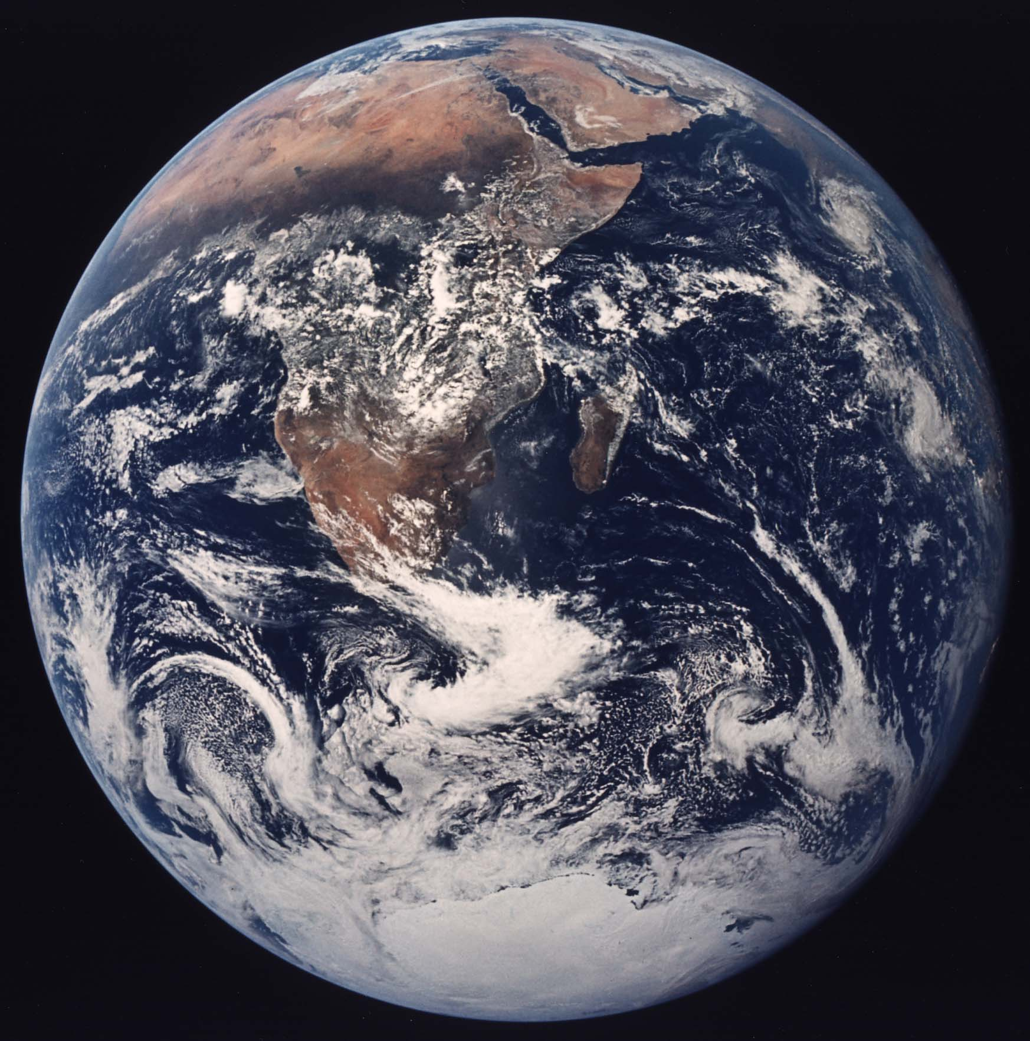
Local group,
The Galaxy,
Orion arm,
Solar system
NASA AS17-148-22727

Slide 12
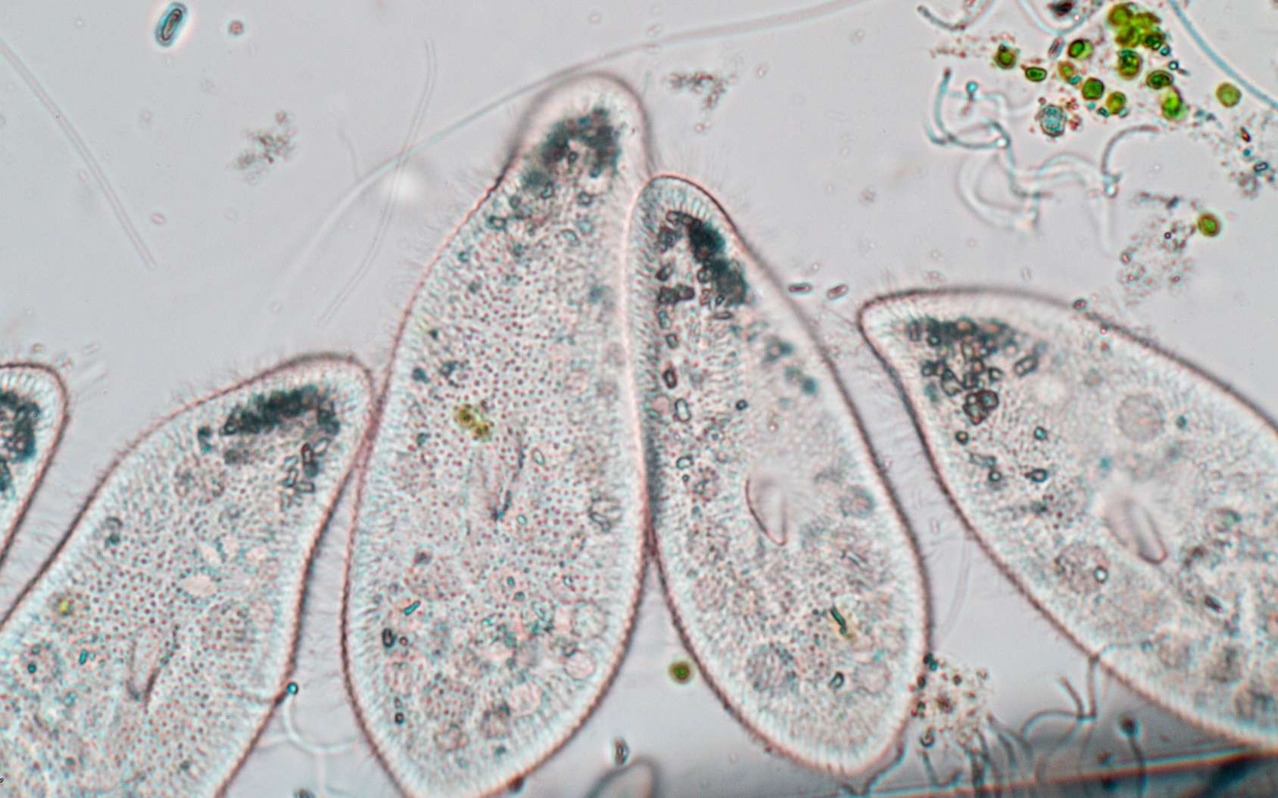
In a drop of water

Slide 13
Can we find a common approach
to study all these objects?
In a drop of water

Slide 14
Ecology addresses difficult questions:

Slide 15
Ecology addresses difficult questions:
climate change
CO2 flux
?
biodiversity

Slide 16


Ecology addresses difficult questions:
climate change
CO2 flux
Ecology and evolution
?
biodiversity
?
trophic network
population dynamics

Slide 17
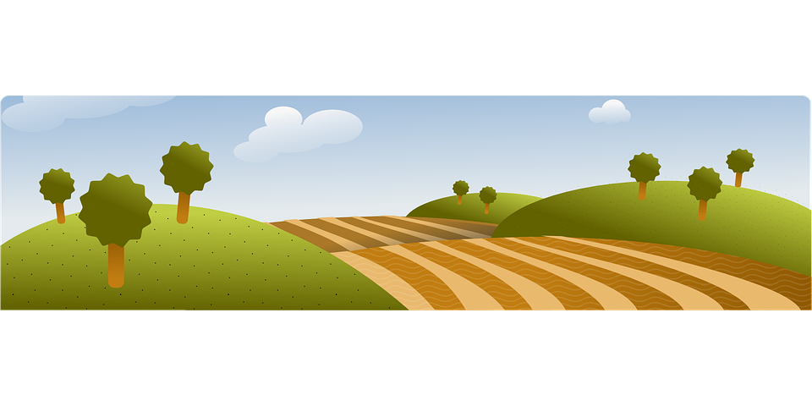
Ecology addresses difficult questions:
climate change
CO2 flux
Ecology and evolution
?
biodiversity
?
trophic network
population dynamics
Enviromnent management
?
flux
ecosystem spatial organisation

Slide 18
Ecology addresses difficult questions:
climate change
CO2 flux
These questions require
a coupling between
different ecological approaches
Ecology and evolution
?
biodiversity
?
trophic network
population dynamics
Enviromnent management
?
flux
ecosystem spatial organisation

Slide 19
Ecology is an integrative science:
administrativology
etc.
oceanography
etc.
endocrinology
entomology
immunology
pedology
histology
geometry
absolutivity
animal behaviour
[bio]geography
systematics
quantum physics
genetics
etc.
statistics
relativity
etc.
geology
law
demography
gastromony
chinese astrology
hydrology
physiology
relativity
ecology
[bio][geo]chemistry
evolution
beerology
etc.
[micro]meteorology
cell biology
political sciences
game design
climatology
graph theory
programming
plant architecture
thermodynamics
game theory
topography
paleo-whatever-ology
system dynamics
etc.
applied epistemology
smallestpublishablebitology
projectology
... borrowing methods from other sciences

Slide 20
Ecological sub-fields use poorly compatible representations:
Matter and energy fluxes
Ecophysiology Ecosystems
Dynamic systems

Slide 21
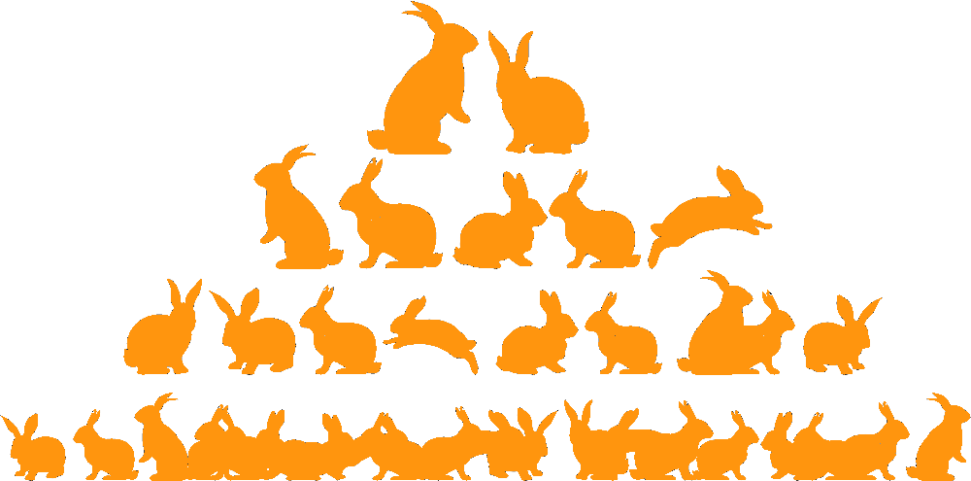
Ecological sub-fields use poorly compatible representations:
Matter and energy fluxes
Ecophysiology Ecosystems
Dynamic systems
Demography
Genetics
Evolution
Population models
Individual-based models

Slide 22





Ecological sub-fields use poorly compatible representations:
Matter and energy fluxes
Ecophysiology Ecosystems
Interaction networks
Dynamic systems
Graphs
Demography
Genetics
Evolution
Population models
Individual-based models

Slide 23
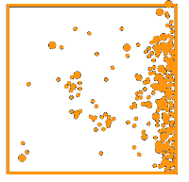
Ecological sub-fields use poorly compatible representations:
Matter and energy fluxes
Ecophysiology Ecosystems
Interaction networks
Dynamic systems
Graphs
Demography
Genetics
Evolution
Landscape ecology
Ecosystem structure
← 50 m →
Population models
Individual-based models
Cellular automata

Slide 24
Ecological sub-fields use poorly compatible representations:
How can we make
these work together?
Matter and energy fluxes
Ecophysiology Ecosystems
Interaction networks
Dynamic systems
Graphs
Demography
Genetics
Evolution
Landscape ecology
Ecosystem structure
← 50 m →
Population models
Individual-based models
Cellular automata

Slide 25
I. The solution to the diversity of objects

Slide 26
The ecosystem concept (Tansley, 1935)
‘Though the organisms may claim our primary interest, when we are trying to think fundamentally we cannot separate them from their special environment, with which they form one physical system.’
Ecosystems
combine physics and biology into a single object
are scale-independent
are observer-dependent
Gignoux et al. 2011. Ecosystems 14:1039-1054

Slide 27
The ecosystem concept (Tansley, 1935)
Ecology consists in viewing
everything as an ecosystem
Ecosystems
combine physics and biology into a single object
are scale-independent
are observer-dependent
Gignoux et al. 2011. Ecosystems 14:1039-1054

Slide 28
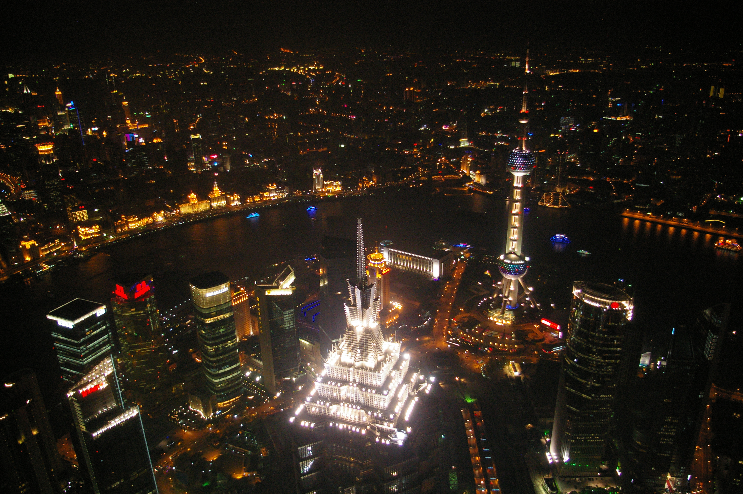
even this:
somewhere on the internet

Slide 29
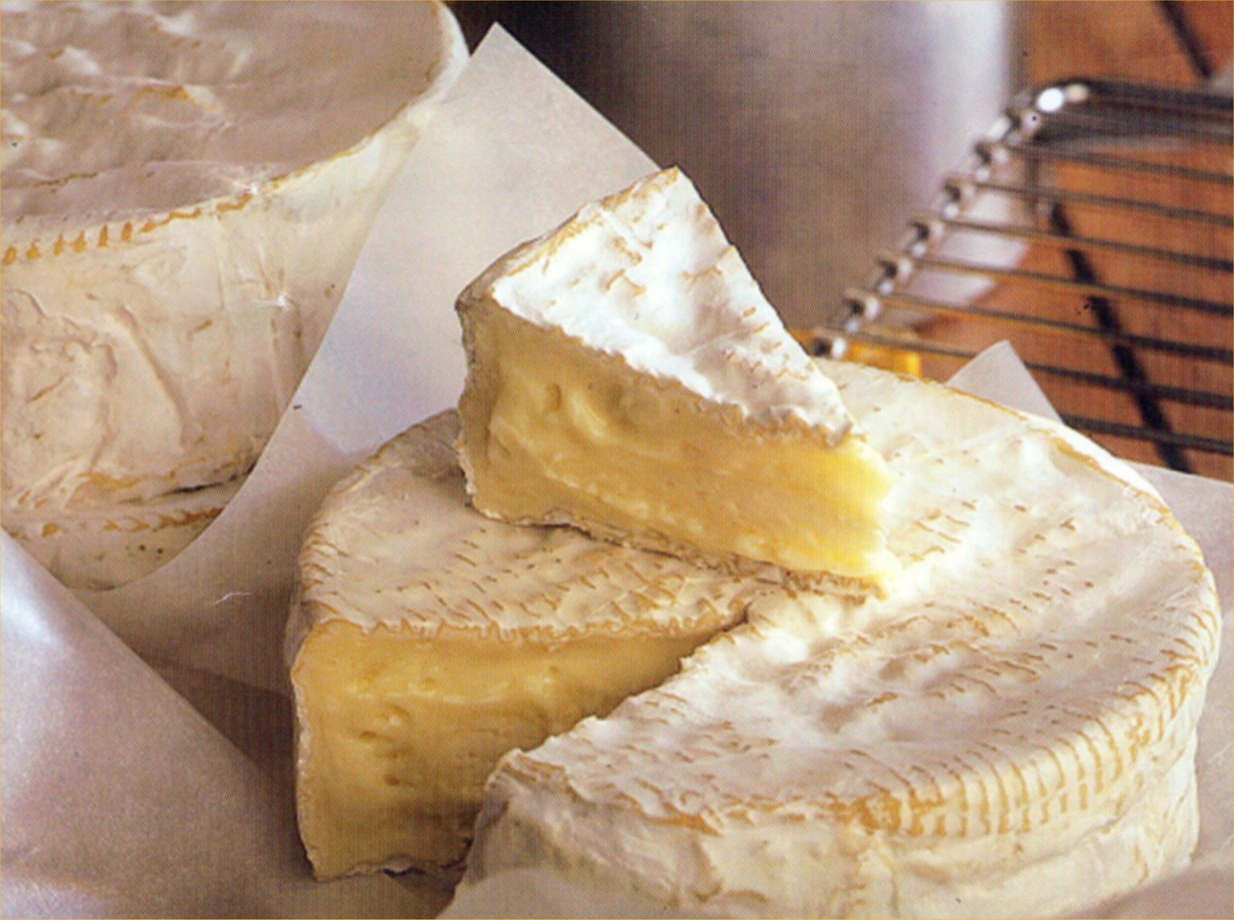
or this:
somewhere else on the internet

Slide 30
II. The solution to the difficulty of these questions

Slide 31
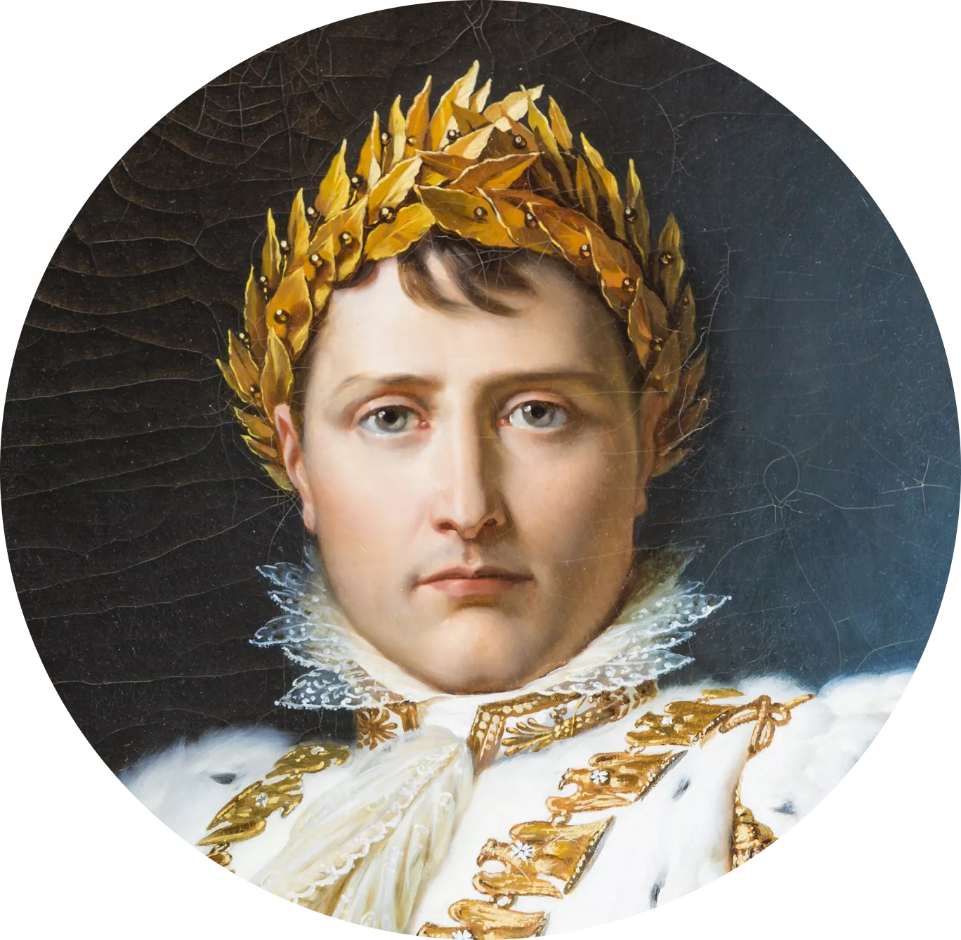
We don’t care!
It’s more fun if questions are not easy!
Plus, practical environmental problems are always going to be difficult, complex, wicked, multi-faceted, without a unique clear definite solution. We must get used to this.
Impossible is not French.
...but a method would help

Slide 32
We don’t care!
It’s more fun if questions are not easy!
Plus, practical environmental problems are always going to be difficult, complex, wicked, multi-faceted, without a unique clear definite solution. We must get used to this.
Impossible is not French.
...but a method would help
huh... maybe a method would help

Slide 33
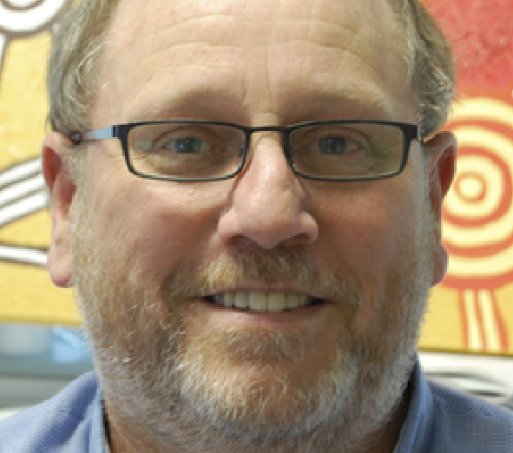
Systems thinking
Churchman, C. W., 1968; Kramer, N., 1977; Checkland, P. & J. Scholes, 1999; Senge, P., 1992.
a set of approaches that can be used to learn about / make decisions on dynamically complex systems
focuses on the whole and the interactions among the parts of a system
this way we can understand emergent properties of an entire system
Shayne Flint
Flint, S 2008, 'Rethinking Systems Thinking', in David Cook (ed.), Proc. 14th ANZSYS Conference, ECU, Perth.

Slide 34
Systems thinking
Churchman, C. W., 1968; Kramer, N., 1977; Checkland, P. & J. Scholes, 1999; Senge, P., 1992.
a set of approaches that can be used to learn about / make decisions on dynamically complex systems
focuses on the whole and the interactions among the parts of a system
this way we can understand emergent properties of an entire system
Shayne Flint
sorry... do you call this a method?
Flint, S 2008, 'Rethinking Systems Thinking', in David Cook (ed.), Proc. 14th ANZSYS Conference, ECU, Perth.

Slide 35
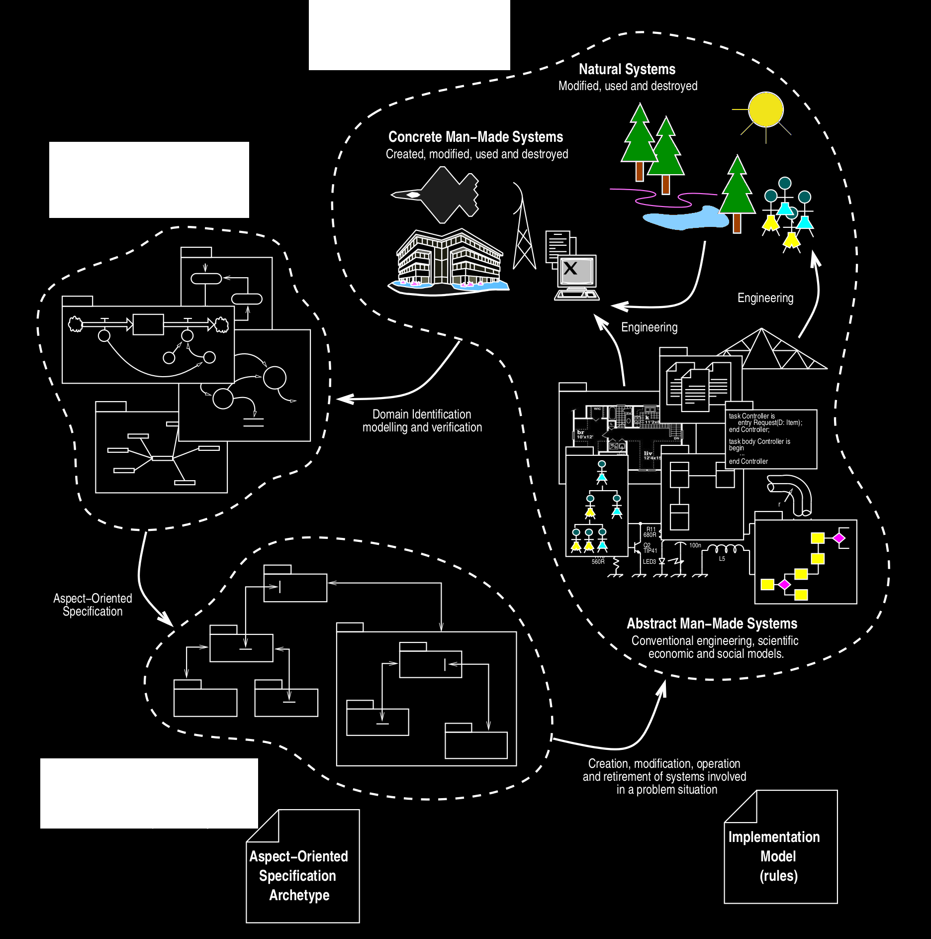
Problem situation
Aspect-oriented thinking
Flint SR, 2006. Aspect-Oriented Thinking - An approach to bridging the disciplinary divides. PhD, ANU.
independently model aspects of a system describing a problem
e.g. any ecosystem complies to physics and biology
use rules for combining these aspects into a new system
e.g. an ecophysiology x population model of my favourite ecosystem
that is used to improve the problem situation
e.g. test if my favourite ecosystem is stable or resilient
Domain models
Aspect-oriented specifications

Slide 36
Problem situation
Aspect-oriented thinking
1. We will not build the ultimate synthesis of all ecological knowledge
rather,
2. We provide a method to specify an ecological model addressing any particular problem
Flint SR, 2006. Aspect-Oriented Thinking - An approach to bridging the disciplinary divides. PhD, ANU.
independently model aspects of a system describing a problem
e.g. any ecosystem complies to physics and biology
use rules for combining these aspects into a new system
e.g. an ecophysiology x population model of my favourite ecosystem
that is used to improve the problem situation
e.g. test if my favourite ecosystem is stable or resilient
Domain models
Aspect-oriented specifications

Slide 37
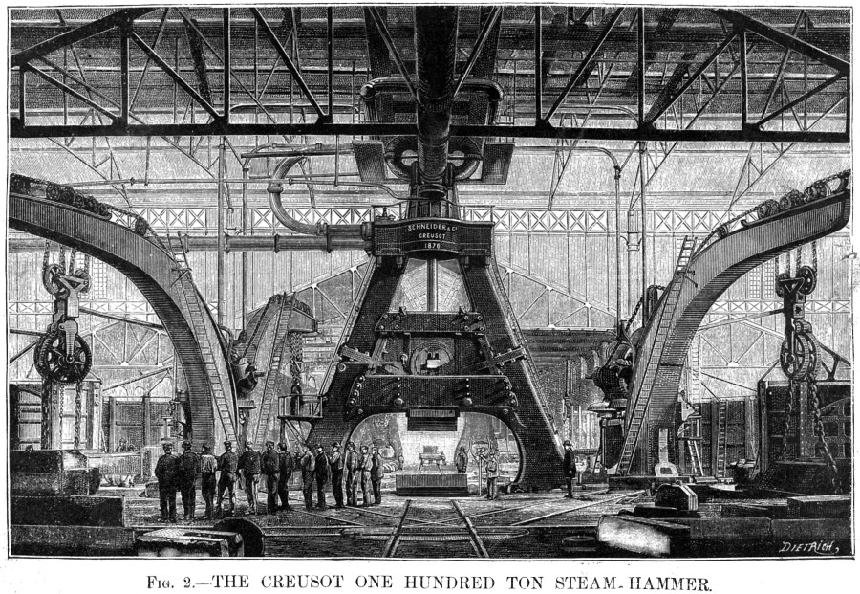
III. The solution to the incompatibility of methods
http://www.lecreusot.com/site/decouvrir/patrimoine/pilon/pilon.php

Slide 38
Make them compatible!
Use good concepts that can be shared
e.g. the system, the ecosystem, etc...
... easy !
(with a steam hammer?)

Slide 39
1. Ecosystems are commonly considered as complex systems

Slide 40
1. Ecosystems are commonly considered as complex systems
2. Complex systems are assumed to display emergent properties

Slide 41

But what is an...
emergent property?
What does that mean?
(does it hurt?)

Slide 42
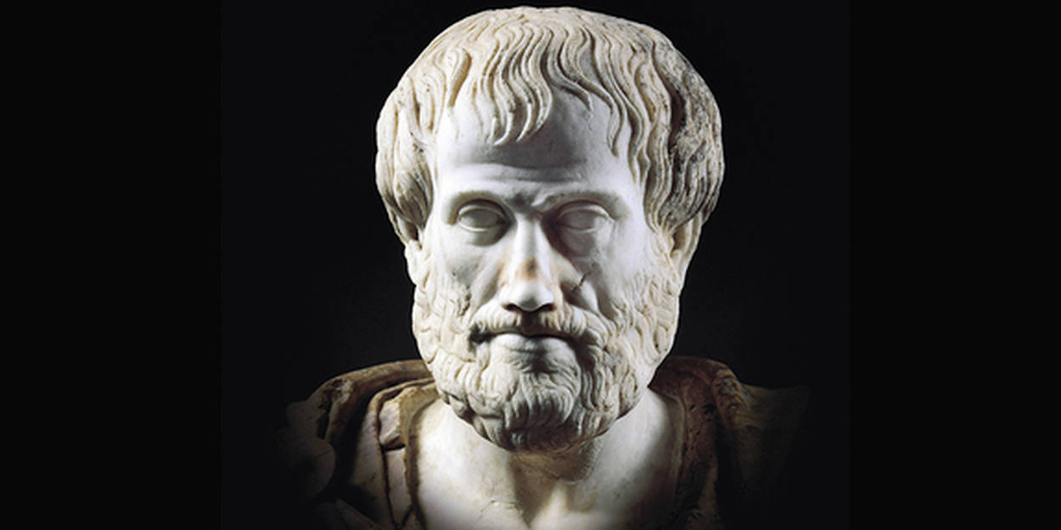
Not much:
The whole is
more than the sum of its parts
Αριστοτέλης (-335)

Slide 43
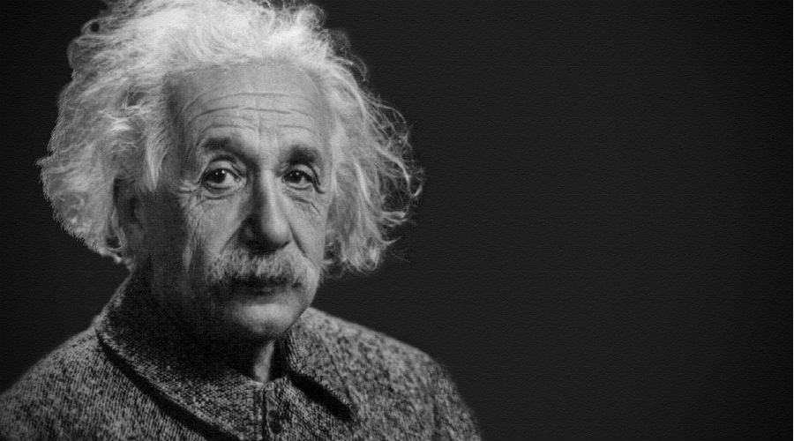
Not much:
The whole is
more than the sum of its parts
Αριστοτέλης (-335)
Einstein (1915): ‘the
mass of an atom is smaller than the sum of the masses of its nucleons’

Slide 44
Thank you, old chap, but this is not very helpful.
Modern specialists have much better definitions:
Bedau 1997: Macrostate P of S with microdynamic D is weakly emergent iff P can be derived from D and S 's external conditions but only by simulation.
Ryan 2007: A property is weakly emergent iff it is present in a macrostate but it is not apparent in the microstate, and this macrostate differs from the microstate only in resolution. A weak emergent property is a limitation of the observer, not a property of the system.
Müller 2003: A phenomenon is emergent iff we have (1) a system of entities in interaction whose expression of the states and dynamics is made in an ontology or theory D ; (2) the production of a phenomenon [...] which is necessarily global regarding the system of entities ; (3) the interpretation of this global phenomenon by an observer [...] in another ontology or theory D' ; (4) D' is irreducible to D.
Chalmers 2006: We can say that a high-level phenomenon is weakly emergent with respect to a low-level domain when the high-level phenomenon arises from the low-level domain, but truths concerning that phenomenon are unexpected given the principles governing the low-level domain.
...
[gurgling]

Slide 45
1. Ecosystems are commonly considered as complex systems
2. Complex systems are assumed to display emergent properties
3. There are dozens of definitions of emergence (Chérel G. 2013, PhD)

Slide 46
1. Ecosystems are commonly considered as complex systems
2. Complex systems are assumed to display emergent properties
3. There are dozens of definitions of emergence (Chérel G. 2013, PhD)
4. This because they do not clearly define the system

Slide 47
1. Ecosystems are commonly considered as complex systems
2. Complex systems are assumed to display emergent properties
3. There are dozens of definitions of emergence (Chérel G. 2013, PhD)
4. This because they do not clearly define the system
5. All emergence definitions imply a system with a microscopic and a macroscopic level of description

Slide 48
1. Ecosystems are commonly considered as complex systems
2. Complex systems are assumed to display emergent properties
3. There are dozens of definitions of emergence (Chérel G. 2013, PhD)
4. This because they do not clearly define the system
5. All emergence definitions imply a system with a microscopic and a macroscopic level of description
6. With a formal definition of the system, we may be able to clearly define emergence.
Gignoux et al. 2017. Ecological Complexity 31:34-49

Slide 49
The hierarchical system
A system is
a part of the world under consideration (Carnot 1824)
composed of identifiable entities and their relationships (Jordan 1981)
Let’s call Hierarchical System a
system (‘macro’-scale)
made of
inter-related parts (‘micro’-scale)
‘Hand with reflecting sphere’
lithograph by M.C. Escher
Gignoux et al. 2017. Ecological Complexity 31:34-49

Slide 50
A hierarchical system is best represented by a mathematical graph
A hierarchical system S is defined as the graph:
S := (C, R, γ)
where C is the set of components (nodes) of the system:
C := {cu} u ≤ nc < ∞ , cu ∈ W
R is the set of relations (edges) between components of the system:
R := {rv} v ≤ nr < ∞ , rv ∈ W ²
and γ is the incidence function, which assigns a relation to a pair of components:
γ : R → C × C
rv → (ci , cj ) i ≤ nc , j ≤ nc
nc is the number of components and nr the number of relations of the system; W ² is the set of applications from
W to W .
Gignoux et al. 2017. Ecological Complexity 31:34-49
Gignoux et al. 2017. Ecological Complexity 31:34-49

Slide 51
A hierarchical system is best represented by a mathematical graph
A hierarchical system S is defined as the graph:
S := (C, R, γ)
where C is the set of components (nodes) of the system:
C := {cu} u ≤ nc < ∞ , cu ∈ W
R is the set of relations (edges) between components of the system:
R := {rv} v ≤ nr < ∞ , rv ∈ W ²
and γ is the incidence function, which assigns a relation to a pair of components:
γ : R → C × C
rv → (ci , cj ) i ≤ nc , j ≤ nc
nc is the number of components and nr the number of relations of the system; W ² is the set of applications from
W to W .
13
5
10
4
7
1
8
the system
6
11
9
the components
3
2
12
the interactions
Gignoux et al. 2017. Ecological Complexity 31:34-49

Slide 52
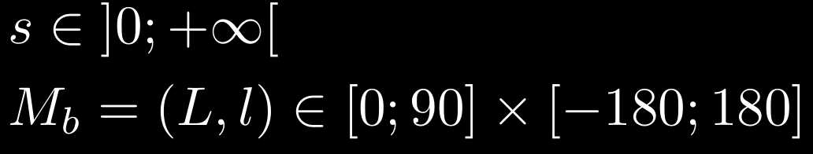
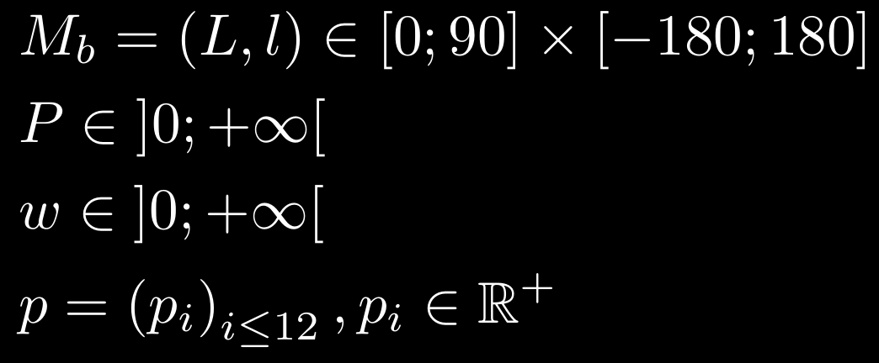
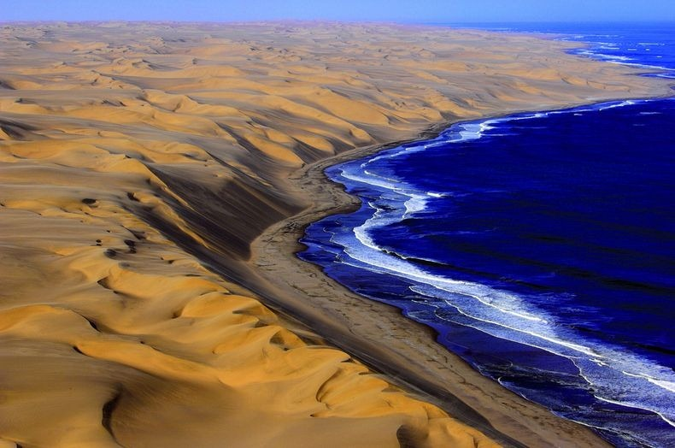
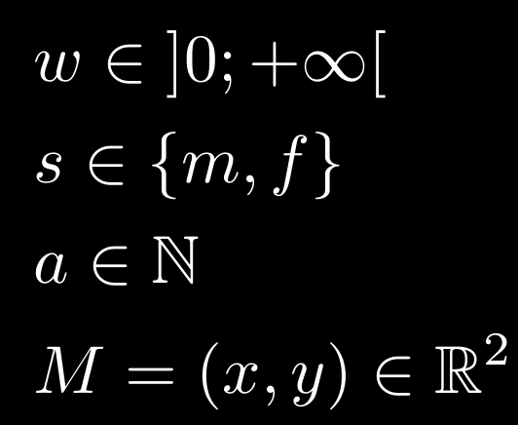
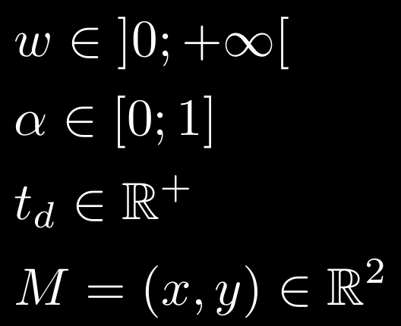
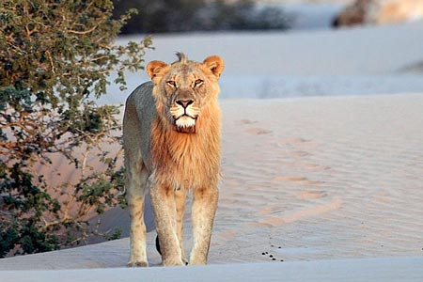
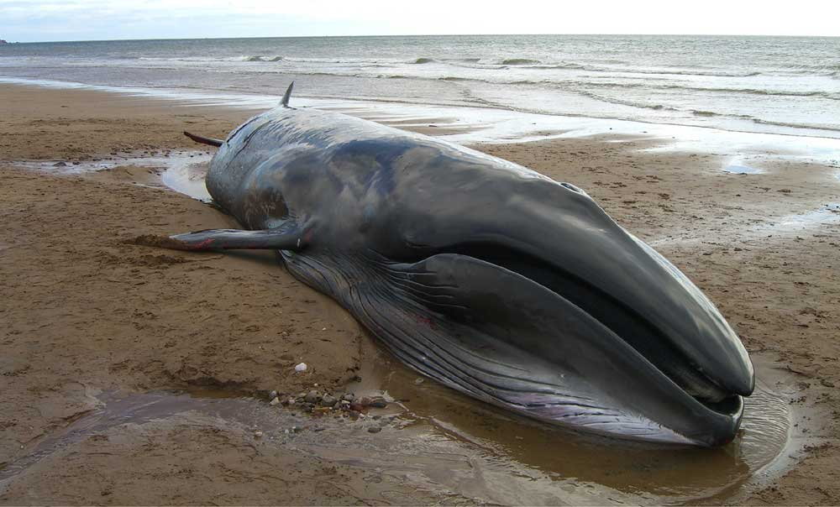
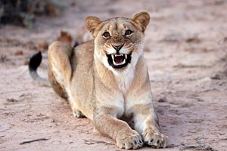
A hierarchical system is best represented by a mathematical graph
structure =
graph
D10
label
surface
location
beach
S2 = an ecosystem of interest
DS
The Namib desert ecosystem
label
location
productivity
biomass
monthly rainfall
photo
13
5
10
4
7
state =
1
8
descriptors
6
9
11
3
2
12
lion No.1
label
biomass
sex
age
location
mating probability
photo
lion No.6
label
biomass
sex
age
location
mating probability
photo
D6
D1
D11
whale
label
biomass
edible fraction
decay rate
location
photo
p ∈ [0;1]
p ∈ [0;1]

Slide 53
A dynamic graph
Harary & Gupta 1997. Dynamic graph models, Math. Comp. Model. 7:79-87
c1
r1
c2
r6
S(t)
r2
r5
r3
c5
c4
r7
c3
r4
t = 1
t = 2
t = 3
t = 4
t = 5
t = 6
t = 7
Changes propagate locally
State changes may be continuous
Structural changes are always discrete
Causality may be analysed

Slide 54
A dynamic graph
Harary & Gupta 1997. Dynamic graph models, Math. Comp. Model. 7:79-87
The dynamic graph model
can handle any dynamics
on any hierarchical system
c1
r1
c2
r6
S(t)
r2
r5
r3
c5
c4
r7
c3
r4
t = 1
t = 2
t = 3
t = 4
t = 5
t = 6
t = 7
Changes propagate locally
State changes may be continuous
Structural changes are always discrete
Causality may be analysed

Slide 55
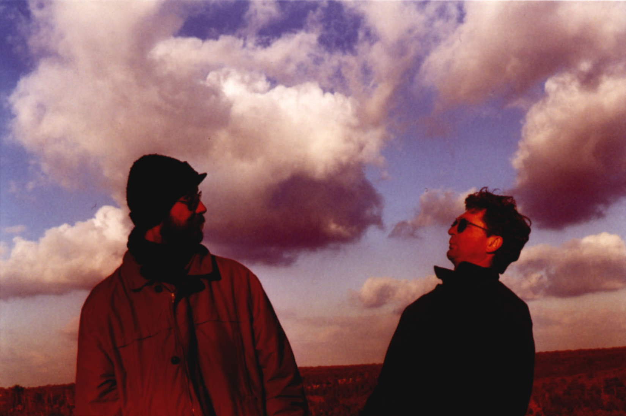
Let’s implement a software based on a dynamic graph to represent any system !
Ian Davies
ANU
Jacques Gignoux
CNRS
photo Antoinette de Saint Blanquat

Slide 56
Let’s implement a software based on a dynamic graph to represent any system !
FYC, automatic translation:
‘Then my dear, you are in the middle of science fiction!’
My translation:
‘Sorry my dear, this is pure science-fiction!’
Or, more direct:
‘Bullshit!’
Gotlib, M. (1971) Incorrigibles rêveurs, Rubrique à brac, 2:26-27

Slide 57
Let’s implement a software based on a dynamic graph to represent any system !
Fundings:
PHC 2003-2004
CNRS LIA 2003-2006
ANR 2007-2011
CNRS 2008-2009
Nananèreuh...
Gotlib, M. (1971) Incorrigibles rêveurs, Rubrique à brac, 2:26-27

Slide 58
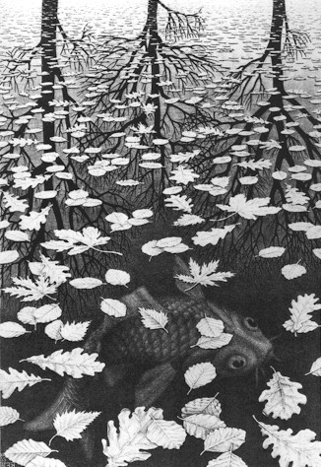
IV. The 3Worlds simulation platform
‘Three worlds’ lithograph by M.C. Escher
1955

Slide 59
Aims of 3Worlds
To provide ecological modellers with a simulation tool able to :
Deal equally well with physics and biology
Handle multiple spatial and temporal scales
Play with the level of detail in system description
Enable modelling of any ecological problem one can think of
Provide quick feedback while building a model
Smoothly scale up to large scale simulation experiments
Facilitate model intercomparison
...all this without reinventing the wheel too many times, if possible

Slide 60
Aspect-oriented approach
The system to model: the Ecosystem
A selection of aspects: the ecosystem as...
...a hierarchical system
...a set of taxonomic (=classifiable) entities
...a dynamic system at all sorts of time scales
...a (possibly spatially) organised system
...an abstract representation at different levels of detail
...an easy-to-use functional concept
...a scientific object (that can be experimented on)
The built system: a software that can be further specialised for particular problems
a specification archetype
+
code to interpret it

Slide 61
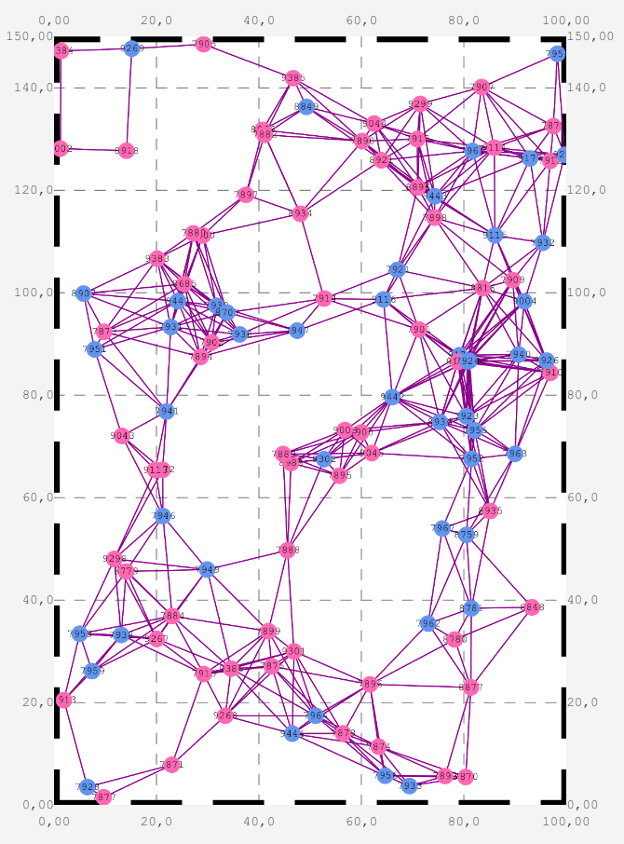
Aspect 1: a hierarchical system
The modelled system is a dynamic graph = { components, relations }
a generalisation for
individual-based models (IBMs)
Grimm V. & Railsback S. 2005. Individual-based modelling and ecology. Princeton U.P.
multi-agent systems (MASs)
Bousquet F. & Le Page C. 2004. Multi-agent simulations and ecosystem management: a review. Ecol. Model. 176:313–332.
...but with explicit relations
3Worlds screen capture

Slide 62
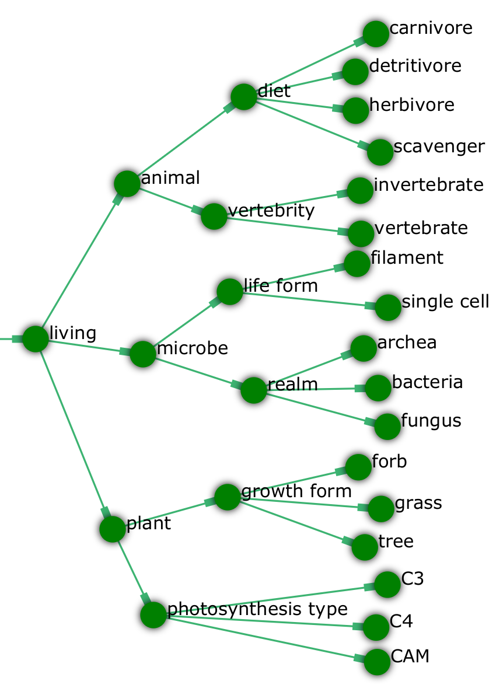
Aspect 2: classification
Categories to group components ‘that look like each other’
Members of a category:
have the same descriptors
are affected by the same processes
cf. the class concept in UML and OOP
http://uml.org/what-is-uml.htm
https://en.wikipedia.org/wiki/Object-oriented_programming
3Worlds screen capture

Slide 63
Aspect 3: a dynamic system
Every possible local change in the graph state or structure is modelled by a specific function that can be modified to suit user needs:
changeState & setInitialState: changes the descriptor values of a component
deleteDecision: a component decides to delete itself
createOther: a component creates other components
changeCategoryDecision: a component becomes member of other categories

Slide 64
Aspect 3: a dynamic system
Every possible local change in the graph state or structure is modelled by a specific function that can be modified to suit user needs:
relateTo: component establishes a relation to another component
maintainRelationDecision: a component decides to keep/delete a relation
changeOtherState & setOtherInitialState: a component changes the descriptor values of another component to which it is related
changeRelationState: components at both ends of a relation change their descriptor values

Slide 65
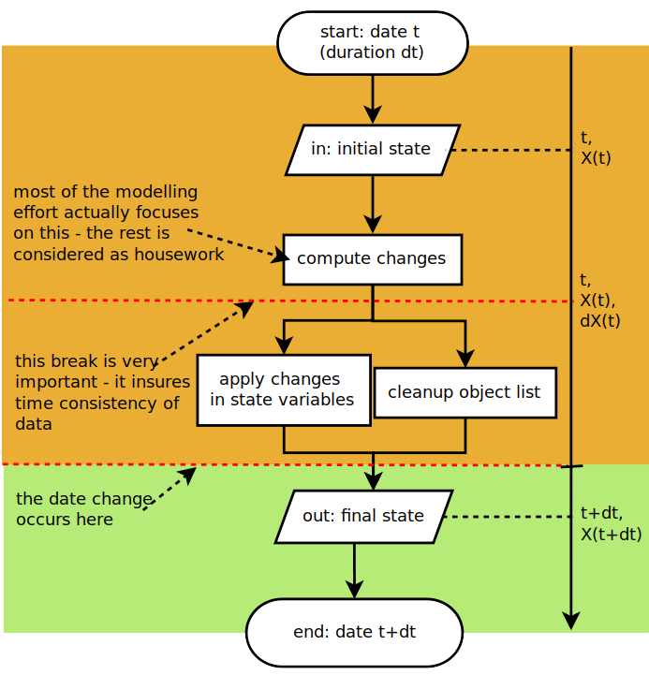
Aspect 3: a dynamic system
Multiple time models
Simultaneous events as the rule
(contrary to MASs)
MONO_UNIT
single time unit, calendar-compatible (default value)
GREGORIAN
real calendar time
YEAR_365D
365-day years, no weeks, no months
YEAR_13M
28-day months, 13-month/52-week years
WMY
28-day months, 12-month/48-week years
MONTH_30D
30-day months, weeks replaced by 15-day fortnights
YEAR_366D
366-day year, months replaced by 61-day bi-months
LONG_TIMES
long time units only (month or longer), calendar-compatible
SHORT_TIMES
short time units only (week or shorter), calendar-compatible
ARBITRARY
arbitrary time units with no predefined name

Slide 66
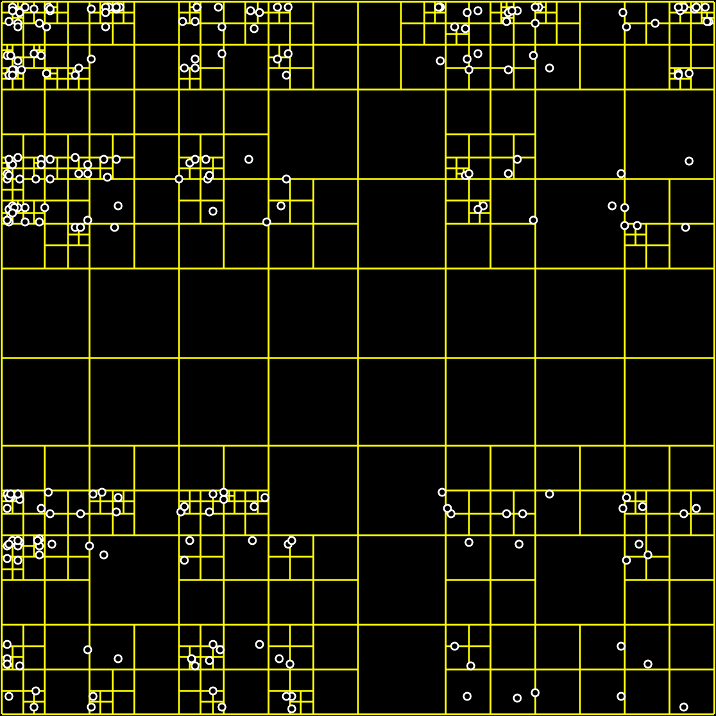
Aspect 4: a (spatially) organised system
Space optional
Uses Kd-trees to optimize searches for establishing relations
Samet H. 1984. The Quadtree and Related Hierarchical Data Structures. Computing Surveys 16:187–260
6 different types of edge-effect correction
2 different types of space
[many more to come!]
https://fr.wikipedia.org/wiki/Quadtree

Slide 67
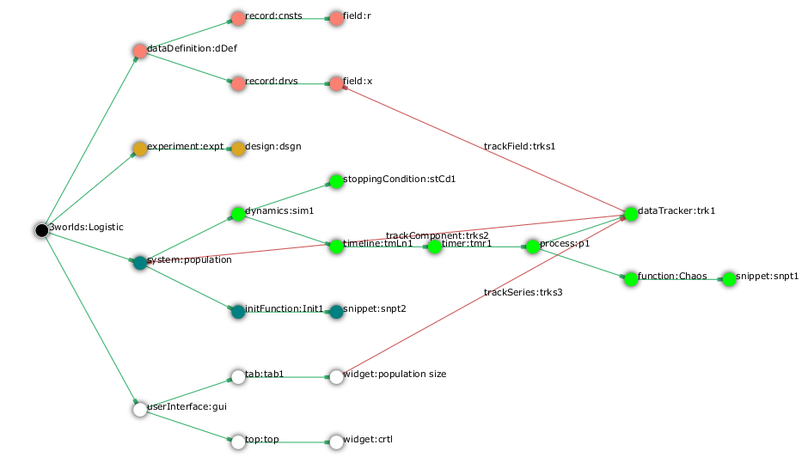
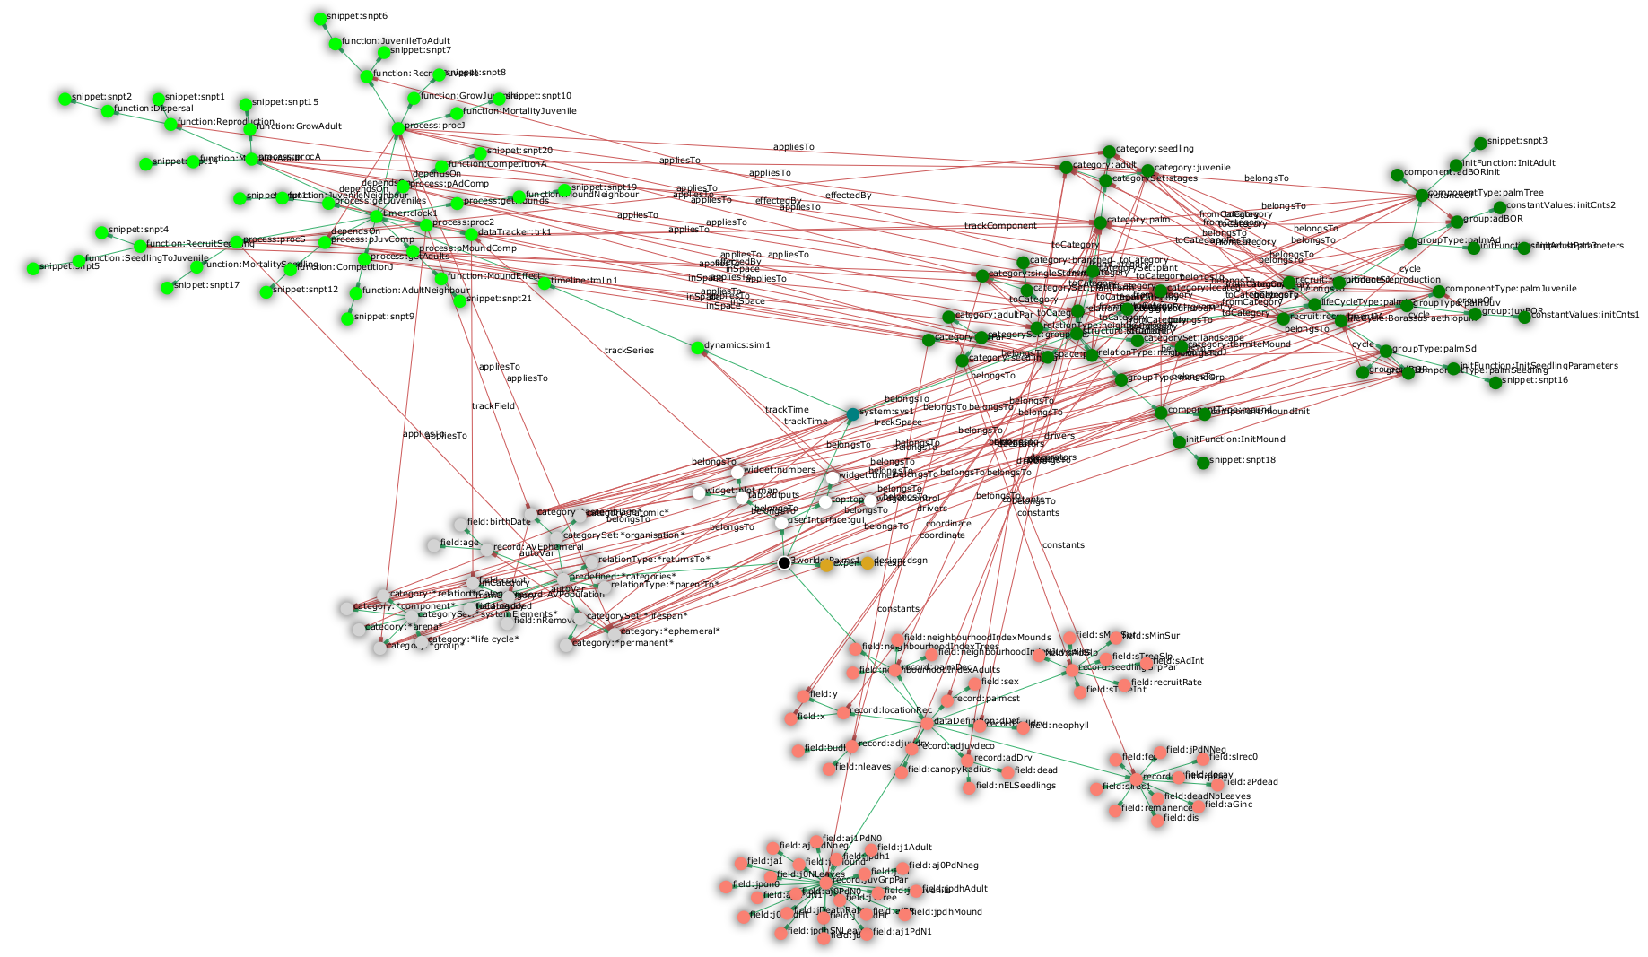
Aspect 5: a representation of a system
the smallest configuration graph in 3Worlds
a bigger one
Configuration
is a graph (static but editable)
is checked against an archetype
Flint S.R. 2006. Aspect-Oriented Thinking - An approach to bridging the disciplinary divides. PhD, Australian National University
‘s can be compared
3Worlds screen captures

Slide 68
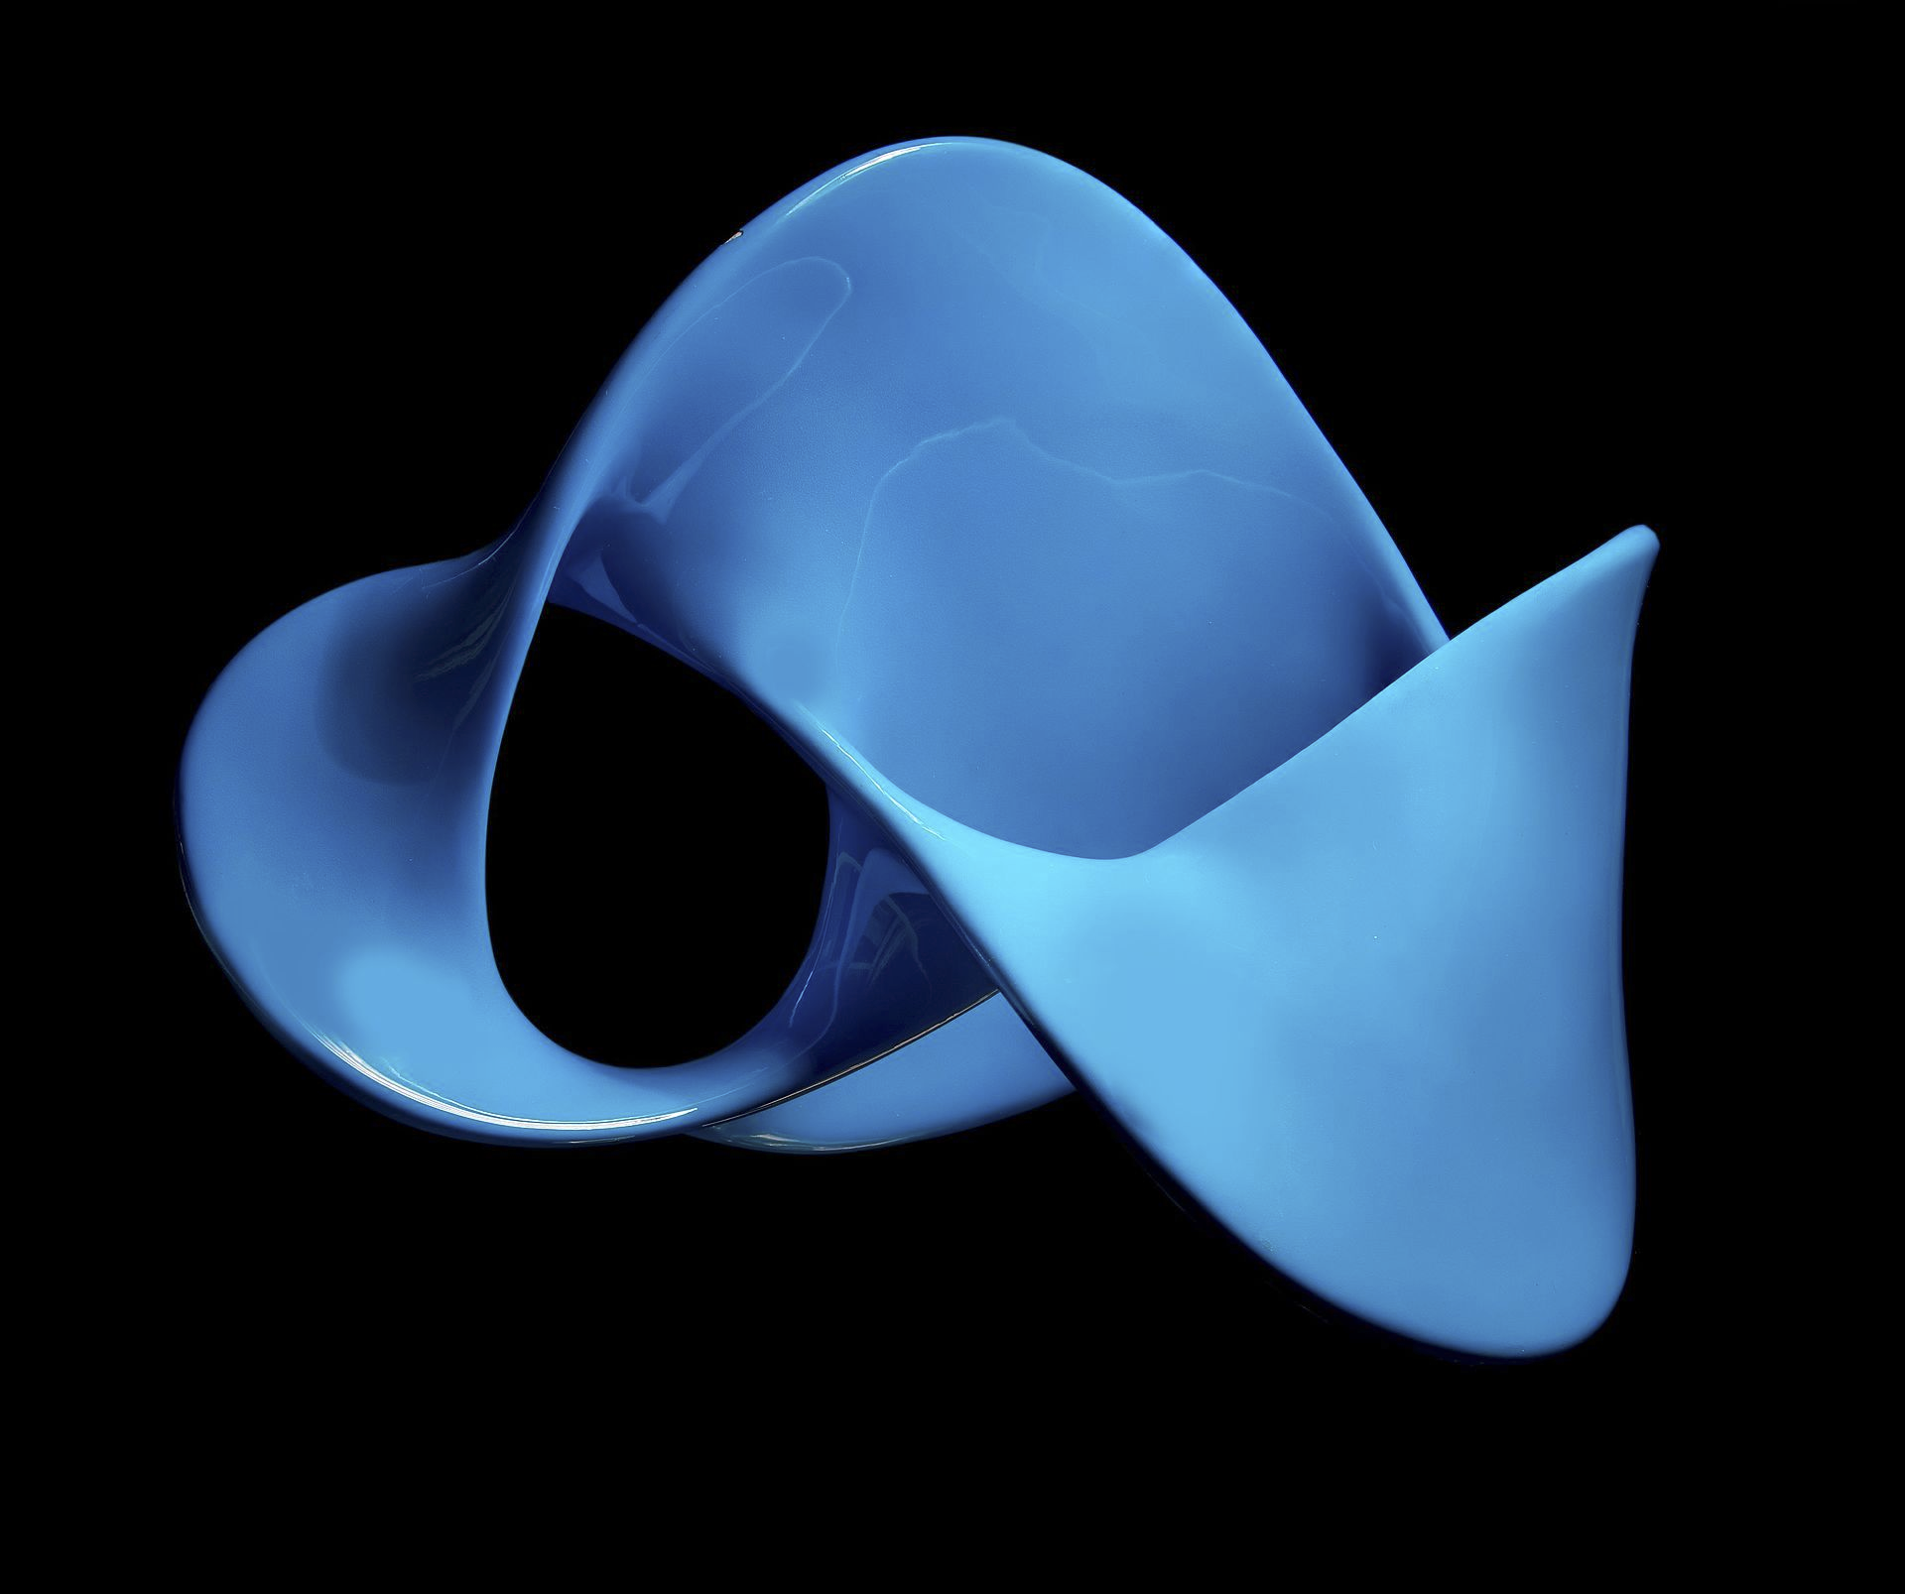
Aspect 6: an easy-to-use functional concept
Flexibility: any function can be used to represent an ecological process
For each 3Worlds model, a single ‘user-code’ file is generated where code for ecological processes can be edited
A complex IBM can be setup in one week of work.
this magnificent illustration of a ‘figure eight knot’ symbolizes the perfection and elegance of the 3Worlds software solutions.
Of course it has nothing to do here
https://en.wikipedia.org/wiki/Figure-eight_knot_(mathematics)#/media/File:Superf%C3%ADcie_-_bordo_n%C3%B3_figura-oito.jpg

Slide 69
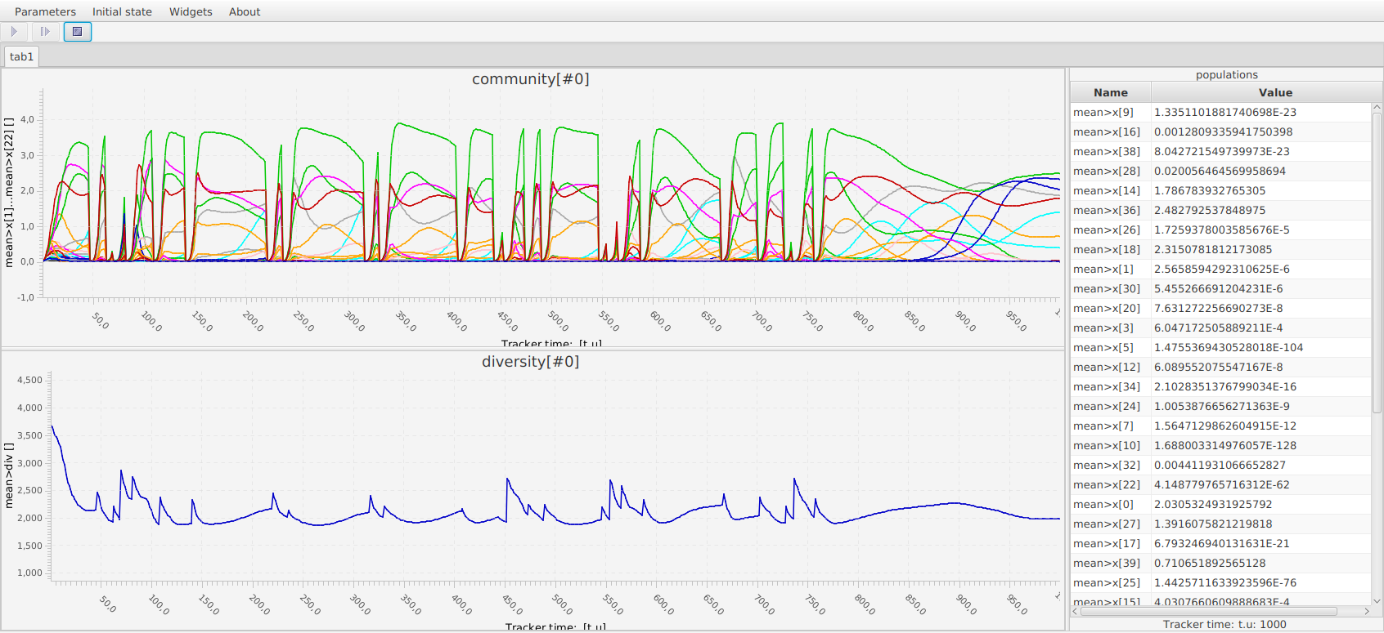
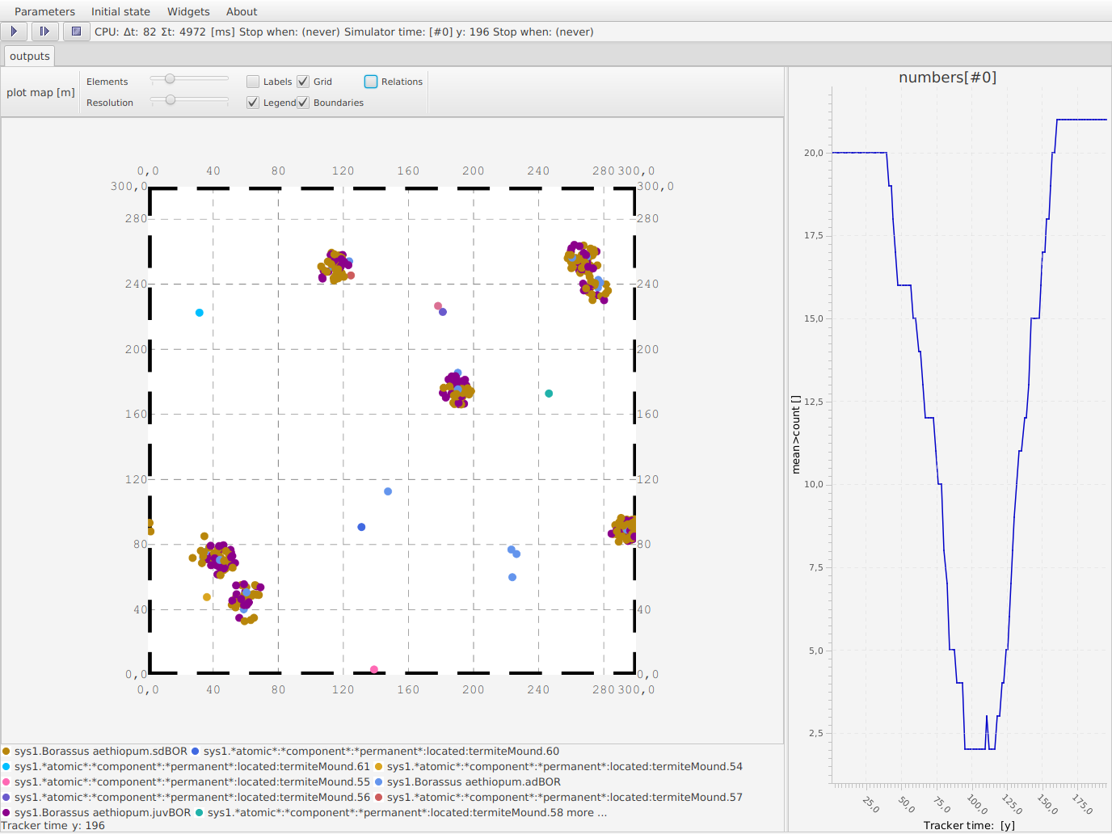
Aspect 7: a scientific object
Use case 1 :
developing model
quick feedback on outputs
3Worlds screen captures

Slide 70

Aspect 7: a scientific object
Use case 1 :
developing model
quick feedback on outputs
Use case 2 :
simulation experiment
parallel computing
[coming soon :
OpenMole integration
https://openmole.org/]
3Worlds screen captures

Slide 71
treegraph // saved by OmugiGraphExporter on Fri Feb 26 15:07:36 CET 2021
edge_factory = java.lang.String(au.edu.anu.twcore.root.TwConfigFactory)
node_factory = java.lang.String(au.edu.anu.twcore.root.TwConfigFactory)
// TREE
3worlds Palms
authors = au.edu.anu.rscs.aot.collections.tables.StringTable(([1]""))
built-by = java.lang.String(gignoux (21 déc. 2020))
contacts = au.edu.anu.rscs.aot.collections.tables.StringTable(([1]""))
precis = java.lang.String()
publication = au.edu.anu.rscs.aot.collections.tables.StringTable(([1]""))
version = java.lang.String()
predefined *categories*
categorySet *organisation*
category *assemblage*
category *atomic*
record AVEphemeral
field birthDate
interval = fr.ens.biologie.generic.utils.Interval(]-∞,+∞[)
precision = java.lang.Double(0.0)
type = fr.cnrs.iees.twcore.constants.DataElementType(Double)
units = java.lang.String()
field age
interval = fr.ens.biologie.generic.utils.Interval([0.0,+∞[)
precision = java.lang.Double(0.0)
type = fr.cnrs.iees.twcore.constants.DataElementType(Double)
units = java.lang.String()
record AVPopulation
field count
range = au.edu.anu.rscs.aot.util.IntegerRange(0..*)
type = fr.cnrs.iees.twcore.constants.DataElementType(Integer)
units = java.lang.String(#)
field nRemoved-
Aspect 7: a scientific object
Provenance made easy:
2 files fully describe a model (possibly more if input data): the configuration graph and the user java code

Slide 72
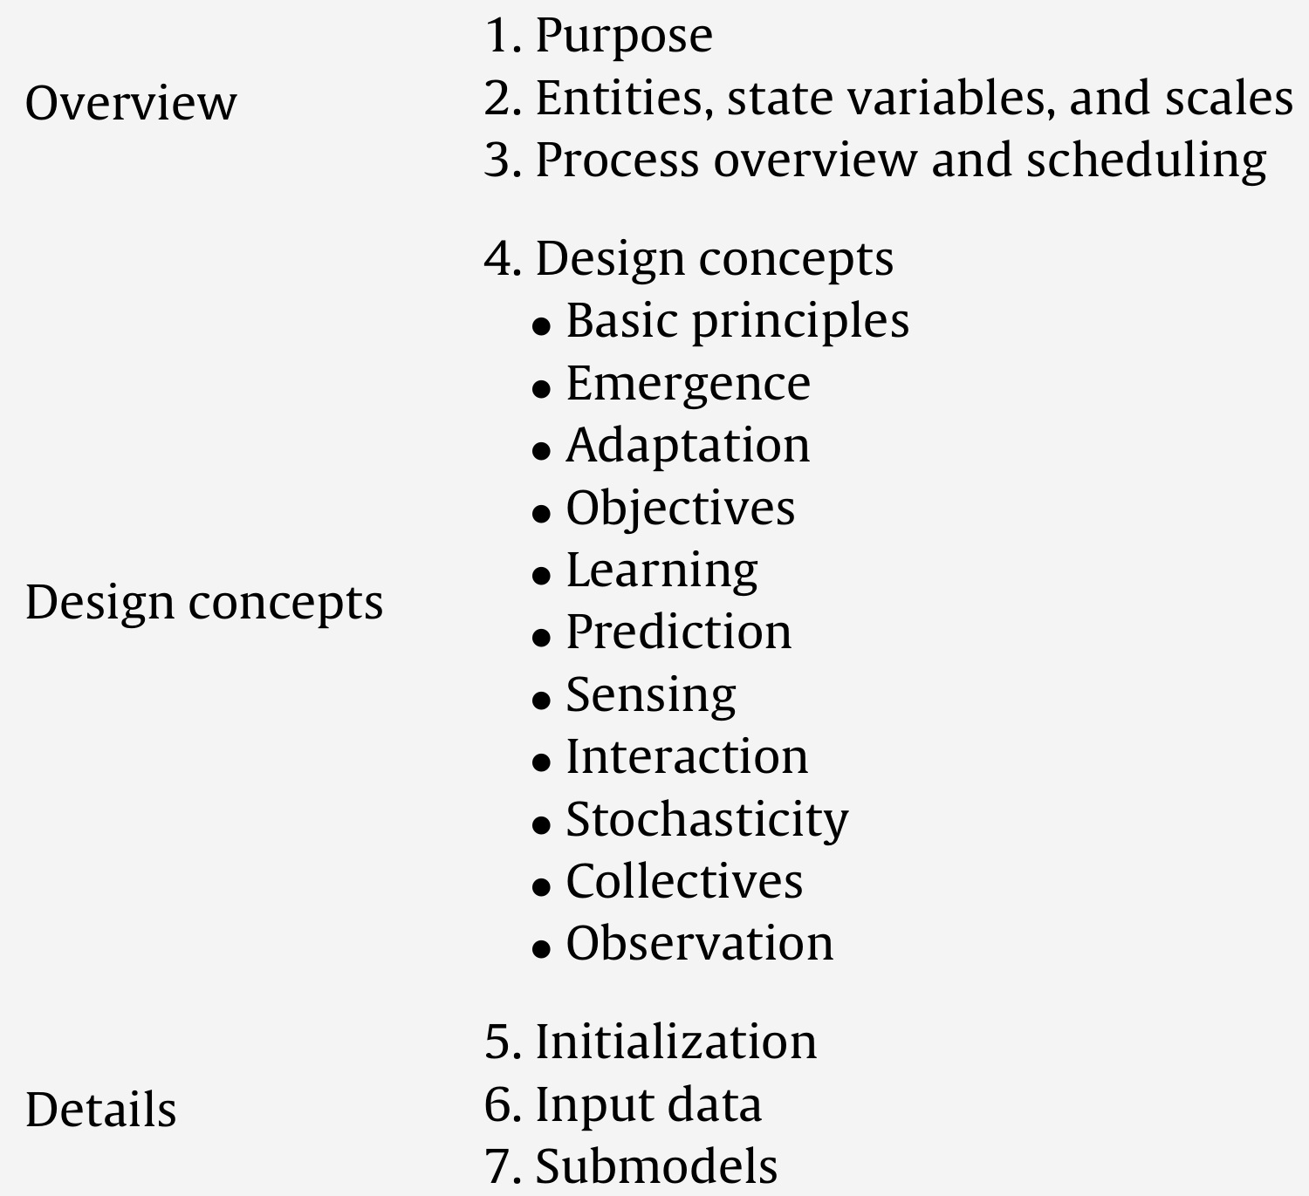
treegraph // saved by OmugiGraphExporter on Fri Feb 26 15:07:36 CET 2021
edge_factory = java.lang.String(au.edu.anu.twcore.root.TwConfigFactory)
node_factory = java.lang.String(au.edu.anu.twcore.root.TwConfigFactory)
// TREE
3worlds Palms
authors = au.edu.anu.rscs.aot.collections.tables.StringTable(([1]""))
built-by = java.lang.String(gignoux (21 déc. 2020))
contacts = au.edu.anu.rscs.aot.collections.tables.StringTable(([1]""))
precis = java.lang.String()
publication = au.edu.anu.rscs.aot.collections.tables.StringTable(([1]""))
version = java.lang.String()
predefined *categories*
categorySet *organisation*
category *assemblage*
category *atomic*
record AVEphemeral
field birthDate
interval = fr.ens.biologie.generic.utils.Interval(]-∞,+∞[)
precision = java.lang.Double(0.0)
type = fr.cnrs.iees.twcore.constants.DataElementType(Double)
units = java.lang.String()
field age
interval = fr.ens.biologie.generic.utils.Interval([0.0,+∞[)
precision = java.lang.Double(0.0)
type = fr.cnrs.iees.twcore.constants.DataElementType(Double)
units = java.lang.String()
record AVPopulation
field count
range = au.edu.anu.rscs.aot.util.IntegerRange(0..*)
type = fr.cnrs.iees.twcore.constants.DataElementType(Integer)
units = java.lang.String(#)
field nRemoved-
Aspect 7: a scientific object
Provenance made easy:
2 files fully describe a model (possibly more if input data): the configuration graph and the user java code
ODD (Overview, Design, Details): a standard for model description
Grimm et al. 2006. Ecol. Model. 198:115–126.
Grimm et al. 2010. Ecol. Model. 221:2760–2768.
3Worlds automatically generates an ODD skeleton for any model as an OpenOffice file
...it doesnt yet write the article, though.

Slide 73



In practice so far...
java language for portability
~125,000 lines of code (GCMs 50-750,000)
2 applications:
ModelMaker to edit configurations
ModelRunner to launch a simulation experiment
a java IDE*, e.g. eclipse to write function details
runs on Linux, Mac, Windows
curently 15+ models [many more to come]
[optimisation to come]
We couldnt reproduce the Windows and MacOS logos because they are not free
* integrated development environment. A ‘user friendly’ software to write code

Slide 74
In practice so far...
java language for portability
~125,000 lines of code (GCMs 50-750,000)
2 applications:
ModelMaker to edit configurations
ModelRunner to launch a simulation experiment
a java IDE*, e.g. eclipse to write function details
runs on Linux, Mac, Windows
curently 15+ models [many more to come]
[optimisation to come]
This is no science-fiction
but more tests are needed
We couldnt reproduce the Windows and MacOS logos because they are not free
* integrated development environment. A ‘user friendly’ software to write code

Slide 75
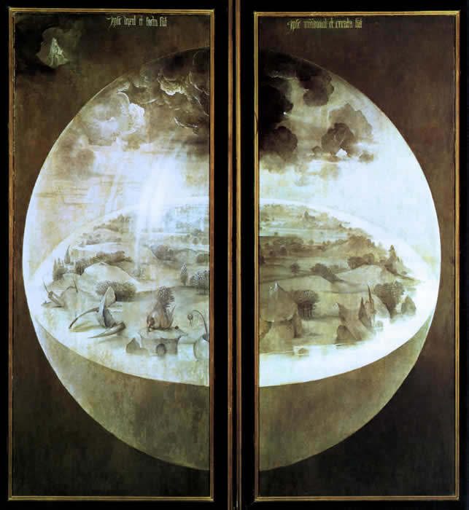
V. Some applications
‘The garden of earthly delights’
triptych (closed) by
H. Bosch, 1503

Slide 76
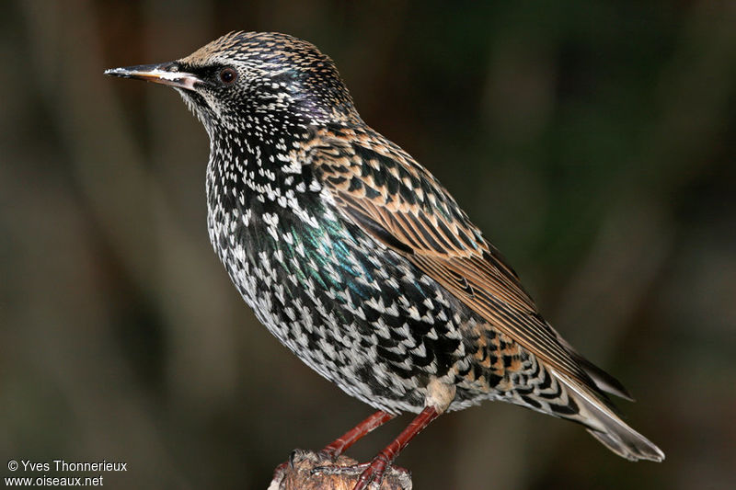
The starling (Sturnus vulgaris).
Flies.
Loves being in a (huge) group.
Is very noisy and shits while perching.

Slide 77
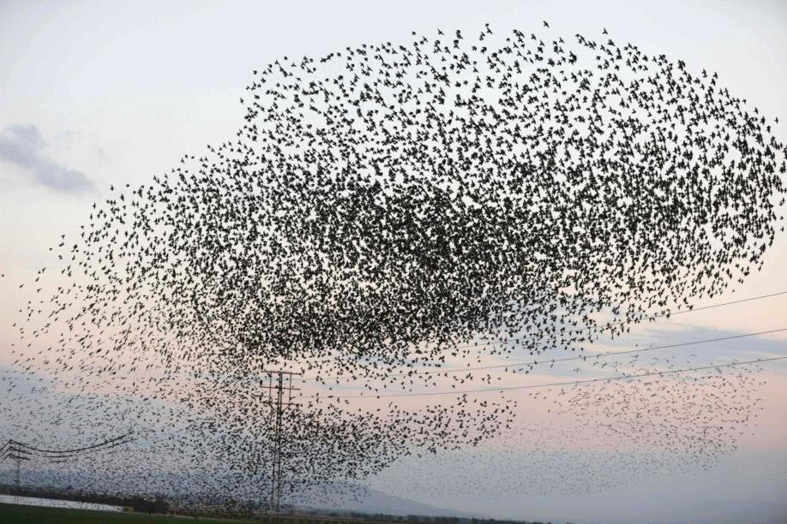
A flock of starlings
https://www.leprogres.fr/multimedia/2017/12/01/les-cliches-insolites-du-mois-de-decembre-a-travers-le-monde

Slide 78
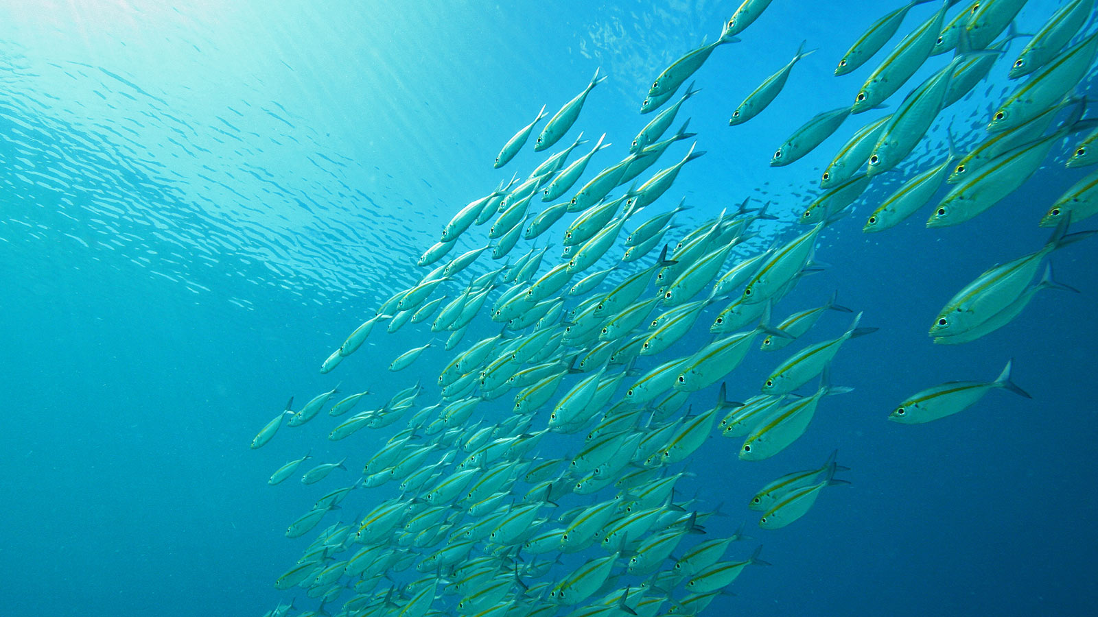
Fish also do it
(so one need not be very smart)
http://www.plongee-libre.fr/slideshow/banc-de-poissons-en-indonesie/

Slide 79
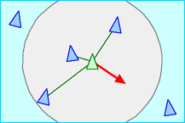
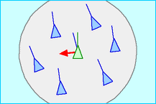
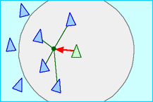
And it’s very easy to model with only 3 rules:
1
separation: avoid flockmates (close neighbours)
2
alignment: follow average heading of flockmates
visual field
3
cohesion: move towards barycentre of local flockmate group
Reynolds, 1987. Computer Graphics 21:25-34
figures from https://en.wikipedia.org/wiki/Boids

Slide 80
Configuration:
size 153
drivers 5
constants 3
decorators 8
component types 1
User code: 97 lines
move(...)
double x = xx;
double y = yy;
double incR = 0.0;
double incT = 0.0;
// default movement based on inertia, ie in the same direction as before + some random tilt
incR = speed;
incT = (random.nextDouble()*PI/4 - PI/8)/speed;
double radHeading = heading*PI/180+incT;
double moveX = incR*cos(radHeading);
double moveY = incR*sin(radHeading);
// if there are visible birds, add corrections:
if (nLocal>0) {
// rule 1: cohesion - flying towards the barycentre of the local group
// move 1% towards the centre
moveX += (avgX/nLocal-x)/100;
moveY += (avgY/nLocal-y)/100;
// rule 2: separation - avoid collision with other boids
moveX += focalDec.avoidX/nLocal;
moveY += focalDec.avoidY/nLocal;
// rule 3: match movement to others
moveX += (avgdX/nLocal-dX)/8;
moveY += (avgdY/nLocal-dY)/8;
}
focalDrv.xx = x+moveX;
focalDrv.yy = y+moveY;
focalDrv.dX = moveX;
focalDrv.dY = moveY;
focalDrv.heading = acos(moveX/euclidianDistance(0.0,0.0,moveX,moveY))*180/PI;
if (moveY<0.0)
focalDrv.heading = 360-focalDrv.heading;
prepareMove(...)
focalDec.avgHeading += other_heading;
focalDec.avgX += other_xx;
focalDec.avgY += other_yy;
focalDec.avgdX += other_dX;
focalDec.avgdY += other_dY;
focalDec.nLocal++;
// rule 2: avoid collisions
if (squaredEuclidianDistance(xx,yy,other_xx,other_yy)<safetyRange*safetyRange) {
focalDec.avoidX -= (other_xx-xx);
focalDec.avoidY -= (other_yy-yy);
}
focalDrv.xx = xx;
focalDrv.yy = yy;
otherDrv.xx = other_xx;
otherDrv.yy = other_yy;

Slide 81
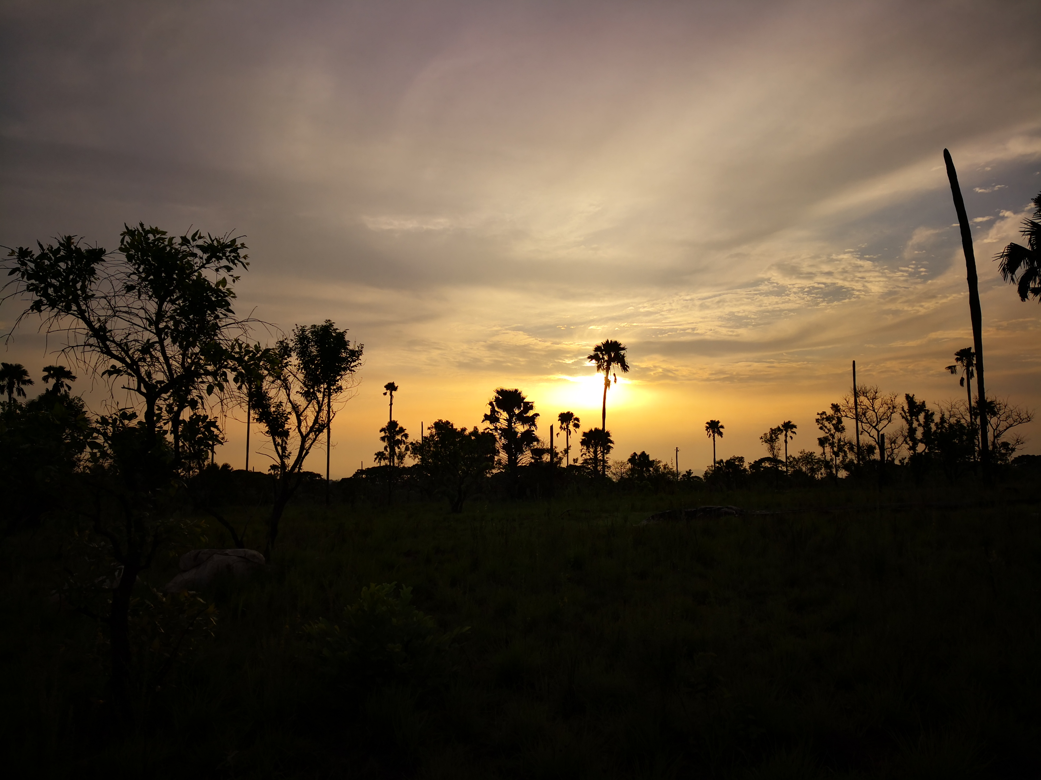
Borassus aethiopum Mart. : the pâlmier rônier*
* sorry, no English translation can faithfully reproduce that French touch
This palm tree doesn’t seem to grow where life is easy for itself
(Barot et al. 1999. Ecology 80:1987–2005)
photo Tristan Charles-Dominique

Slide 82
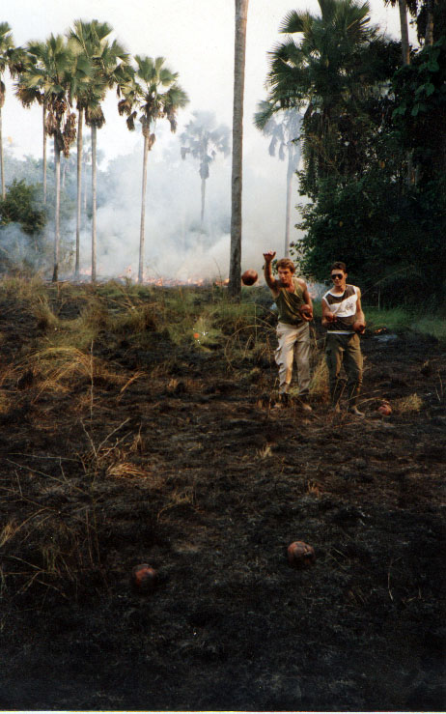
A data-supported model
3 stages : seedling, juvenile, adult (categories)
adults reduce seedling and juvenile survival
termite mounds increase growth
reproduction starts at adult stage
seed dispersal is very short ranged
spatial pattern gets less agregated with palm age
Barot & Gignoux 1999, Biotropica
Barot et al. 1999, Oikos
Barot & Gignoux 2003, JVS
Barot & Gignoux 1999, Biotropica
Barot et al. 1999, Oikos
Barot et al. 1999, Ecology
Hypotheses
1. B. aethiopum is lacking former dispersers (elephants and baboons) and its spatial pattern will change
2. Without termite mounds there will be no more palm trees in Lamto
photo Jacques Gignoux

Slide 83

Hypotheses
1. B. aethiopum is lacking former dispersers (elephants and baboons) and its spatial pattern will change
...
seedling and juveniles are still clumped around adults,
but
adults are much more clumped than in reality
3Worlds screen capture

Slide 84

Hypotheses
2. Without termite mounds there will be no more palm trees in Lamto
...
The difference is not obvious. A formal simulation experiment is needed.
3Worlds screen capture

Slide 85
Configuration:
size 627
drivers 5
constants 43
decorators 5
component types 4
relation types 3
User code: 217 lines
moundEffect(...)
// relativedistance weight, ie = 1 if at focal location, =0 at searchRadius distance
double weight = 1-euclidianDistance(x,y,other_x,other_y)/searchRadius;
focalDec.neighbourhoodIndexMounds += weight;
mortalityAdult(...)
if (dead>=group_remanence)
return true;
else
return false;
juvenileNeighbour(...)
return true;
growJuvenile(...)
double crownSurface = PI*sqr(canopyRadius);
double niMound = neighbourhoodIndexMounds/crownSurface; // TODO: replace by neighbourhood index
double niTree=0;
double niAdult = neighbourhoodIndexAdults/crownSurface;
double niJuv = neighbourhoodIndexJuveniles/crownSurface;
// increment in number of leaves
double[] proba = new double[3];
if (budHt>0.0) {
double neighb = group_j0Mound*niMound + group_j0NLeaves*nleaves;
double logit = neighb + group_aj0PdNneg;
proba[0] = 1/(1+exp(-logit));
logit = neighb + group_aj0PdN0;
proba[1] = 1/(1+exp(-logit));
logit = neighb + group_aj0PdN1;
proba[2] = 1/(1+exp(-logit));
}
else {
double neighb = group_j1Tree*niTree + group_j1Adult*niAdult + group_j1Juvenile*niJuv + group_j1BudHt*budHt;
double logit = neighb + group_aj1PdNneg;
proba[0] = 1/(1+exp(-logit));
logit = neighb + group_aj1PdN0;
proba[1] = 1/(1+exp(-logit));
logit = neighb + group_aj1PdN1;
proba[2] = 1/(1+exp(-logit));
}
double real = random.nextDouble();
int result = 3;
for (int i=0; i<3; i++)
if (real<proba[i]) {
result = i;
break;
}
int dN = result-1; // possible outcomes: -1,0,1,2

Slide 86

Testing the intermediate disturbance hypothesis
40 species following Lotka-Volterra competition model (random parameters), 2 disturbances.
3Worlds screen capture

Slide 87
Configuration:
size 127
drivers 41
constants 122
decorators 2
component types 2
User code: 57 lines
effects(...)
for (int i=0; i<other_x.size(); i++) {
if (other_x.getByInt(i)>other_K.getByInt(i)*intensity/100000)
otherDrv.x.setByInt(otherDrv.x.getByInt(i)*other_K.getByInt(i)*intensity/10000, i);
}
otherDrv.lastDistT = t;
initComm(...)
double initfreq = 1.0/x.size();
focalDrv.x.fillWith(initfreq);
for (int i=0; i<r.size(0); i++) {
focalCnt.r.setByInt(random.nextDouble(),i);
focalCnt.K.setByInt(5.0+initfreq+random.nextDouble(),i);
for (int j=0; j<alpha.size(1); j++) {
if (i==j)
focalCnt.alpha.setByInt(1.0,i,j);
else
focalCnt.alpha.setByInt(max(0.0001,random.nextDouble()),i,j);
}
}
focalDrv.lastDistT = 0.0;
setup(...)
return true;
growth(...)
// population growth
double[] dxdt = new double[x.size(0)];
for (int i=0; i<x.size(0); i++) {
double sum = 0;
for (int j=0; j<alpha.size(1); j++)
sum += alpha.getByInt(i,j) * x.getByInt(j);
dxdt[i] = r.getByInt(i) * x.getByInt(i) * (1-sum/K.getByInt(i));
}
for (int i=0; i<dxdt.length; i++)
focalDrv.x.setByInt(max(x.getByInt(i)+dxdt[i]*dt,0.0), i);
// compute diversity
double xtot = 0.0;
for (int i=0; i<focalDrv.x.size(0);i++)
xtot += focalDrv.x.getByInt(i);
focalDec.div = 0.0;
for (int i=0; i<focalDrv.x.size(0);i++)
if (focalDrv.x.getByInt(i)>0.0)
focalDec.div -= (focalDrv.x.getByInt(i)/xtot) * log(focalDrv.x.getByInt(i)/xtot);
// compute time since last disturbance
focalDec.timeSinceLastDisturbance = t-lastDistT;
initDist(...)

Slide 88
VI. Conclusions
1. to couple approaches of a complex system, use aspect-oriented thinking
2. any ecosystem can be modelled with a dynamic graph
3Worlds is there*, use it!
*Well... come and see me after the talk

Slide 89

VII. Needs & future plans
testers:
develop models
check GUIs
check checks
programmers:
space library
openMole integration
optimisation
graph analysis
https://valerianpierret.artstation.com/projects/e0m4eJ

Slide 90
VII. Needs & future plans
testers:
develop models
check GUIs
check checks
programmers:
space library
openMole integration
optimisation
graph analysis
And, anyway, what do you
have against science-fiction
when people spend billions
to grow tomatoes on Mars?
https://valerianpierret.artstation.com/projects/e0m4eJ

