Slide 1

welcome
to Lecture 3

Slide 2
Computation and the Brain

Slide 3
First: What happened last Wednesday

Slide 4
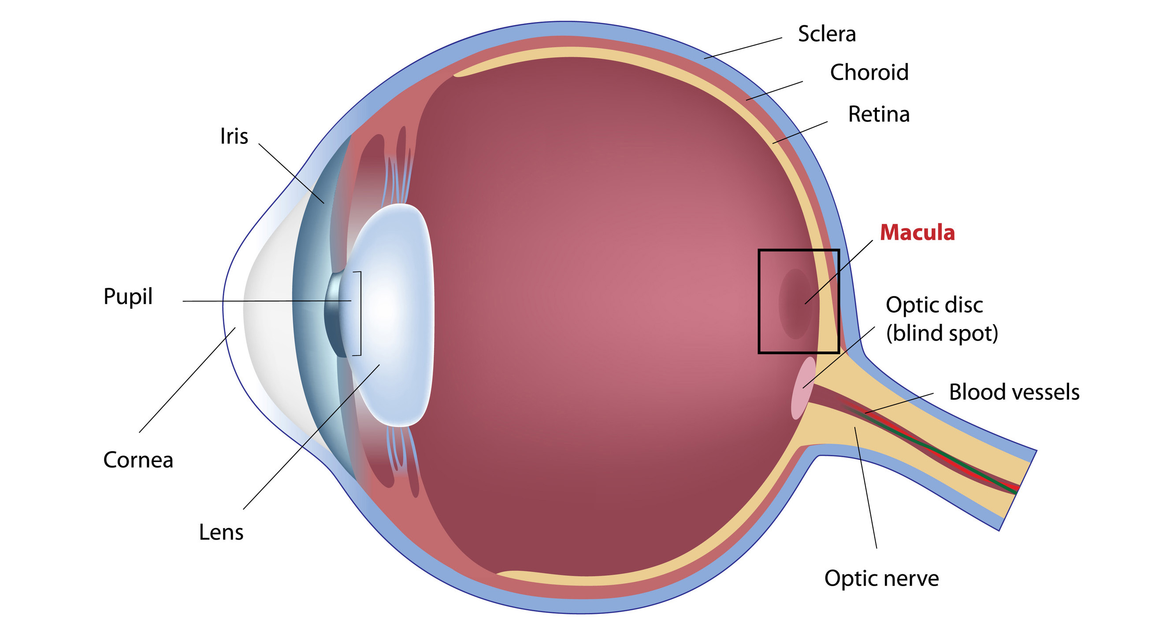

Slide 5
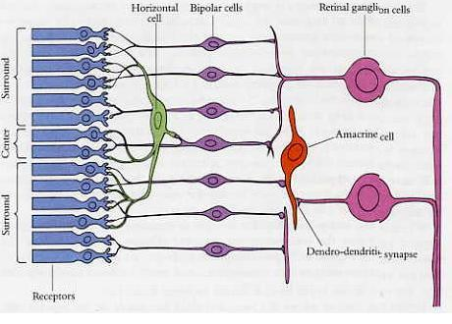

Slide 6
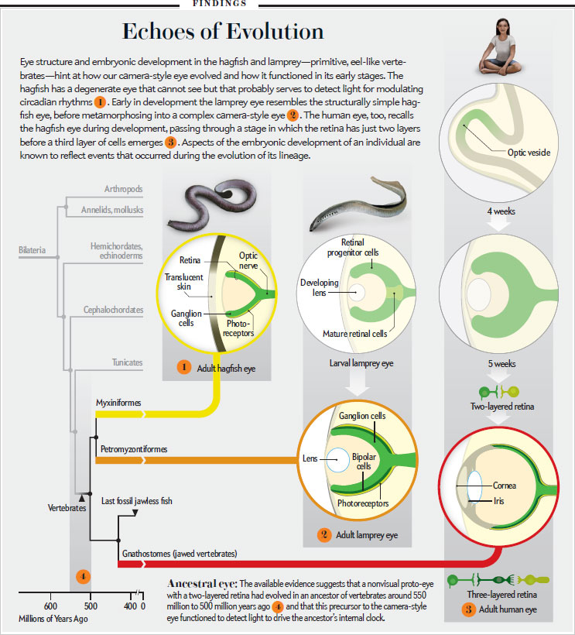
One of them is the vertebrate eye…

Slide 7
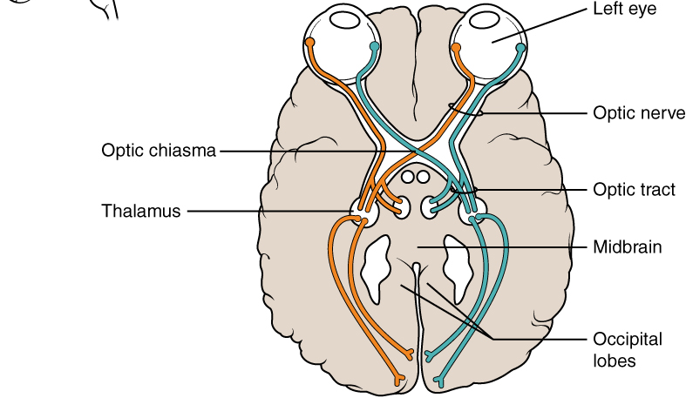
The chiasm

Slide 8
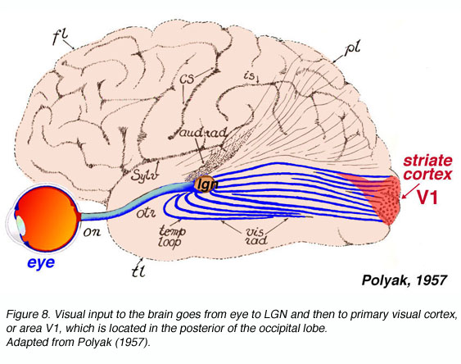
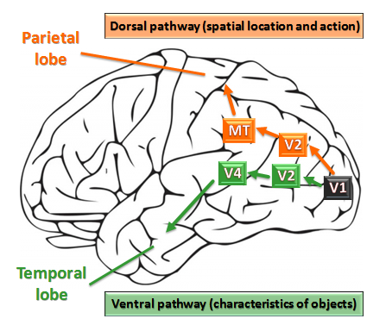
The archetypical deep net

Slide 9
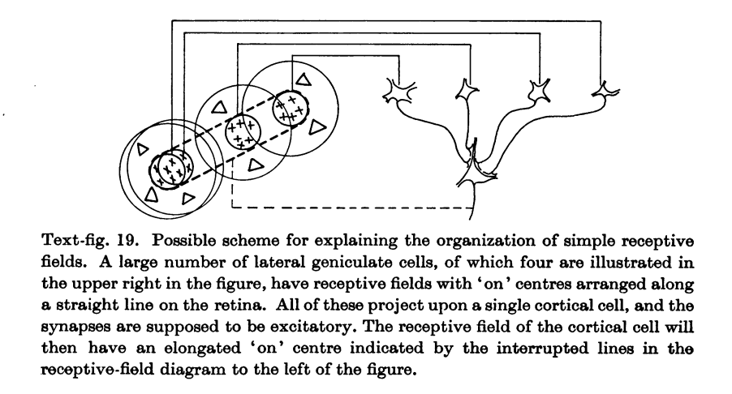
The Hubel – Wiesel conjecture: simple cells

Slide 10
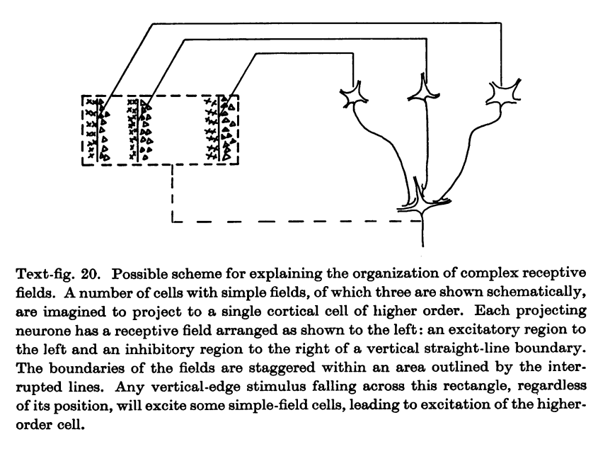
The Hubel – Wiesel conjecture: complex cells

Slide 11
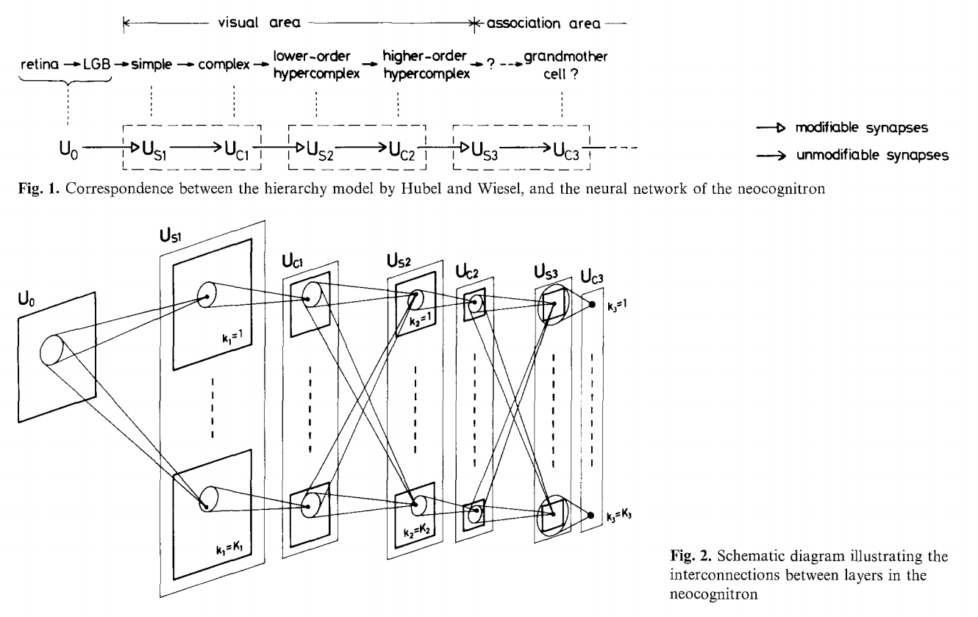
K Fukushima 1980: The Neocognitron
Explicitly inspired by
Hubel and Wiesel
”unsupervised learning”
of weights

Slide 12
Gradient descent
To approximate the minimum of a differentiable function f: R^{d} → R
Set t = 0, and set x⁰ to some initial point
Repeat
calculate the gradient ∇f(x^{t})
and the ``learning rate’’ 𝝰_{t}
x^{t+1} = x^{t} - 𝝰_{t} ∇f(x^{t})
Until termination condition (typically, |x^{t+1} – x^{t}| very small)
This is the science/
dark art of the matter

Slide 13
What is known about gradient descent
Theorem: If f is a strictly convex quadratic function
x^{T}A x + b x, and L is the largest eigenvalue of A, taking 𝝰_{t} = 1/L guarantees logarithmic convergence (the distance from the optimum decreases exponentially fast).
Theorem: Ditto is f is a general strictly convex function, and L is an upper bound on the Hessian’s eigenvalues.
Theorem: If f is not convex, then no convergence can be guaranteed whatsoever
It doesn’t matter!

Slide 14
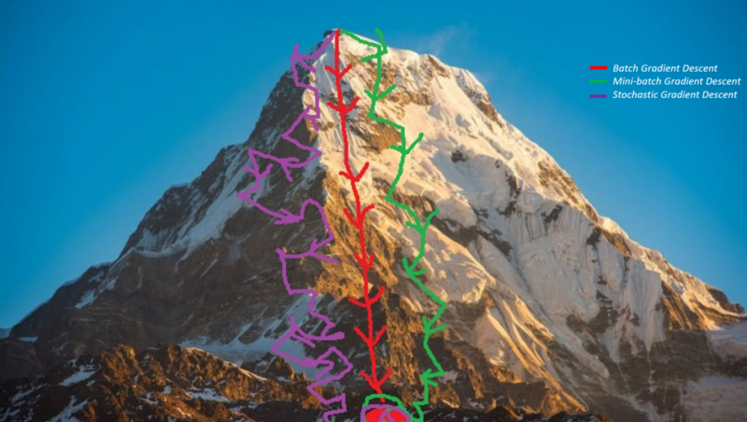

Slide 15
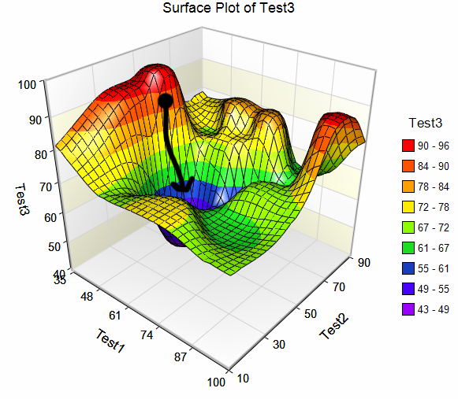

Slide 16

Can you visualize 10-dimensional data? Are you sure?
…the amazing shrinking inscribed ball
1-d 1.00
2-d 0.79…
3-d 0.52…
4-d 0.31…
5-d 0.16…
…
10-d 0.002…
16-d 0.000004…

Slide 17
Questions? Thoughts? Feedback?

Slide 18
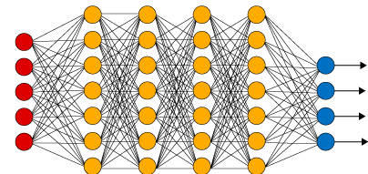
Connection between gradient descent and Deep Nets
To find a Deep Net model of a
function such as f: {images} → {0,1}
“does the image contain a car?”
you approximate the minimum of the differentiable function:
∑_{data} (net_answer[parameters,data] – correct_answer[data])² by stochastic gradient descent (SGD: try a few new data points at each step). To do this, you apply the chain rule on the parameters and partial results (= the values of the intermediate nodes).
This is called back propagation [Rumelhart 1986]

Slide 19
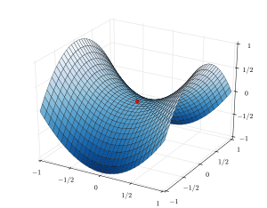
Why does gradient descent succeed in approximating the optimum?*
saddle
points

Slide 20
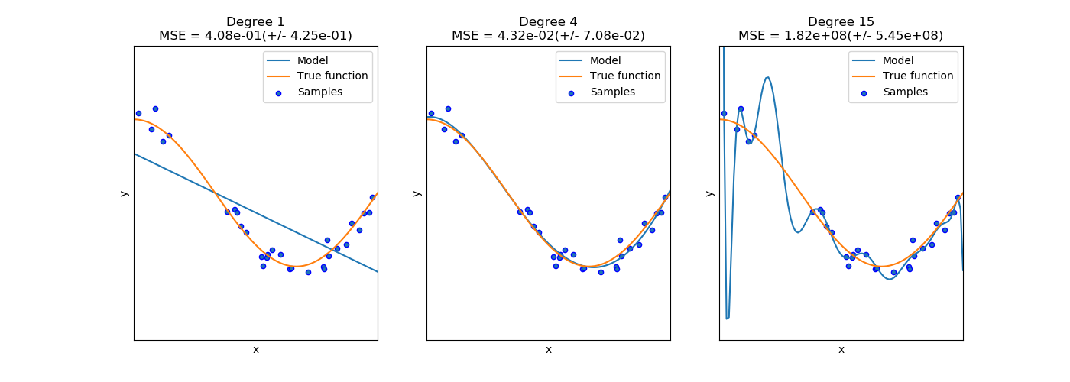
But getting to the optimum is the (relatively) easy part… Overfitting

Slide 21

How does SGD avoid overfitting*? “Understanding deep learning requires rethinking generalization” ICLR 2017; also, cf T. Poggio I, II, III 2017
no overfitting

Slide 22
So, where do we go from here?
Convolutional Neural Nets – Neural Nets – Back Prop?
Perceptron and Support Vector Machines?
Machine learning theory?
Unsupervised learning – PCA – Sparse Coding?
Information Theory, Machine Learning, and the Brain?

Slide 23


Slide 24
Unsupervised Learning: Reducing the dimensionality of data
The true curse of dimensionality: you have never been
We lack geometric intuition
Q: Is there such thing as ``redundantly high dimension?”
E.g., 10⁸ points in 10⁵ dimensions?
YES! If √ln (#points)/dimension << 1, you are wasting dimensions….

Slide 25
The Johnson – Lindenstrauss Lemma (JLL)
Theorem (JL, 1984): For any set of n d-dimensional vectors x₁, …, x_{n} there is another set of vectors x’₁, …, x’_{n} with dimension k = 8(ln n)/ 𝛆² such that for all i, j: |x_{i} – x_{j}|² ≈ |x’_{i} – x’_{j}|² (1 ± 𝛆)
What happens if you project a specific d-dim vector on a random k-dim space?
What happens if you project a random d-dim vector on a specific k-dim space?

Slide 26
The Johnson – Lindenstrauss Lemma (JLL): The Moral
for any data set
if the dimensions have no special meaning for you
and you are mainly interested in the distances between the data
and you can tolerate an error of 𝛆
then your dimension should not exceed 8 ln n/𝛆²

Slide 27
Aside: an application to complexity theory:
The d-dimensional traveling salesman problem can be approximated when d is constant (1, 2, 3, …)
But when dimension ~ cities, it is NP-complete to approximate
Q: What happens when dimension ~ √cities?
A: NP-complete, because you can project so the distances are essentially the same

Slide 28
What if…
Dimension is not super high
“My data is not any data!”
Principal component analysis (PCA, or SVD: singular value decomposition, or LSI: latent semantic indexing)

Slide 29
Alice Bob Claire Dave Eve
Saving Private Ryan 3 2 3 5 4
Crouching tiger… 5 3 3 3 4
Memento 4 1 1 3 3
Almost famous 4 5 4 1 2
Eternal sunshine… 4 3 1 3 3
The departed 2 2 5 3 2
White men can’t jump 1 3 5 2 3
No country for old men 2 1 4 5 4
Gladiator 1 2 3 2 2
Zoolander 2 2 5 3 1

Slide 30
3 2 3 5 4 PCA to the rescue!
5 3 3 3 4 Q: can you approximate these
4 1 1 3 3 five 10-d vectors x₁, x₁, …, x₅ as
4 5 4 1 2
4 3 1 3 3 x_{i} ≈ x_{ave} + a_{i} v + b_{i} u
2 2 5 3 2 for two appropriate vectors u, v?
1 3 5 2 3
2 1 4 5 4
1 2 3 2 2
2 2 5 3 1

Slide 31
PCA to the rescue!
highbrow
Dave
Alice
Eve
romance
Claire
Bob

Slide 32
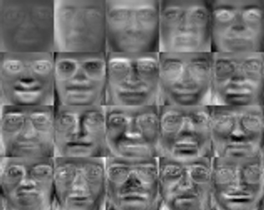
200 “eigenfaces” are enough to approximate reasonably well most faces (1990)

Slide 33
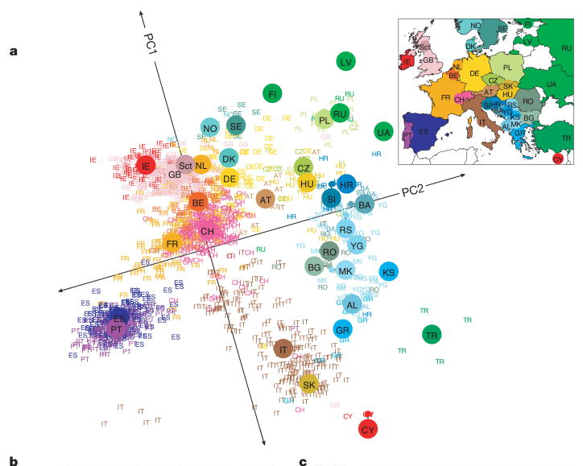
DNA of Europeans: n = 3,000 d = 500,000

Slide 34
Latent semantic indexing of documents [Gerard Salton 1975]
Every book is a 10,000 (say) dimensional vector, where every dimension is a word
Preprocessing: stopwords, word forms, log of #appearances
So, the Library of Congress is a collection of 15,000,000 vectors of dimension 10,000
What are the principal components?
How many?
cf: word embeddings
“Parallelogram analogies”*

Slide 35
PCA of the flu virus database…

Slide 36
So, how do you find this?
Preprocessing: Curate data, subtract to zero mean, normalize coordinates
Then do some linear algebra and geometry…
<on the board>

Slide 37
Sparse coding (as in the Olshausen-Fields paper)
You are given data vectors y₁, …, y_{n} in R^{d}
find an mXd coding matrix B with column vectors b₁, …, b_{m} in R^{d} (expect m > d)
and sparse vectors x₁, …, x_{n} in R^{m}
Such that min_{A, x} [∑_{i} |y_{i} – Bx_{i} |² +
∑_{I} S(x_{i}) (a sparsity penalty function)

Slide 38
Sparse coding: Algorithms
Gradient descent [OF 1998]
Maximum likelihood, assuming a ganerative model and noise [Lewicki and Sejnowski 200]
Alternating minimization:
Start with a basis B
Repeat: Sparse decode the data on B to get x
Gradient step on B
Performance guarantees, see [Arora et al 2015]

