Slide 1

SDL: Past, Present, and Future
Sam Lantinga and Ryan Gordon

Slide 2
What Is SDL?
Simple DirectMedia Layer
Cross-platform interface for hardware abstraction
Windows, macOS, Linux, iOS, Android, etc.
Covers audio, video, controllers, and much more
Used by game engines and game/app developers
No, my middle initial isn’t ‘D’

Slide 3
Who Are We?
Sam Lantinga
Author of SDL, Software Engineer at Valve Corporation
Ryan Gordon
Partner in crime, Software Engineer at icculus.org
Unsung heroes
@1bsyl, @Kontrabant, @madebr, @sezero
And many many more…
Notes:
@1bsyl, Sylvain, handles many miscellaneous cleanups and Android bug reports
@Kontrabant, Frank, is our resident Wayland guru @madebr, Maartin, is our resident CMake guru
@sezero, Ozkan, makes sure our i‘s are dotted and t’s crossed

Slide 4
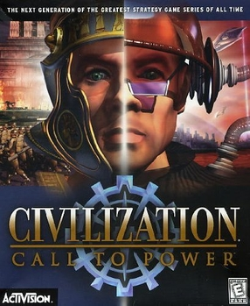
The Past: SDL 1.2
Born out of Executor, a 68k Macintosh emulator
Single window, framebuffer access, single audio callback, keyboard/mouse/joystick input, CD-ROM support
Used by Loki Software in Linux ports

Slide 5
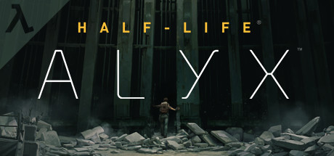
The Present: SDL 2.0
Added support for multiple windows, surround sound, accelerated 2D video API, Vulkan graphics context, game controller API
Used by Valve Corporation in Steam and the Source 2 engine across all platforms

Slide 6
25 Years of History
Started with Loki Software in 1998
Civilization: Call To Power, Heroes of Might and Magic III, Sid Meier’s Alpha Centauri, Tribes 2, Unreal Tournament, etc.
Continues with Valve Corporation in 2023
DOTA 2, Half-Life: Alyx, Portal 2, Steam, Steam Link, Steam VR, Team Fortress 2, etc.
Used by hundreds of games, including many published on Steam
Used by several major game engines, including Unity and Source 2
Used by games, emulators, embedded environments, and more!
Has bindings for over a dozen programming languages
Notes:
* SDL is actually used in Source 1 as well, but only on Linux and for controller support. SDL is fully used for all platforms in Source 2.

Slide 7
25 Years of Portability
Windows, Linux, *BSD, macOS, iOS, tvOS, Android
Windows RT, Windows UWP, Windows and Xbox GDK
Playstation, Nintendo Switch
Emscripten: reimplemented SDL 1.2 API using Javascript, now directly supported in SDL 2.0
And many more over the course of time… Haiku, N3DS, OS/2, PS Vita, QNX, etc.

Slide 8
Open Source Is Great
Moving to GitHub has greatly increased developer engagement and feedback, and has directly contributed to the move to SDL 3
There are almost 400 contributors and 1000 forks of the core library
Moving to GitHub has made it much easier to release quickly, and now we have a monthly cadence of stable release updates

Slide 9
Commercial Products Are Great
Great feedback from professional developers shipping large products
Battle tested, shipping in Steam to millions of customers every day
Used by Steam Link exclusively for audio, video, and input across mobile and desktop platforms
Shipping SDL pre-release code in Steam betas results in more stable releases

Slide 10
The Future: SDL 3.0
Simplifying and streamlining the build process
Standardizing on Cmake
Visual Studio and Xcode projects still available

Slide 11
The Future: SDL 3.0
Simplifying and streamlining the API
Symbol naming conventions are more consistent
Simplifying functions where it makes sense
Removing functions where it makes sense
main() handling moved to a standalone header library

Slide 12
The Future: SDL 3.0
Adding new useful functionality
New 3D GPU API in development
Full support for high DPI displays
Added nanosecond time precision
Added sub-frame event timing
And much, much more!

Slide 13
The Compatibility Story
Compatibility is important so older commercial games continue to run as platforms evolve
sdl12-compat allows running SDL 1.2 games on the SDL 2.0 runtime
sdl2-compat allows running SDL 2.0 games on the SDL 3.0 runtime
SDL 1.2 => sdl12-compat => sdl2-compat => SDL 3.0 works!
Civilization: Call To Power from 1999 runs seamlessly on a modern Linux system running Wayland

Slide 14
Easing the Transition
Careful decisions about how to change the codebase
Code style reformatting was applied to both SDL2 and SDL3 so bug fixes could be more easily merged between major versions
We decided not to switch to stdint types for internal code

Slide 15
Easing the Transition
Careful decisions about how to change the API
Does the change make life better for developers?
Are we changing the API in a way that will still make sense 10 years from now?

Slide 16
Easing the Transition
Transition guide
As part of the change acceptance process, each change must be documented and a developer transition plan provided in docs/README-migration.md
Coccinelle is a tool that can be used on Linux or on Windows via WSL

Slide 17
Topic: Relative Mouse Motion

Slide 18
Topic: Relative Mouse Motion
When is it useful?
Camera control in FPS style games
Dragging the map in RTS or RPG style games
Precise mouse positioning in emulators
… etc.
Notes:
* Warping can also run into problems where you hit the edge of the window, or in rare cases, escape the window * RDP coalesces mouse updates and if you set position you often won’t get back that same position

Slide 19
Topic: Relative Mouse Motion
Classic approach:
Mouse warping - originally used in the id DOOM engine
Generates additional mouse events
Deltas are affected by desktop mouse acceleration
Doesn’t work over Windows Remote Desktop
Notes:
* Warping can also run into problems where you hit the edge of the window, or in rare cases, escape the window * RDP coalesces mouse updates and if you set position you often won’t get back that same position

Slide 20
Topic: Relative Mouse Motion
SDL_SetRelativeMouseMode()
Automatically hides the mouse cursor
Automatically constrains the mouse to the window
Provides low level, low latency mouse deltas
Delta scaling disabled by default for predictable movement
Works with Windows Remote Desktop (sorta)

Slide 21
Topic: Relative Mouse Motion
Considerations
You can save and restore mouse position when enabling and disabling relative mouse mode
Warping the mouse in relative mode does not generate a mouse event, but does change mouse position
You can change relative motion sensitivity by setting SDL_HINT_MOUSE_RELATIVE_SPEED_SCALE
You can enable desktop mouse acceleration curves in relative mode by setting SDL_HINT_MOUSE_RELATIVE_SYSTEM_SCALE

Slide 22

Topic: Relative Mouse Motion
Code example, accumulating floating point relative mouse motion

Slide 23
Conclusion: Relative Mouse Motion
SDL_SetRelativeMouseMode() is a great way to easily add relative mouse motion to your application

Slide 24
Topic: High DPI Support

Slide 25
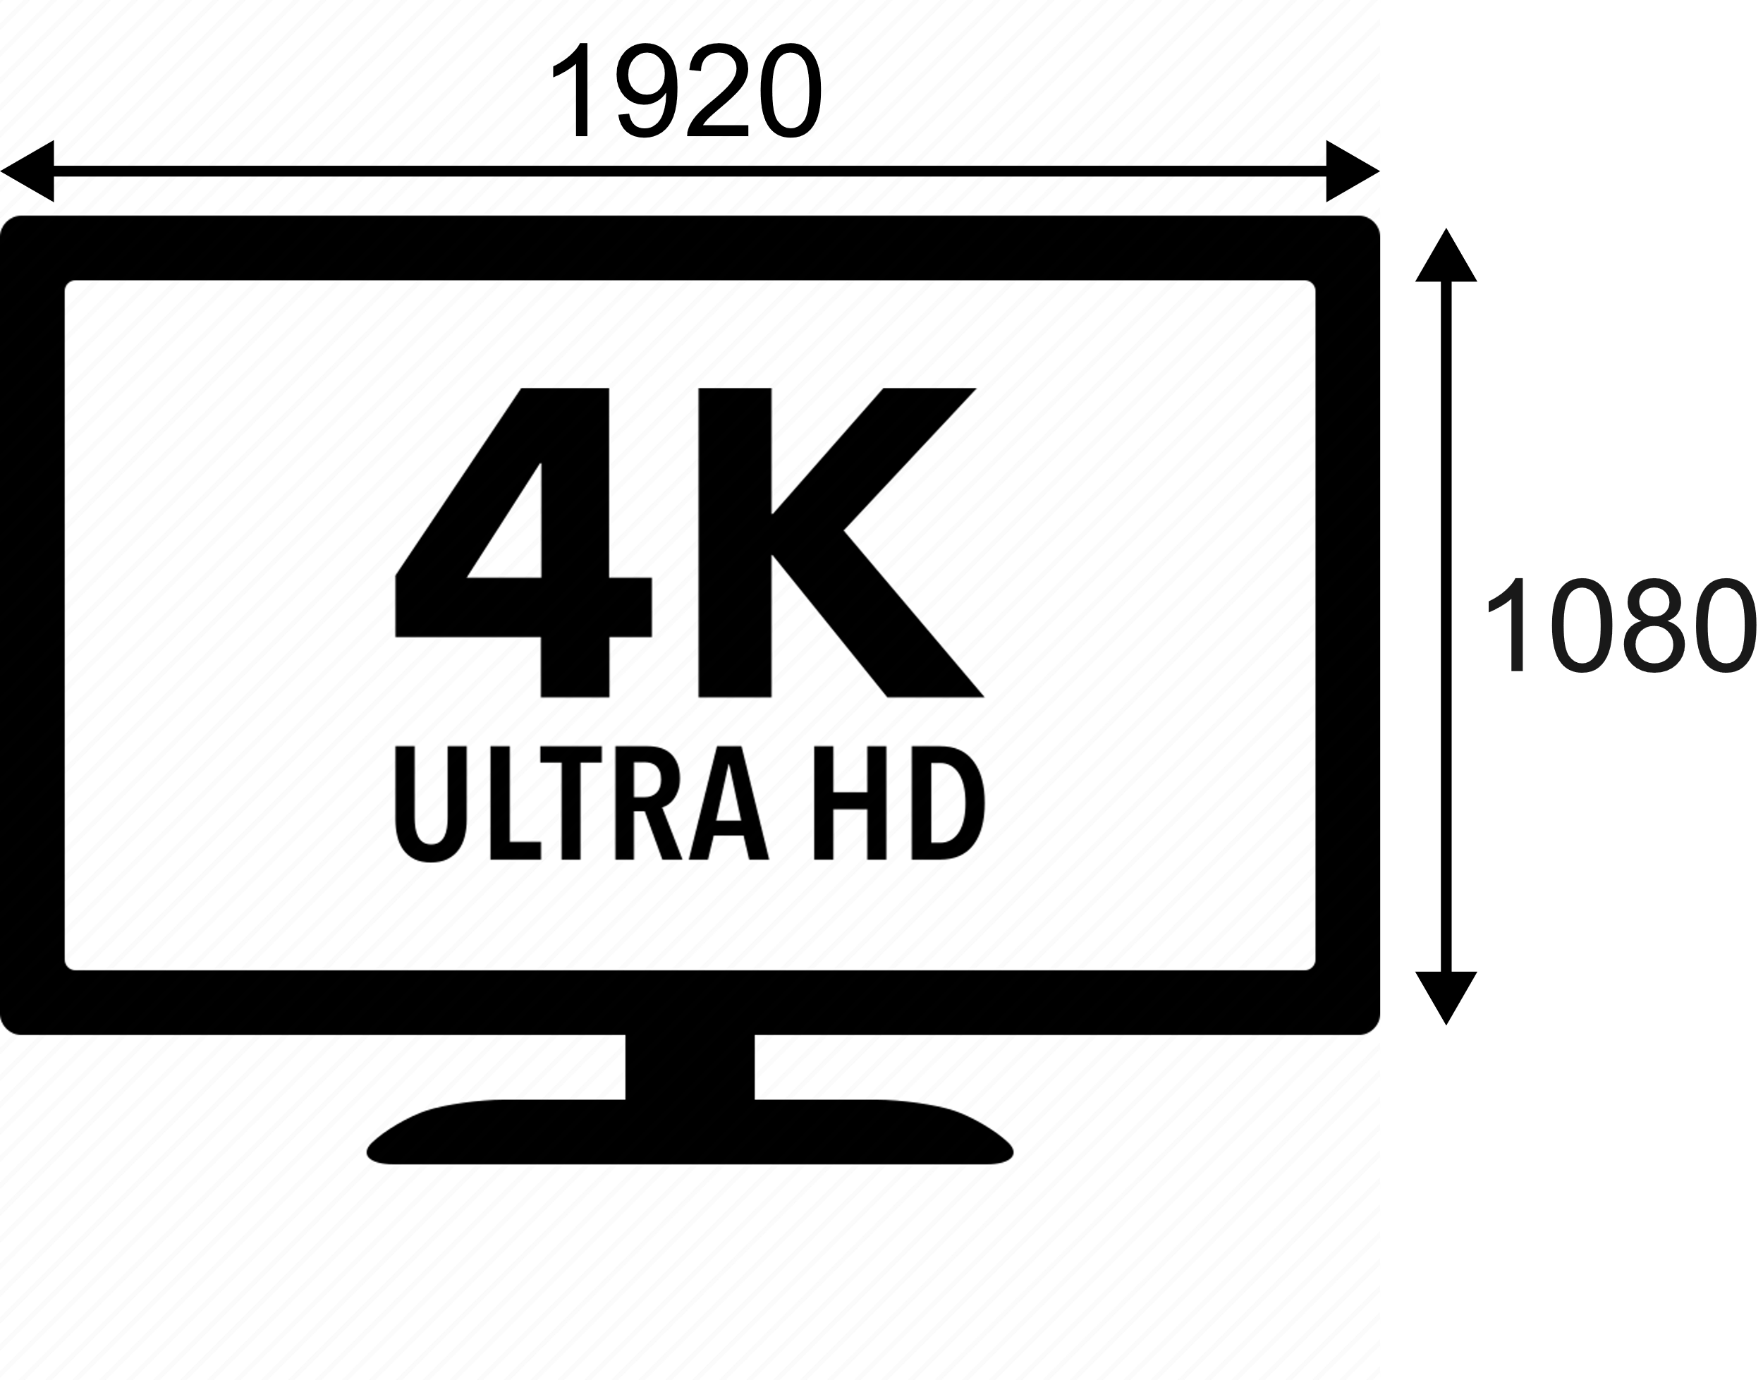
Topic: High DPI Support
A tale of screen coordinates, scale, and pixels…
A 4K display with 200% scaling has 1080p screen coordinate size
Notes:
* Screen coordinates are also known as points or Device Independent Pixels

Slide 26
Topic: High DPI Support
Apple platforms provide screen coordinates, optionally allows high DPI back buffers
Windows provides screen coordinates for non-DPI aware applications, pixels for DPI aware applications
Notes:
* On Apple platforms, scale will always be an integer scale factor. On Windows this will be one of the standard desktop scales, 100%, 125%, 150%, etc.

Slide 27
Topic: High DPI Support
SDL 3.0 applications always get screen coordinates and high DPI back buffers
Display bounds, window coordinates, and mouse coordinates are all specified in screen coordinates
Display modes include size in screen coordinates, size in pixels, and a display scale
Mouse coordinates are floating point
Notes:
* Windows maintain their screen coordinate sizes when moved between displays with different scales or when display scale changes
* Standardizing on points allows consistent UI coordinate systems regardless of display density, becoming more important in 8K and 16K displays

Slide 28
Topic: High DPI Support
SDL_GetDesktopDisplayMode() returns the current desktop mode, including scale
SDL_GetWindowSizeInPixels() returns the size of the back buffer for a window
Notes:
* SDL_ConvertEventToRenderCoordinates() converts mouse coordinates and touch coordinates

Slide 29
Topic: High DPI Support
SDL 2D Render API has convenience functions:
SDL_SetRenderLogicalPresentation() sets a logical size for the content, rendering to an offscreen texture and then scaling it as needed for presentation
SDL_RenderCoordinatesToWindow() and SDL_RenderCoordinatesFromWindow() convert between screen coordinates and coordinates in the render viewport
SDL_ConvertEventToRenderCoordinates() will convert all coordinates in an event into coordinates in the render viewport
Notes:
* SDL_ConvertEventToRenderCoordinates() converts mouse coordinates and touch coordinates

Slide 30
Topic: High DPI Support
High DPI events:
SDL_EVENT_WINDOW_RESIZED is sent when a window is resized in screen coordinates
SDL_EVENT_WINDOW_PIXEL_SIZE_CHANGED is sent when the size of a window’s backbuffer has changed, which can happen when moving between high and low density displays
SDL_EVENT_DISPLAY_SCALE_CHANGED is sent when a display changes scale, which also triggers window pixel size events

Slide 31

Topic: High DPI Support
Code example, getting the desktop scale as a UI scaling factor

Slide 32
Topic: High DPI Support
Considerations:
Fullscreen desktop windows use screen coordinates
Unusual scaling factors can result in rounding, e.g. 1920 pixel wide display at 175% scale gives a screen coordinate width of 1097.143, rounded to 1097
True fullscreen modes always have an integer scale, usually 1, but desktop scale should still be applied as a content scale as appropriate
Mouse coordinates have floating point precision, usually centered on pixels

Slide 33
Conclusion: High DPI Support
High DPI support is becoming more important as displays become higher and higher resolution
SDL gives you a consistent way of handling high DPI scenarios across all supported operating systems

Slide 34
Topic: SDL 3.0 GPU API

Slide 35
The 2D problem
SDL's 2D API is limited
Extending it is hard
Even in 2D, the thing people want is shaders
State machine APIs cause trouble

Slide 36
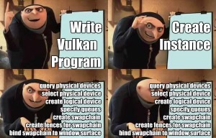
The 3D problem
Most of it is hard to use
Nothing is portable

Slide 37
SDL 3.0 GPU API
Turbo charge SDL's rendering offerings
Offers SDL's focus on simplicity and portability
Built on next-gen APIs
Not required!
Existing 2D API built on top of it

Slide 38
SDL 3.0 GPU Overview
C-callable API offering modern GPU concepts
Command queues, pipelines, shaders, fences
Thread safe!
Uses own shader language and bytecode format

Slide 39
Wait, what?
Existing offerings didn't meet portability and simplicity goals
You can use other rendering APIs with SDL if you like!
Transpiling is possible

Slide 40
SDL 3.0 GPU Shaders
Uses own shader language and compiled shader bytecode format
Bytecode is cross-platform: build once, ship everywhere
Shader compiler is small open source C library
Use command line to compile, or embed in your own tools or your own game, to use shader source at runtime!

Slide 41
SDL 3.0 GPU Shading Language
Looks a lot like GLSL, HLSL, MSL, or C
Removed some footguns
Improved some syntax in mostly optional ways
If you’ve ever written a shader, you can handle this
Vertex and pixel shaders for now, more to come

Slide 42
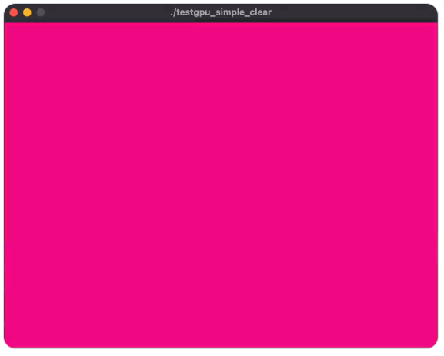
SDL 3.0 GPU Example
The "S" stands for "Simple“
Vulkan: 1157 lines of C.
SDL GPU API: 153 lines (including error checking!)

Slide 43
SDL 3.0 GPU Conclusion
Still early in development, but looking good
Feedback welcome!

Slide 44

Questions?
Presented by Sam Lantinga (slouken@libsdl.org) and Ryan Gordon (icculus@icculus.org)
Slides and code examples at https://www.libsdl.org/gdc2023
Thank you!

