Slide 1
Docker
David R. Soller
@DrSoller
https://github.com/3ygun/docker-demo

Slide 2

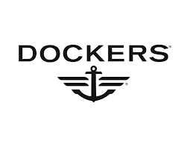

Slide 3

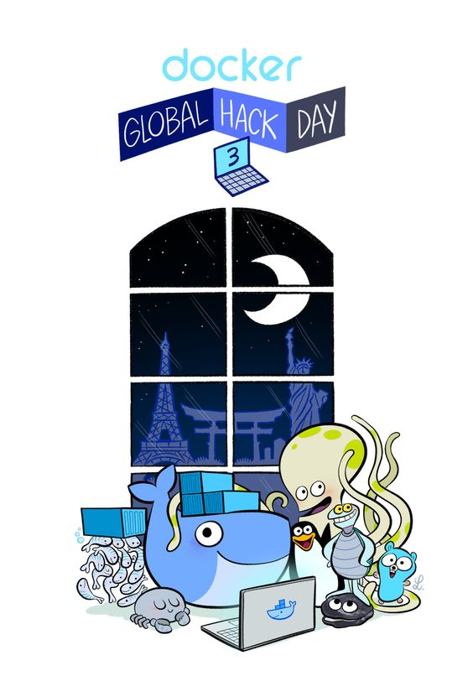
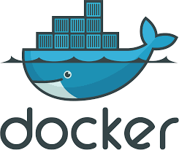
Docker Fan Art: pinterest.com/pin/93238654763325339/

Slide 4





Lol

Slide 5
Why I wanted Docker
Unix consistency on Windows UI
Light weight, fast and non-niche
Easy development environment

Slide 6
What is Docker?
A container for your software.
This container has:
Filesystem
Runtime
System tools & libraries
Your code

Slide 7
But what does that mean?
In a terminal: $ echo “FROM ubuntu:latest” >> Dockerfile $ docker build -t docker-d1 . $ docker run -it docker-d1 /bin/bash
Where:
docker build -t docker-d1 .
Creates a image titled “docker-d1” from the Dockerfile located at .
docker run -it docker-d1 /bin/bash
Runs a container in “interactive terminal” mode of the image “docker-d1” invoking run on the program /bin/bash

Slide 8
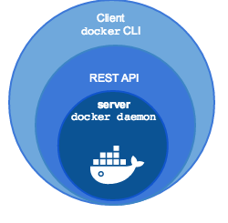
What did we do?
Invoked the Docker Engine to create & run a headless Ubuntu 16.04 container
Docker Engine →

Slide 9
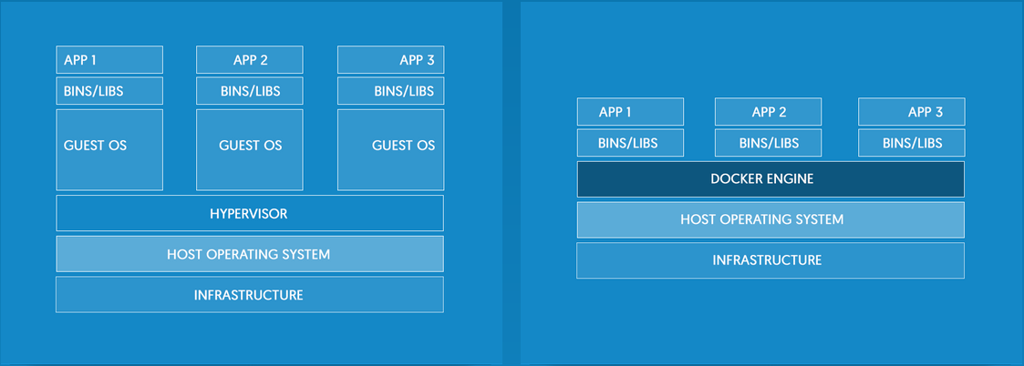
How is this different then a VM?
Simple,
Baggage
VM →
Docker →
See:
docker.com/what-docker
Notes:
VIRTUAL MACHINES
Virtual machines include the application, the necessary binaries and libraries, and an entire guest operating system -- all of which can amount to tens of GBs.
CONTAINERS
Containers include the application and all of its dependencies --but share the kernel with other containers, running as isolated processes in user space on the host operating system. Docker containers are not tied to any specific infrastructure: they run on any computer, on any infrastructure, and in any cloud.
Dockers 3 pillars
Lightweight, open, secure by default

Slide 10
What is Docker useful for?
Repeatability
Scaling
Distributed recreation
Safety
Accelerated development and deployment

Slide 11

Docker Engine vs Docker Machine vs Docker Compose

Slide 12
Docker Engine
Usual docker cli
Client-server application
Made up of:
docker daemon
REST API
docker CLI
Accepts docker commands & preforms their function
For development this is the main thing docker is

Slide 13
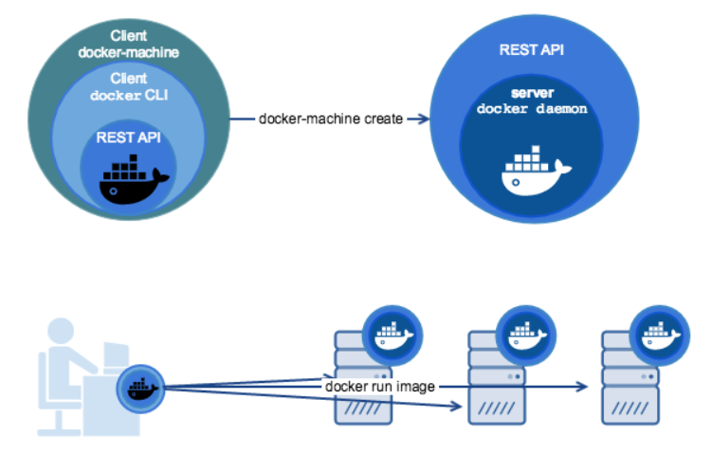
Docker Machine
Tool for provisioning & managing Dockerized hosts (e.g. hosts with Docker Engine on them!)
Basically run Docker Engine elsewhere!
Docker Machine
https://docs.docker.com/machine/overview/

Slide 14
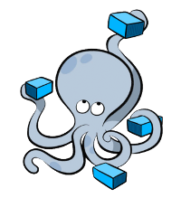
Docker Compose
Handle defining & running multi-container Docker applications
Management of a container only system
Docker Compose
docs.docker.com/compose/overview/

Slide 15
Demo: Dockerfile
Newpath React App Demo
github.com/atareshawty/newpath-react-app-demo

Slide 16
Docker Hub
hub.docker.com/
Github for containers
Type what you’re looking to run in docker to get a image, Dockerfile or view crazy configurations

Slide 17
Demo: Docker Hub Dockerfile
Newpath React App Demo & Node Docker Image
github.com/atareshawty/newpath-react-app-demo & hub.docker.com/_/node/

Slide 18
Demo: Docker Compose
Newpath React App Demo & Docker Compose
github.com/atareshawty/newpath-react-app-demo

Slide 19
Demo: Dockerfile
Watson-TA
github.com/signofthehorns/watson-ta

Slide 20
So what have we gotten ourselves into?
We’ve made a lot of Docker images
$ docker images
We may have some containers waiting to be executed
$ docker ps -a
How do we cleanup?
Remove container
$ docker rm <HASH>
Remove image
$ docker rmi <HASH>
Remove them all!
$ docker rm $(docker ps -a -f status=exited -q) $ docker rmi $(docker images -a -q)
Google “docker rm all” and find: https://www.digitalocean.com/community/tutorials/how-to-remove-docker-images-containers-and-volumes

Slide 21
For the unsatisfied. Why???
Docker principles:
Isolation, Minimum Size, Packaged Product
Isolation
Provides security & consistency
Minimum Size
Easier distribution with less overhead
Packaged Product
Easier deployments & onboarding
Just download & run NOT download complete & these 30 manual steps

Slide 22
Docker all the things!

Slide 23
Demo: Docker in Docker
Docker in Docker
github.com/3ygun/docker-demo

Slide 24
Container Orchestration
We have a zillion containers what now?
Manage them!
Container orchestration:
Spawn more containers on demand
Monitor if they go down
Etc.

Slide 25
Kubernetes
Kubernetes (kubernetes.io)
Open Source
Spawned from Googles container orchestration platform

Slide 26
Docker Swarm
Docker Swarm (docker.com/products/docker-swarm)
Open Source
Dockers version

Slide 27
Something Built on Docker
Pachyderm (pachyderm.io)
Containerize your big data & move through it that way

Slide 28

Some Advice

Slide 29
Dockerfile vs Runtime
Includes:
ADD vs run –v <local_dir>:<image_dir>
ADD:
Bundles/adds the file to the image
Use when the file isn’t going to change or is integral to the image
run –v <local_dir>:<image_dir>:
Mounts the local directory <local_dir> as a volume located at some <image_dir> on the image
Use when the file needs to change across images or when wanting faster development
Allows for improved sharing of resources

Slide 30
Questions?

