Slide 1
Machine Learning
David Soller

Slide 2
What is Machine Learning (ML)?
“Machine Learning is the study of computer algorithms that improve automatically through experience.”
– Tome Mitchell (1997)

Slide 3
“Machine Learning is the study of computer algorithms that improve automatically through experience.”
– Tome Mitchell (1997)

Slide 4
Types of ML
Supervised learning
Learning a map from input to output
Ex: regression, classification
Unsupervised learning
Ex: clustering, dimensionality reduction
Reinforcement learning
Learn from series of rewards or punishments
Ex: autonomous robots, maze-finding
* Slide contents from Dr. Jihun Hamm

Slide 5
What is Deep Learning?
Modeling high dimensionality data using multiple layers of processing
Deep Learning is simply a type of machine learning

Slide 6
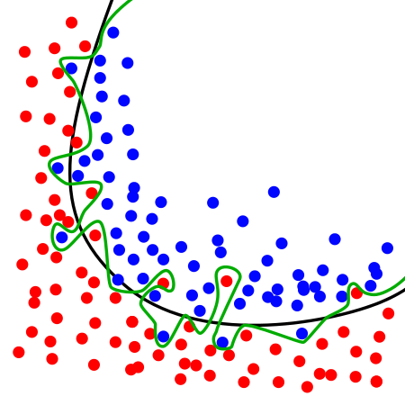
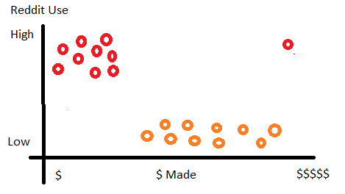
Overfitting
When a model has poor predictive performance although possibly high testing performance
“Overfitting is the enemy of both utility and privacy” – Dr. Reza Shokri
Contrived Example:
Classify Reddit Users Money Made
Bill Gates is in the set
Overfitting Wikipedia Example

Slide 7
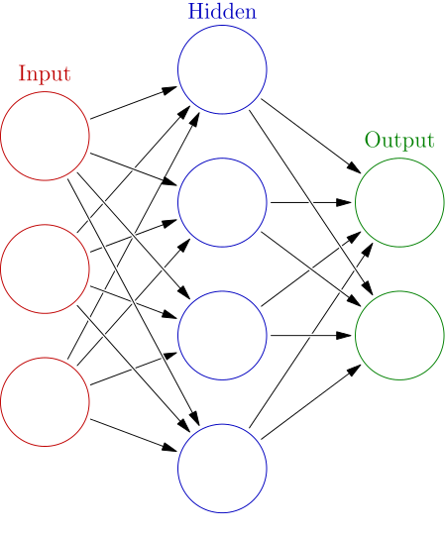
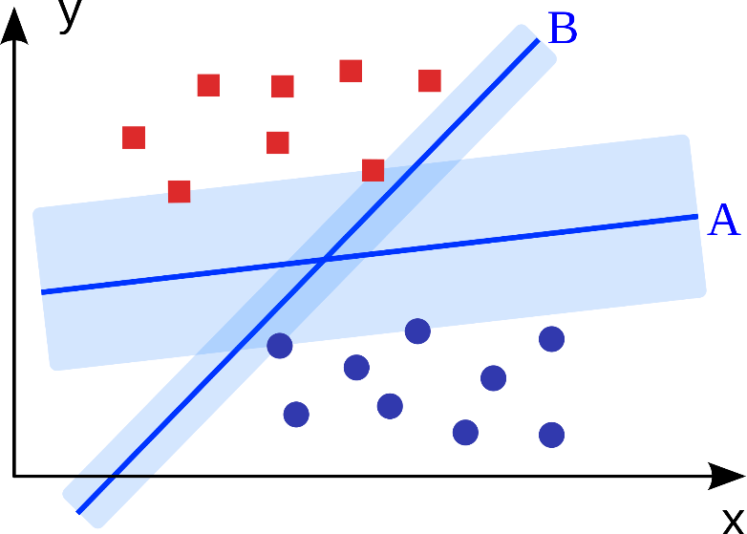
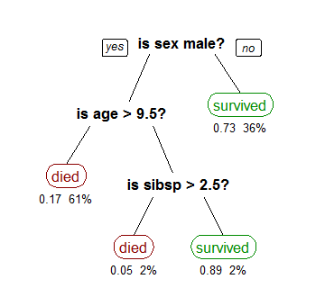
Supervised learning
Regression – predict a value (age, etc.)
Classification – predict a category (It’s a bird, It’s a plane, It’s super cat!)
What? - Using historic data to predict future events
Learn - weights
Models:
Neural Networks
Decision Trees
Support Vector Machine
Etc.

Slide 8
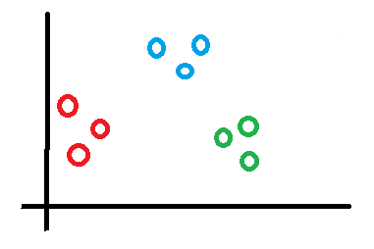
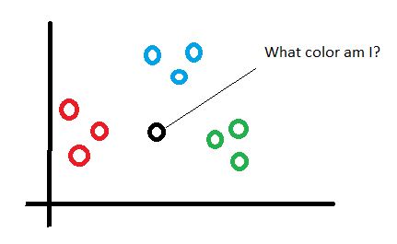
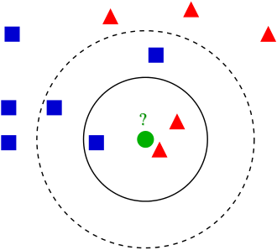
Unsupervised learning
What? - Relating unlabeled data together
Models:
K-means clustering
K-nearest neighbors
Etc.

Slide 9
Reinforcement learning
Learn from series of rewards or punishments
Models:
Markov decision processes
Swarm Intelligence
Game Agents

Slide 10
Example

Slide 11
Questions?

