Slide 1
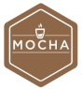









FTP Server
Development
Testing
Building
Deployment

Slide 2
Development
Testing
Building
Deployment
FTP Server

