Slide 1


Slide 2
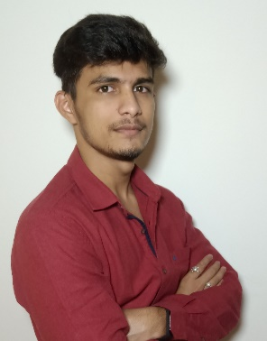
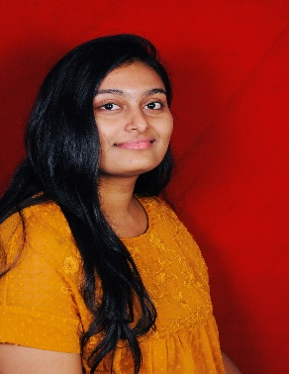

Project Highlights
Project Name : PyTool Configurator
Team Size : 05
BU Mentor Name : Bandaru Edukondalu Mentor PS#
Deepak Kumar Sahoo
40013395
CVR College of Engineering(ECE)
Mula Reethu
40013397
GNITS
(ECE)
Samudrala Apurva
40013399
GNITS
(ECE)

Slide 3
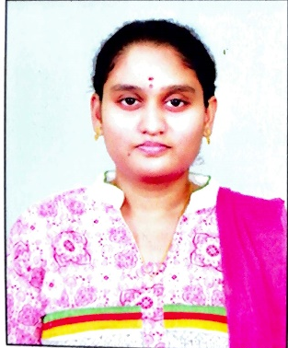
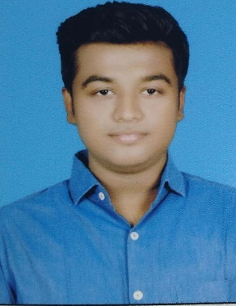
Project Highlights
Project Name : PyTool Configurator
Team Size : 05
BU Mentor Name : Mentor PS#
Neeli Usha Chinmai Sai
40013390
Sri Vasavi Engineering College, AP(CSE)
Chinnam Ashutosh Patro
40013396
NIST, Orissa(CSE)

Slide 4
Project Summary
In the project PyTool Configuration, we have implemented the basic operations using python script dealing with Virtual Machines.
Operations that are performed are like :
Development of Menu driven program which able to access the menu displayed.
Creating the guest VMs and Deleting the guest VMs.
Getting information from the guest VMs to the host VMs.

Slide 5
Future development that can be implemented further
Future Development :
Features like logging all the outputs from the guest machines to a file in our host machine, dynamic updation of VM configuration whenever required, trying to create VM’s with different ISO images and other such feasible features can also be added as per the requirements as it is flexible to further add features and can be updated for future development.

Slide 6

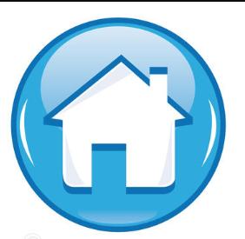
Thank You !

