Slide 1
How do knights move?

Slide 3
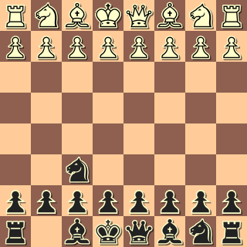

Slide 4
Can Move
Cannot Move

Slide 5
knightMoves = [
[2 , 1],
[-2, -1],
[2 , -1],
[-2, 1],
[1 , 2],
[1 , -2],
[-1, 2],
[-1, -2]
];

Slide 6
The magic part 1
let arrAdd = function(current, delta) {
let [cy, cx] = [...current];
let [dy, dx] = [...delta];
[cy, cx, dy, dx] = [
parseInt(cy),
parseInt(cx),
parseInt(dy),
parseInt(dx)
];
return [cy + dy, cx + dx];
};

Slide 7
The magic part 2
let possMoves = [];
knightmoves.forEach(move => {
possMoves.push(arrAdd(this.currentSpace, move));
});
possMoves = possMoves.filter(move => this.canMove(move, board));
newAvailableMoves = [...possMoves];
return newAvailableMoves;

Slide 8
The magic part 3
canMove(space, board) {
let [s, b] = [space, board];
if (
this.isOnBoard(space) &&
!this.isFriend(s, b) &&
(this.isEmpty(s, b) || this.isFoe(s, b))
) {
return true;
} else {
return false;
}
}

Slide 9
isFriend
isFriend(space, board) {
let [y, x] = [space[0], space[1]];
if (board[y][x] && board[y][x].color === this.color) {
return true;
} else {
return false;
}
}

Slide 10
isFoe
isFoe(space, board) {
if (
board[space[0]][space[1]] &&
board[space[0]][space[1]].color &&
board[space[0]][space[1]].color !== this.color
) {
return true;
} else {
return false;
}
}

Slide 11
isEmpty
isEmpty(space, board) {
if (board[space[0]][space[1]] && board[space[0]][space[1]].color) {
return false;
} else {
return true;
}
}

Slide 12
IsOnBoard
isOnBoard(space) {
let [y, x] = [...space];
if (y >= 0 && y <= 7 && x >= 0 && x <= 7) {
return true;
} else {
return false;
}
}

Slide 13
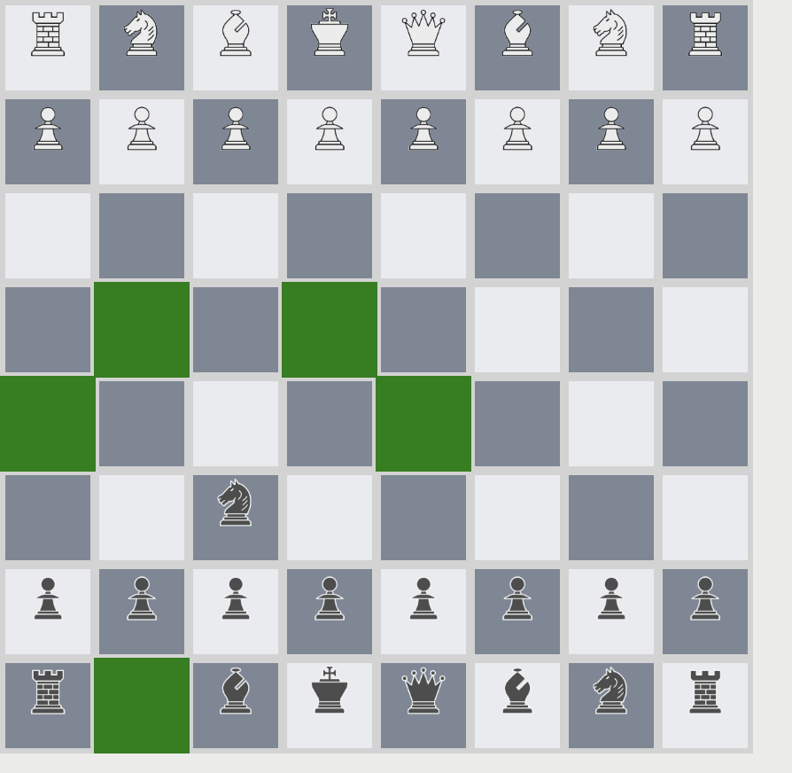
IRL how it looks

Slide 14
How do Queens, Rooks, and Bishops move?

Slide 16
Can Move
Cannot Move

Slide 17
It slides everywhere
howItMoves = (currentSpace, color, board) => {
let newAvailableMoves = [];
//left slide
this.slide([0, -1],
this.currentSpace, board).forEach(move =>
newAvailableMoves.push(move)
);
…. Also every other direction
But what is slide?

Slide 18
Slide
slide(direction, currentSpace, board) {
let newAvailableMoves = [];
let [y, x] = [currentSpace[0], currentSpace[1]];
let [dy, dx] = [direction[0], [direction[1]]];
let current = [y + parseInt(dy), x + parseInt(dx)];
while (this.canMove(current, board)) {
let [cy, cx] = [...current];
newAvailableMoves.push(current);
if (this.isFoe(current, board)) {
break;
}
current = [cy + parseInt(dy), cx + parseInt(dx)];
}
return newAvailableMoves;
}

Slide 19
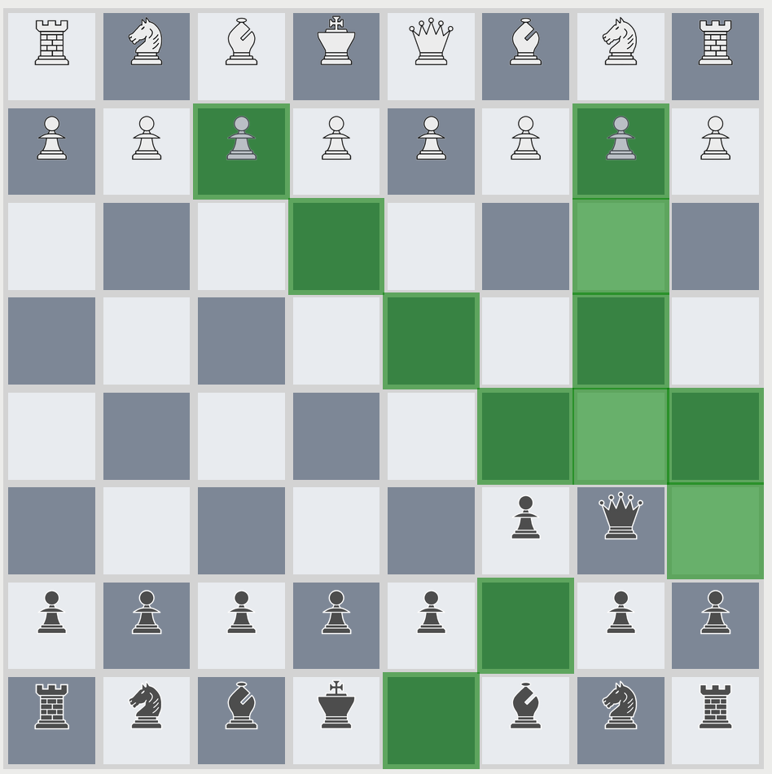
irl

