Slide 1
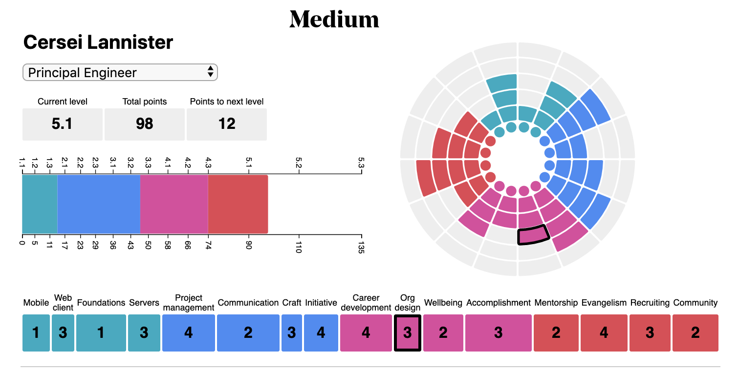
1
Date Span
2
3
Client Requirements
This existing span should be converted to a text box where an admin user can manually edit the users title (regular user cannot edit)
Add a span where the user can select previously submitted review scores that will render a specific state object.
TODO: Group review date by month or other client defined milestone (Example: Even if there are 20 review changes in May, the previous review span would only have May 2019 as an option.
Competencies will display of the averages of the scores of all of their proficiencies but clicking them will not change the graph directly.

Slide 2
Date Span
4
5
Client Requirements
Current level will be calculated with a conditional statement.
Example: If total points >= 100 && total points < 200, Current level = 1
TODO: Provide functionality for the admin user to change the point thresholds for a given level
Thermometer will be a graphical representation of the total points within a specific proficiency. Adjust the scale down to 4 levels.
TODO: Provide functionality for the admin user to change the number of total points needed to reach a new level.

Slide 3
Date Span
8
6
7
Client Requirements
Total points will be the sum of all of the points from all proficiencies
“Points to next level” will subtract the number of total points from the point level needed for the level (see previous page #5).
MVP nightingale graph will include a possible score of 4 for each of the proficiencies (4 rings). Each piece of the “pie” will represent a proficiency and each color will designate a competency.
TODO: Implement a method for adding/removing competencies/proficiencies from an administrative interface

Slide 4
Date Span
9
10
2
2
1.2
2.6
2
1
4
0
Proficiencies
2
1
3
2
8 Competencies
Client Requirements
Clicking on a level in the proficiency “pie” will open the specific competency at the bottom of the page and will change the “score” both on the graph and in with in the proficiency score detail section.
Competencies render the average of their proficiencies

Slide 5
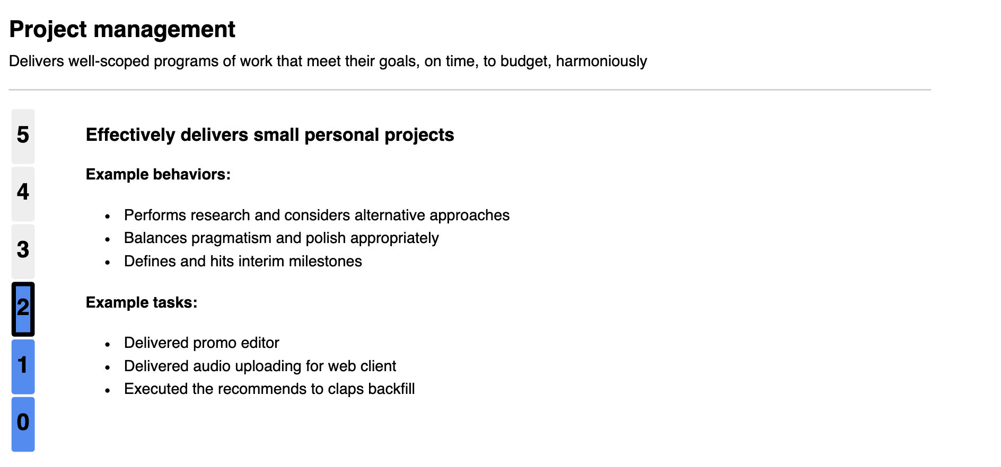
2
2
1.2
2.6
2
1
4
0
Proficiencies
11
2
1
3
2
Competencies
12
= 10 Points
= 6 Points
= 3 Points
= 1 Point
= 0 Points
13
Client Requirements
The number inside the selected proficiency matches the score selected
Proficiency description is visible for all selected score levels
The points (that contribute to the “total points” value [see #6]) are different from the score and accumulate as the score increases.
TODO: Make the point values assigned to a specific score scalable and editable from an admin interface.
TODO: Implement a method that would allow additional priority (or weight) to be applied to specific proficiencies dynamically from an admin interface.
TODO: An admin user should be able to easily increase the possible score (from an admin interface) for a proficiency but the increase in score would apply to all proficiencies
TODO: An increase in score would also increase the number of rings in the circle (nightingale) graph.
Example: If the top score was increased to 10, the graph would have 10 rings.

Slide 6
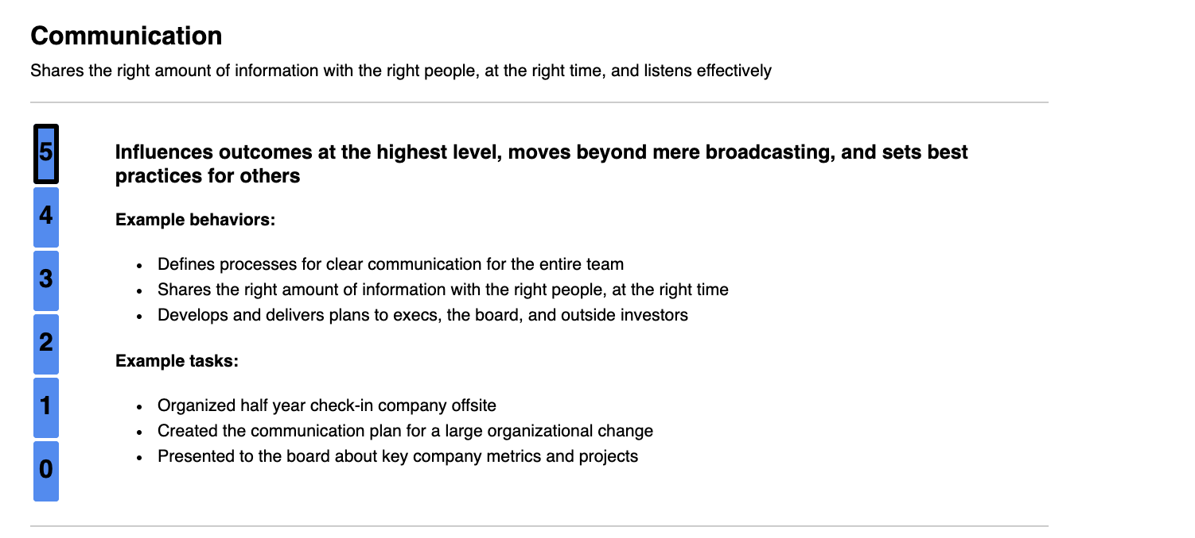
14
Client Requirements
Score descriptions (including example tasks and behaviors) will change as the score changes
TODO: Have a simple method where an admin can edit the text descriptions as needed from an admin interface or by uploading an edited file.

Slide 7
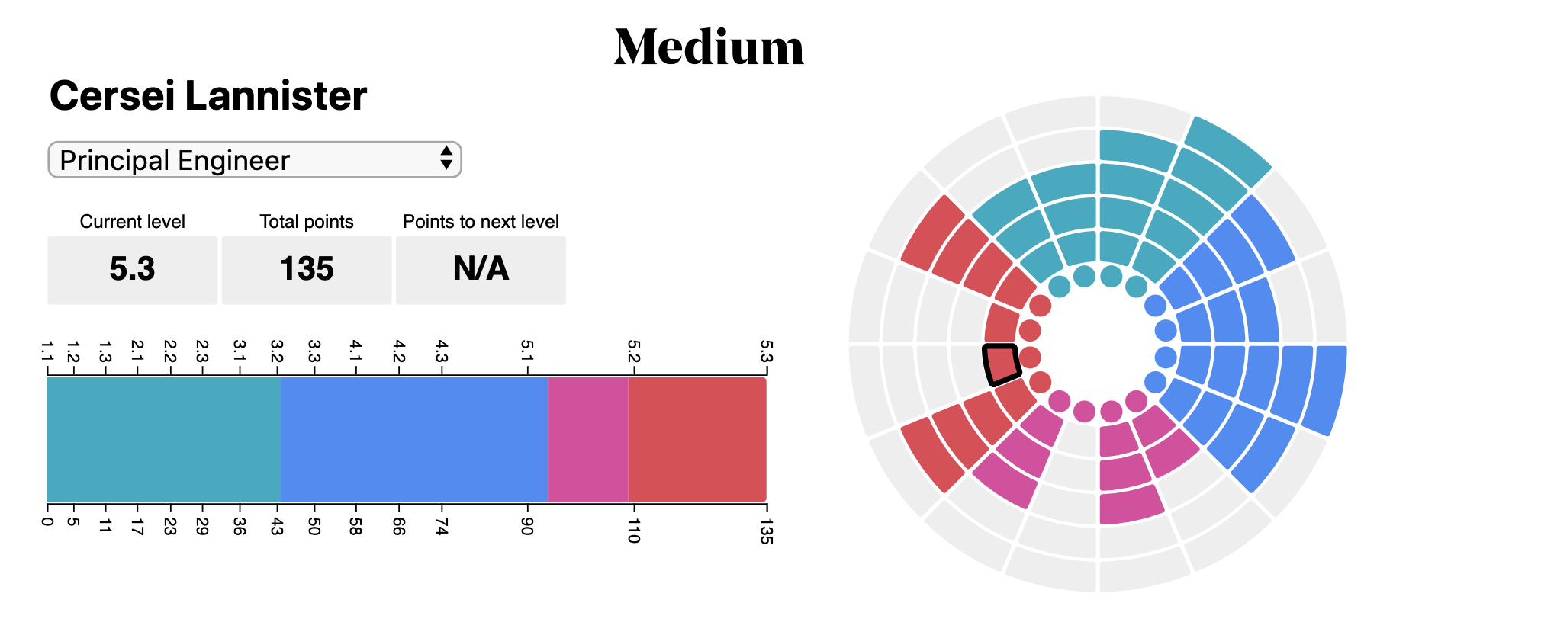
Date Span
15
16
Client Requirements
It is not required to max out all points to achieve the highest level.
TODO: Once the total points value triggers the current level to change to the highest level possible, the points to next level should switch to “N/A” (Total points can continue to increment as proficiency scores continue to increase.
Thermometer will show point levels and visually represent the progress towards reaching goal and the proportions of the goal made up by each proficiency.

