Slide 1
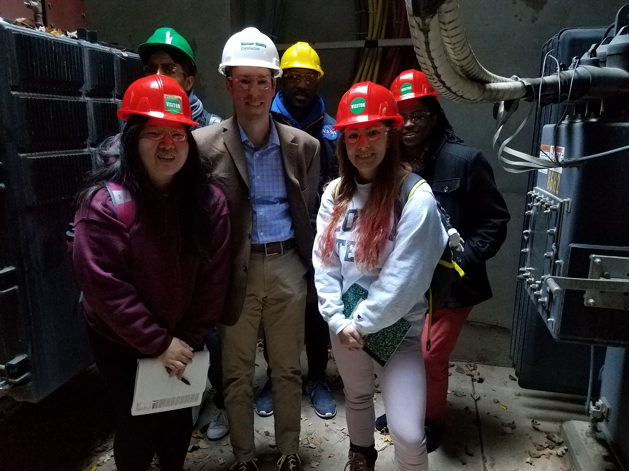
P.V.I.R Proposal Presentation
1/15/2019
Project Advisor: Lukas Graber
Stephanie Chan, stephchan40@gatech.edu
Elizabeth Fuller, efuller3@gatech.edu
Adrian Muñoz, am262601@gatech.edu
Nelson Raphael, nraphael7@gatech.edu
Lemek Robinson, lrobinson61@gatech.edu

Slide 2
Introduction
What Is It?
Powervault Inspection Robot
Will contain a movable robot with a sensor package on arm, testing environment for expo
What is the purpose in industry?
Reduces dangers for workers and speeds up repair and maintenance of vault
Notes:
Stephanie

Slide 3
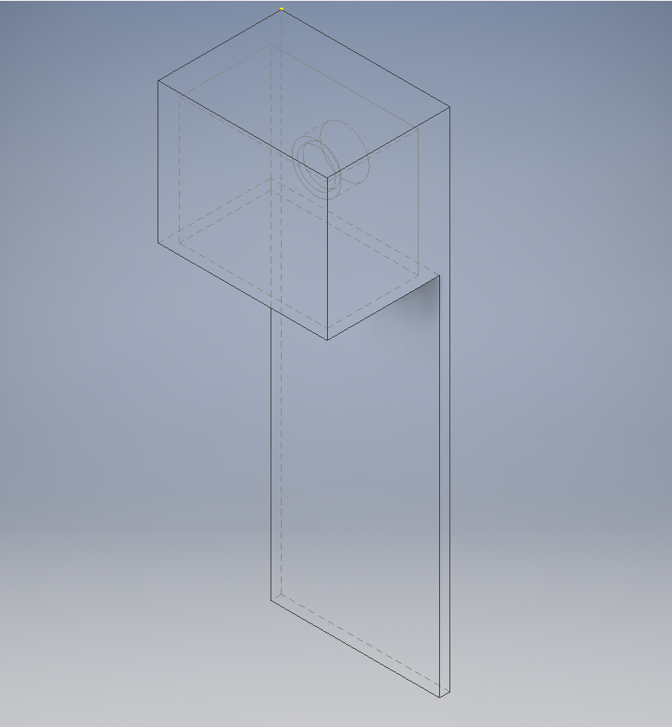
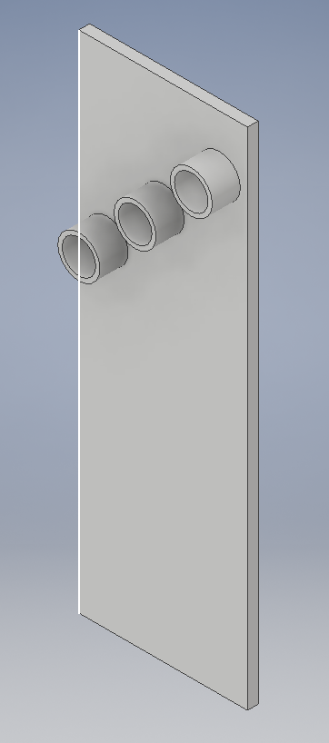
Goals
Create boards with dummy gauges that represent a powervault setup
Design remote controlled robot
Display videofeed and sensor information
Notes:
Adrian

Slide 4
Specifications
Mechanical Arm Specs
Height : Variable height from 1 - 6 feet
Degrees of Freedom : 2 degrees of rotation
Base Size : Fits in a 760mm Diameter Manhole
Sensor Package Specs
Video : Can Stream Video to GUI
Gas Sensor : Check Air Quality
IR Thermal Camera : Record Thermal Images
Microphone : Record Sounds
GUI Specs
Mobile: Usable on Mobile Platforms
Control Capabilities: Remotely Controllable Robot
Logging: Log Information
Data Streaming: Real-Time Data Streaming
Notes:
Stephanie

Slide 5
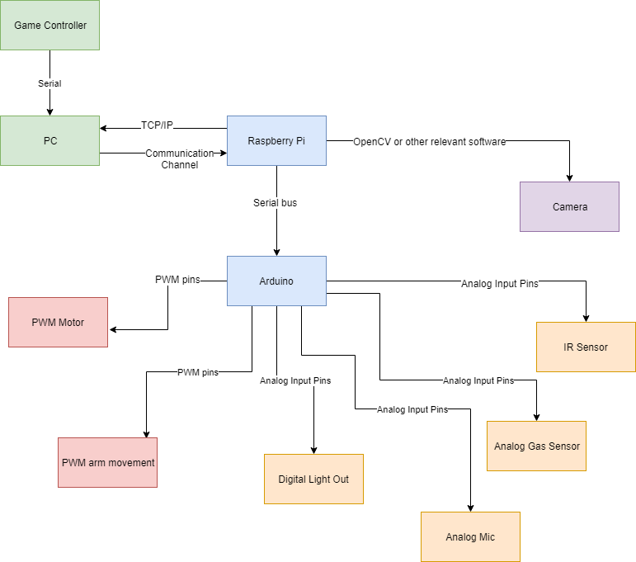
Design Approach Overview
Notes:
Lemek

Slide 6
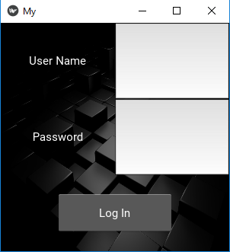
Design Approach (GUI)
Kivy
Matlab App Builder
C#
1
Visual Graphical App Builder
2
Easy Communication to a Python System
3
Easy Parallel Task Completion
4
Easily Exportable to IOS or Android
5
Compatible with gaming controllers
Notes:
Lemek

Slide 7
Design Approach (Control System)
Perf Boards for mounting sensors
Aren’t enough connections to need a PCB
Sensor Package protective casing
Needs to be exposed to the air
Needs to be water resistant
3D printed
Speed restrictions on motors
Restrict movement while arm is extended
Object detection to prevent collisions
Ethernet Communication from PC to Pi
Easiest solution for our testing environment
Notes:
Elizabeth

Slide 8
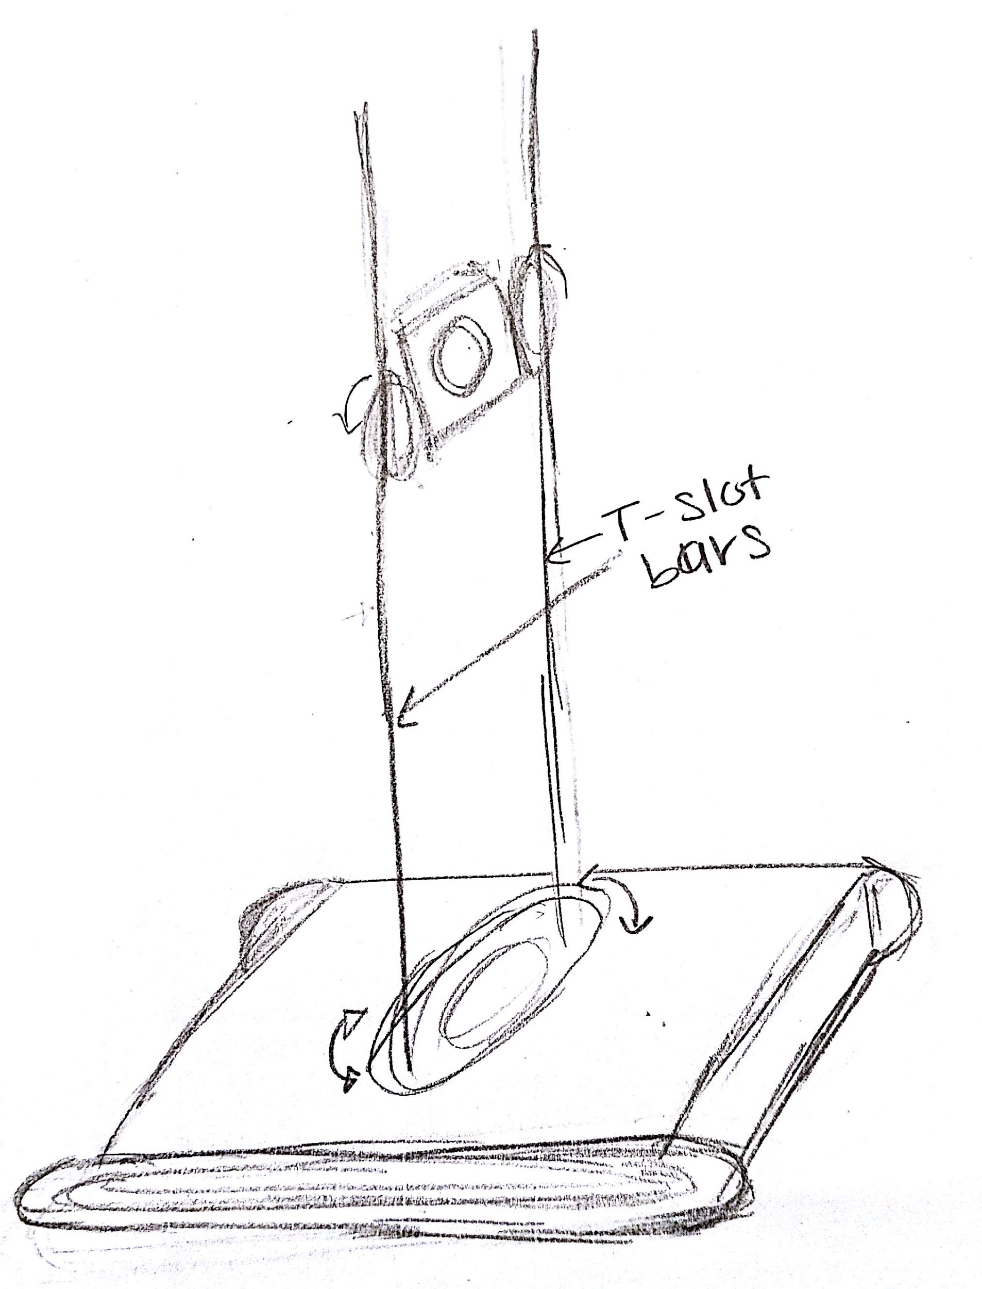
Design Approach (Mechanical Arm)
Max Extension Height
6 ft
Degrees of Rotation
360 degrees
Material
Metal T-Slots
Camera Movement
Can move up and down vertically
Lights
Mounted to camera
Notes:
Nelson

Slide 9
Testing Procedure and Criteria
Moving robot with a controller
Speed/direction tests
Control/latency tests
Xbox 360/PS3 wired controller compatibility
Mechanical Arm Mobility
Weight distribution tests
Total movement (up & down; rotation)
Sensors relaying data to GUI
Accuracy tests
Expo is an non ideal environment for practical tests
Readability (how easy is it to interpret)
GUI
Displays sensor data and video feed
Notes:
Elizabeth

Slide 10
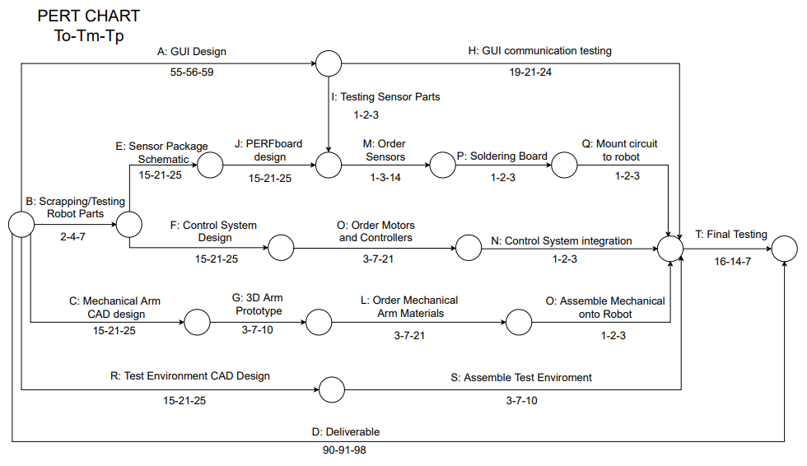
Schedule
Notes:
Nelson

Slide 11
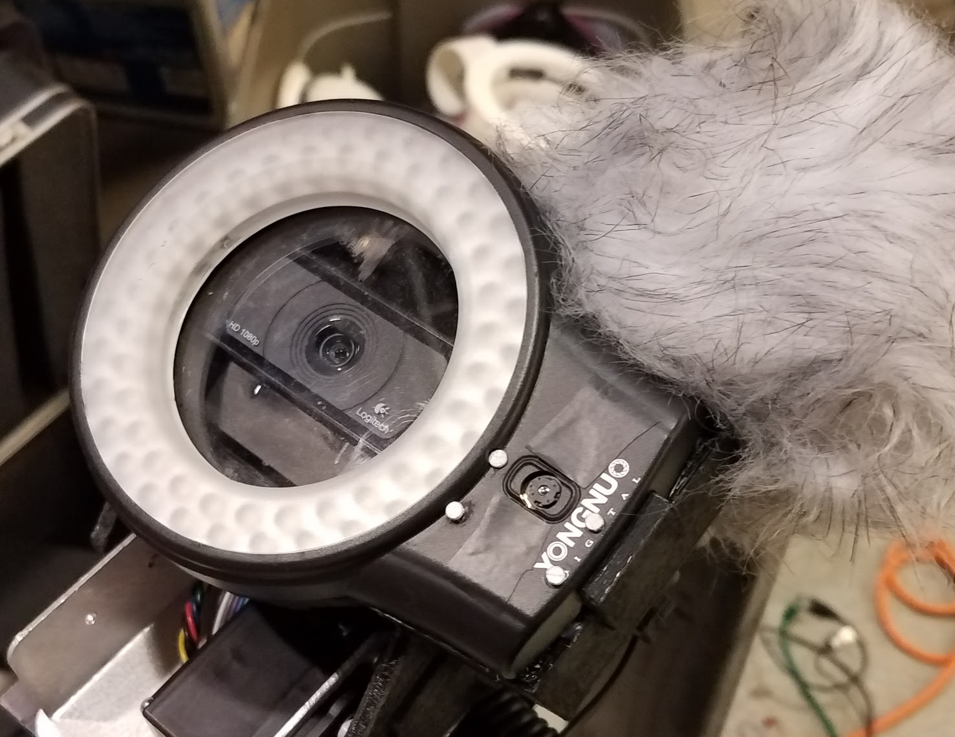
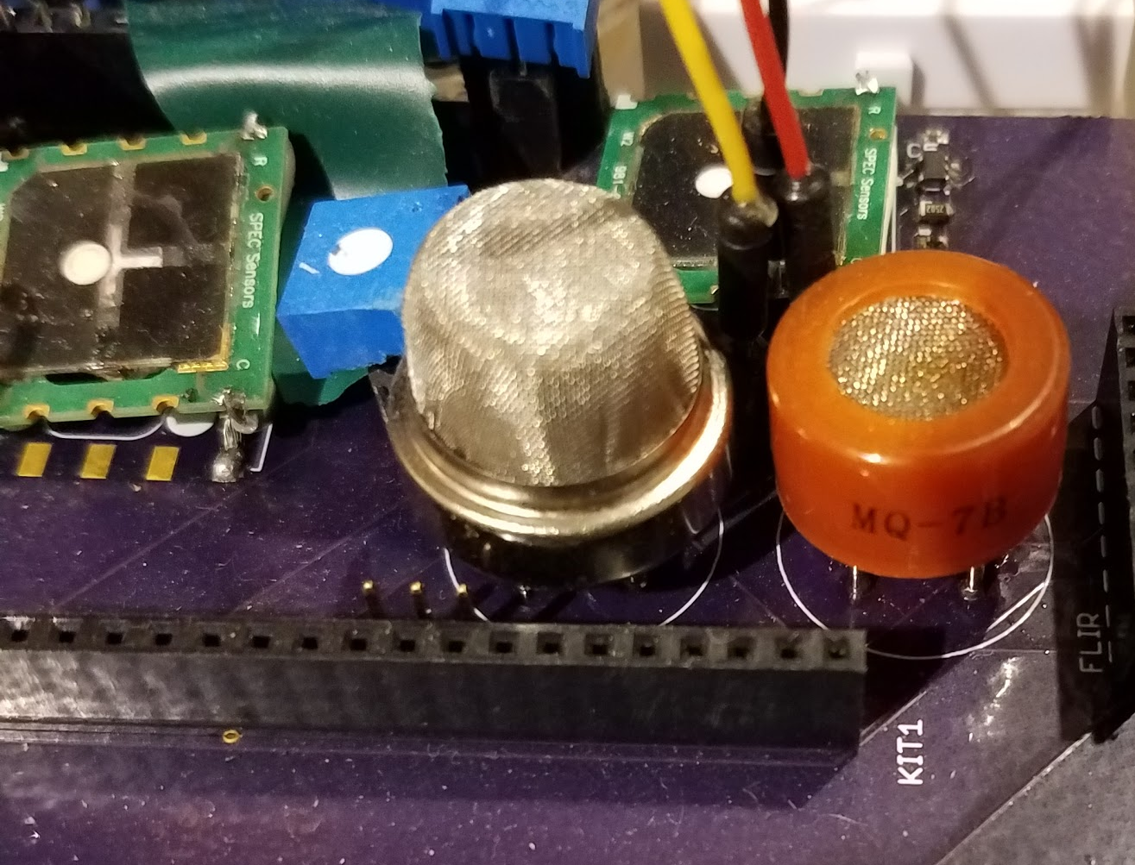
Status
GUI Design: 20% compete
Previous Robot/Sensor Package: Scrapped
Materials acquired from past project:
Microphone w/pop filter
2 Raspberry Pi B+
2 Servos
2 Motors
Light sensor/ring light
2 Speed controllers
1080p WebCam
Physical Robot
Sensor board
Robot currently located in West’s lab
Notes:
Adrian

Slide 12
Status
Mechanical Arm CAD design: 50% complete
T-slot bars designed in Solidworks
CAD Model of Testing Environment: 95% complete
Design Schematic: 50% complete
Bill of Materials/Parts Ordering: 90% complete - On hold
Notes:
Adrian

