Slide 1
BazToGo
404 Group:
Alexander McCutcheon
Braden Prather
Nathan Gilbert
Notes:
Alex

Slide 2
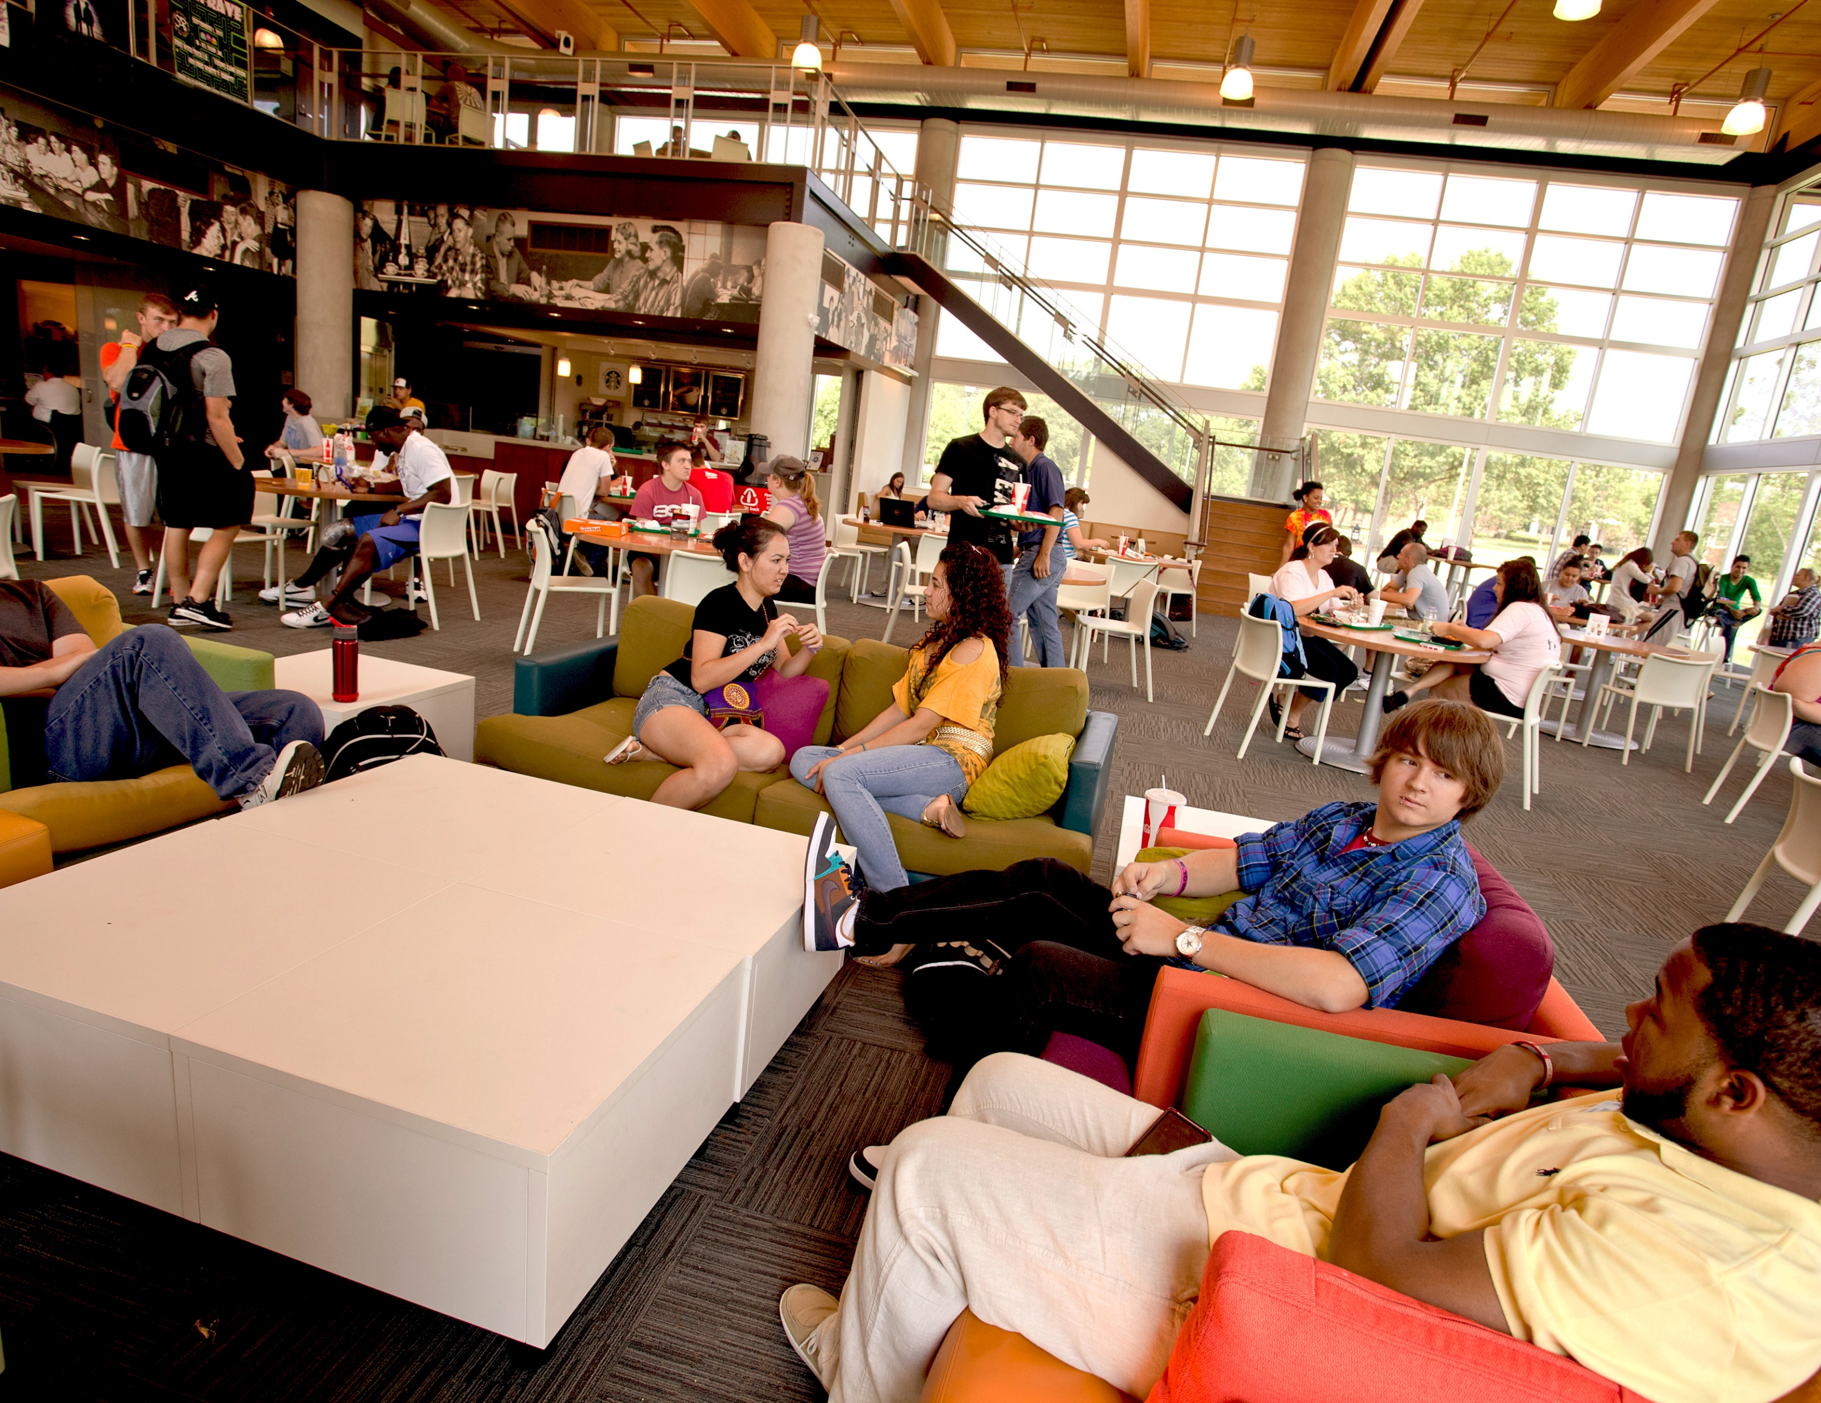
We all love BazTech Right?
Notes:
Alex

Slide 3
But that’s the problem!
We
“all”
love
BazTech.
Notes:
Alex

Slide 4

The Goal
BazTech can easily get overwhelmed by the large number of people leaving class at the same time.
One big way that normal fast-food restaurants are solving this issue is by allowing people to “skip the line” by ordering ahead on a mobile application.
Notes:
Alex

Slide 5
Proof of Concept – Expected Implementations
The main risks of these applications are handling payment and account data properly.
If we were to properly integrate this system into BazTech, we would include integration with the existing OneTech infrastructure.
On-campus payments through Meal Trades or DCB would be handled by the Blackboard integration, meaning that we need to ensure the account is properly charged.
A real implementation would also include Stripe or a similar payment framework to allow direct credit/debit payments, which will have the same risks.
Notes:
Braden

Slide 6



Background and Technology Used:
For this project, we have written our mobile application using the cross-platform .NET MAUI to allow us to write one codebase for both Android and iOS devices.
We used:
Visual Studio 2022 Community Edition as our IDE.
GitHub for Version Control
GitHub Projects for Kanban and task planning.
Discord for Group Communication
Notes:
Braden

Slide 7
BazToGo
The Main Application
Notes:
Nathan

Slide 8
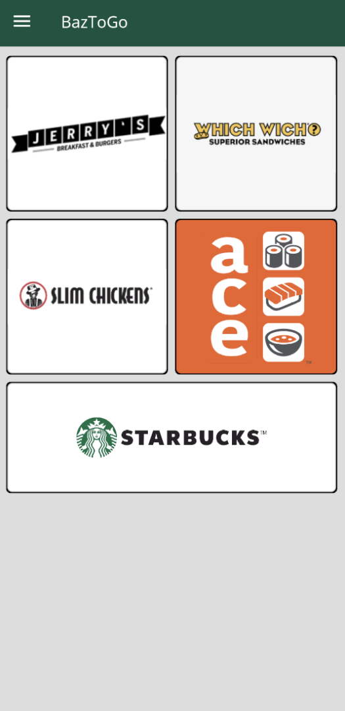
Design: Home Page
BazToGo has 4 main pages that make up the UI:
Home page:
The first page that is seen when the app is opened.
Provides access to each restaurant page in a grid pattern.
Notes:
Nathan

Slide 9
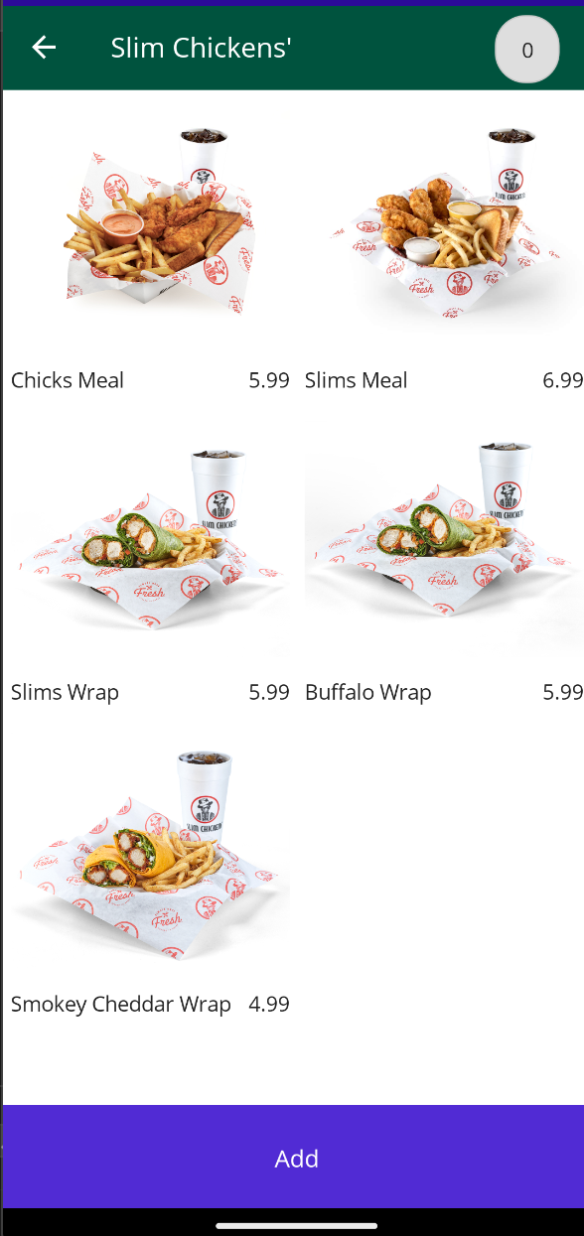
Design: Restaurant Pages
When a restaurant square is clicked on the homepage, a restaurant page opens.
Restaurant Pages:
Provides a list of items available for purchase from each restaurant and prices.
For this example, the Slim Chickens page is shown.
Notes:
Nathan

Slide 10
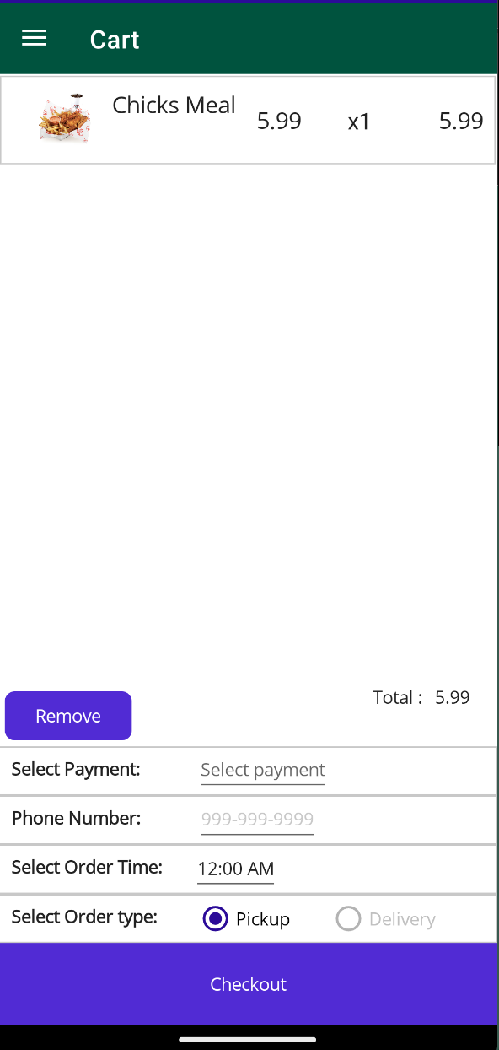
Design: Cart Page
Once an item has been added to the cart, the cart can be reached from the flyout menu in the top left corner of the screen.
Cart Page:
The cart page allows the user to view the cart of the items they added.
A total is shown at the bottom.
The bottom half of the page shows options for payment, phone number, order time, and order type.
Notes:
Nathan

Slide 11
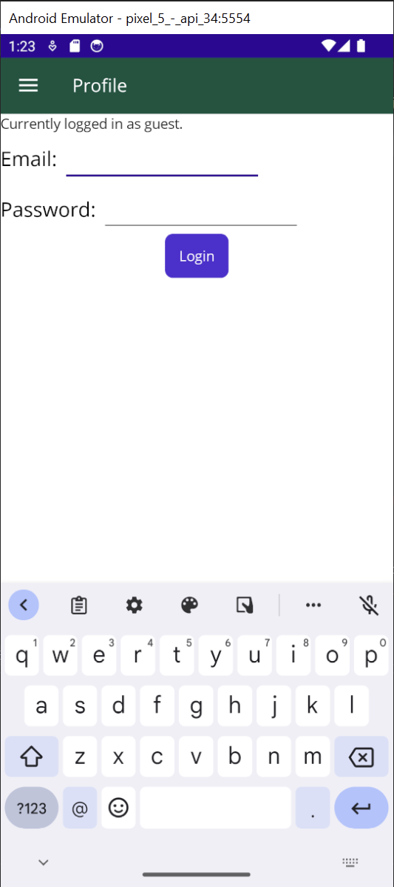
Design: Profile Page
From the flyout menu, the profile page can be selected
Profile Page:
By default, the app uses a guest account.
Email and password fields are shown to login to an account.
Notes:
Braden

Slide 12
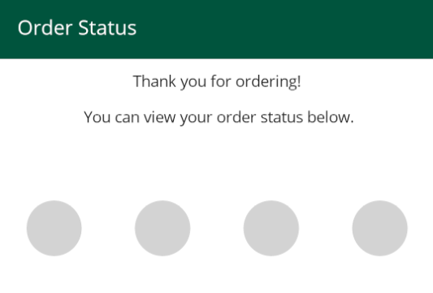



Design: Order Status Page
Once an order has been placed, the order status page appears
A green circle follows the status of the order from start to finish.
Notes:
Braden

Slide 13
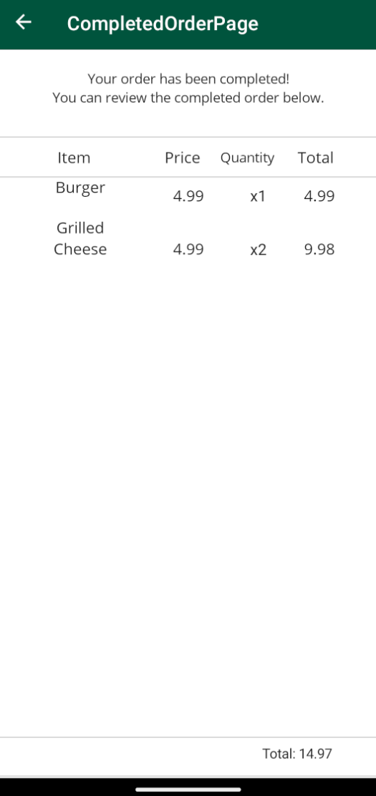
Design: Receipt Page
After the Order Status page completes, an itemized receipt of the order is shown.
This includes the quantity of items and the total price.
Notes:
Braden

Slide 14
Features Needed for Full Implementation:
Optional OneTech integration
Provides On-campus payment options (see below)
Payment Features:
On campus payment through Meal Trades or DCB
Credit/Debit Card payments through Stripe or a similar payment framework
Order Customization
Allow user to customize each item individually
Interaction between BazToGo and BazToYou Portion
Utilizing user-provided information from the Cart page
Notes:
Braden

Slide 15
And finally…
Notes:
Alex

Slide 16
BazToYou
The Delivery Portion
Notes:
Alex

Slide 17
BazToYou
BazToYou is a separate section of the application, accessible from the flyout menu.
In the normal BazToGo order flow, the customer has an option for either Pickup or Delivery.
If the order is set to pickup, the person will pickup their order as normal.
However, if they choose delivery, an open delivery request will be made on the BazToYou page, allowing members to pick up the delivery in exchange for points that can be traded in for rewards.
Notes:
Alex

Slide 18
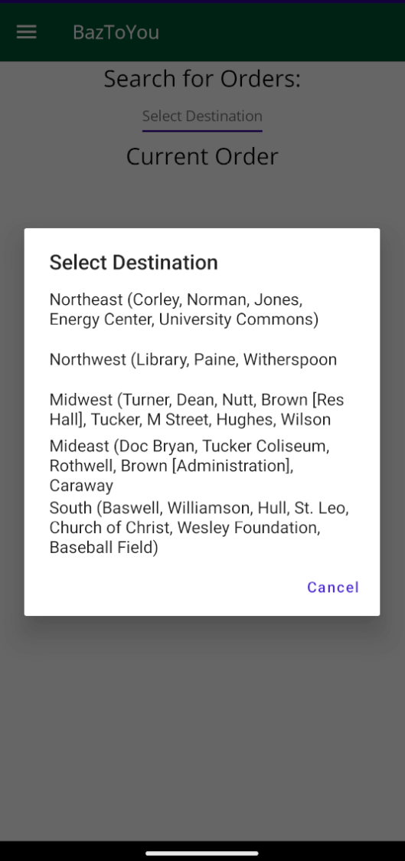
Design: BazToYou
2 main components.
A view of available delivery requests
A view of the currently selected order (if one has been selected).
Notes:
Alex

Slide 19
Features for Full Implementation: BazToYou
Login through OneTech
A rewards system to work towards free food for being a deliverer.
Order tracking for the request containing:
Customer information such as name and phone number
Contents of the order
Drop-off style:
Indirect (leave it by a door)
Direct (handed to the customer)
Notes:
Alex

Slide 20
What Went Wrong?
Database Connection
Software/Language Learning curves
Time Management
Notes:
Braden / Nathan

Slide 21
Demo!
Notes:
All

Slide 22
Questions?
Notes:
Braden / Nathan

