Slide 1

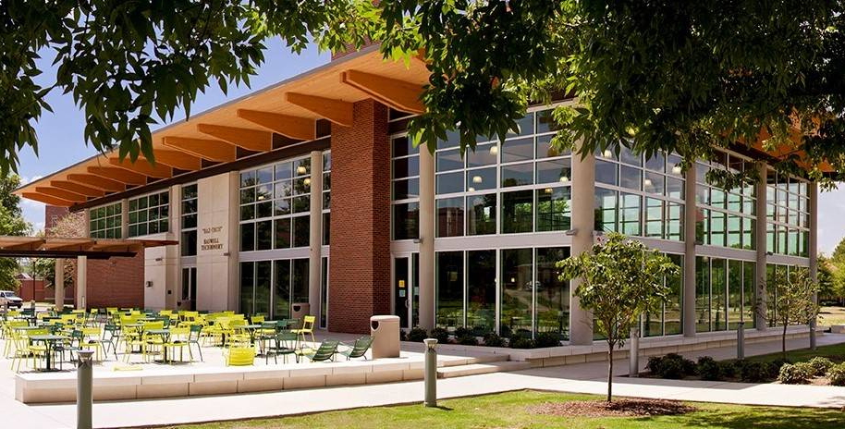
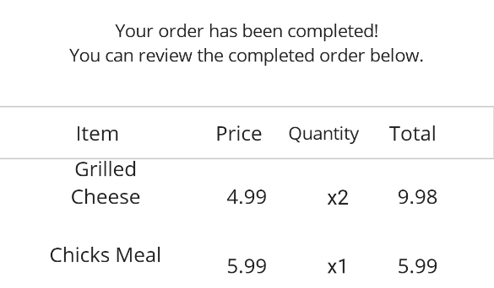
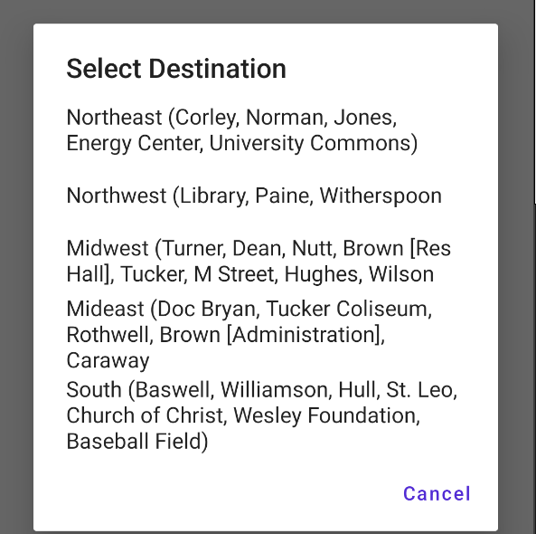
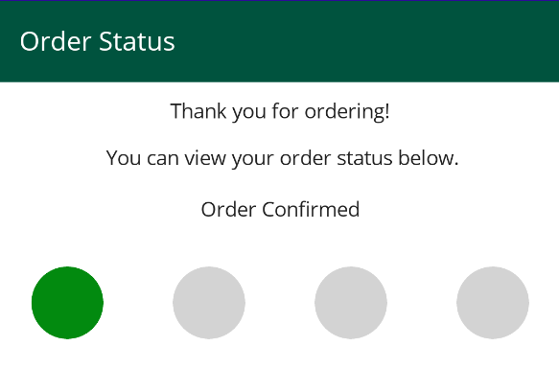
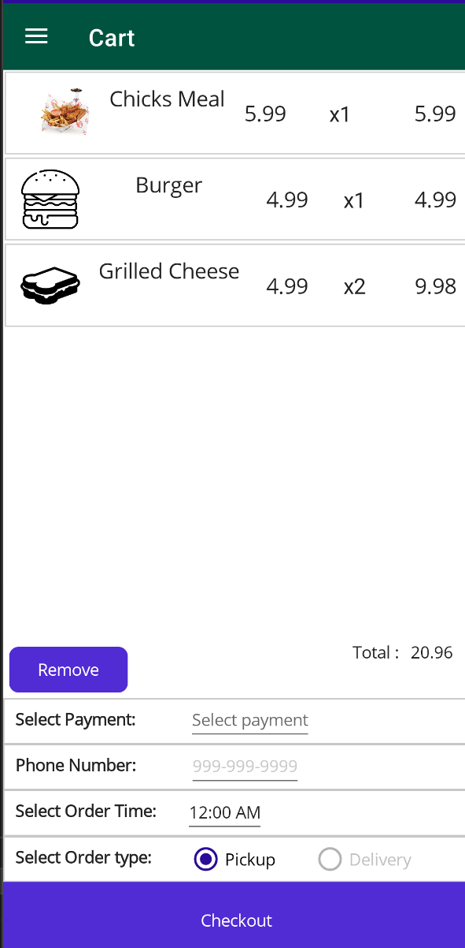
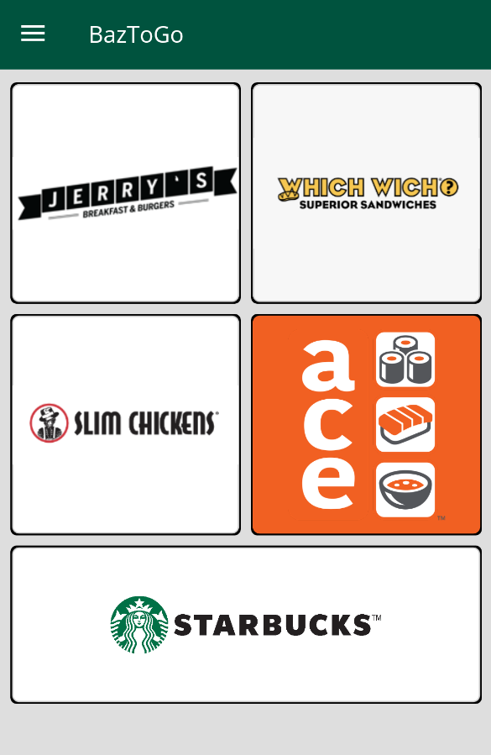
BazToGo
Alexander McCutcheon, Braden Prather, Nathan Gilbert
Faculty Advisor: Dr. Bhaskar Ghosh
Department of Engineering and Computer Science
Introduction
Methodology
Conclusions
We need to overcome the overcrowding that occurs at Baswell Techionery (Baz-Tech) when everyone releases from classes at the same set times.
Create a food ordering and delivery application similar to those created by fast food restaurants to allow users to “order ahead.”
Directly integrate the application into Baz-Tech to allow for on campus payments and user verification.
Developed with the cross-platform .NET MAUI to build on Android and iOS from one codebase.
Utilizes a SQL database to track order logs
Hurdles we faced:
Lack of Experience with .NET MAUI
Database Integration with .NET MAUI
Lack of Project Management Experience
As is, the app would still function as an "Order Ahead" service, but the complete implementation of BazToYou would allow BazToGo to serve as a fully integrated ordering system that could be made into a template which could be integrated into other locations without building the framework from the bottom up as our team was required to do.
Abstract
BazToGo is an online food ordering and delivery platform designed to aid in the overcrowding issues that are commonplace at Baz-Tech. Aiming to provide a convenient and easy-to-use service, BazToGo draws inspiration from similar food-delivery services. Like these services, BazToGo allows users to either order ahead to skip the line or have their order delivered directly to them.
References and Acknowledgements
Baswell Techionery. www.atu.edu/foodservice/BaswellTechionery.php.
“Dine on Campus.” Dine on Campus, dineoncampus.com/arkansastech.
Slim Chickens. “Our Menu | Slim Chickens.” Slim Chickens | Chicken Tenders, Wings and House Sauces, 17 Mar. 2022, slimchickens.com/menu.
“Starbucks Coffee Company.” Starbucks, www.starbucks.com.
“Which Wich® Superior Sandwiches : Get YOUR Wich On!” Which Wich, 8 Dec. 2023, www.whichwich.com.
“Doordash Food Delivery & Takeout – From Restaurants Near You.” Doordash, 2023,
www.doordash.com.
Objectives
Currently Implemented:
Basic Order Flow
Adding and removing items from Cart
Itemized Receipt Generation
Required for a full implementation:
Order Customization
Onetech Integration (Accounts)
Baz-Tech Integration (Order Tracking)
Stripe Integration (Payments)

