Slide 1
BazToGo – Semester 2 Midterm
404 Group:
Alexander McCutcheon
Braden Prather
Nathan Gilbert

Slide 2
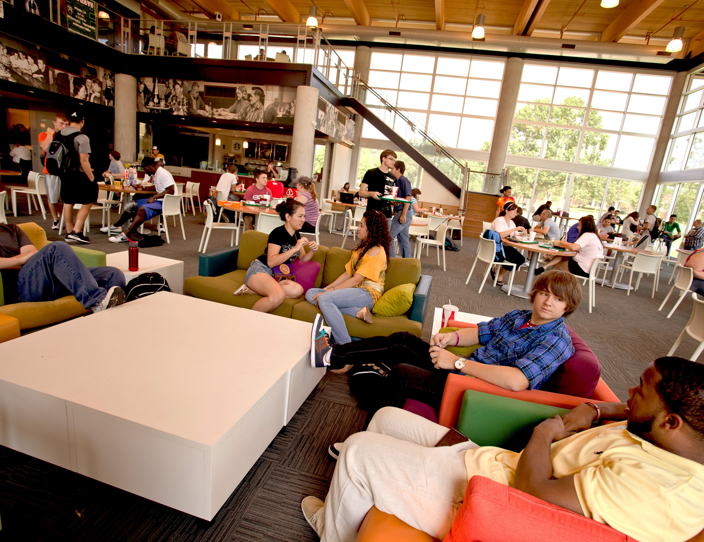
We all love BazTech Right?
Notes:
Braden

Slide 3
But that’s the problem!
We
“all”
love
BazTech.
Notes:
Nathan

Slide 4

The Goal
BazTech can easily get overwhelmed by the large number of people leaving class at the same time.
One big way that normal fast-food restaurants are solving this issue is by allowing people to “skip the line” by ordering ahead on a mobile application.
Notes:
Alex

Slide 5
Risks
The main risks of these applications are handling payment and account data properly.
The plan is to integrate the OneTech account system directly into the application, meaning that we need to handle that cached account data properly.
On-campus payments through Meal Trades or DCB will be handled by the Blackboard integration, meaning that we need to ensure the account is properly charged.
We also plan to implement Stripe or a similar payment framework to allow direct credit/debit payments, which will have the same risks.
Notes:
Braden

Slide 6



Background and Technology Used:
We have three applications for this project, two mobile and one web application.
For this project, we have written our mobile applications using the cross-platform .NET MAUI to allow us to write one codebase for both Android and iOS devices.
We also have written a web application component that is written using ASP.NET.
We use:
Visual Studio 2022 Community Edition as our IDE.
GitHub for Version Control
GitHub Projects for Kanban and task planning.
Discord for Group Communication
Notes:
Nathan

Slide 7
BazToGo
The Main Application
Notes:
Nathan

Slide 8
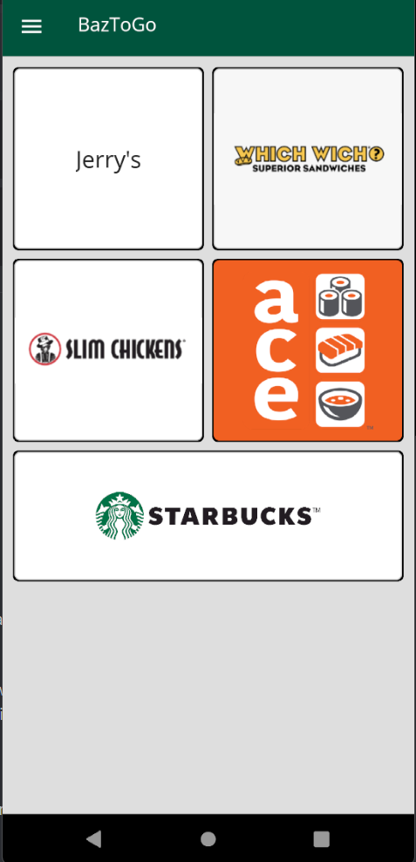
Design
There are 4 components :
Home page
Provides access to each restaurant page
Cart page
Gives an itemized view of each item selected and allows the user to provide all necessary information for the order to be processed(phone number, delivery instructions, etc.)
Profile page
Allows the user to look at their order history, saved payments
Restaurant pages
Each restaurant has a page. Here, the user can select what items they would like to add and provide instructions to tailor each item to their needs.
Notes:
Nathan

Slide 9
Features Currently Implemented:
Navigation between pages
Basic formatting for Cart Page and Home Page
Cart Page allows the user to provide necessary information for the order.
Formatting for Restaurant pages
Item display
Total number of items in cart is displayed on each restaurant page
As of February 2024:
Add to cart implemented.
Remove from cart to be implemented.
Order status page and completed order page.
User receives notifications for each step in the process.
Profile Page:
Displays Name, email address, and previous orders.
Previous orders do not currently display on the profile page, but the infrastructure is there.
Notes:
Nathan

Slide 10
Planned Features:
Optional OneTech integration
Provides On-campus payment options (see below)
Payment Features:
On campus payment through Meal Trades or DCB
Credit/Debit Card payments through Stripe or a similar payment framework
Order Customization
Allow user to customize each item individually
Interaction between BazToGo/Web App and BazToYou Portion
Utilizing user-provided information from the Cart page
Login page
Option to continue as guest
Delivery Instructions
Currently only a textbox, this will be where the user declares where the order is going as well as whether they want it dropped off or handed to them.
Notes:
Nathan

Slide 11
BazToGo
The Web Application
Notes:
Braden

Slide 12
Why a Web App? (BazToGo Web)
Almost every good application has a website these days.
The main goals of the web application are to appease customers that either:
Were already using a computer to do their classwork and are ready to order when they finish
Do not want to install yet another application on their devices
And even those select few that do not have a mobile device
Notes:
Braden

Slide 13
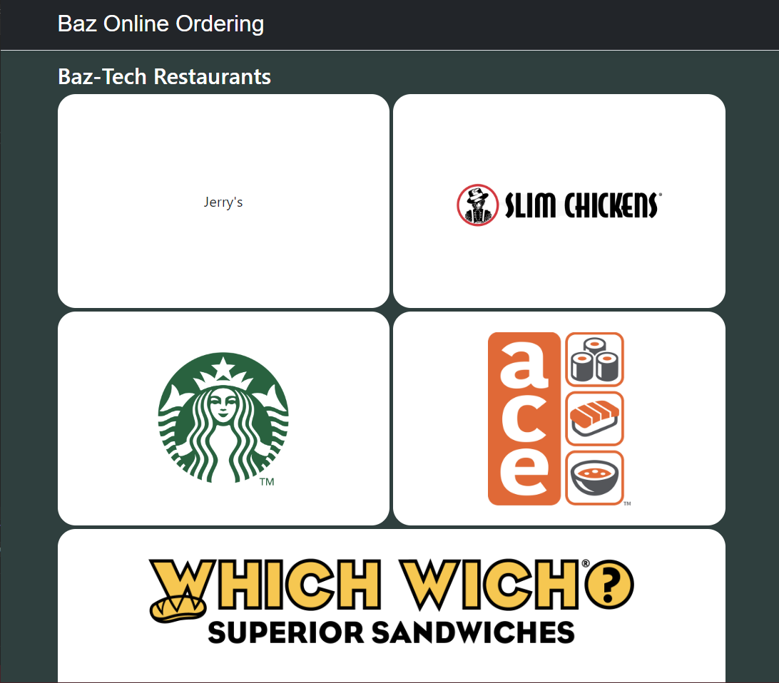
Design (BazToGo Web)
The design of the BazToGo Web application is planned to have 4 main design components.
A view of the user’s profile
A view of the available restaurants
A view of the currently selected restaurant if there is one
A Cart for all the items selected for order
Notes:
Braden

Slide 14
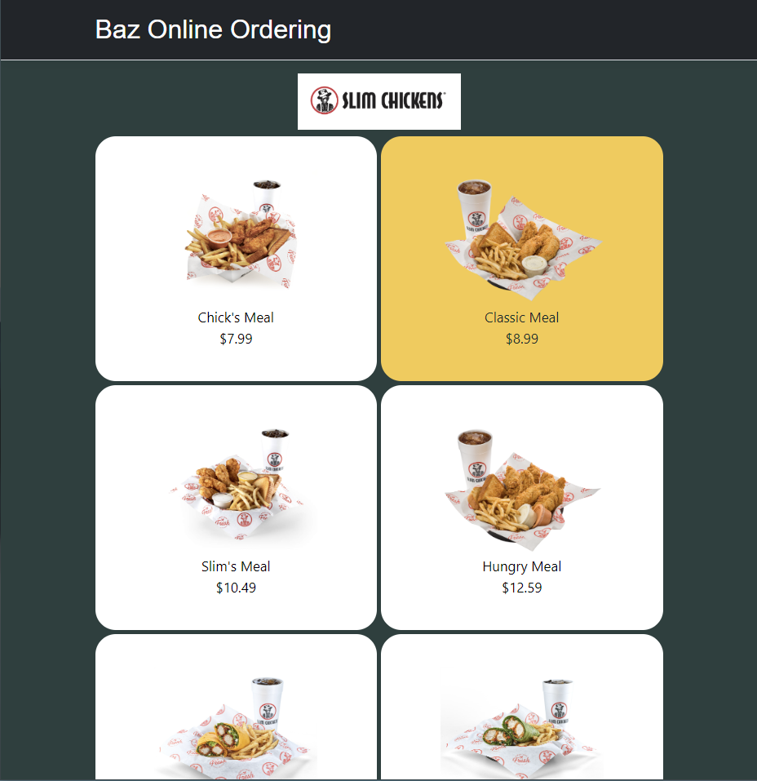
Features Currently Implemented
A foundation with a pretty good start to the layout
Restaurant pages (Slim Chickens is the only one set up now)
Start of database implementation (Not currently connected)
Notes:
Braden

Slide 15
Planned Features
Optional OneTech integration
Provides On-campus payment options (see below)
Payment Features:
On campus payment through Meal Trades or DCB
Credit/Debit Card payments through Stripe or a similar payment framework
Notes:
Braden

Slide 16
And finally…
Notes:
Alex

Slide 17
BazToYou
The Delivery Portion
Notes:
Alex

Slide 18
BazToYou Goal
New to this semester, BazToYou is now a separate section of the main application rather than its own application.
In the normal BazToGo order flow, the customer has an option for either Pickup or Delivery.
If the order is set to pickup, the person will pickup their order as normal.
However, if they choose delivery, an open delivery request will be made on the BazToYou page, allowing members to pick up the delivery in exchange for points that can be traded in for rewards.
Notes:
Alex

Slide 19
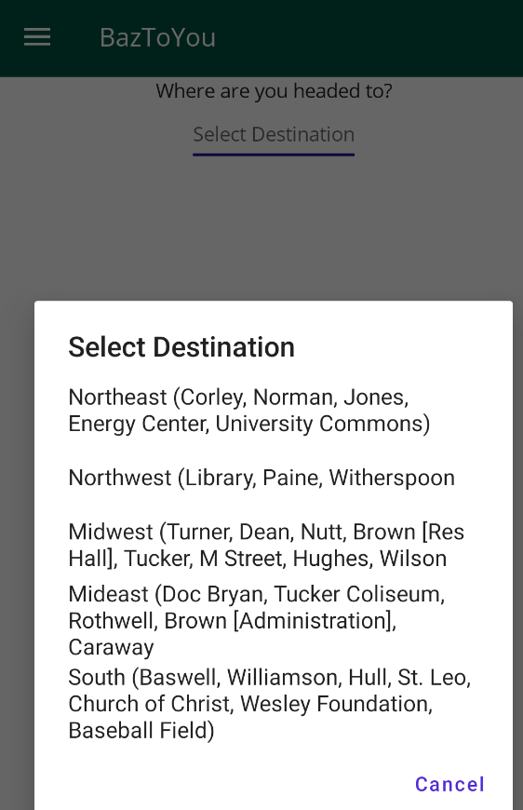
Design (BazToYou)
The design of the BazToYou section has changed entirely due to it now being a part of the same application.
Planned to have 2 main components.
A view of available delivery requests
A view of the currently selected order (if one has been selected).
Notes:
Alex

Slide 20
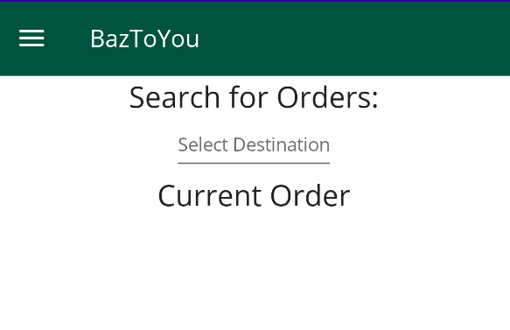
Features Currently Implemented
In the order flow, the user can choose delivery and pick what location to deliver to.
BazToYou currently has the ability to click through menus of locations on campus to search for active orders.
The delivery order flow has a proof of concept window that can click through the stages of the order being ordered and delivered. (Not Shown)
Notes:
Alex

Slide 21
Planned Features (BazToYou)
Login through OneTech
A rewards system to work towards free food for being a deliverer.
Order tracking for the request containing:
Customer information such as name and phone number
Contents of the order
Drop-off style:
Indirect (leave it by a door)
Direct (handed to the customer)
Notes:
Alex

Slide 22
What’s left to do?
Login to OneTech
Payment system integration
A rewards system to work towards free food for being a deliverer.
Linking the database to actually track orders
Progress has been made on this using MySQL
Acquiring the logo for Jerry’s
We are in contact with Chartwells

Slide 23
Demo!
Notes:
Braden

Slide 24
Questions?
Notes:
Braden / Nathan

