Slide 1

SMART INDIA HACKATHON 2026
TITLE PAGE
Problem Statement ID – SIH26102
Problem Statement Title-Development of an AI-powered system to detect anomalies, fraud, and inefficiencies in MPLAD Scheme implementation regd.
Theme- Smart Automation
PS Category- Software
Team ID- 16
Team Name- Mindmaze

Slide 2
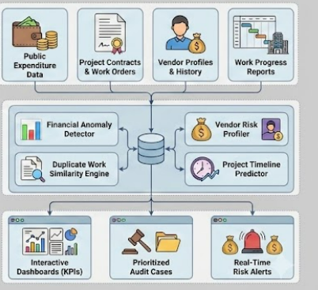
NIRIKSHAN AI
Mind Maze
Proposed Solution
📊 Financial Anomaly Detection
Detect unusual expenditure patterns
Identify budget/cost outliers
Flag abnormal fund utilization
🔍 Duplicate Work Detection
NLP-based project comparison & TF-IDF + Cosine Similarity
Identify potentially duplicated/similar works
💰 Vendor & Payment Risk Analysis
Detect unusual payment patterns
Identify high-risk vendor/work combinations
⏱️ Project Delay Monitoring
Track sanctioned → ongoing → completed works
🚨 Risk-Based Alerts
Composite risk scoring
Prioritized audit queue & explainable risk indicators

Slide 3
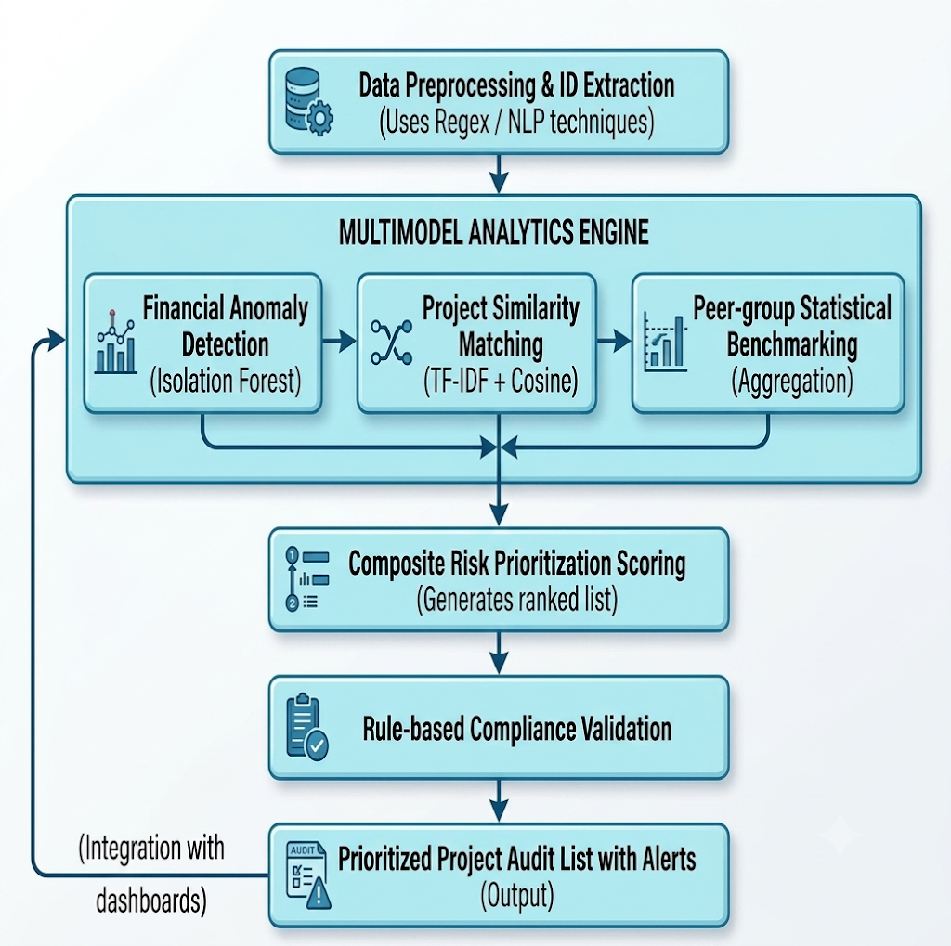
TECHNICAL APPROACH
Mind Maze
⚛️ Frontend
React, TypeScript, Vite, Tailwind CSS
📊Visualization & UI
Recharts , Lucide React
⚡Backend
FastAPI, Uvicorn, REST API
🤖Machine Learning / AI
Scikit-learn ,Isolation Forest ,TF-IDF ,Cosine Similarity ,
SciPy
🐍 Programming & Data
Python ,Pandas ,PyArrow ,Parquet

Slide 4
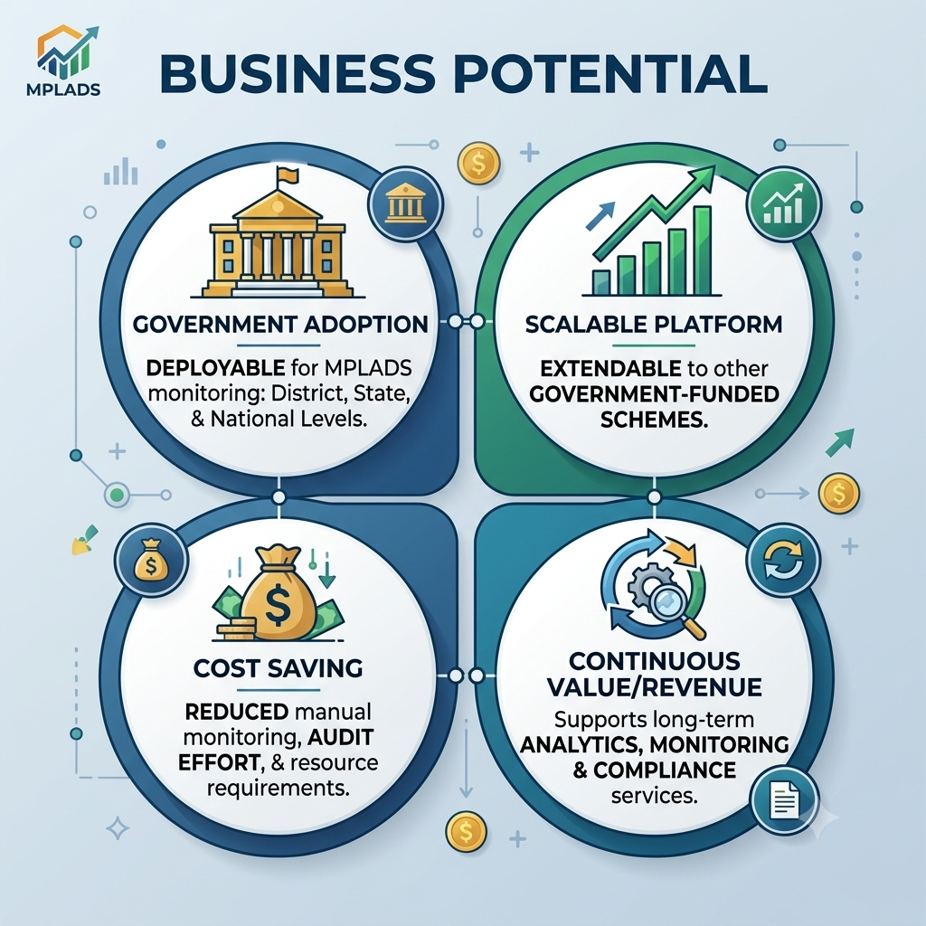
FEASIBILITY AND VIABILITY
Mind Maze
⚙️Feasibility of the Idea
Uses open-source technologies
Python-based ML ecosystem
Automated data processing
Minimal manual analysis
📈Viability of the Project
Cost-Effective: Built primarily with open-source technologies.
Scalable: Can expand from the current 79,068+ works to nationwide.
High Government Utility: Helps authorities prioritize audits, monitor funds
⚠️ Potential Challenges
Incomplete, inconsistent, or missing data may affect accuracy.
🛡️Strategies for Overcoming Challenges
Automated data cleaning & validation, Multi-factor risk scoring .

Slide 5
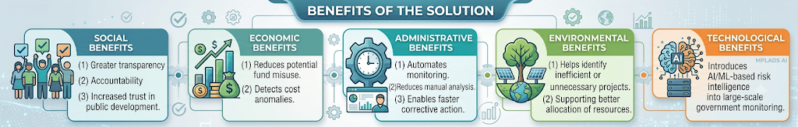
IMPACT AND BENEFITS
Mind Maze
Benefits of the Solution
Social: Greater transparency, accountability, and trust in public development.
Economic: Reduces potential fund misuse, detects cost anomalies.
Administrative: Automates monitoring, reduces manual analysis, and enables faster corrective action.
Environmental: Helps identify inefficient or unnecessary projects, supporting better allocation of resources.
Technological: Introduces AI/ML-based risk intelligence into large-scale government monitoring.
Potential Impact on Target Audience
Faster identification of high-risk works and better audit prioritization.
Real-time insights for informed and timely decisions.
Reduces manual effort by automatically highlighting suspicious patterns.
Improves transparency and accountability in the utilization of public funds.

Slide 6
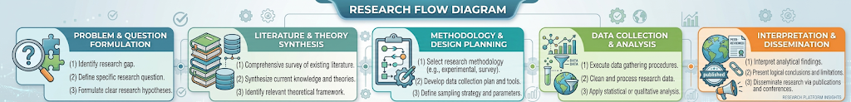
RESEARCH AND REFERENCES
Mind Maze
Research References
MoSPI – MPLADS Official Portal MPLADS Official Portal
MoSPI – Programme Implementation Wing MoSPI Programme Implementation Wing
MPLADS Monitoring Guidelines MPLADS Guidelines
NIRIKSHAN AI — Key Differentiators
Feature | NIRIKSHAN AI | MPLADS Portal | PAIMANA
ML-based Anomaly Detection | ✅ | ❌ | ❌
NLP-based Duplicate Work Detection | ✅ | ❌ | ❌
Peer-Group Cost Analysis | ✅ | ❌ | ❌
Composite Risk Scoring | ✅ | ❌ | ❌
Risk-Based Audit Prioritization | ✅ | ❌ | ❌

Slide 7
IMPORTANT INSTRUCTIONS
Please ensure below pointers are met while submitting the Idea PPT:
Kindly keep the maximum slides limit up to six (6). ( Including the title slide)
Try to avoid paragraphs and post your idea in points /diagrams / Infographics /pictures
Keep your explanation precise and easy to understand
Idea should be unique and novel.
You can only use provided template for making the PPT without changing the idea details pointers (mentioned in previous slides).
You need to save the file in PDF and upload the same on portal. No PPT, Word Doc or any other format will be supported.
Note - You can delete this slide (Important Pointers) when you upload the details of your idea on SIH portal.

