Slide 1
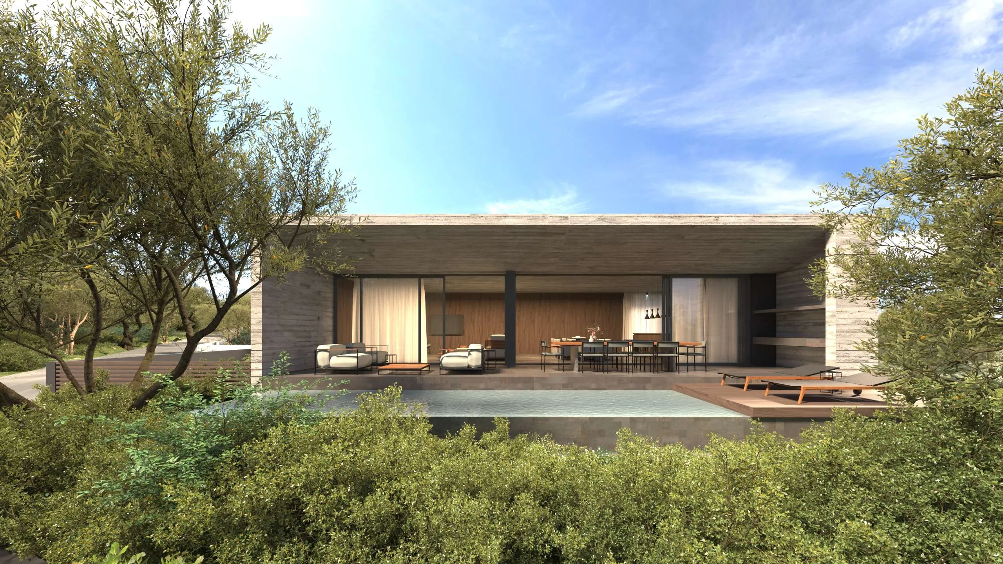
404200 × AMSA
AMSA,
easier to find.
Search, content, social and a maintainable website — one connected operating system.
PROPOSAL / 20 OCTOBER 2026
404200 / AMSA ARCHITECTS
01
Notes:
[Sources]
- https://amsa.com.cy/ — AMSA project image and public practice positioning
- https://www.404200.ai/ — 404200 visual identity

Slide 2
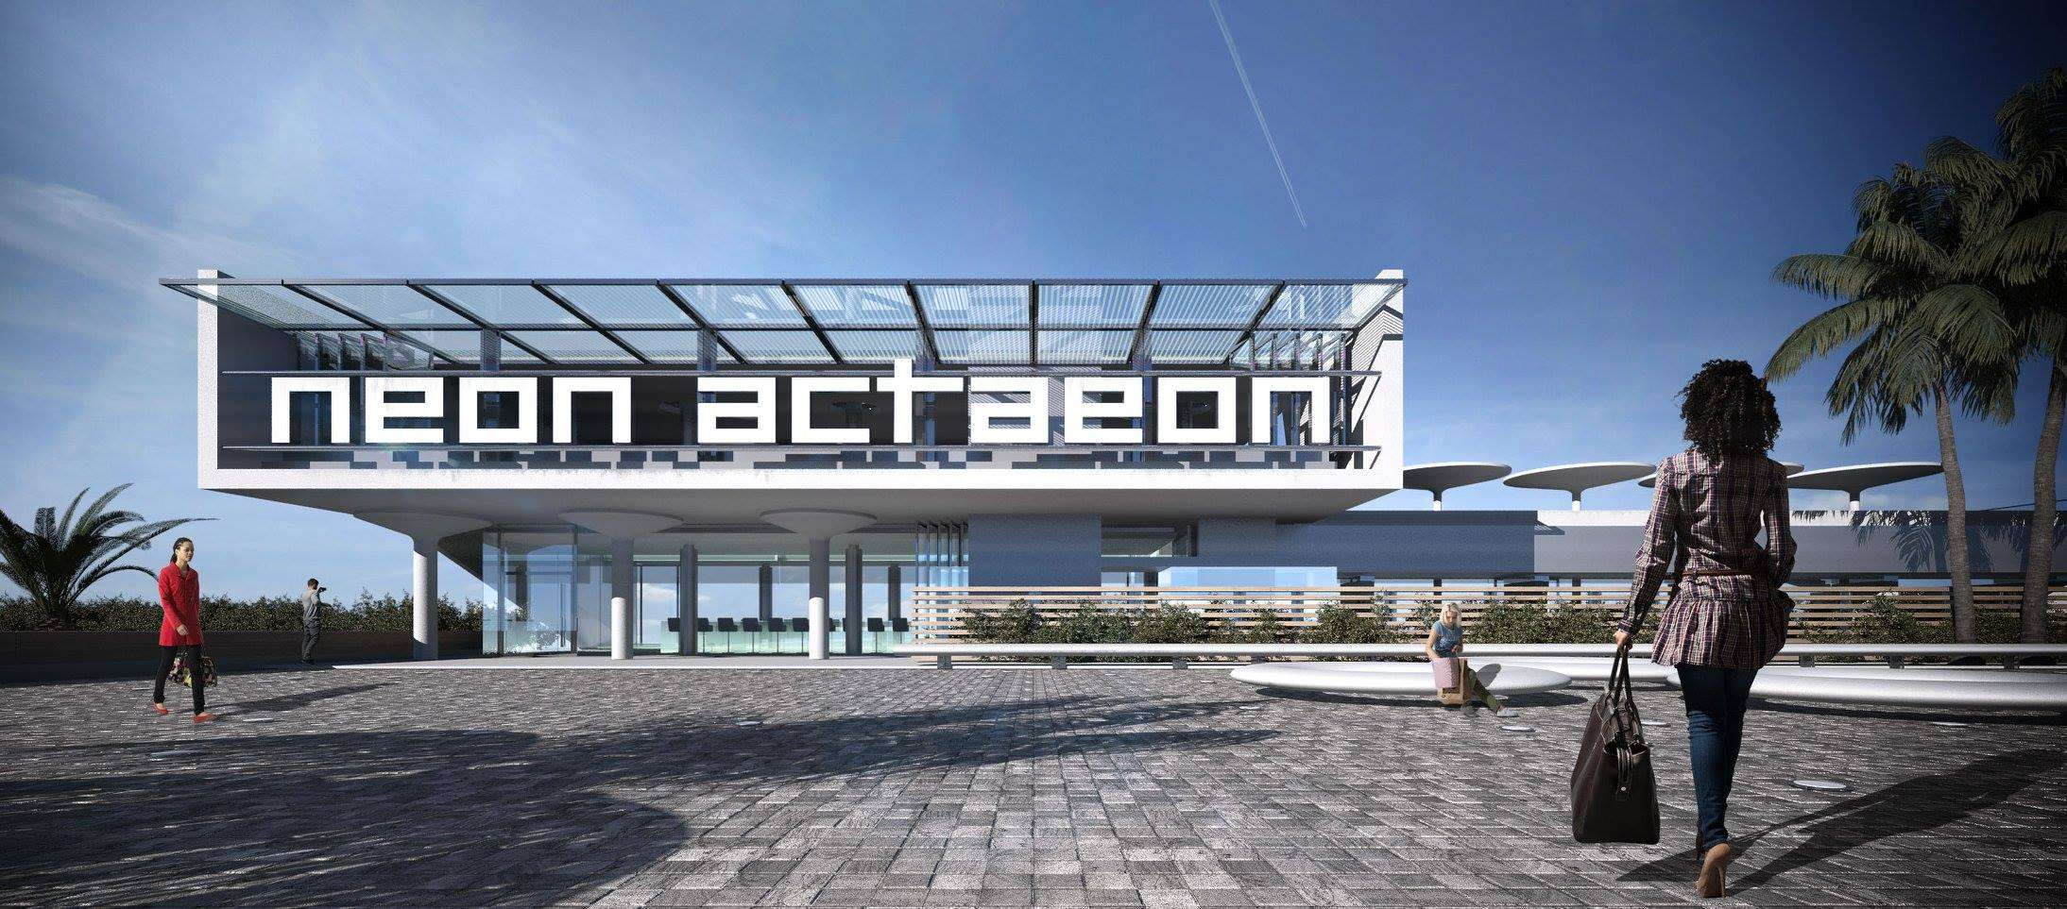
01 / THE OPPORTUNITY
AMSA’s thinking deserves visibility.
01
Name the work
Replace project codes with descriptive titles where confidentiality permits.
02
Explain the response
Show the brief, constraints, material choices, collaborators and outcome.
03
Connect the evidence
Link each project to services, locations, related work and contact routes.
The site already proves AMSA can design. Clear project stories explain why the practice fits a specific brief.
Visual archive → searchable project stories
404200 / AMSA ARCHITECTS
02
Notes:
[Sources]
- https://amsa.com.cy/competitions-awards/ — awards page structure and AMSA-owned imagery
- https://amsa.com.cy/about-us/ — practice history and positioning

Slide 3
02 / MONTHLY SERVICE
Every month produces visible work.
01
SEARCH
02
PUBLISH
03
GROW
Strategy + opportunity map
One project story or blog article
Local profile care
Technical crawl + index review
Four core social stories
Five authority opportunities
Two priority page improvements
Up to eight channel publications
Work log + review call
PLUS / routine website care · one clear priority queue · evidence of every completed item
404200 / AMSA ARCHITECTS
03
Notes:
[Sources]
- https://www.404200.ai/ — current 404200 Foundation plan and service model
- https://developers.google.com/search/docs/fundamentals/seo-starter-guide — common SEO work areas
Monthly quantities are proposal terms, not claims sourced from the cited pages.

Slide 4

03 / SEO IN PLAIN LANGUAGE
SEO works like a resolved submission.
01
TECHNICAL
The submission can be opened and read.
02
ON-PAGE
Every drawing has a useful title and explanation.
03
LOCAL
The practice and location are easy to verify.
04
OFF-PAGE
Credible publishers and juries refer to the work.
05
CONTENT
Complete evidence supports a decision.
SEO helps search engines understand the work — and helps clients decide.
404200 / AMSA ARCHITECTS
04
Notes:
[Sources]
- https://developers.google.com/search/docs/fundamentals/seo-starter-guide — definition and core practices of SEO
- https://amsa.com.cy/wp-content/uploads/2023/10/0021-02-1024x451.jpg — AMSA project image

Slide 5
04 / THE FIVE OPERATING LAYERS
Each SEO layer solves a distinct problem.
01
TECHNICAL
Reach, crawl, index, speed, mobile, forms
02
ON-PAGE
Titles, structure, project narratives, internal links
03
LOCAL
Maps, business data, service areas, reviews
04
OFF-PAGE
Publications, awards, collaborators, credible mentions
05
CONTENT
A growing body of useful first-hand evidence
ONE CONNECTED SYSTEM
404200 / AMSA ARCHITECTS
05
Notes:
[Sources]
- https://developers.google.com/search/docs/fundamentals/seo-starter-guide — technical, content, titles and links
- https://support.google.com/business/answer/7091 — local relevance, distance and prominence
- https://developers.google.com/search/docs/essentials/spam-policies — off-page/link-policy guardrails
- https://developers.google.com/search/docs/fundamentals/creating-helpful-content — people-first, first-hand content

Slide 6
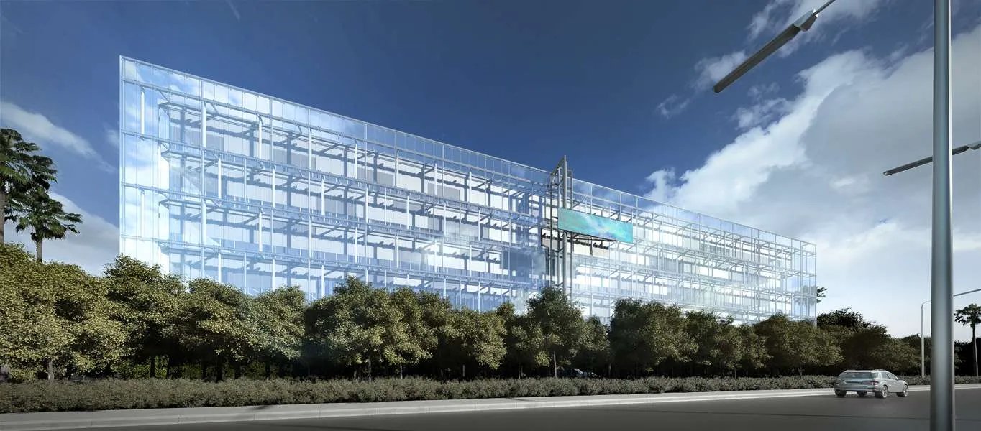
05 / CONTENT ENGINE
One project powers a month of content.
01
Instagram carousel
04
LinkedIn narrative
02
Facebook update
05
Google profile update
03
Pinterest pins
06
Editorial fact sheet
SOURCE OF RECORD
AMSA project story
AMSA supplies approved facts and images once. 404200 researches, writes, adapts, schedules and records the output.
404200 / AMSA ARCHITECTS
06
Notes:
[Sources]
- https://developers.google.com/search/docs/fundamentals/creating-helpful-content — people-first and first-hand content principles
- https://amsa.com.cy/wp-content/uploads/2023/10/0001-01.jpg — AMSA project image

Slide 7
06 / ONLINE PRESENCE
Twenty destinations, prioritised and owned.
FIND + VERIFY
SOCIAL
PORTFOLIO
PUBLISH
01 Google Business Profile
06 LinkedIn
11 Vimeo
16 ArchDaily
02 Bing Places
07 Instagram
12 Houzz Pro
17 Dezeen
03 Apple Business
08 Facebook
13 Architizer
18 designboom
04 ETEK
09 Pinterest Business
14 Archello
19 Issuu
05 World-Architects
10 YouTube
15 Behance
20 GitHub
UP TO FOUR PROFILES CREATED, CLAIMED OR COMPLETED EACH MONTH / EDITORIAL ACCEPTANCE REMAINS WITH THE PUBLISHER
404200 / AMSA ARCHITECTS
07
Notes:
[Sources]
- https://www.google.com/business/
- https://www.bingplaces.com/
- https://business.apple.com/
- https://www.linkedin.com/
- https://www.instagram.com/
- https://www.facebook.com/pages/create
- https://business.pinterest.com/
- https://www.youtube.com/
- https://vimeo.com/
- https://www.houzz.com/pro
- https://architizer.com/
- https://archello.com/
- https://www.archdaily.com/submit-a-project
- https://www.dezeen.com/submissions/
- https://www.designboom.com/submissions/
- https://world-architects.com/
- https://www.behance.net/
- https://issuu.com/
- https://github.com/
- https://www.etek.org.cy/
Availability, eligibility, fees and editorial acceptance must be confirmed before action.

Slide 8
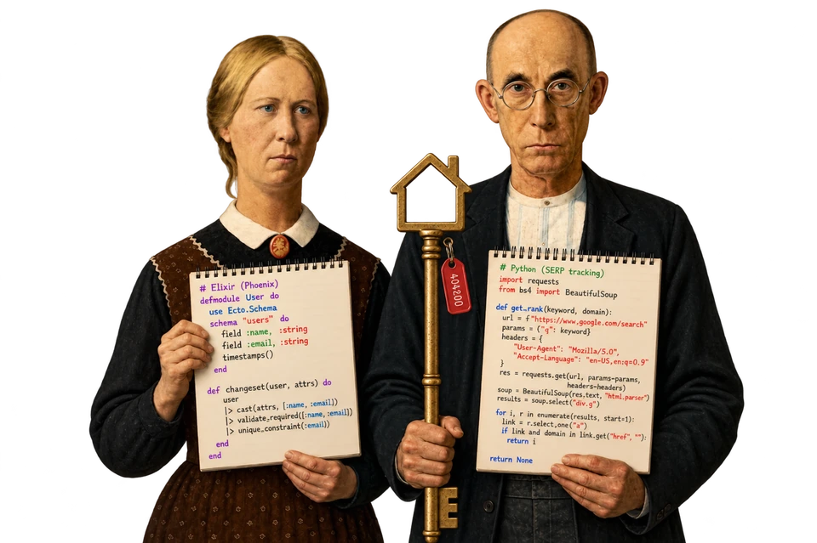
07 / ACCOUNT OPENING
AMSA owns every account.
01
CREATE OR CLAIM
Use an AMSA-owned email address where the platform permits.
02
COMPLETE
Logo, biography, contact details, website, services and categories.
03
SECURE
Two-factor security, recovery ownership and named admins.
04
LAUNCH
Publish an initial content set so the profile opens with context.
05
REVIEW
Keep the channels that show relevance, referrals or editorial value.
AMSA keeps permanent access.
404200 / AMSA ARCHITECTS
08
Notes:
[Sources]
- https://www.404200.ai/ — 404200 brand illustration
- Account-ownership process is a proposed operating control.

Slide 9
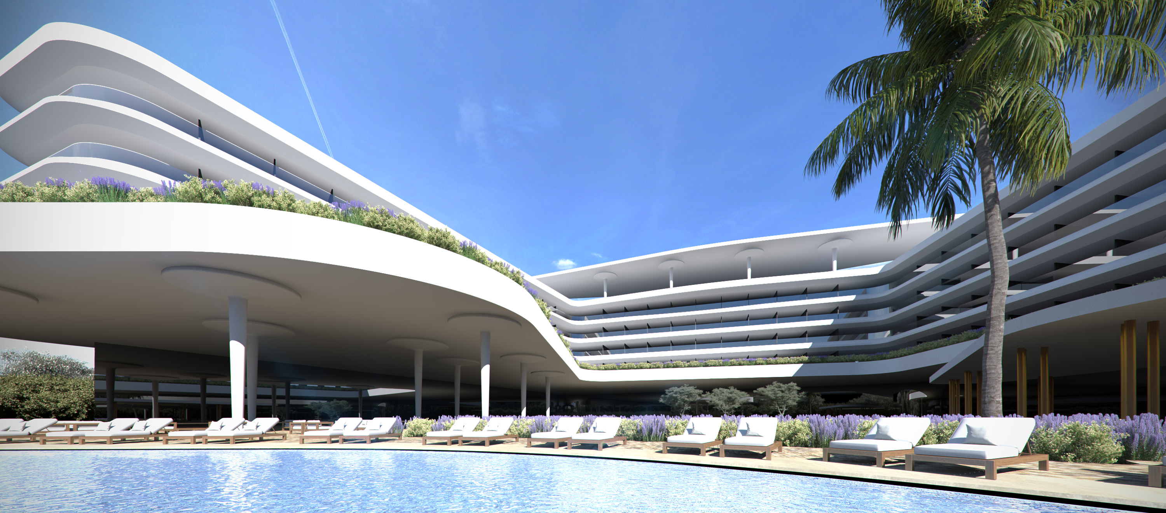
08 / WEBSITE REBUILD
WordPress stays. Elementor speeds updates.
01
REUSABLE TEMPLATES
Global header, footer, project pages and consistent design tokens.
02
EASIER UPDATES
Future project pages start from an approved structure.
03
SEARCH FOUNDATIONS
URLs, metadata, images, internal links and sitemaps stay protected.
Elementor runs inside WordPress.
Custom HTML/CSS refines the precise details.
404200 / AMSA ARCHITECTS
09
Notes:
[Sources]
- https://elementor.com/help/wordpress-and-elementor-2/ — Elementor operates with WordPress
- https://elementor.com/help/the-elementor-theme-builder/ — reusable site-part templates
- https://developers.google.com/search/docs/crawling-indexing/site-move-with-url-changes — preserving URLs, redirects and monitoring during site changes
- https://amsa.com.cy/wp-content/uploads/2023/12/1007-02.jpg — AMSA project image

Slide 10
09 / 8–12 WEEK IMPLEMENTATION
The work is inventory, migration and testing.
WEEKS 1–2
WEEKS 3–6
WEEKS 7–9
WEEKS 10–12
INVENTORY
BUILD
TEST
RELEASE
Pages, URLs, images, forms, analytics, plugins, backups
Global parts, project templates, approved content and responsive layouts
Mobile, browsers, galleries, forms, links, accessibility and performance
Review, corrections, redirects, sitemap, analytics, launch and monitoring
01
02
03
04
THE CURRENT WEBSITE STAYS LIVE UNTIL AMSA APPROVES THE REPLACEMENT
404200 / AMSA ARCHITECTS
10
Notes:
[Sources]
- https://developers.google.com/search/docs/crawling-indexing/site-move-with-url-changes — inventory, URL mapping, redirects, testing and monitoring
- https://web.dev/articles/vitals — loading, interactivity and visual stability
The 8–12 week range is a scoped proposal estimate for the current public website, subject to access, approved material and hidden complexity.

Slide 11
10 / WHY SEO TAKES SIX TO TWELVE MONTHS
SEO moves fast. Search takes time.
MONTHS 1–2
MONTHS 3–4
MONTHS 5–6
MONTHS 7–12
FOUNDATION
EARLY SIGNALS
COMPARISON
COMPOUNDING
Baseline, access, fixes, profiles, first pages
Indexing, query visibility, first referral patterns
Enough work and data to compare themes and pages
Deeper content, links, mentions and repeated refinement
WHAT CHANGES THE PACE
Competition · site history · publishing pace · approvals · difficulty · recrawling
404200 / AMSA ARCHITECTS
11
Notes:
[Sources]
- https://developers.google.com/search/docs/appearance/core-updates — effects can take days to several months; no guarantee
- https://ahrefs.com/blog/how-long-does-seo-take/ — poll-based 3–6 month expectation
- https://www.semrush.com/blog/how-long-does-seo-take/ — 4–12 month industry planning range
- https://developers.google.com/search/docs/crawling-indexing/site-move-with-url-changes — recrawling and reindexing take time
The slide presents a planning model, not a guarantee of timing or outcome.

Slide 12
11 / SIX-MONTH OPERATING PLAN
Six months of focused, visible progress.
01
BASELINE
02
PUBLISH
03
RELEASE
Access, measurement, crawl, first correction
First project story, social cycle, templates
Second cycle, site QA, approved launch
04
EXPAND
05
AUTHORITY
06
EVALUATE
Improve gaining pages; complete priority profiles
Awards, collaborators and editorial submissions
Six-month evidence review and next recommendation
Six months is the first meaningful evaluation point — AMSA keeps the right to end at any time.
404200 / AMSA ARCHITECTS
12
Notes:
[Sources]
- https://support.google.com/webmasters/answer/7576553 — search impressions, clicks, queries and pages
- https://developers.google.com/search/docs/appearance/core-updates — changes require time to be assessed by search systems
Roadmap and cancellation language are proposal terms.

Slide 13

12 / MEASUREMENT
Visibility should lead to qualified action.
01
VISIBILITY
Relevant impressions and query coverage
02
INTEREST
Clicks, priority-page visits and project depth
03
DISTRIBUTION
Social referrals, saves and publication links
04
ACTION
Contact clicks, forms and qualified enquiries
05
DELIVERY
Completed work, live URLs and next priority
Measure discovery to enquiry.
404200 / AMSA ARCHITECTS
13
Notes:
[Sources]
- https://support.google.com/webmasters/answer/7576553 — clicks, impressions, CTR, position, queries and pages
- https://support.google.com/analytics/answer/13965727 — key events for important website actions
- https://www.404200.ai/ — AMSA villa image reproduced on 404200 selected work with AMSA attribution

Slide 14
13 / COMMERCIAL TERMS
One rate. Two options. Exit anytime.
CLIENT RIGHT
€350
□ QUARTERLY
End at any time with written notice.
€1,050
PER MONTH
Paid every three months in advance
Unused complete prepaid months are refunded after completed work and approved external costs are reconciled.
Reserved capacity across search, content, social, local visibility and website implementation.
□ SEMI-ANNUAL
€2,100
SEO RUNWAY
Paid every six months in advance
Plan for six months. AMSA can still end at any time.
404200 / AMSA ARCHITECTS
14
Notes:
[Sources]
- https://www.404200.ai/ — 404200 Foundation plan public monthly price
- Payment and termination terms are proposal terms and must be completed with legal entity details before signature.

Slide 15
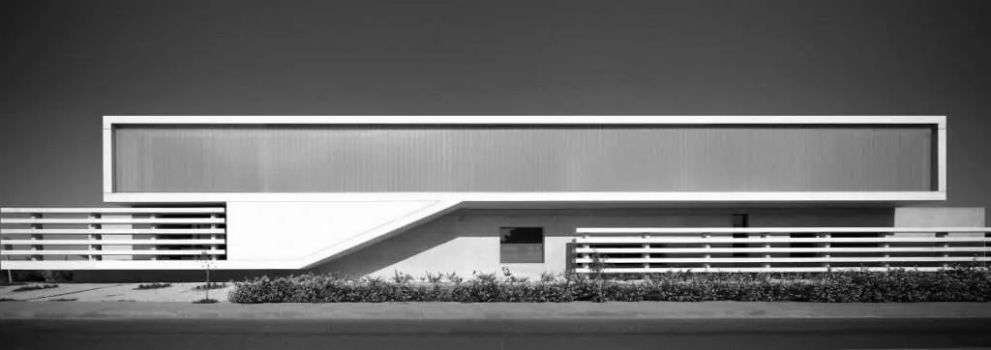

NEXT STEP
Approve the six-month plan.
Sign + schedule
the access session
01
Priority project + audience
02
First three approved projects
03
Named approver + access
04
Choose quarterly or semi-annual
404200 / AMSA ARCHITECTS
15
Notes:
[Sources]
- https://amsa.com.cy/ — AMSA project image
- https://www.404200.ai/ — 404200 logo and visual identity
Decision steps are proposal terms.

