Slide 1

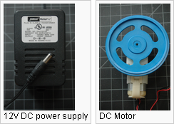
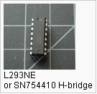
DC Motor Control Using an H-Bridge
目的:使用直流馬達驅動IC 。
材料:

Slide 2
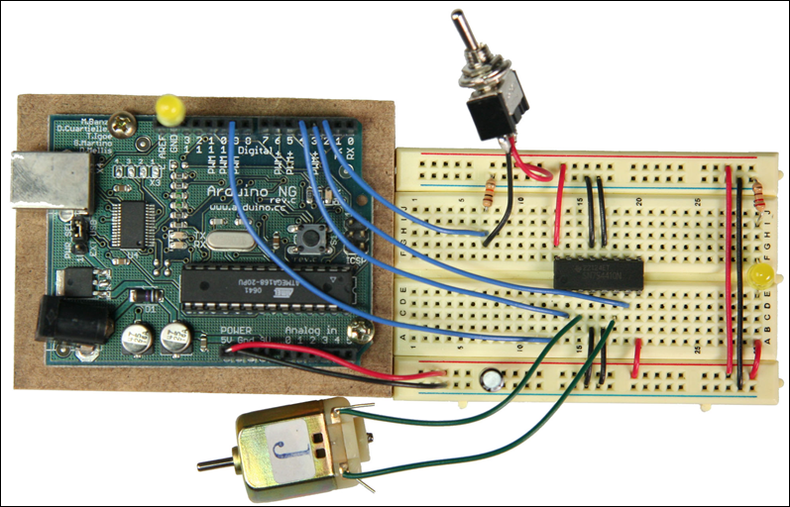
DC Motor Control Using an H-Bridge

Slide 3
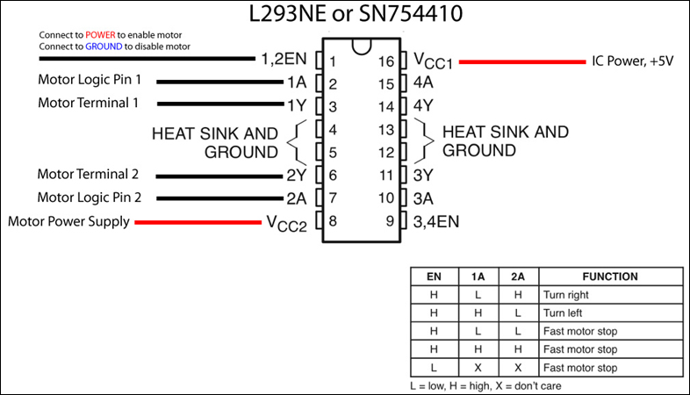
DC Motor Control Using an H-Bridge

Slide 4
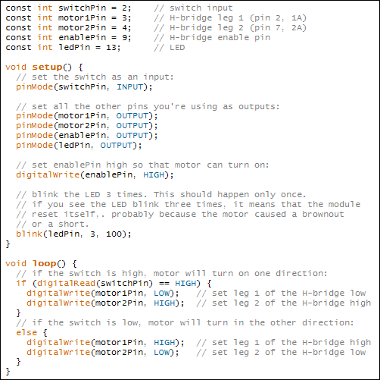
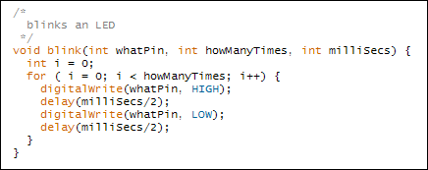
DC Motor Control Using an H-Bridge

Slide 5
DC Motor Control Using an H-Bridge

Slide 6
DC Motor Control Using an H-Bridge

Slide 7
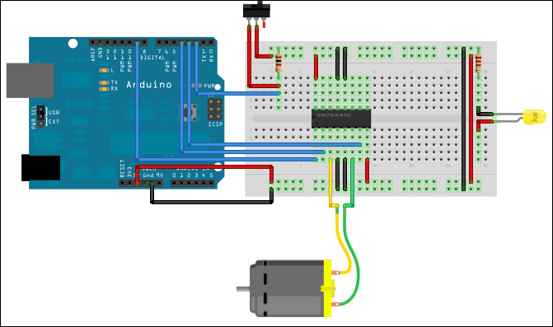
DC Motor Control Using an H-Bridge

Slide 8
DC Motor Control Using an H-Bridge

Slide 9
DC Motor Control Using an H-Bridge

Slide 10
const int switchPin = 2; // switch input
const int motor1Pin = 3; // H-bridge leg 1 (pin 2, 1A)
const int motor2Pin = 4; // H-bridge leg 2 (pin 7, 2A)
const int enablePin = 9; // H-bridge enable pin
const int ledPin = 13; // LED
void setup() {
// set the switch as an input:
pinMode(switchPin, INPUT);
// set all the other pins you're using as outputs:
pinMode(motor1Pin, OUTPUT);
pinMode(motor2Pin, OUTPUT);
pinMode(enablePin, OUTPUT);
pinMode(ledPin, OUTPUT);
// set enablePin high so that motor can turn on:
digitalWrite(enablePin, HIGH);
// blink the LED 3 times. This should happen only once.
// if you see the LED blink three times, it means that the module
// reset itself,. probably because the motor caused a brownout
// or a short.
blink(ledPin, 3, 100);
}
void loop() {
// if the switch is high, motor will turn on one direction:
if (digitalRead(switchPin) == HIGH) {
digitalWrite(motor1Pin, LOW); // set leg 1 of the H-bridge low
digitalWrite(motor2Pin, HIGH); // set leg 2 of the H-bridge high
}
// if the switch is low, motor will turn in the other direction:
else {
digitalWrite(motor1Pin, HIGH); // set leg 1 of the H-bridge high
digitalWrite(motor2Pin, LOW); // set leg 2 of the H-bridge low
}
}
/*
blinks an LED
*/
void blink(int whatPin, int howManyTimes, int milliSecs) {
int i = 0;
for ( i = 0; i < howManyTimes; i++) {
digitalWrite(whatPin, HIGH);
delay(milliSecs/2);
digitalWrite(whatPin, LOW);
delay(milliSecs/2);
}
}
DC Motor Control Using an H-Bridge

Slide 11
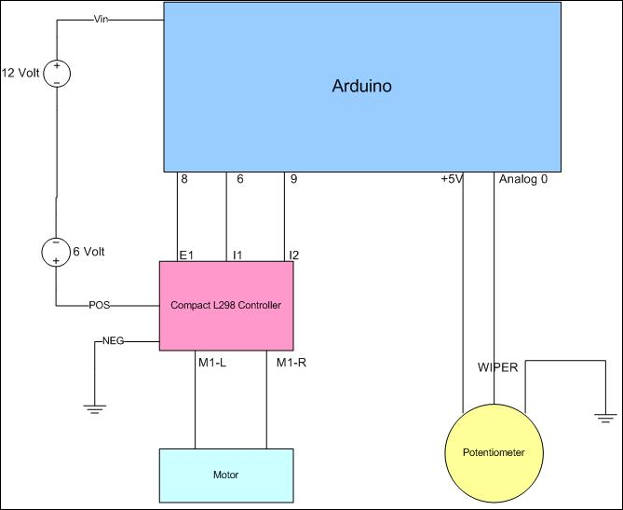
DC Motor Position Control Using an H-Bridge
http://roamingdrone.wordpress.com/2008/07/24/diy-servo-with-arduino-dc-motor-and-potentiometer/

Slide 12
/*
DIYServo 1.0
Controller Motor Speed and Movement with Absolute Positioning
A sketch for turning a standard DC gear motor into a servo
using a potentiometer. Can also be used to add finer-grained
control over existing servos.
Control over motor :
Speed (PWM)
Direction
Number of degrees to move (up to 1024) per move
How to long to wait between moves
To get finer control (1024 degrees, instead of 360) of an existing
servo, remove the controller and any stop-pins, disconnect the
potentiometer wires. Connect power lines from servo motor to a
DC motor controller, potentiometer wiper to an input pin on the arduino,
and the ouside potentiometer pins to 5v/GND.
Serial monitor:
use 'l' to tell the servo to move left
use 'r' to tell the servo to move right
use 's' to stop the servo
use 'g' to go (run the servo)
(c) 2008 C. A. Church - www.dronecolony.com
7/24/08 - initial version
*/
// USING_CONTROLLER says whether we have to bring an
// enable pin high (such as for the Compact L298 controller)
// before sending PWM down the LT/RT pins
// set this to 0 if you don't need an enable pin
#define USING_CONTROLLER 1
// enable pin
#define MOTOR_EN_PIN 8
// right direction pin
#define MOTOR_RT_PIN 6
// left direction pin
#define MOTOR_LT_PIN 9
// READ_AVG is how many readings to average
// set it to one less than the actual #
// e.g.: 10 readings = set to 9
//
// the more you average, the more accurate your reading is likely to
// be -- too many though, and you'll start missing changes if the motor
// is moving quickly
#define READ_AVG 9
// motor speed is from 0-255, test with low values
// as not all will move consistently for you
int motor_speed = 75;
// how many ms to pause between allowed movements
int motor_pause_tm = 1000;
// how many 'degrees' (absolute differences between
// potentiometer readings) to move before pausing
int motor_move_deg = 5;
// a counter for how many degrees we have moved
int move_deg_cnt = 0;
// setting to a default value
int motor_cur_pin = MOTOR_RT_PIN;
// control indicators
bool motor_started = false;
bool motor_paused = false;
bool first_run = true;
bool motor_run = false;
long paused_tm;
// our current and previous potentiometer readings
int cur_reading = 0;
int pre_reading = 0;
int steps = 0;
// our current readings array, and our previous average readings array
int vals[READ_AVG + 1];
int prev_posts[2] = { 0, 0 };
void setup() {
Serial.begin(19200);
Serial.println("Ready");
memset( (char *)vals, 0, sizeof(int) * (READ_AVG + 1) );
// set motor control pins
if( USING_CONTROLLER )
digitalWrite(MOTOR_EN_PIN, HIGH);
digitalWrite(MOTOR_LT_PIN, LOW);
digitalWrite(MOTOR_RT_PIN, LOW);
}
void loop() {
// see if any input has come in the serial port
check_input();
// figure out how many degrees we've moved (if at all)
move_deg_cnt = move_deg_cnt + read_pot();
if( motor_run == true ) {
// if the motor is supposed to be running
// the following check is to prevent attempting to rotate all the
// way around on a potentiometer that has a stop. If yours doesn't
// have a stop in it, ou can remove this check
if( (motor_cur_pin == MOTOR_RT_PIN && prev_posts[1] >= 1020 ) ||
( motor_cur_pin == MOTOR_LT_PIN && prev_posts[1] <= 3 ) ) {
// we've reached our maximum point (don't want to harm our
// potentiometer
motor_run = false;
motor_started = false;
motor_paused = false;
// bring pin low
digitalWrite(motor_cur_pin, LOW);
// print status
Serial.println("Have Reached Edge of Movement");
}
else if( motor_started == false ) {
// the motor is supposed to be running, but we haven't started
// it yet
// PWM output
analogWrite(motor_cur_pin, motor_speed);
// set status values
motor_started = true;
motor_paused = false;
first_run = true;
}
else if( move_deg_cnt >= motor_move_deg && motor_paused == false && first_run == false) {
// we've gone our specific # of degrees, pause by stopping the
// motor
Serial.println("Pausing");
digitalWrite(motor_cur_pin, LOW);
motor_paused = true;
// record when we started our pause (so we know when to stop)
paused_tm = millis();
}
else if( motor_paused == true && (millis() - paused_tm) > motor_pause_tm ) {
// if enough time has passed to stop pausing
Serial.println("Unpausing");
motor_paused = false;
paused_tm = millis();
// set move_deg_cnt to zero when re-starting to avoid any
// jitter while paused
move_deg_cnt = 0;
// generate PWM
analogWrite(motor_cur_pin, motor_speed);
}
}
}
int read_pot() {
//read the voltage on the potentiometer:
cur_reading = analogRead(0);
int diff = 0;
// we're going to average the last READ_AVG reads
// put in a value for our current step
vals[steps] = cur_reading;
// if we've saved enough values to go ahead and perform an average...
if( steps == READ_AVG ) {
// reset our read counter
steps = -1;
// determine the average value read
// -- this is mostly to deal with big jitter
int tot = 0;
int avg = 0;
// sum up totals
for (int i = 0; i <= READ_AVG; i++)
tot += vals[i];
avg = tot / READ_AVG + 1;
// ignore current reading if it was either of our last two readings
// avoid bouncing back and forth between two readings (slight voltage
// variation in the same range)
if( avg == prev_posts[0] || avg == prev_posts[1] ) {
return(0);
}
// determine the absolute difference between the current average
// and the previous average
diff = avg > prev_posts[1] ? avg - prev_posts[1] : prev_posts[1] - avg;
// if there's a difference between the averages
if( diff > 0 ) {
// print our new reading
Serial.println(avg, DEC);
// move our last reading back, and put our current reading in
// our array to track the last two positions
prev_posts[0] = prev_posts[1];
prev_posts[1] = avg;
// update this so the pause check knows that we have changed a position
// (otherwise, starting in a position oher than 0 will mess up our
// pause check)
first_run = false;
}
}
// increment our saved value # for the next loop
steps++;
// return the difference recorded
return(diff);
}
void check_input() {
if ( Serial.available()) {
char ch = Serial.read();
switch(ch) {
case 'g':
Serial.println("Go - Running Motor");
motor_run = true;
digitalWrite(13, HIGH);
break;
case 's':
Serial.println("Stopping Motor");
motor_run = false;
motor_started = false;
analogWrite(motor_cur_pin, 0);
digitalWrite(13, LOW);
break;
case 'l':
motor_cur_pin = MOTOR_LT_PIN;
Serial.println("Direction = LEFT");
break;
case 'r':
motor_cur_pin = MOTOR_RT_PIN;
Serial.println("Direction = RIGHT");
break;
}
}
}
DC Motor Position Control Using an H-Bridge

Slide 13
DC Motor Position Control Using an H-Bridge
http://docs.google.com/View?id=dhjz44fg_8f6sh7tcj
http://subzonepen.blogspot.com/
http://subzonepen.blogspot.com/

Slide 14
motorShield_v3
http://blushingboy.net/p/motorShieldV3/
controlling DC motors with encoders

Slide 15
motorShield_v3
http://blushingboy.net/p/motorShieldV3/
controlling DC motors with encoders

Slide 16
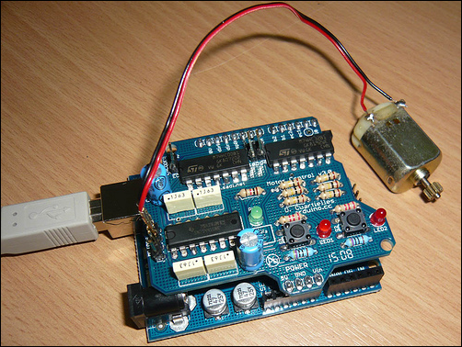
motorShield_v3
controlling speed and direction of a small DC motor

Slide 17
motorShield_v3
int dirB = 13; // not used in this example
int speedA = 10;
int speedB = 11; // not used in this example
void setup()
{
pinMode (dirA, OUTPUT);
pinMode (dirB, OUTPUT);
pinMode (speedA, OUTPUT);
pinMode (speedB, OUTPUT);
}
void loop()
{
// move the motor A to one direction increasing speed
digitalWrite (dirA, HIGH);
for (int j = 0; j < 255; j += 10) {
analogWrite (speedA, j);
delay (100);
}
delay(1000); // keep the motor rolling for one second
// move the motor A to one direction decreasing speed
digitalWrite (dirA, HIGH);
for (int j = 255; j >= 0; j -= 10) {
analogWrite (speedA, j);
delay (100);
}
// stop the motor
digitalWrite(speedA, LOW);
delay(1000); // keep the motor stopped for one second
}

