Slide 1

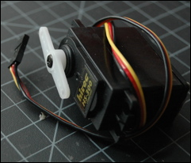
Servo Motor Control with an Arduino
目的:伺服馬達驅動。
材料:

Slide 2
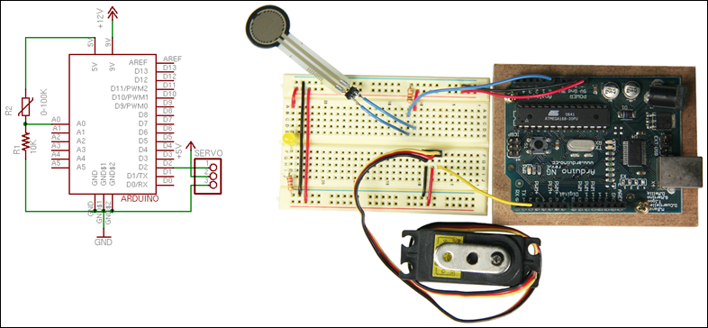
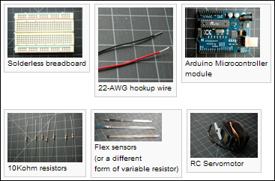
Servo Motor Control

Slide 3
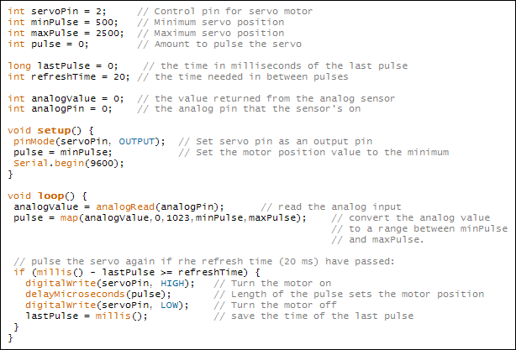
Servo Motor Control

Slide 4
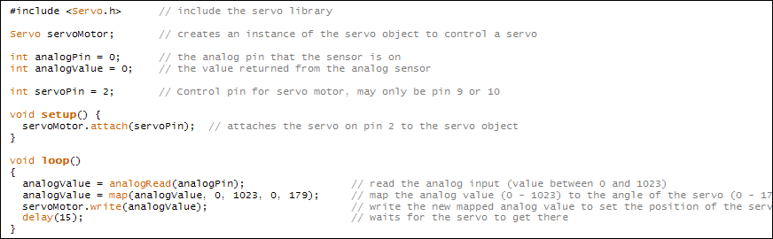
Servo Motor Control

Slide 5
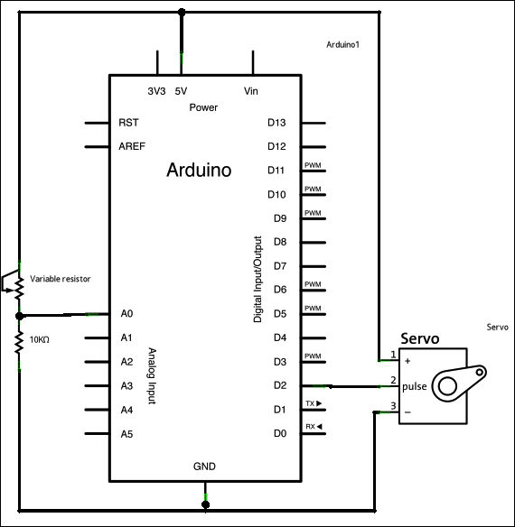
Servo Motor Control with an Arduino

Slide 6
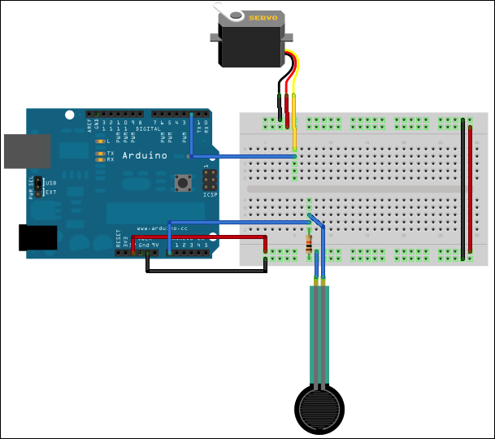
Servo Motor Control with an Arduino

Slide 7
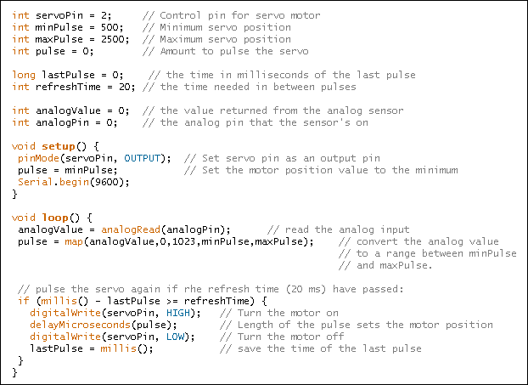
Servo Motor Control with an Arduino

Slide 8
Servo Motor Control with an Arduino
int servoPin = 2; // Control pin for servo motor
int minPulse = 500; // Minimum servo position
int maxPulse = 2500; // Maximum servo position
int pulse = 0; // Amount to pulse the servo
long lastPulse = 0; // the time in milliseconds of the last pulse
int refreshTime = 20; // the time needed in between pulses
int analogValue = 0; // the value returned from the analog sensor
int analogPin = 0; // the analog pin that the sensor's on
void setup() {
pinMode(servoPin, OUTPUT); // Set servo pin as an output pin
pulse = minPulse; // Set the motor position value to the minimum
Serial.begin(9600);
}
void loop() {
analogValue = analogRead(analogPin); // read the analog input
pulse = map(analogValue,0,1023,minPulse,maxPulse); // convert the analog value
// to a range between minPulse
// and maxPulse.
// pulse the servo again if rhe refresh time (20 ms) have passed:
if (millis() - lastPulse >= refreshTime) {
digitalWrite(servoPin, HIGH); // Turn the motor on
delayMicroseconds(pulse); // Length of the pulse sets the motor position
digitalWrite(servoPin, LOW); // Turn the motor off
lastPulse = millis(); // save the time of the last pulse
}
}

Slide 9
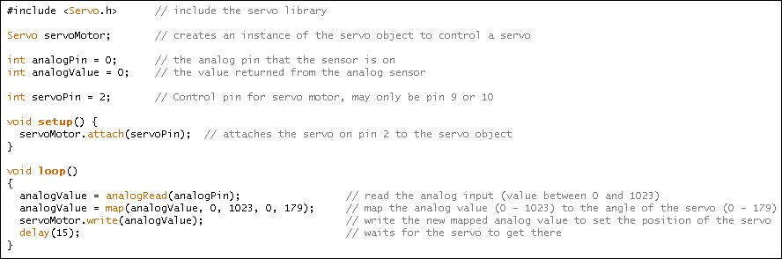
Servo Motor Control with an Arduino

Slide 10
Servo Motor Control with an Arduino
#include <Servo.h> // include the servo library
Servo servoMotor; // creates an instance of the servo object to control a servo
int analogPin = 0; // the analog pin that the sensor is on
int analogValue = 0; // the value returned from the analog sensor
int servoPin = 2; // Control pin for servo motor, may only be pin 9 or 10
void setup() {
servoMotor.attach(servoPin); // attaches the servo on pin 2 to the servo object
}
void loop()
{
analogValue = analogRead(analogPin); // read the analog input (value between 0 and 1023)
analogValue = map(analogValue, 0, 1023, 0, 179); // map the analog value (0 - 1023) to the angle of the servo (0 - 179)
servoMotor.write(analogValue); // write the new mapped analog value to set the position of the servo
delay(15); // waits for the servo to get there
}

