Slide 1
Final Project Presentation - Project Electrooster
By: Minghui Ni & Yizhe Wang

Slide 2
Project Vision
Smart Clock with temperature monitoring
Supported by a PICO4ML microcontroller
Get the temperature when you get up in the morning and know our cloth suggestions!
All information displayed on a LCD screen!
Morning Alarm, serves on time like a rooster !
Automatic initialization with WIFI!

Slide 3
Components
PICO4ML dev toolkit
Microcontroller: Raspberry Pi RP2040
0.96 inch LCD SPI Display (160x80 ST7735)
IMU: ICM-20948, with digital-output temperature sensor
HiMax HM01B0 Camera Module
ESP8266 WIFI Module
Power Bank for 5V Power Supply
3.3V DC Buzzer

Slide 4
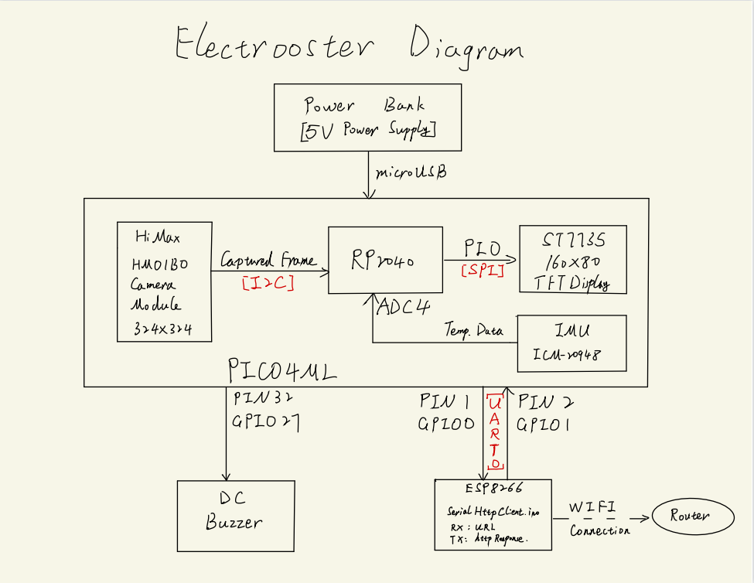
Project Plan
Project Diagram

Slide 5
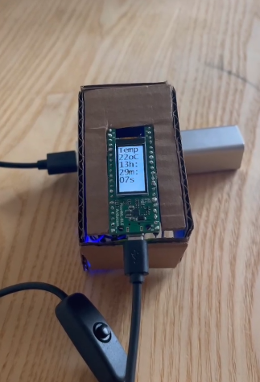
Live Demo

Slide 6
Thanks!

