Slide 1
Sequent System to Truth Tree Converter
Andrew Nazareth and Andrii Bonenberger

Slide 2
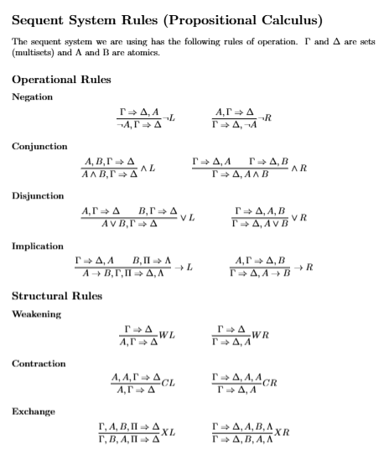
Sequent System Rules
Notes:
Andrii So a sequent is basically formulas on the left of the arrow and formulas on the right. The way you read it is, if everything on the left is true, then at least one thing on the right has to be true. The operational rules are how you break down the logical connectives. Negation moves a formula across the arrow and flips it. Conjunction on the left is straightforward, but conjunction on the right makes the proof branch into two. Disjunction is the opposite. Implication left branches, implication right doesn't. Then the structural rules are just housekeeping, weakening lets you add formulas, contraction removes duplicates, exchange lets you reorder. You build these derivations bottom up until every branch reaches the axiom A implies A.

Slide 3
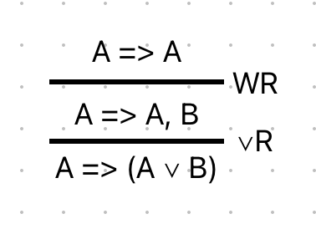
Software Implementation
Binary tree
Two types: binary (two parents), unary (one parent)
By parent I mean above it in text representation
Stores rule (from previous/parent), antecedents, succedents
References to parent(s) and child(ren), if any
Notes:
Andrii For how we represent this in code, the derivation is stored as a binary tree. There's two node types. Binary nodes have two parents above them, and those are for branching rules like conjunction right or disjunction left. Unary nodes have one parent, for the linear rules like negation or weakening. Each node stores which rule was applied, the formulas on both sides of the arrow, and references to its parents and children.

Slide 4
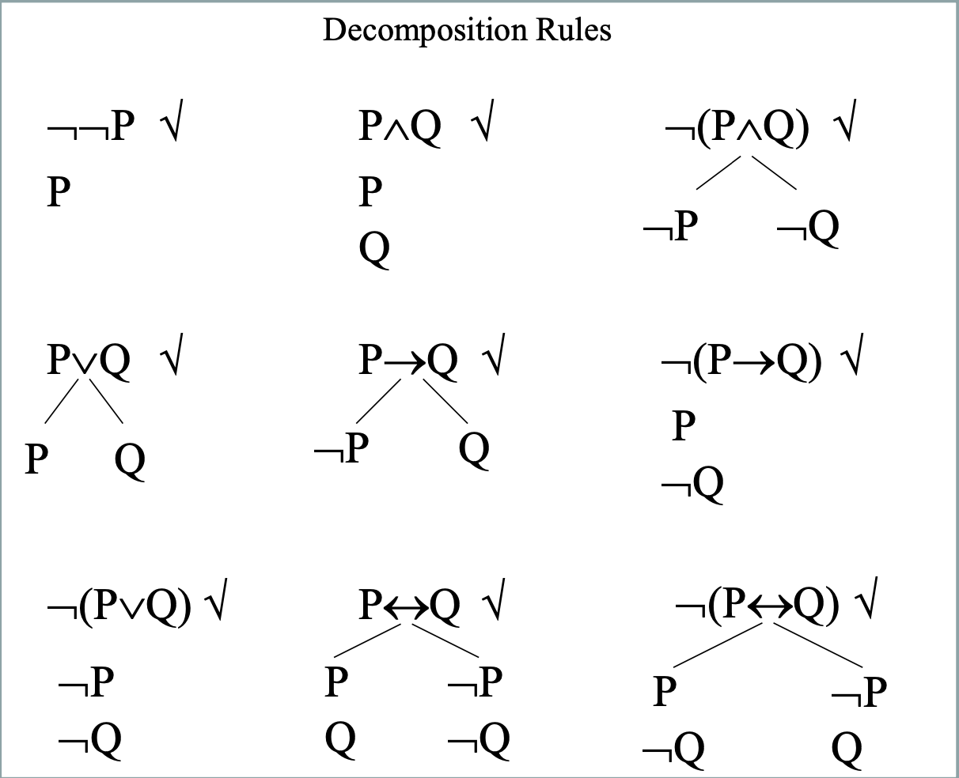
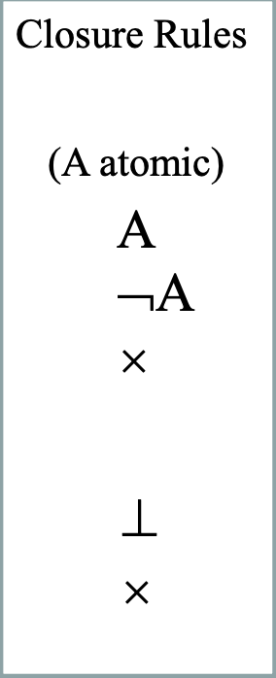
Truth Tree Rules
Notes:
Andrii
These are the decomposition and closure rules. Some decompositions are linear, like P and Q just gives you both P and Q on the same branch, or double negation just cancels out. Others branch, like P or Q splits into a P side and a Q side. The negated versions flip which ones branch and which ones don't. For closure, a branch closes when you find a formula and its negation on the same branch. If all branches close, the root formulas can't all be true at the same time.

Slide 5
Software Implementation
Binary tree
4 types: Binary (two children), unary (one child), open node (for open branches, not used in current implementation), closed node (for closed branches)
Stores statement that the node represents
Has references to parent and child(ren), if any
Notes:
Andrii
On the truth tree side we have four node types. Binary nodes have two children, those are for branching decompositions. Unary nodes have one child, for linear decompositions. Then closed nodes mark where a branch hit a contradiction, and open nodes are for branches that finished clean, though we don't use open nodes in the current implementation. Each node stores the formula it represents and references to its parent and children.

Slide 6

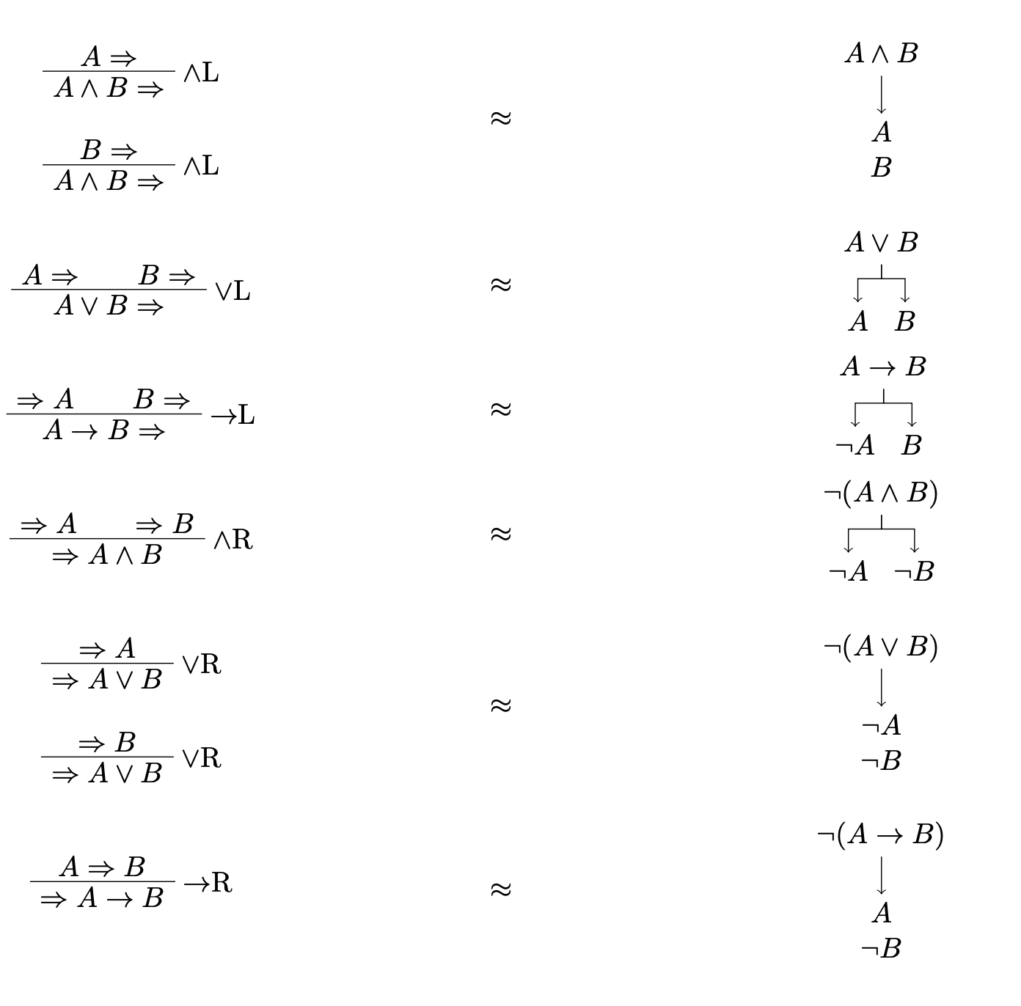

Conversion from Sequent to Tree
Notes:
Andrew

Slide 7
Software Implementation
Visitor pattern to convert each rule
Go as deep as possible to create the nodes and pull them back up the tree, attaching where applicable
We unit tested it :)
Notes:
Andrew

Slide 8
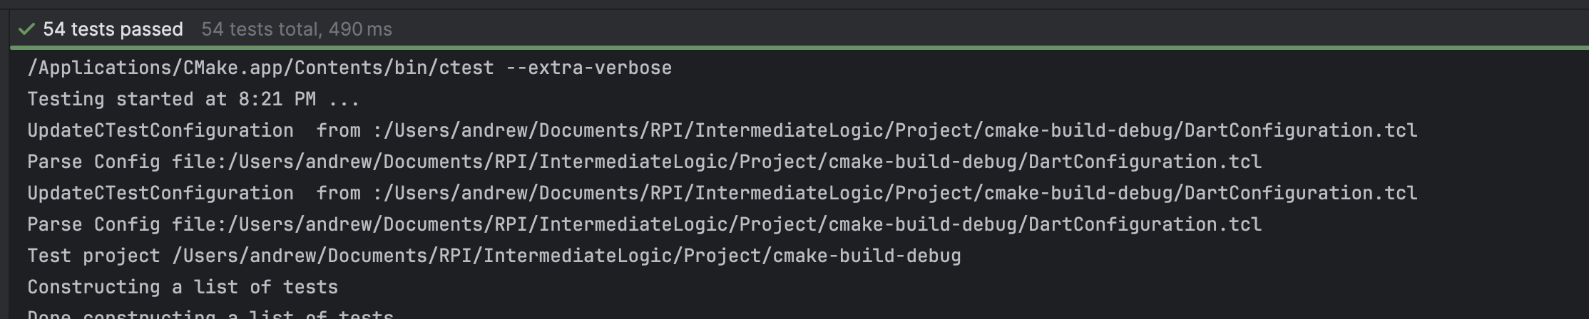
Unit Tests
Notes:
Andrii
We have 54 tests passing across the codebase. They cover the expression classes, the tree node wiring, the serializer output, and then conversion tests that check specific sequent derivations produce the correct truth trees.

Slide 9
Data Format
JSON formatted output for use in willow
No input format; you currently must use the raw code to create the sequent system or the trees
Notes:
Andrii
The output is JSON formatted for the Willow proof tree visualizer. Each node gets an ID, the formula text, references to its children, and decomposition info. There's no input format right now, you have to build the sequent systems directly in C++ code.

Slide 10
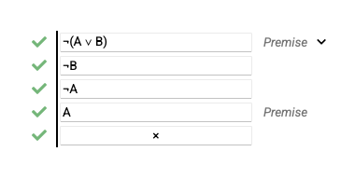
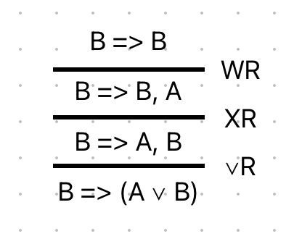
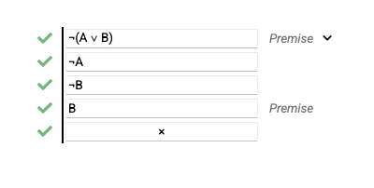
Ex0
Notes:
Andrew
Willow image and sequent system image

Slide 11
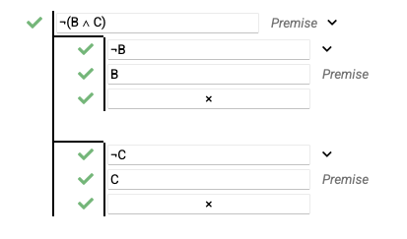
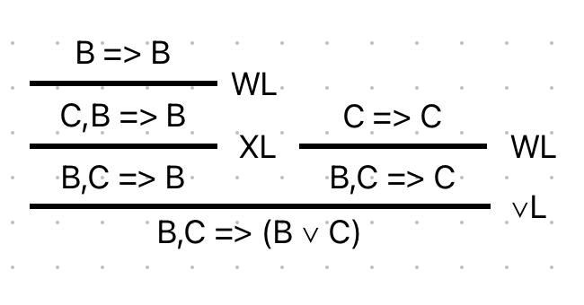
Ex1
Notes:
Andrew
Willow image and sequent system image

Slide 12
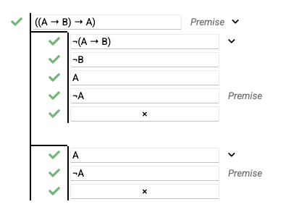
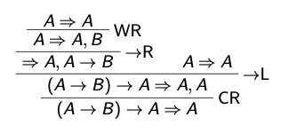
Ex2
*Note: This one had to remove the double A,A after the CR for it to work properly due to the way we are detecting what the node that needs to be created is
Notes:
Andrew
Willow image and sequent system image

Slide 13
Known Bugs / Issues
Cases with duplicates on one side that is checked by the next step (CR into ->L for example) don’t work properly
May not work with cascaded operands; ((A and B) and (C and D)) for example
Notes:
Andrii
We have a couple known issues. Cases with duplicate formulas on one side that need contraction before the next step don't work properly yet. And it can also have trouble with cascaded operations, like when you have nested parentheses grouping A and B together with C and D.

Slide 14
Future Plans / Improvements
Fix the converter so it works with more interesting/complex cases – Known bugs and issues
Implement more robust storage and conversion algorithms
Design and implement data storage for the sequent nodes.
Notes:
Andrew

Slide 15
QUESTIONS?

