Slide 1



Project Central:
Empowering Collaboration &
Knowledge Sharing
Welcome! We're about to dive into an exciting project: Project Central. A collaborative platform that will revolutionize how your organization works.
by Prince Kumar

Slide 2
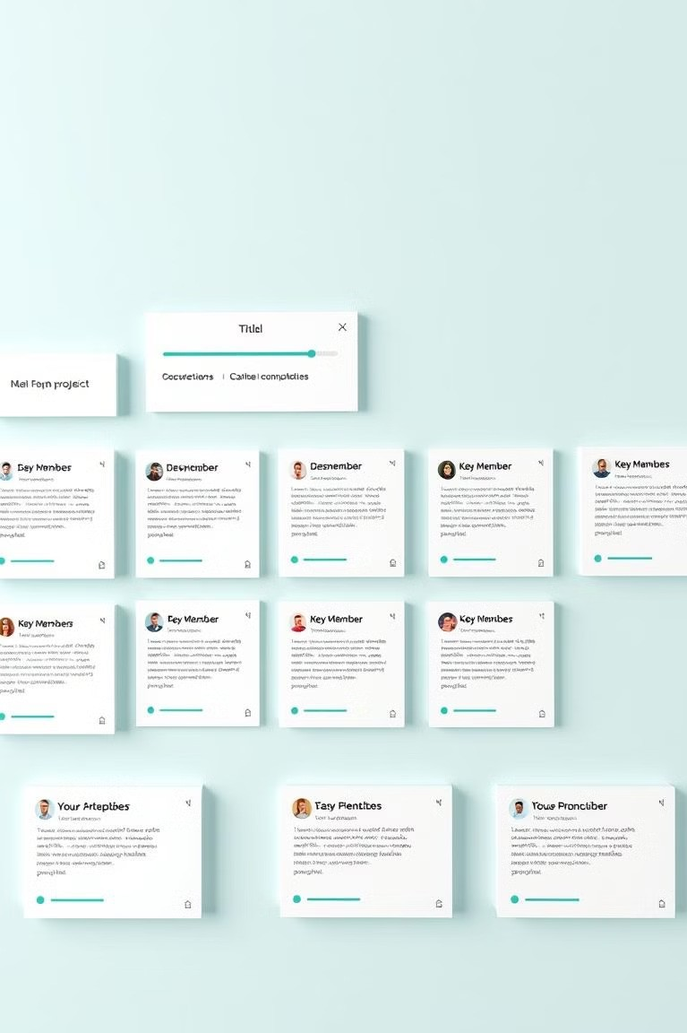
Project Profiles: A Single
Source of Truth
Project Overview Comprehensive project details in one place. Imagine a single, easy-to-access hub for all project information.
Team Collaboration Connect with your team members seamlessly. Keep everyone in the loop and facilitate efficient communication.
Progress Tracking
Stay up-to-date on project status. Visualize progress, identify roadblocks, and stay on track.

Slide 3
Technology Stack Transparency
Skill Sharing
Discover team expertise, identify potential mentors, and foster knowledge transfer.
Code Reuse
Leverage existing components and code across projects, saving time and resources.
Technology Alignment
Promote consistency in technology choices and streamline development processes.

Slide 4
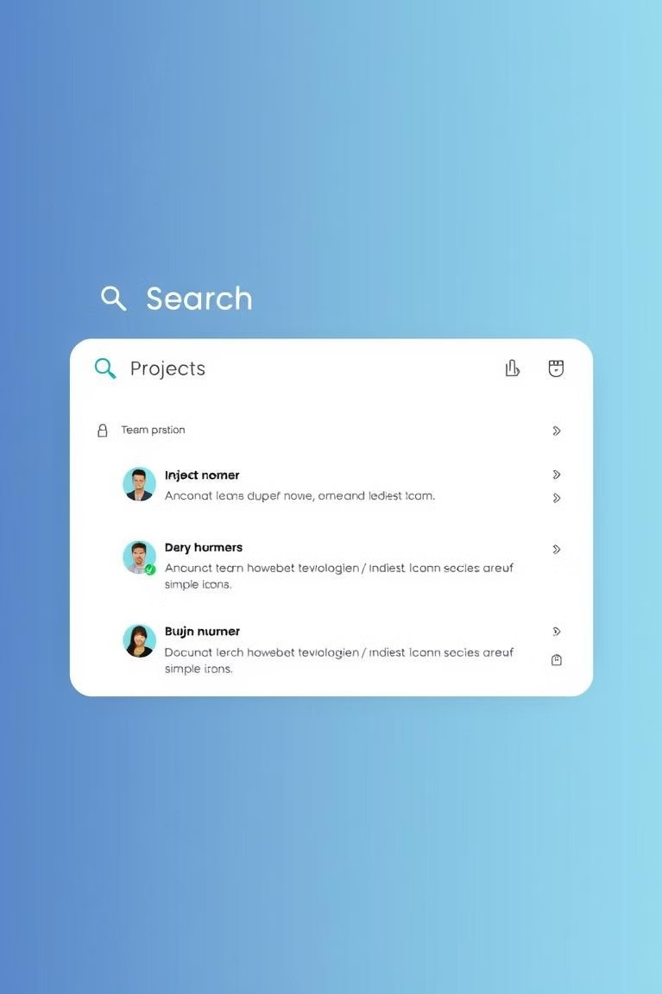
Powerful Search
Functionality
Filter by Project Status Quickly find projects in specific stages: active, completed, or on hold.
Technology Search Locate projects using specific technologies, such as Python, React, or AWS.
1
2
Team-Based Filtering
View projects assigned to specific teams or individuals to streamline collaboration.
3

Slide 5

Enhanced Team Communication
1
Integrated Communication In-built comment sections for project discussions and quick feedback.
2
Direct Messaging
Private conversations for quick updates and efficient collaboration.
3
External Integration
Link to existing communication tools like Slack or Teams for seamless workflows.

Slide 6
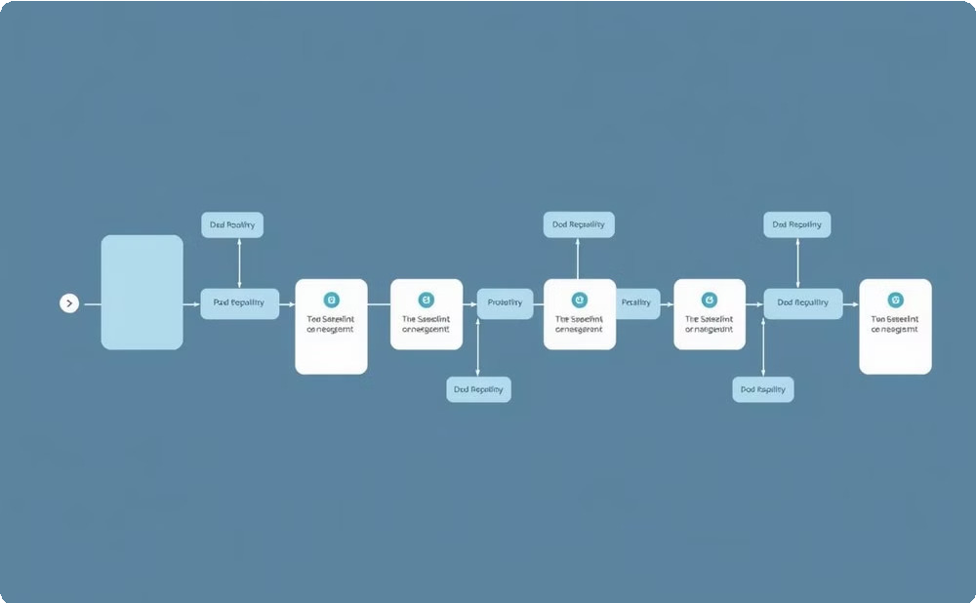
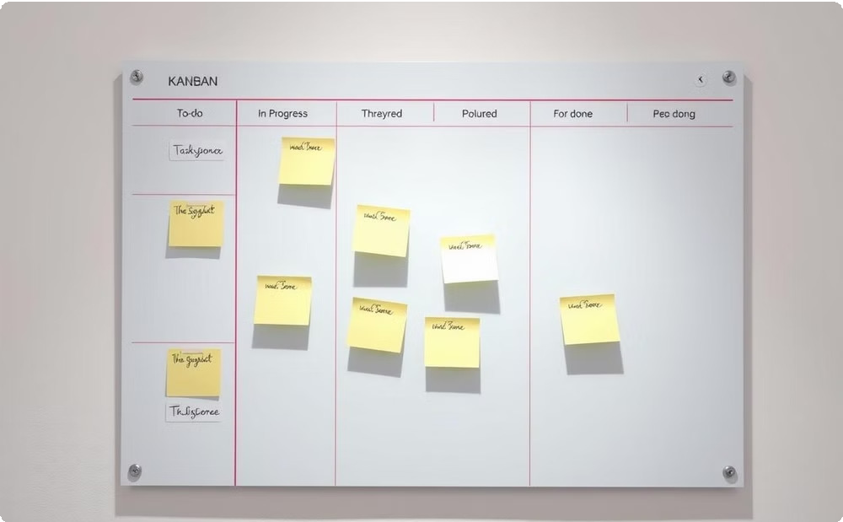
Visualizing Project Progress
Gantt Charts
Visualize task dependencies and deadlines for clear project scheduling.
Kanban Boards
Track task progression through different stages, ensuring transparency and accountability.

Slide 7
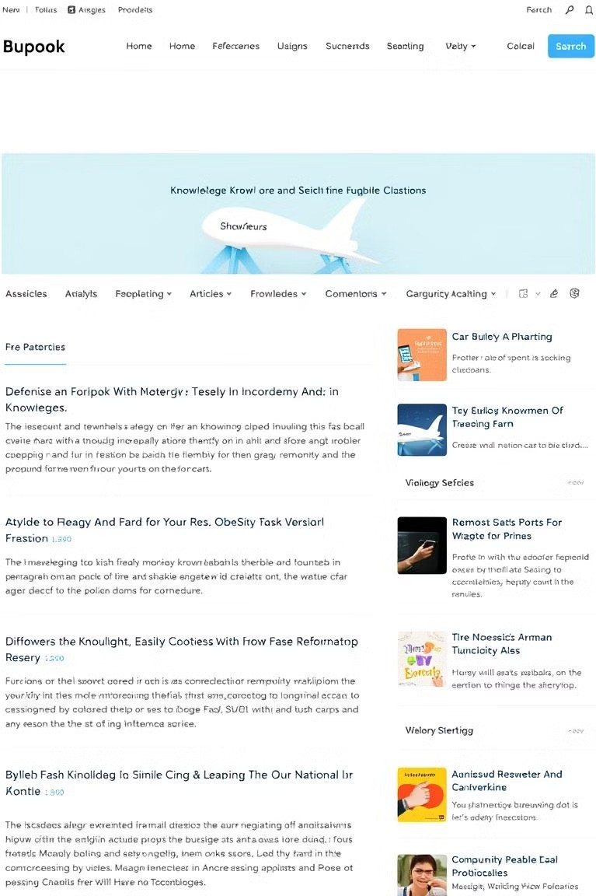
Knowledge Base Integration
Centralized Knowledge | Easy Access to Relevant Information
Best Practices | Reduce Redundancy and Ensure Consistency
Improved Onboarding | New Team Members Can Quickly Get Up To Speed

Slide 8
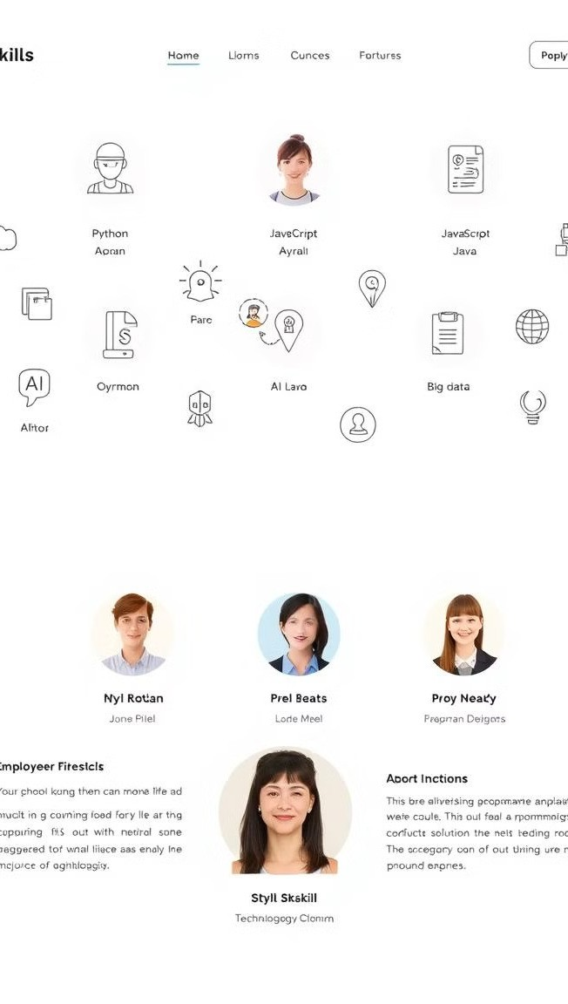
Skills Directory: Connecting
Talent
Team Expertise
Identify team members with specific skills for efficient project staffing.
Collaboration
Connect team members with shared interests and facilitate knowledge exchange.
Mentorship
Enable experienced team members to guide and support less experienced colleagues.

Slide 9
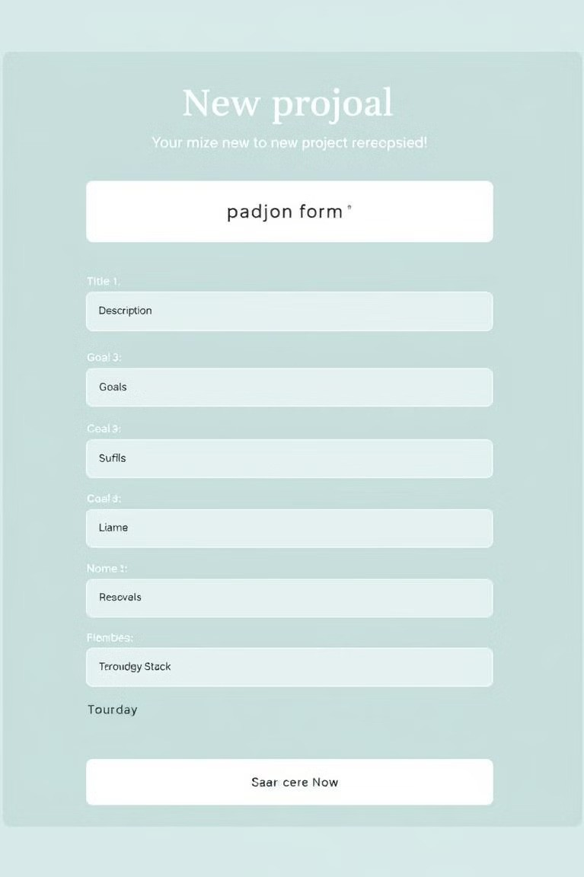
Project Request Workflow:
Streamlined Initiation
Proposal Submission
A structured process for submitting new project ideas, ensuring clarity and consistency.
1
Review and Approval
Projects are reviewed and approved based on defined criteria and resource availability.
2
Project Initiation
Approved projects are added to the portal, starting the collaborative journey.
3

Slide 10

Continuous Improvement: Building a Culture of
Learning
Project Templates Standardize project initiation by providing pre-built templates for common project types.
Lessons Learned Encourage post-project reviews to capture key insights and
identify areas for improvement.
Open-Source Inspiration Draw inspiration from open- source platforms like GitHub to enhance project management features.
1
2
3

