Slide 1
Domain Name System (DNS)
Copyright © The McGraw-Hill Companies, Inc. Permission required for reproduction or display.

Slide 2
19-1 NEED FOR DNS
TCP/IP protocols use the IP address, which uniquely identifies the connection of a host to the Internet.
People prefer to use names instead of numeric addresses.
Need a system that can map a name to an address or an address to a name.

Slide 3
Figure 19.1 Purpose of DNS
When the Internet was small, mapping was done using a host file.
The host file had only two columns: name and address.
Every host could store the host file on its disk and update it periodically from a master host file.
Today, it is impossible to have one single host file.
The host file would be too large to store in every host.
It would be impossible to update all the host files every time there is a change.

Slide 4
Figure 19.1 Purpose of DNS
One solution :
To store the entire host file in a single computer and allow access to this centralized information to every computer that needs mapping.
This would create a huge amount of traffic on the Internet.
Another solution, (used today) :
To divide this huge amount of information into smaller parts and store each part on a different computer.
Host that needs mapping contact the closest computer holding the needed information.

Slide 5
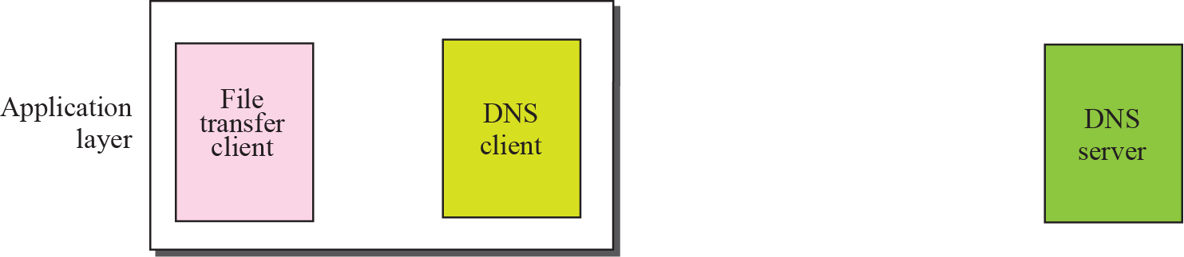
Figure 19.1 Purpose of DNS

Slide 6
Purpose of accessing Internet is to make a connection between file transfer client and server,
But before this can happen, another connection needs to be made between the DNS client and DNS server.
We need two connections;
the first is for mapping the name to an IP address;
the second is for transferring files.

Slide 7
19-2 NAME SPACE
Names assigned to machines must be carefully selected from a name space.
The names must be unique because the addresses are unique.
A name space that maps each address to a unique name can be organized in two ways: flat or hierarchical.
namespace refers to the hierarchical structure used to name and organize all the domain names on the internet.
DNS namespace is like a tree, with each node representing a part of the domain name

Slide 8
Flat Name Space
In a flat name space, a name is assigned to an address.
A name in this space is a sequence of characters without structure.
Names may or may not have a common section; if they do, it has no meaning.
Disadvantage :
It cannot be used in a large system such as the Internet
it must be centrally controlled to avoid ambiguity and duplication.

Slide 9
Hierarchical Name Space
In a hierarchical name space, each name is made of several parts.
The first part can define the nature of the organization,
the second part can define the name of an organization,
the third part can define departments in the organization, and so on.
A central authority can assign the part of the name that defines the nature of the organization and the name of the organization.
rest of the name can be given to the organization itself.

Slide 10
Domain Name Space
The domain name space refers to the hierarchical system used to organize and manage domain names on the Internet.
It is a structured system that assigns unique names to websites.
In this design names are defined in an inverted-tree structure with root at the top.

Slide 11
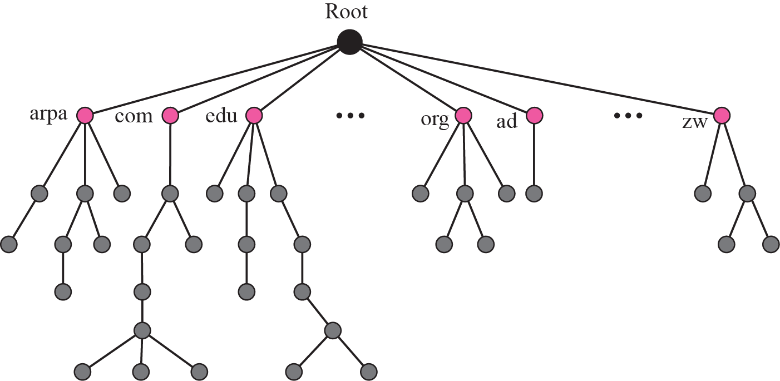
Figure 19.2 Domain name space

Slide 12
Domain Name
Each node in the tree has a domain name.
A full domain name is a sequence of labels separated by dots (.).
The domain names are always read from the node up to the root.

Slide 13
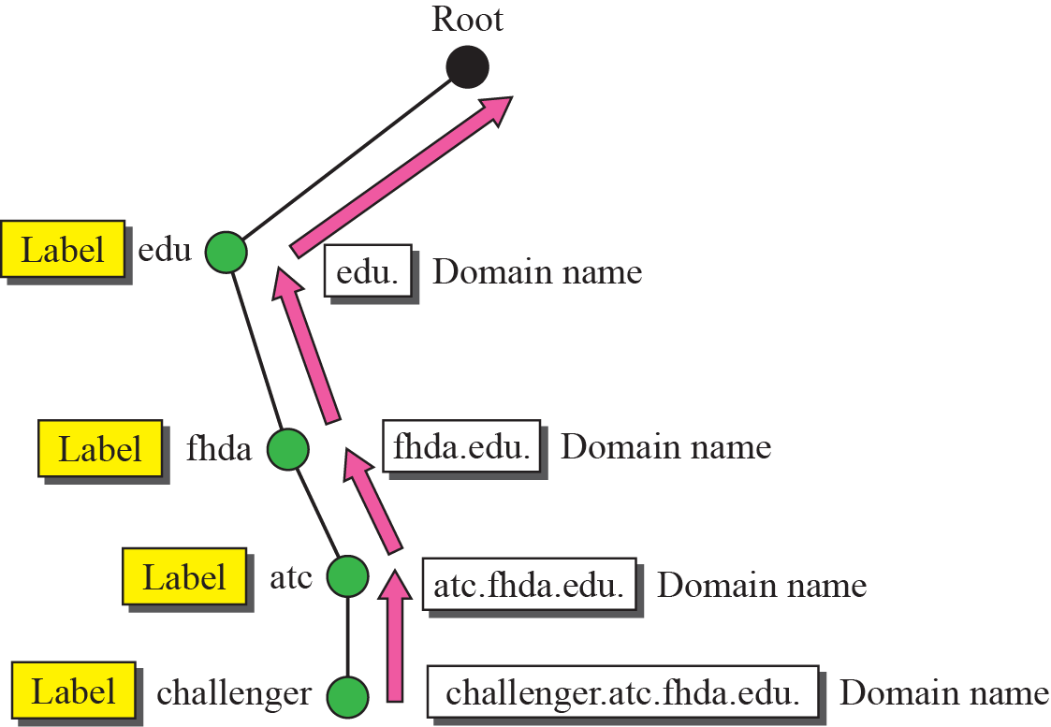
Figure 19.3 Domain names and labels
Figure 19.3 shows some domain names.

Slide 14

Fully Qualified Domain Name (FQDN)
If a label is terminated by a null string, it is called a fully qualified domain name (FQDN).
An FQDN is a domain name that contains the full name of a host.
It contains all labels, from the most specific to the most general, that uniquely define the name of the host.
A DNS server can only match an FQDN to an address.

Slide 15
Partially Qualified Domain Name (PQDN)
If a label is not terminated by a null string, it is called a partially qualified domain name (PQDN).
Here resolver can supply the missing part, called the suffix, to create an FQDN.

Slide 16
Distribution of Name Space
The information contained in the domain name space must be stored.
it is very inefficient and also not reliable to have just one computer store such a huge amount of information.
It is inefficient because responding to requests from all over the world places a heavy load on the system.

Slide 17
Figure 19.6 Hierarchy of name servers
Hierarchy of Name Servers
Solution is to distribute information among many computers called DNS servers.
Divide the whole space into many domains based on the first level.

Slide 18
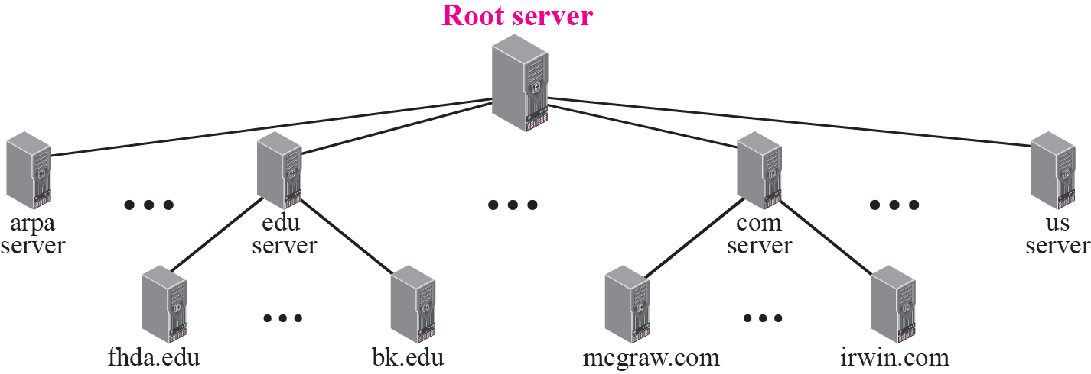
Figure 19.6 Hierarchy of name servers
In other words, we have a hierarchy of servers.

Slide 19
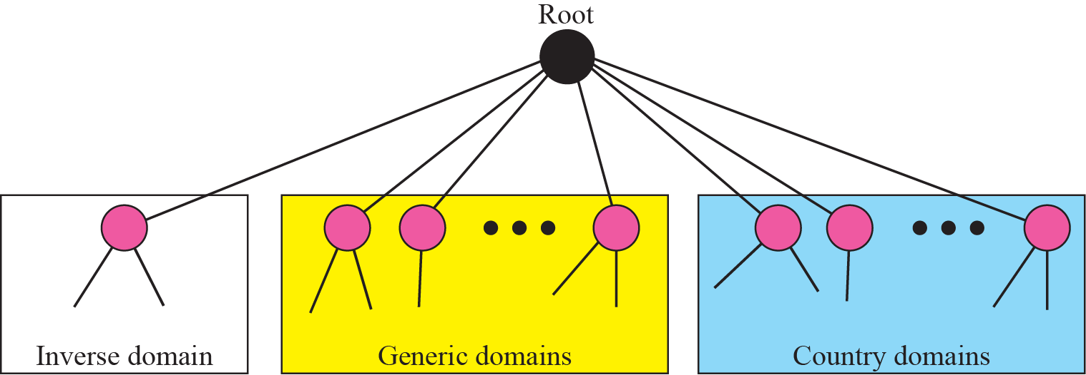
19-3 DNS IN THE INTERNET
In the Internet, the domain name space (tree) is divided into three different sections: generic domains, country domains, and the inverse domain.

Slide 20
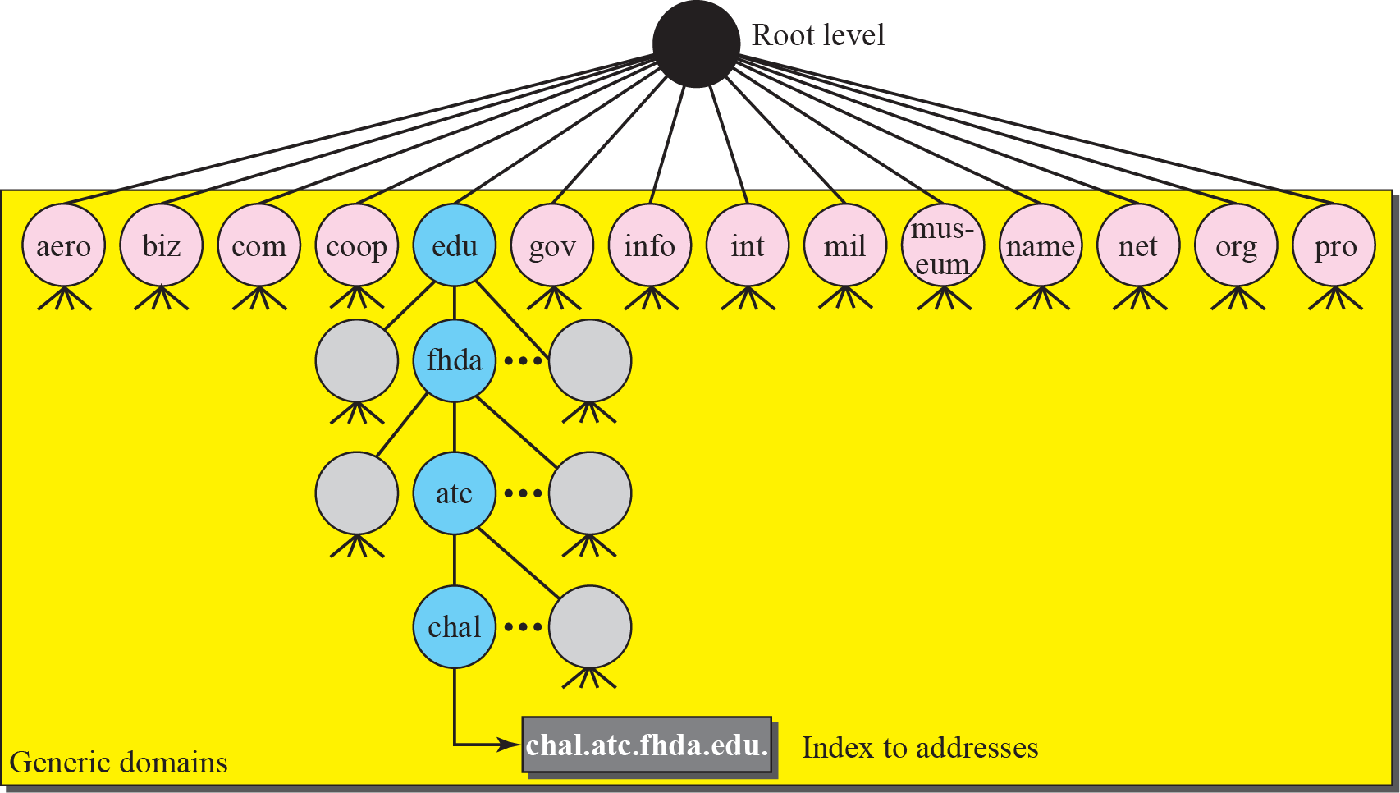
Figure 19.9 Generic domains
Generic Domains
Generic domains define registered hosts according to their generic behavior.

Slide 21
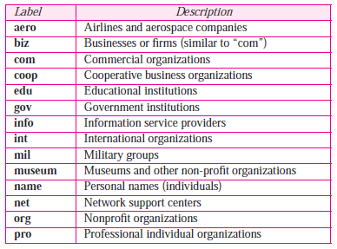
Figure 19.9 Generic domains
Generic Domains
Table 19.1 Generic domain labels

Slide 22
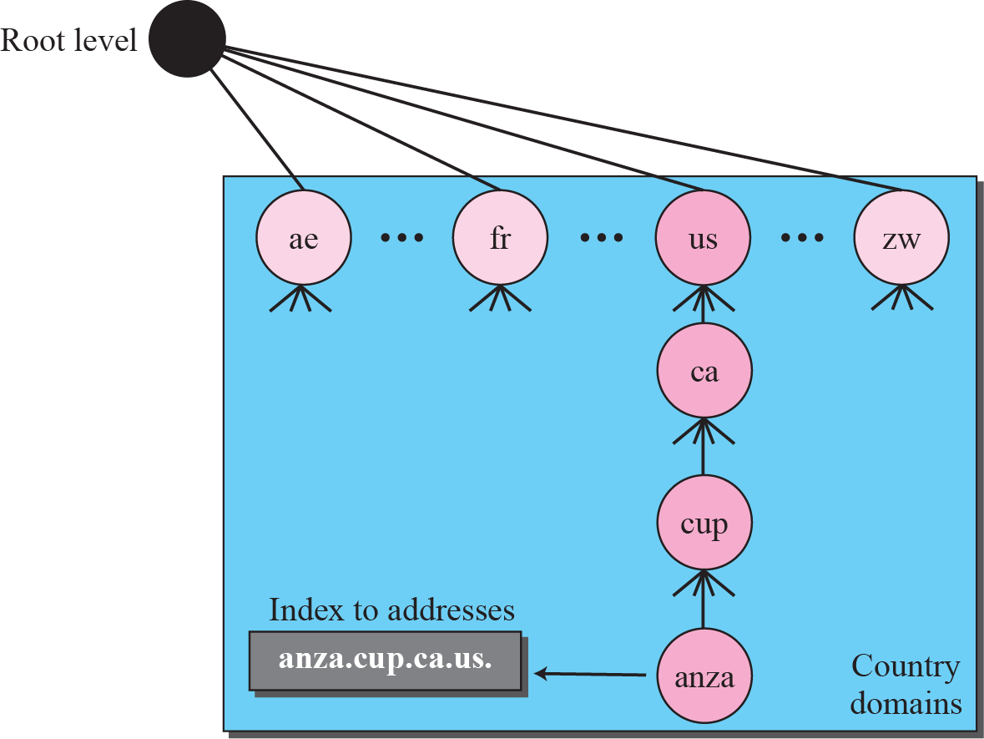
Figure 19.10 Country domains
Country Domains
Country domains uses two-character country abbreviations (us for United States).
Second labels can be organizational, or can be more specific, national designations.
Example: United States uses state abbreviations as a sub-division of us (e.g., ca.us.).
.

Slide 23
Inverse Domain
Used to map an address to a name.
This happen, when a server has received a request from a client to do a task.
The server has a file that contains a list of authorized clients, only the IP address of the client is listed.
The server asks its resolver to send a query to the DNS server to map an address to a name to determine if the client is on the authorized list.
This type of query is called an inverse or pointer (PTR) query.
To handle a pointer query, inverse domain is added to the domain name space with the first-level node called arpa.
second level is also one single node named in-addr (for inverse address).
The rest of the domain defines IP addresses.

Slide 24
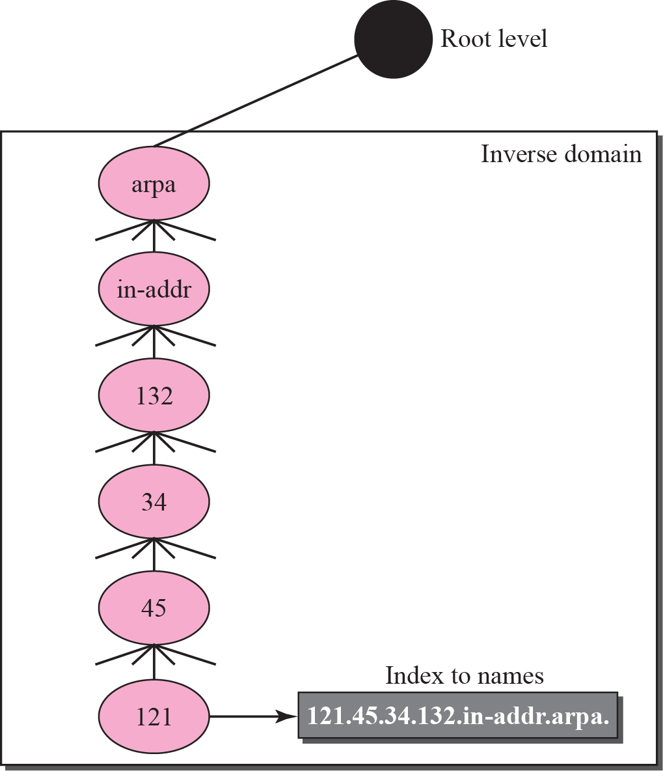
Figure 19.11 Inverse domain
Inverse Domain
The servers that handle the inverse domain are also hierarchical.
This means the netid part of the address should be at a higher level than the subnetid part, and the subnetid part higher than the hostid part.
IP address such as 132.34.45.121 is read as 121.45.34.132.in-addr. arpa.

Slide 25
Registrar
How are the new domains added to DNS?
This is done through a registrar, a commercial entity accredited by ICANN.
A registrar first verifies that the requested domain name is unique and then enters it into the DNS database.
A fee is charged.

Slide 26
19-4 RESOLUTION
Mapping a name to an address or an address to a name is called name-address resolution.

Slide 27
Resolver
DNS is designed as a client-server application.
A host that needs to map an address to a name or a name to an address calls a DNS client called a resolver.
The resolver accesses the closest DNS server with a mapping request.
If the server has the information, it satisfies the resolver; otherwise, it either refers the resolver to other servers or asks other servers to provide the information.
After the resolver receives the mapping, it interprets the response to see if it is a real resolution or an error, and finally delivers the result to the process that requested it.

Slide 28
Mapping Names to Addresses
Resolver gives a domain name to the server and asks for corresponding address.
In this case, server checks the generic domains or country domains to find the mapping.
The query is sent by the resolver to the local DNS server for resolution.
If the local server cannot resolve the query, it either refers the resolver to other servers or asks other servers directly.

Slide 29
Mapping Addresses to Names
A client can send an IP address to a server to be mapped to a domain name.
this is called a PTR query.
To answer queries of this kind, DNS uses the inverse domain.
In the request, the IP address is reversed and two labels, in-addr and arpa, are appended to create a domain acceptable by the inverse domain section.
If the resolver receives the IP address 132.34.45.121, resolver first inverts the address and then adds the two labels before sending.
The domain name sent is “121.45.34.132.in-addr.arpa.”, which is received by the local DNS and resolved.

Slide 30
Recursive Resolution
The client (resolver) can ask for a recursive answer from a name server.
This means that the resolver expects the server to supply the final answer.
If the server is the authority for the domain name, it checks its database and responds.
If the server is not the authority, it sends the request to another server (the parent usually) and waits for the response.
If the parent is the authority, it responds; otherwise, it sends the query to yet another server.
When the query is finally resolved, the response travels back until it finally reaches the requesting client.

Slide 31
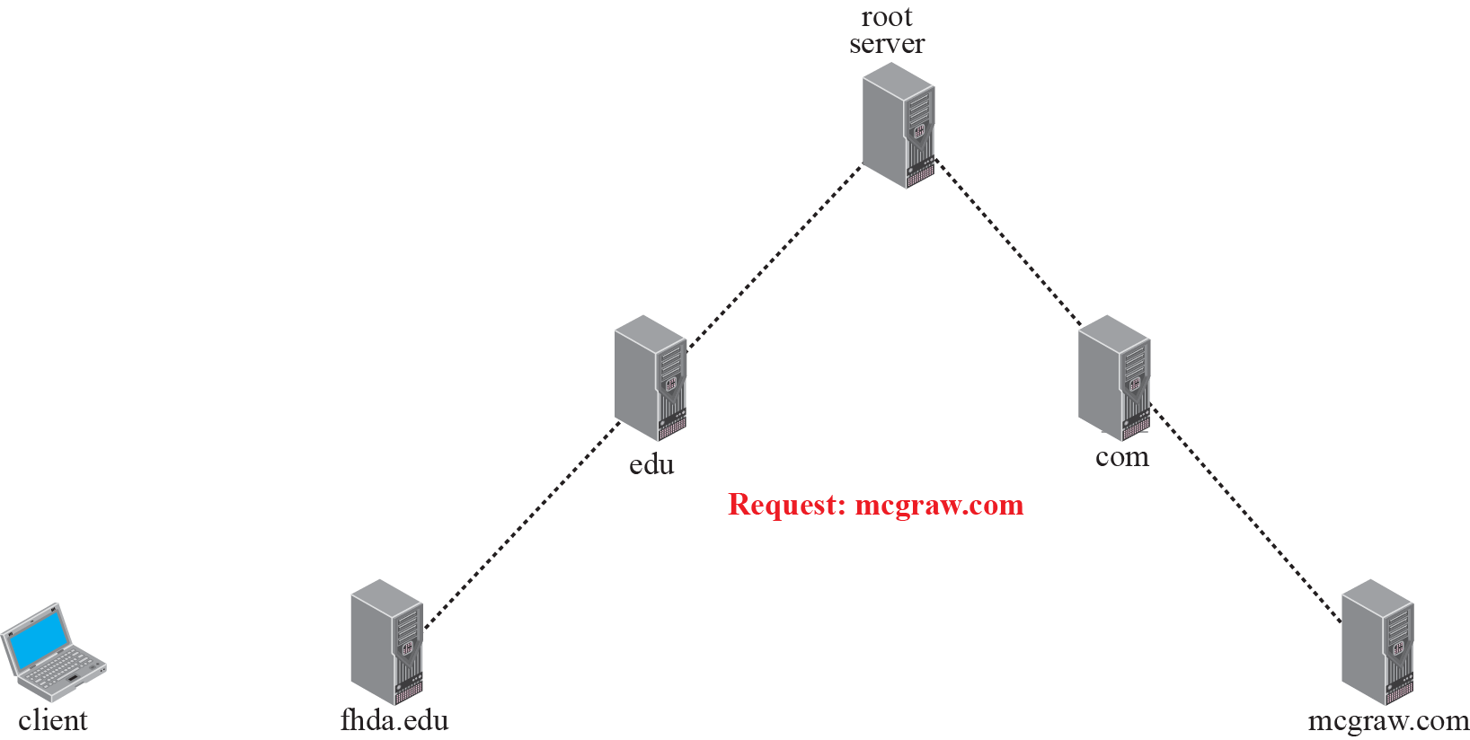
Figure 19.12 Recursive resolution

Slide 32
Iterative Resolution
If the server is an authority for the name, it sends the answer.
If it is not, it returns (to the client) the IP address of the server that it thinks can resolve the query.
The client is responsible for repeating the query to this second server.
If the newly addressed server can resolve the problem, it answers the query with the IP address; otherwise, it returns the IP address of a new server to the client.
Now the client must repeat the query to the third server. This process is called iterative because the client repeats the same query to multiple servers.
In Figure 19.13 client queries 5 servers before it gets an answer from mcgraw.com server.

Slide 33
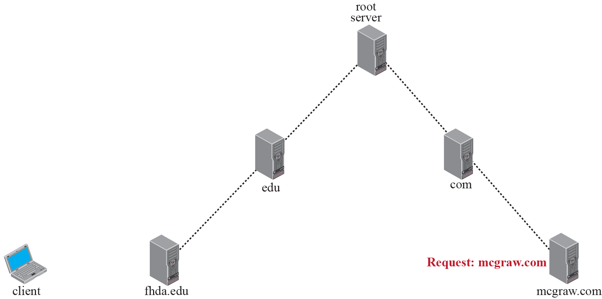
Figure 19.13 Iterative resolution

Slide 34
Caching
Each time a server receives a query for a name that is not in its domain, it needs to search its database for a server IP address.
Reduction of this search time would increase efficiency.
DNS handles this with a mechanism called caching.
When a server asks for a mapping from another server and receives the response, it stores this information in its cache memory before sending it to the client.
If the same or another client asks for the same mapping, it can check its cache memory and resolve the problem.
However, to inform the client that the response is coming from the cache memory and not from an authoritative source, the server marks the response as unauthoritative.

Slide 35
Caching (contd)
Caching speeds up resolution, but it can also be problematic.
If a server caches a mapping for a long time, it may send an outdated mapping to client.
To counter this, two techniques are used.
First, authoritative server always adds information to the mapping called time-to-live (TTL).
It defines the time in seconds that the receiving server can cache the information.
After that time, mapping is invalid and any query must be sent again to authoritative server.
Second, DNS requires that each server keep a TTL counter for each mapping it caches.
Cache memory must be searched periodically and those mappings with an expired TTL must be purged.

