Slide 1
Greenhouse-Gas-Emission-Aware Optimization of Large-Language-Model Training (Simulation and Modeling II)

Slide 2
Motivation
LLM training involves thousands of GPU cycles over a period of couple of months.
CO2 consumption from LLM is immense, resulting in high amount of CO2 emission.
The change of CO2 intensity depends on renewable energy used during training in an area.
Proper coordination between training times and energy grid usage reduces CO2 emission.
Simulation study quantify trade-off between reduced CO2 emissions and training duration.
TODO: Were only simulating the pretraining phase (and show diagram that it is the most time/energy consuming phase)
Citations:
KIMI K2: OPEN AGENTIC INTELLIGENCE, 2023
DeepSeek-V3 Technical Report, 2026

Slide 3
Project Objectives
Obligatory:
Carbon Intensity and Temporal Trade-offs.
Impact Assessment on SOTA Architectures.
Wishful:
Spatiotemporal Optimization.
Geospatial Grid Analysis.
Optional:
Computational Granularity and Resumption Logic

Slide 4
Show Electricity Map

Slide 5
Parameters
Table with most important parameters that are necessary for the activity diagram

Slide 6
Optimization Problem
Primary key performance indicators (KPIs):
<Formula>
Composite score used for ranking policies:
<Formula>
Optional constraint for practical recommendations:
<Formula>

Slide 7
Hysteresis
Short explanation of the principle

Slide 8
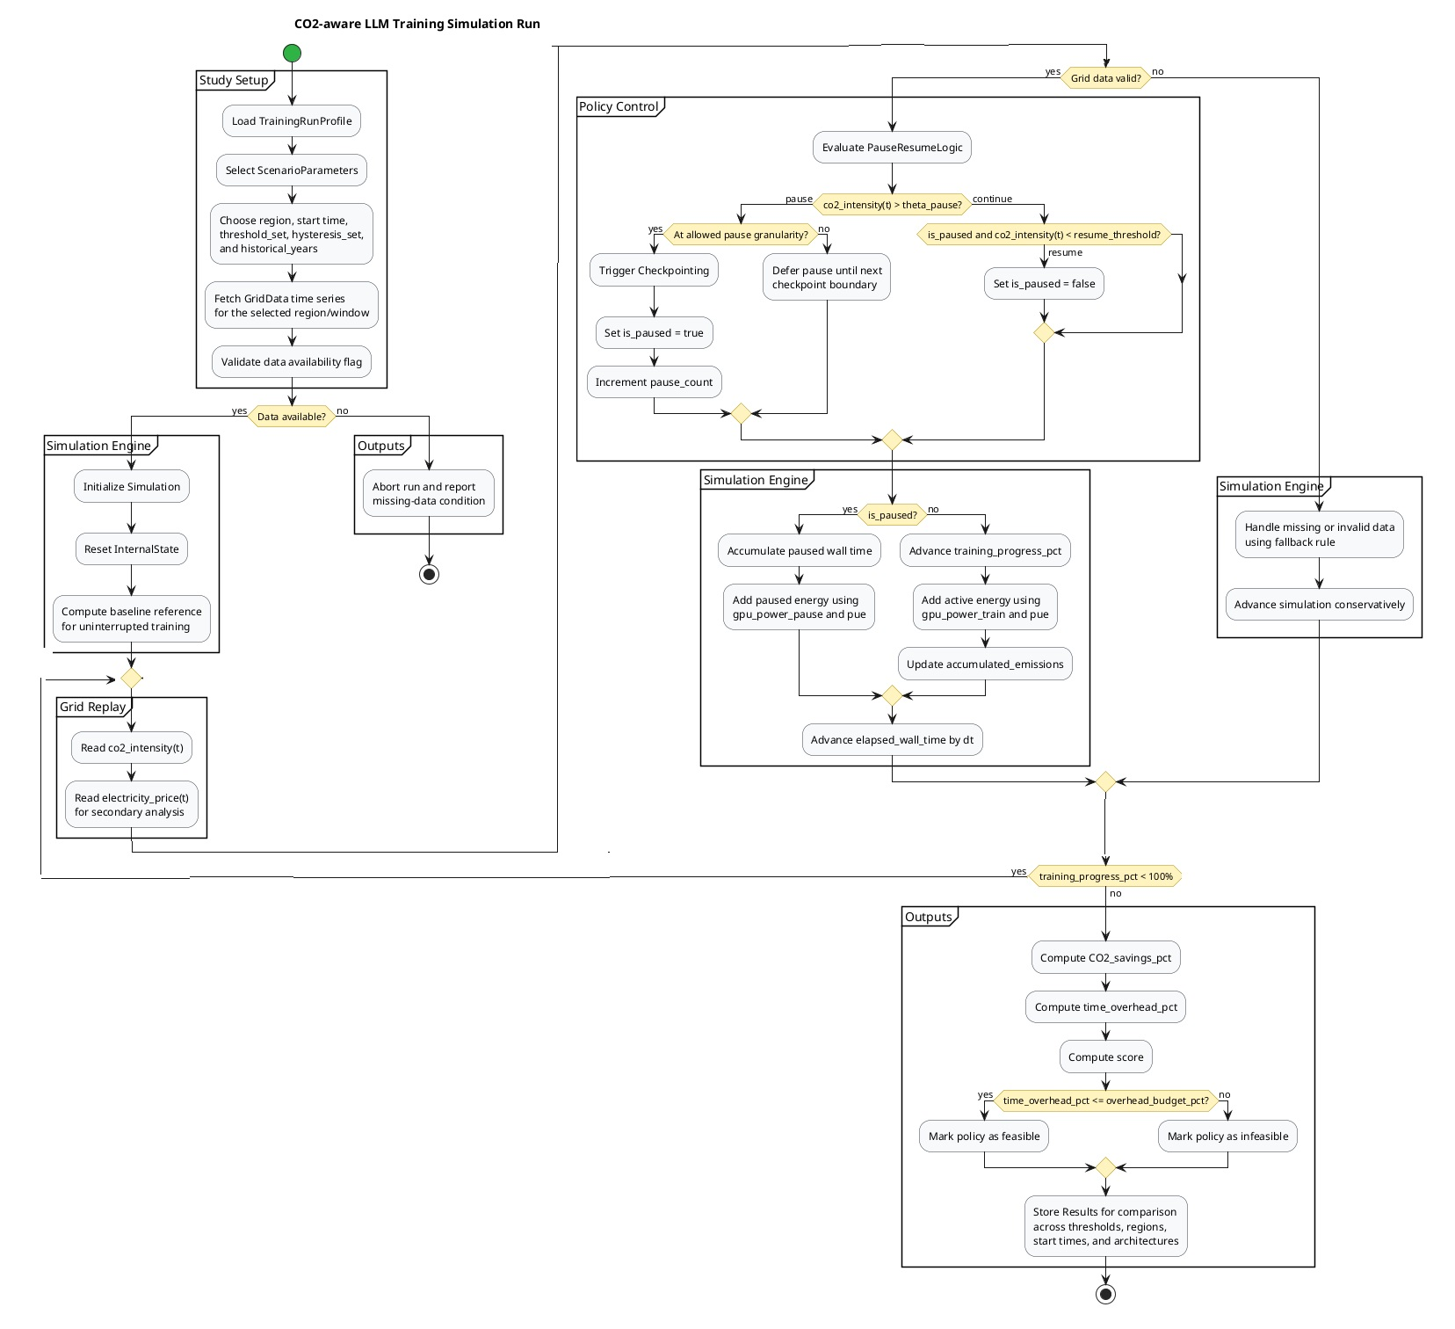
Project Design
TODO: Update with new svg

Slide 9
Scenarios (67)
Add booleans csv

Slide 10
Result Evaluation
Verification
Measure the average and 95th percentile batch delay, and total CO2 saving.
Vary training duration, energy consumption, starting time, region, season, and CO2 threshold.
Validation
Validate against model training using the historic data.
Using 'Electricity Maps' API for CO2 intensity data.
TODO presentation: List all verification and verification methods and explain for each of them just one

Slide 11
GANT CHART

Slide 12
Way Forward
Questions?
Thank you

