Slide 1
Greenhouse-Gas-Emission-Aware Optimization of
Large-Language-Model Training
(Simulation and Modeling II)

Slide 2
Background
LLM training involves thousands of GPU cycles over a period of couple of months.
CO2 consumption from LLM is immense, resulting in high amount of CO2 emission.
The change of CO2 intensity depends on renewable energy used during training in an area.
Proper coordination between training times and energy grid usage reduces CO2 emission.
Simulation study quantify trade-off between reduced CO2 emissions and training duration.
Citations:
KIMI K2: OPEN AGENTIC INTELLIGENCE, 2023
DeepSeek-V3 Technical Report, 2026

Slide 3
Project Objectives
Obligatory:
Carbon Intensity and Temporal Trade-offs.
Impact Assessment on SOTA Architectures.
Wishful:
Spatiotemporal Optimization.
Geospatial Grid Analysis.
Optional:
Computational Granularity and Resumption Logic

Slide 4
Optimization Problem
Primary key performance indicators (KPIs):
  <Formula>
Composite score used for ranking policies:
<Formula>
Optional constraint for practical recommendations:
<Formula>

Slide 5
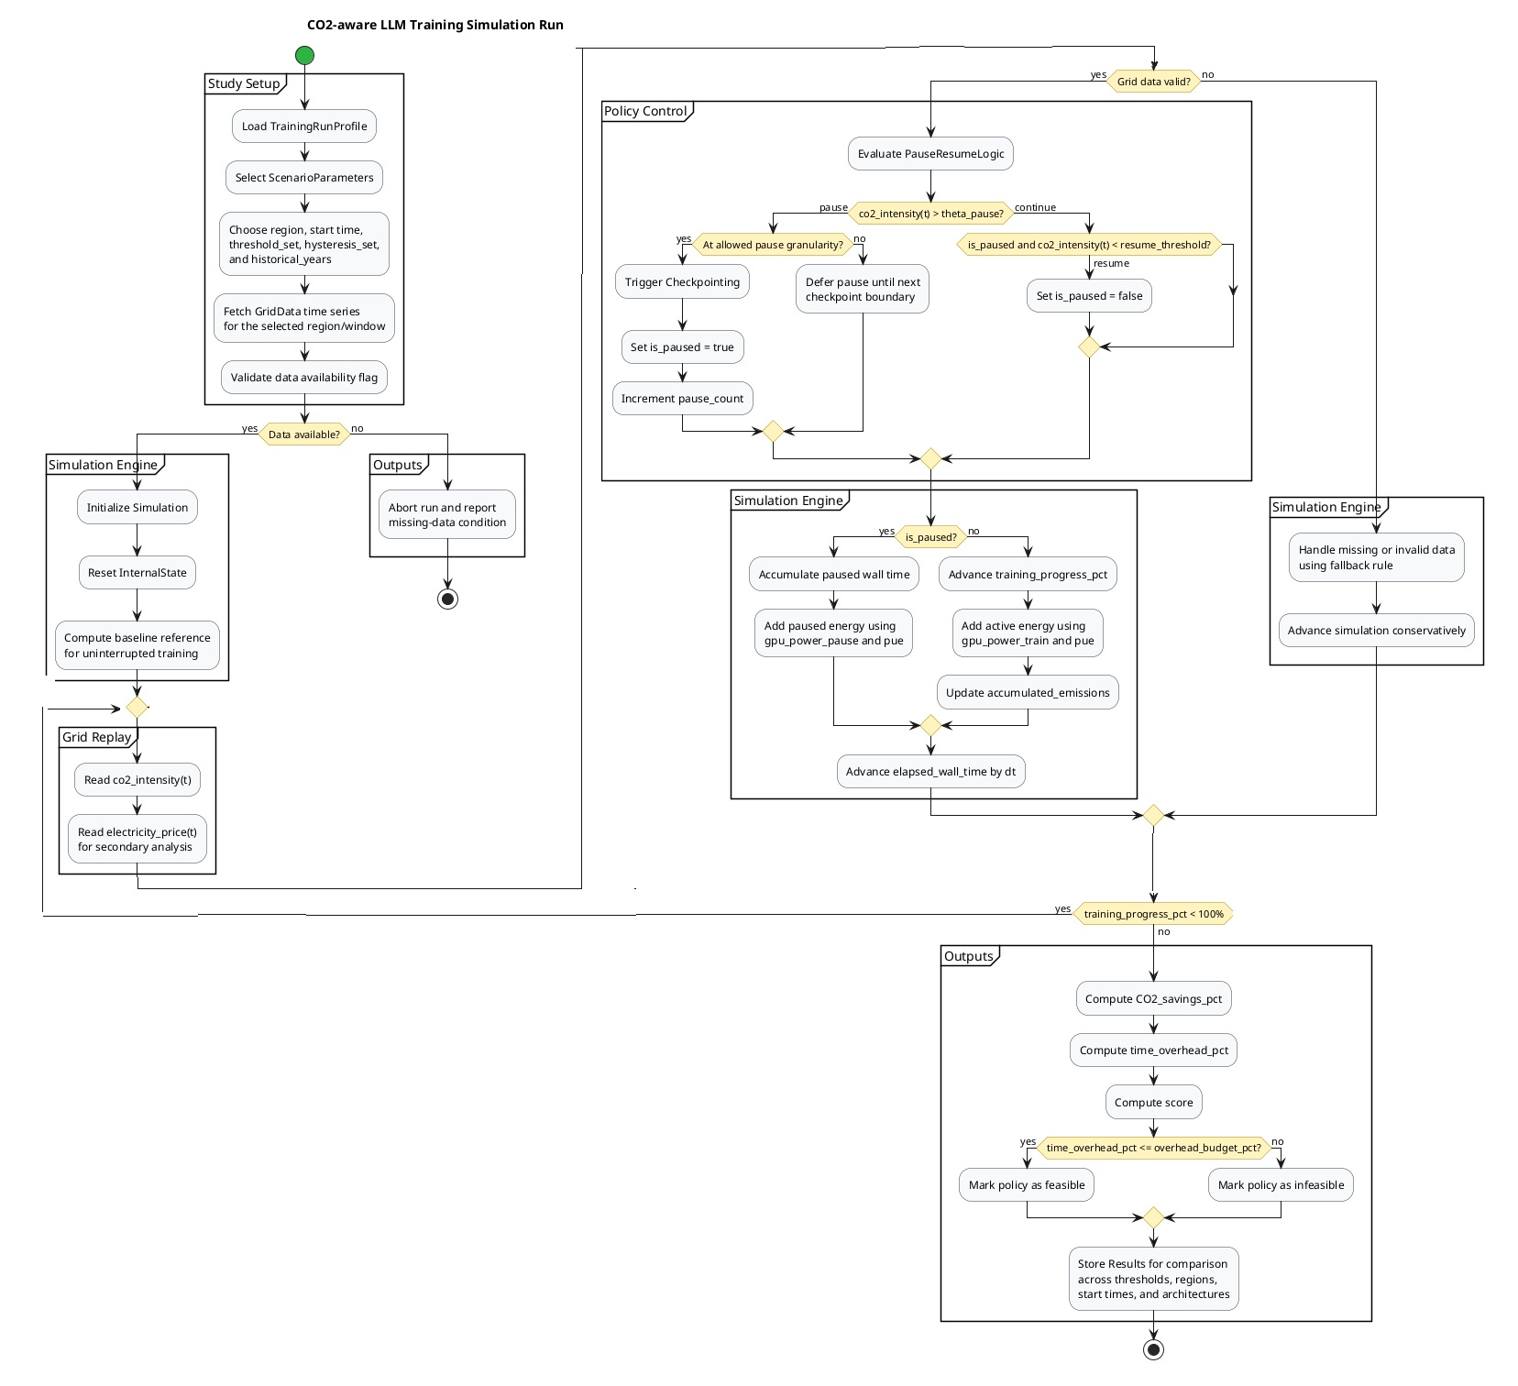
Project Design

Slide 6
Result Evaluation
Verification
Measure the average and 95th percentile batch delay, and total CO2 saving.
Vary training duration, energy consumption, starting time, region, season, and CO2 threshold.
Validation
Validate against model training using the historic data.
Using 'Electricity Maps' API for CO2 intensity data.

Slide 7
Way Forward
Questions?
Thank you

