Slide 1
WOXSEN UNIVERSITY • SCHOOL OF TECHNOLOGY
DBMS COURSE PROJECT
Student & College
Management System
FINAL PBL PACKAGE
Vardan Desai
25WU0104029
AIML Rhinos
Semester III
Academic Year 2026–27
Relational database application for admissions, academics, attendance, examinations, grades and fee records
Requirements • Conceptual Design • Database Logic
Student & College Management System • Vardan Desai • 25WU0104029 • AIML Rhinos
1

Slide 2
01 — THE PROBLEM
Fragmented records create avoidable work
The project starts from one simple question: can common college records be managed from one consistent data model?
Duplication
No shared source
Delayed reporting
Unenforced rules
Student, course and fee facts are easy to repeat when maintained in separate records.
Academic and financial information needs joins across modules to answer combined questions.
Attendance, results and fee status should come from the same underlying records.
Duplicate registration, full sections and fee overpayment need database-side checks.
Student & College Management System • Vardan Desai • 25WU0104029 • AIML Rhinos
2

Slide 3
02 — SCOPE
Scope from admission to fee settlement
A compact academic management system rather than a full college ERP.
In scope
Out of scope
Student + guardian records
Departments and programmes
Courses + faculty + sections
Registration + attendance
Examinations + grades
Fee bills + payments
Reports and login
Hostel management
Library systems
Payroll and HR
Alumni tracking
Online exam proctoring
Institution-wide deployment
Advanced notification services
Student & College Management System • Vardan Desai • 25WU0104029 • AIML Rhinos
3

Slide 4
03 — OBJECTIVES
Objectives across design and implementation
The final system is evaluated primarily on the DBMS concepts visible in the implementation.
01 Normalize to 3NF
02 Enforce integrity
03 Support transactions
Separate master and transaction data; remove repeated facts.
PK, FK, UNIQUE, NOT NULL, CHECK and triggers.
Admission, registration, attendance, exams and fees.
04 Build reports
05 Connect application
Use joins, aggregates and views for analysis.
React frontend → Flask API → MySQL database.
Student & College Management System • Vardan Desai • 25WU0104029 • AIML Rhinos
4

Slide 5
04 — FUNCTIONAL REQUIREMENTS
What the final prototype must do
Each requirement maps directly to a screen, route or database object.
FR1 Student admission
FR2 Academic setup
Student + guardian via procedure
Department / course / section master data
FR3 Registration
FR4 Attendance
Capacity + duplicate checks
Daily status + shortage analysis
FR5 Examination
FR6 Fees
Marks + automatic grade
Bills + payment + balance
FR7 Reports
FR8 Authentication
Eight SQL views
Login + protected routes
Student & College Management System • Vardan Desai • 25WU0104029 • AIML Rhinos
5

Slide 6
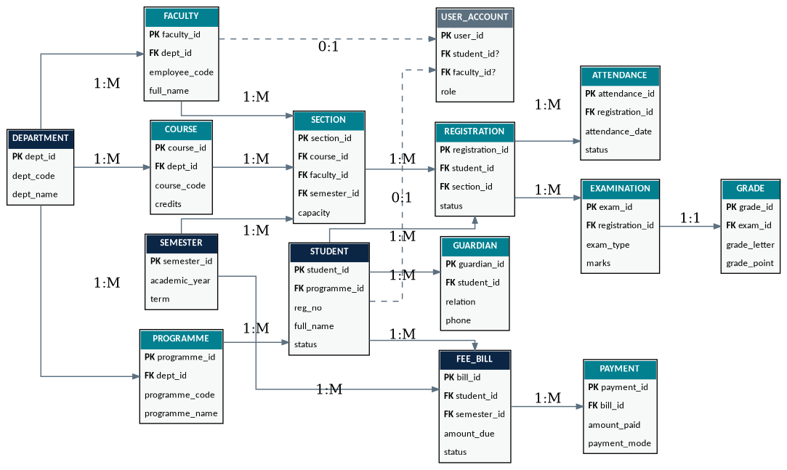
05 — CONCEPTUAL DESIGN
Final ER model
The implemented database keeps the academic relationships explicit; user_account is added for authentication.
Student & College Management System • Vardan Desai • 25WU0104029 • AIML Rhinos
6

Slide 7
06 — RELATIONAL MODEL
15 tables: 14 domain tables + user_account
Primary keys identify rows; foreign keys carry the relationships.
TABLE
PK
FOREIGN KEYS
department
dept_id
—
programme
programme_id
dept_id
faculty
faculty_id
dept_id
course
course_id
dept_id
semester
semester_id
—
section
section_id
course_id, faculty_id, semester_id
student
student_id
programme_id
guardian
guardian_id
student_id
registration
registration_id
student_id, section_id
attendance
attendance_id
registration_id
examination
exam_id
registration_id
grade
grade_id
exam_id
fee_bill
bill_id
student_id, semester_id
payment
payment_id
bill_id
user_account
user_id
student_id?, faculty_id?
Student & College Management System • Vardan Desai • 25WU0104029 • AIML Rhinos
7

Slide 8
07 — BUSINESS RULES
Rules are checked where the data is written
Database triggers are used for row-dependent rules that simple form validation cannot guarantee.
REGISTRATION
Section capacity
Reject when seats are full
REGISTRATION
Duplicate course
Reject same course twice in one semester
ATTENDANCE
Calendar rules
Reject future or out-of-semester dates
EXAMINATION
Grade mapping
Calculate A+ to F and grade points
PAYMENT
Overpayment
Reject payment above remaining balance
PAYMENT
Bill status
Update Unpaid / Partially Paid / Paid
Student & College Management System • Vardan Desai • 25WU0104029 • AIML Rhinos
8

Slide 9
08 — NEXT MILESTONE
From conceptual design to a runnable database
The final implementation moves the model into MySQL and connects it to the React + Flask application.
1 Build
2 Connect
3 Validate
Create schema, seed data, triggers, procedures and views.
Expose CRUD and report operations through Flask.
Run positive and negative tests against business rules.
Student & College Management System • Vardan Desai • 25WU0104029 • AIML Rhinos
9

Slide 10
REVIEW 1 → REVIEW 2
Review 1 closes the conceptual design stage
The next presentation covers implementation, normalization and database objects.
Approved
Mapped
Next
Problem, scope, requirements and ER model.
Relations, keys, constraints and SQL plan.
MySQL build + reports + working application.
Student & College Management System • Review 1
Student & College Management System • Vardan Desai • 25WU0104029 • AIML Rhinos
10

