Slide 1
WOXSEN UNIVERSITY • SCHOOL OF TECHNOLOGY
DBMS COURSE PROJECT · REVIEW 2
Logical design, normalization
and database implementation
CURRENT STACK
React + Vite
Python + Flask
MySQL 8.0+
Connector/Python
bcrypt + PyJWT
Vardan Desai • 25WU0104029 • AIML Rhinos
Student & College Management System • Vardan Desai • 25WU0104029 • AIML Rhinos
1

Slide 2
01 — IMPLEMENTATION MILESTONE
From the ER model to 15 MySQL tables
The relational design is now implemented using MySQL 8.0+ and InnoDB.
Relational mapping
Integrity layer
Database objects
14 domain entities become base relations. user_account is added for login identity.
PK / FK, UNIQUE, NOT NULL and CHECK constraints protect the stored data.
Triggers, stored procedures and views extend the basic DDL.
Student & College Management System • Vardan Desai • 25WU0104029 • AIML Rhinos
2

Slide 3
02 — NORMALIZATION
Why the schema stops at Third Normal Form
The goal is to keep each fact in one logical place and make updates predictable.
1NF
2NF
3NF
Atomic attributes
Full dependency
No transitive dependency
No repeating group stored inside a row
Transaction attributes belong to their row key
Department / programme / course facts are separated
Student & College Management System • Vardan Desai • 25WU0104029 • AIML Rhinos
3

Slide 4
03 — DATABASE BUILD
Objects that make the DBMS concepts visible
The implementation separates the database responsibilities instead of placing everything in one file.
DDL
Triggers
Procedures
schema.sql
15 tables + constraints
triggers.sql
6 rule groups
procedures.sql
2 atomic operations
Views
Seed
views.sql
8 analytical reports
seed.sql
demo data + login accounts
Student & College Management System • Vardan Desai • 25WU0104029 • AIML Rhinos
4

Slide 5
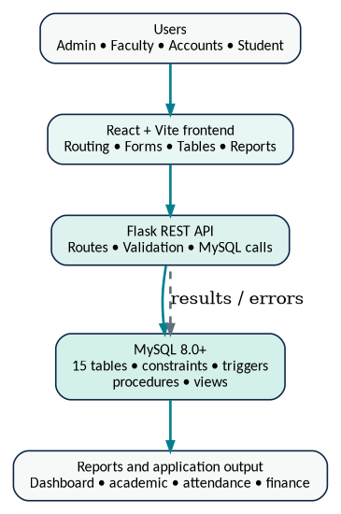
04 — CONNECTIVITY
Application-to-database path
The frontend remains simple; Flask owns the API routes and the database remains the system of record.
Student & College Management System • Vardan Desai • 25WU0104029 • AIML Rhinos
5

Slide 6
05 — DATABASE RULES
Representative trigger logic
The important rules are checked again at the database boundary.
Registration
Attendance
Active student + no duplicate course + section has capacity
Not dropped + date not future + date within semester
Examination
Payment
marks / max_marks → deterministic grade letter + point
amount_paid ≤ remaining balance; update bill status
Procedures
sp_admit_student and sp_record_exam_result keep multi-step operations together
Student & College Management System • Vardan Desai • 25WU0104029 • AIML Rhinos
6

Slide 7
06 — RELATIONAL SCHEMA
15 relations and the important foreign-key paths
The transaction tables sit between master records and derived reports.
department
→
programme, faculty, course
programme
→
student
course + faculty + semester
→
section
student + section
→
registration
registration
→
attendance, examination
examination
→
grade
student + semester
→
fee_bill
fee_bill
→
payment
student / faculty
→
user_account
Student & College Management System • Vardan Desai • 25WU0104029 • AIML Rhinos
7

Slide 8
07 — REPORTING LAYER
Eight views answer repeatable questions
The reports screen consumes SQL views rather than storing separate report tables.
v_section_occupancy
v_attendance_summary
SELECT * FROM v_section_occupancy …
SELECT * FROM v_attendance_summary …
v_exam_details
v_result_analysis
SELECT * FROM v_exam_details …
SELECT * FROM v_result_analysis …
v_student_academic_history
v_fee_dues
SELECT * FROM v_student_academic_history …
SELECT * FROM v_fee_dues …
v_student_dues
v_department_summary
SELECT * FROM v_student_dues …
SELECT * FROM v_department_summary …
Student & College Management System • Vardan Desai • 25WU0104029 • AIML Rhinos
8

Slide 9
08 — VALIDATION CHECKLIST
Positive and negative paths for the final prototype
The implementation is strongest when the evaluator can see both accepted and rejected transactions.
TC1
TC2
TC3
Available section
accepted
Duplicate course
rejected
Full section
rejected
TC4
TC5
TC6
Future attendance date
rejected
Exam marks
grade generated
Excess payment
rejected
Student & College Management System • Vardan Desai • 25WU0104029 • AIML Rhinos
9

Slide 10
REVIEW 2 → REVIEW 3
Implementation is ready for final application demonstration
The final presentation focuses on working screens, database validation and report outputs.
Database complete
API connected
Next
15 tables, triggers, procedures, views and seed data.
Flask route modules read and write MySQL data.
Run end-to-end workflows and capture evidence.
Student & College Management System • Review 2
Student & College Management System • Vardan Desai • 25WU0104029 • AIML Rhinos
10

