Slide 1
WOXSEN UNIVERSITY • SCHOOL OF TECHNOLOGY
DBMS COURSE PROJECT • REVIEW 1
Student & College
Management System
REVIEW 1 • CONCEPTUAL DESIGN
Student & College
Management System
Problem definition, scope, functional requirements and conceptual database design
Academic Year 2026–27
Semester III
Database-centric prototype
Vardan Desai • 25WU0104029 • B.Tech CSE – AIML • Rhinos
Python • Streamlit • MySQL • SQL
Requirements • Design • Implementation
Student & College Management System • Vardan Desai • 25WU0104029 • AIML Rhinos
1

Slide 2
01 — THE PROBLEM
Fragmented records create avoidable work
The project asks whether common college records can be maintained through one consistent relational model.
Duplication
No shared source
Delayed reporting
Unenforced rules
Student, course and fee facts become repetitive when maintained in disconnected records.
Academic and financial information needs linked records to answer cross-module questions.
Attendance, results and dues should be derived from the same underlying tables.
Duplicate registration, full sections and excess payments need database-side checks.
Student & College Management System • Vardan Desai • 25WU0104029 • AIML Rhinos
2
Notes:
Explain the problem through four concrete data-management issues: duplication, fragmented records, delayed reporting, and unenforced business rules.

Slide 3
02 — SCOPE
Scope from admission to fee settlement
A compact academic management system focused on relational data, transactions and reporting.
In scope
Out of scope
Student + guardian records
Departments and programmes
Courses + faculty + sections
Course registration + attendance
Examinations + grades
Fee bills + payments
Reports + login
Hostel management
Library systems
Payroll and HR
Alumni tracking
Online exam proctoring
Institution-wide deployment
Advanced notification services
Student & College Management System • Vardan Desai • 25WU0104029 • AIML Rhinos
3

Slide 4
03 — OBJECTIVES
Objectives across design and implementation
The final prototype is evaluated primarily on the DBMS concepts visible in the implementation.
01 Normalize to 3NF
02 Enforce integrity
03 Support transactions
Separate master and transaction data; reduce redundancy.
PK, FK, UNIQUE, NOT NULL, CHECK, DEFAULT and triggers.
Admission, registration, attendance, exams and fees.
04 Build reports
05 Connect application
Use joins, aggregates and SQL views for analysis.
Python + Streamlit interface connected to MySQL.
Student & College Management System • Vardan Desai • 25WU0104029 • AIML Rhinos
4

Slide 5
04 — FUNCTIONAL REQUIREMENTS
What the prototype must support
Each requirement maps to a screen, database object, transaction or report.
ID | Requirement | DBMS / application evidence
FR1 | Student admission | Student + guardian through stored procedure
FR2 | Academic setup | Department / programme / course / faculty / section master data
FR3 | Registration | Capacity + duplicate-registration checks
FR4 | Attendance | Daily status + attendance summary
FR5 | Examination | Marks + trigger-generated grade
FR6 | Fees | Bills + payment + balance/status
FR7 | Reports | Eight SQL views for academic and financial analysis
FR8 | Authentication | Login + Streamlit session state
Student & College Management System • Vardan Desai • 25WU0104029 • AIML Rhinos
5

Slide 6
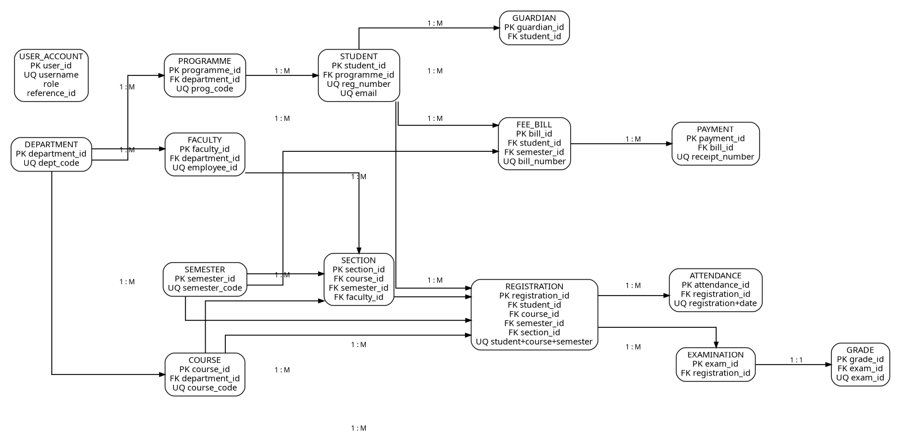
05 — CONCEPTUAL DESIGN
Final ER model
15-table ER model used as the basis for the MySQL relational schema.
Figure 1. Conceptual ER model used for the relational design
Student & College Management System • Vardan Desai • 25WU0104029 • AIML Rhinos
6

Slide 7
06 — ENTITY SET
Core entities and why they exist
The conceptual model separates master data, academic transactions and finance records.
Entity | Primary role in the system | Key relationship
department | Academic organizational unit | → programme / faculty / course
programme | Degree programme definition | → student
faculty | Teaching staff directory | → section
course | Course catalogue item | → section / registration
semester | Academic term | → section / registration / fee_bill
section | Course offering for a semester | → registration
student | Student master record | → guardian / registration / fee_bill
guardian | Student-linked contact | → student
registration | Student-section enrollment | → attendance / examination
attendance | Per-session status | → registration
examination | Assessment record | → grade
grade | Derived result record | → examination
fee_bill | Student billing record | → payment
payment | Payment transaction | → fee_bill
user_account | Application login account | → role / reference
Student & College Management System • Vardan Desai • 25WU0104029 • AIML Rhinos
7

Slide 8
07 — RELATIONAL APPROACH
How the conceptual model becomes database tables
Entity separation is maintained before application development begins.
Master data
Academic operations
Results + finance
department
programme
course
faculty
semester
section
registration
attendance
examination
grade
fee_bill
payment
Design principle
Store each fact once, reference it through keys, and let the database enforce relationships.
Access
user_account
Streamlit login
Student & College Management System • Vardan Desai • 25WU0104029 • AIML Rhinos
8

Slide 9
08 — PROPOSED WORKFLOW
One transaction path, one source of truth
The interface collects input; MySQL remains responsible for relational integrity and database-side rules.
Login
Select record
Write
Validate
Commit / reject
Read back
Streamlit session
Student / section / bill
Parameterized SQL / procedure
Constraints + trigger
MySQL decision
Updated table / report
Key principle
Application input validation improves usability; database constraints remain the final integrity boundary.
Student & College Management System • Vardan Desai • 25WU0104029 • AIML Rhinos
9

Slide 10
REVIEW 1 → REVIEW 2
Next milestone: logical database implementation
Review 1 closes the problem-definition and conceptual-design stage.
01 Approved
02 Mapped
03 Next
Problem, scope, functional requirements and final ER model.
Relations, keys, foreign keys, constraints and normalization plan.
MySQL schema, sample data, triggers, procedures, views and connected prototype.
REVIEW 2
Logical design • 3NF • SQL implementation
Student & College Management System • Vardan Desai • 25WU0104029 • AIML Rhinos
10

