Slide 1


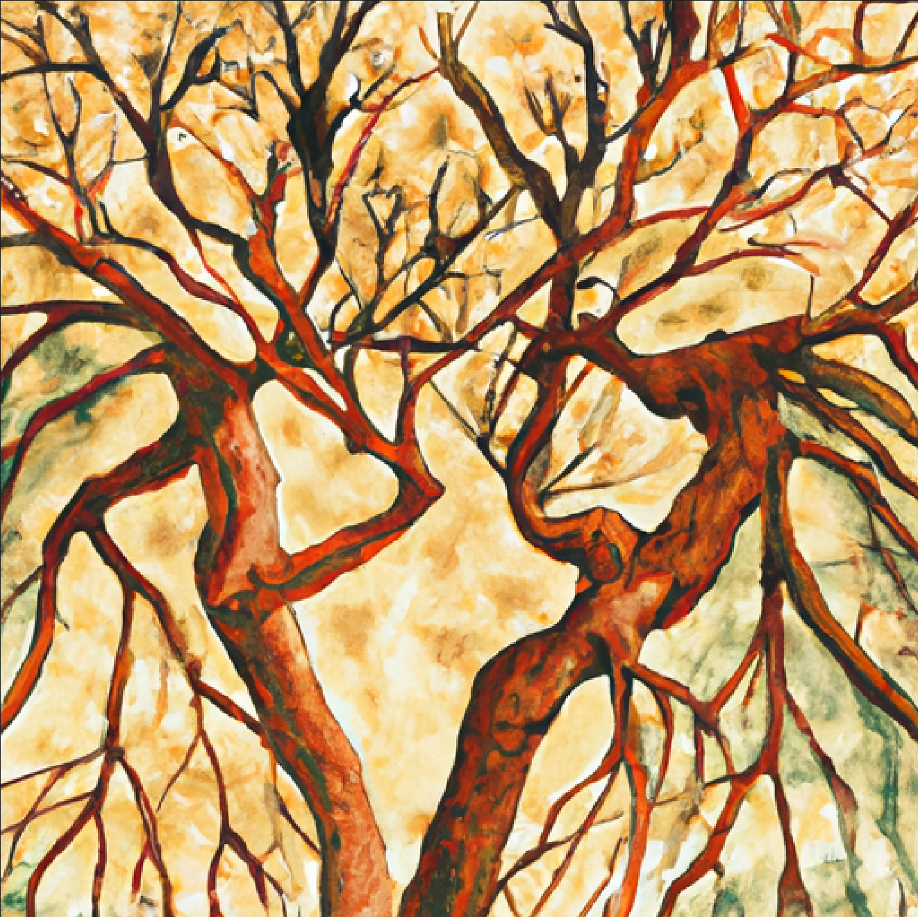


Propinquity
Noun
Proh-ping-kwuh-tee
“Propinquity breeds possibility; the closer we are to something, the more likely we are to achieve it”
The propinquity of the two buildings made it easier to move equipment.
The propinquity of the park to my house makes it my favorite spot.
The propinquity of our workspaces led to a friendship.

