Slide 1
Memory Management

Slide 2
MMU
The hardware that performs the mapping from Virtual address to Physical address is called Memory Management Unit
Address Binding
Compile Time
Load Time
Execution Time

Slide 3
Compile Time
Already pre-determined address for data and instructions
Base Register → Represents the starting address of the process
Limit Register → Range of addresses a particular process can use

Slide 4
Loading Time
What if the physical address is not pre-determined and will be known during the loading of the process
Relocation Register → instead of Base Register
While compiling to calculate an address only offset will be calculated
Finally during loading of process, this relocation register value will be added to all the addresses so that the correct physical address is obtained

Slide 5
Dynamic Loading
Sometimes you cannot bind the address until the execution has started
A routine is not loaded until it is called
Ensures an unused routine is never used
Also uses relocation register

Slide 6
Dynamic Linking and Shared Libraries
Linking modules / libraries
Stub included with dynamic linking of library references
Includes how to load the referred library
All processes (that uses) can share the same library loaded in physical address space

Slide 7
Swapping
Roll out and Roll in
Depending on priority or memory space allocated

Slide 8
Contiguous memory allocation
Divide memory into fixed size blocks (partitions)
Each partition may contain only one process
Multiprogramming degree → dependent on the partition

Slide 9
Internal Fragmentation
Fixed sized contiguous blocks
Lot of internal space wasted → internal fragmentation

Slide 10
Dynamic storage allocation problem
Allocate varied sized blocks
First Fit
Best Fit
Worst fit

Slide 11
Dynamic storage allocation
Different sized partitions
Initially all unused memory → one big hole
When a process arrives, depending on its requirement partition and allocate memory
What’s the catch?

Slide 12
External Fragmentation
Assume already 5 processes occupied the entire memory efficiently
One of the process leaves and it creates a hole
What if that hole is not optimized for the new process that has to be allocated memory?
Small sized process may leave lot of holes that is not a best fit for many processes → memory available for a new process but as broken little pieces

Slide 13
Solution?
Compaction
Shuffle memory contents so as to bring all holes to a side
Time consuming
Can be done only for dynamic relocation
Allow non-contiguous memory allocation

Slide 14
Paging
A technique to allocate non-contiguous blocks to processes
Page table is maintained to map the virtual address to physical address
Pages are fixed sized blocks

Slide 15
Virtual Memory
A virtual memory block is called a page, and a virtual memory miss is called a page fault
With virtual memory, the processor produces a virtual address, which is translated by a combination of hardware and software to a physical address, which in turn can be used to access main memory.
This process is called address mapping or address translation

Slide 16
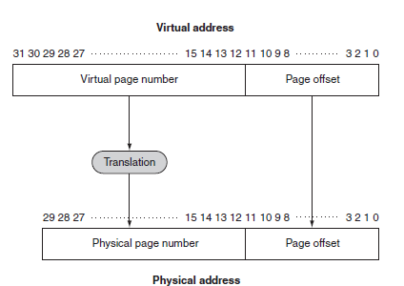
Mapping from Virtual Address to Physical Address

Slide 17
Page Table
The table containing the virtual to physical address translations in a virtual memory system.
The table, which is stored in memory, is typically indexed by the virtual page number
Each entry in the table contains the physical page number for that virtual page if the page is currently in memory.
Page table register : To indicate the location of the page table in memory, the hardware includes a register that points to the start of the page table
Assume for now that the page table is in a fixed and contiguous area of memory
Operating system maintains an “allocated” list and a “free” list
whether or not a physical page is free depends on which list the page currently resides in

Slide 18
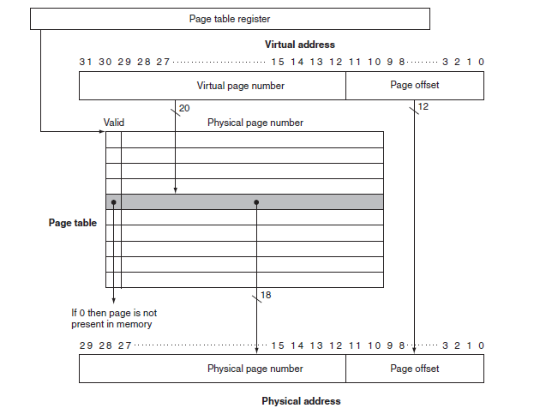

Slide 19
Access Time
Page table resides in main memory
To access a page, minimum 2 main memory accesses are needed
To access Page Table
To access the page (if it’s a hit. For miss penalty will be included)
A special type of cache to point to the physical address of most critical/used pages

Slide 20
Points to ponder
Should there be 1 page table / process?
What should be the size of the page?

Slide 21
Smaller sized pages
Reduces internal fragmentation but increases page table size
If page table size increases, the access time also increases

Slide 22
Bigger Pages…
Bigger pages improves page table access time but internal fragmentation may occur
Lot of addresses inside the big page may go waste for a small process

Slide 23
TLB
Since the number of pages is very high, the page table
capacity is too large to fit on chip
A translation lookaside buffer (TLB) caches the virtual
to physical page number translation for recent accesses
A TLB miss requires us to access the page table, which
may not even be found in the cache – two expensive
memory look-ups to access one word of data!
A large page size can increase the coverage of the TLB
and reduce the capacity of the page table, but also
increases memory waste

Slide 24
TLB and Cache
Is the cache indexed with virtual or physical address?
To index with a physical address, we will have to first
look up the TLB, then the cache → longer access time
Multiple virtual addresses can map to the same
physical address – can we ensure that these
different virtual addresses will map to the same
location in cache? Else, there will be two different
copies of the same physical memory word
Does the tag array store virtual or physical addresses?
Since multiple virtual addresses can map to the same
physical address, a virtual tag comparison can flag a
miss even if the correct physical memory word is present

Slide 25
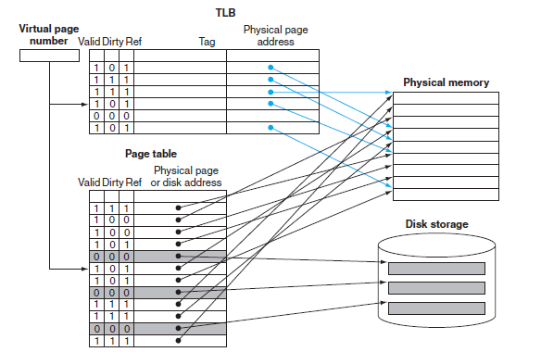
TLB
A cache that keeps track of recently used address mappings to avoid an access to the page table.

Slide 26

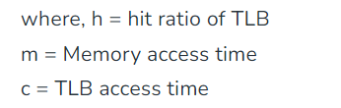
Effective memory access time(EMAT)

Slide 27
Protection in pages
1 bit to define if a page is read-write / read only
1 more bit for valid / invalid
What if multiple process wants to share the same library? Do they have to store redundant copies wasting memory? How will paging address this issue?

Slide 28
Continued…
For re-entrant code, same physical address for multiple virtual address in the page table

Slide 29
Structure of Page Table
Is paging table going to be a contiguous memory allocation?
May not be possible and easy most of the time
Divide Page table in to smaller pieces

Slide 30
Two level paging algorithm
Outer Page Table
Inner Page Table
Multi-level page tables
Also called Hierarchical page tables
Unsuitable for huge address space

Slide 31
Hashed Page Table
Hash value→ Virtual page number
Each entry in hash table contains that hash to the same location
Each element consists of
Virtual page number
Value of mapped page frame
A pointer to the next element

Slide 32
Inverted Page Table
Page table Virtual address and corresponding physical address
Inverted page table:
Physical address to virtual addresses
Each physical address may be mapped to multiple virtual address
Each virtual address may have details about the process that owns it
Cons? Shared memory implementation

Slide 33
Problems with paging?
Internal Fragmentation
Large address space → bigger page table → increased access time

Slide 34
Solution to internal fragmentation of pages?
Non-contiguous varied size partition → segments
Similar to dynamic memory allocation but the difference here is the partitions are not contiguous

Slide 35
Segmentation
How will you find the size of the segment?
Give length along with the beginning of the offset
This increases segment table size compared to page table
For a program (process), how will you decide on the segments?

Slide 36
Segmentation…
Consider each logical block as a segment
Where-ever space are available to fit the segment, the physical memory will be accordingly occupied
Still external fragmentation can exist

Slide 37
Segmentation with paging
Usually for the process, segments will be identified and according split (logical address space)
Physical address space will then be partitioned into fixed size smaller (optimal) pages

Slide 38
Demand Paging
When we want to execute a process, we swap it into memory
lazy swapper

Slide 39
Copy on write
Fork() → bypass demand paging
Minimizes the number of pages for newly created process
Instead of copying on the address space of the parent, initially parent and child share the same address space
Before child executes exec()
Try vfork() and see how the pages are allocated

Slide 40
Page Replacement
FIFO
Belady’s anomaly
Optimal page replacement
LRU
Time of field counter (or)
Stacks
Thrashing

