Slide 1
Concurrent Process Management

Slide 2
Concurrent Processes
Process that can get executed in parallel
It can be distributed across multiple nodes
In a concurrent programming system, no process should use the CPU while waiting for another process.

Slide 3
Requirements for avoiding Race Conditions
No two processes may be simultaneously inside their Critical Region
No Assumptions may be made about the speed or the number of CPUs
No process running outside its critical region may block other processes
No Process should have to wait forever to enter its critical region

Slide 4
Mutual Exclusion with busy waiting
Disabling Interrupts
One process has disabled interrupts, it can examine and update the shared memory without intervention from others
Very unattractive→ What if one user process forgets to turn the interrupts on again?
Can be used by kernel itself
But with multi-core, even within OS its getting reduced

Slide 5
Continued…
Lock Variables
S/W solution
Shared lock variable → Initially 0
When a process wants to enter a critical section, it checks the lock.
If it is 0, process changes it to 1 and enters critical region
If another process comes to execute the critical region, it cannot do so until lock becomes 0
Lock will become 0 when the first process completes the critical region and exits out of it.

Slide 6
Continued….
Sample
P0
{
While(1)
{
Read lock variable
If (lock==0)
{
lock=1;
access CS();
lock=0;
nonCS();
}
}
P1
{
While(1)
{
Read lock variable
If (lock==0)
{
lock=1;
access CS();
lock=0;
nonCS();
}
}

Slide 7
Continued…
Problems with lock variables
The lock itself is a shared memory that could result in race condition
There is a possibility both the process can be in CS at the same time

Slide 8
Continued…
Strict Alteration
P1
{
While(1)
{
Read lock variable
While (lock!=1);
access CS();
lock=0;
nonCS();
}
}
P0
{
While(1)
{
Read lock variable
while (lock!=0);
access CS();
lock=1;
nonCS();
}
}

Slide 9
Problems with strict alteration
What if one of the process does not want CS execution and it has not executed the above task
It cannot be predicted that the need for CS for the two process can be strictly alternative

Slide 10
Peterson’s Solution
Enter_CS(int process)
{
int other;
other = 1- process;
interested[process]=TRUE;
turn=process;
while (turn==process && interested[other]==TRUE);
// Wait for CS() access;
Access CS();
}
Leave_CS( int process)
{
interested[process]=FALSE
}

Slide 11
Hardware Support for Mutual Exclusion
TSL
Test & Set Lock
Syntax:
TSL REGISTER,LOCK
It reads the content of memory word lock and store that value in register “REGISTER”
It stores a nonzero value at memory address “lock”
The above two steps are indivisible
The above steps will disable the bus
Disabling bus will not allow interruptions from other processors

Slide 12
Continued….
Enter Region
TSL REGISTER,LOCK
CMP REGISTER,#0
JNE Enter Region
RET
Leave Region
Move LOCK,#0
RET

Slide 13
Busy Waiting
Both TSL and Peterson’s solution are correct but they involve busy waiting
A process either can enter its CS or wait busily checking its turn to access CS
CPU Time is wasted
Can lead to Priority Inversion Problem

Slide 14
Interprocess synchronization without busy waiting

Slide 15
Sleep & Wakeup
Sleep is a system call that causes the caller to suspend itself till other process wakes it up
Wakeup call has one parameter, the process to be awakened.

Slide 16
Continued…
Enter_CS(int process)
{
int other;
other = 1- process;
interested[process]=TRUE;
turn=process;
if (turn==process && interested[other]==TRUE)
Sleep(process);
Access CS();
}
Leave_CS( int process)
{
interested[process]=FALSE
Wakeup(1-process);
}

Slide 17
Continued…
But the Sleep and wakeup should be synchronized.
If wakeup is sent to a process that is not sleeping (yet), then this could result in race condition

Slide 18
Continued….
Solution:
Add a wakeup waiting bit
When a wake up is sent to a process that is still awake, this bit is set
If a process tries to go to Sleep, first this bit will be checked.
If it is set, then the process will stay awake
Next issue is to decide the number of wake up bits

Slide 19
Semaphores
Integer variable to count the number of wakeups saved for future use.
Semaphore is a new variable type
A semaphore can have 0 if no wakeups are pending (or) a positive number depending on the number of wakeups pending.

Slide 20
Continued..
Semaphore has two operations associated with it
Up → Increments the value of semaphore addressed
If one or more processes are sleeping on that semaphore, unable to complete an earlier down operation, one of them is chosen by the system and allowed to complete its Down.
Down → checks for the semaphore value is > 0.
If so it decrements it by 1 and continues work (wakeup)
If not process is put to sleep without completing down

Slide 21
HOT Question Discussion
1. Assume you are going to develop an OS. What are the major modules you will develop? Give a brief about all the modules.
2. In the OS you designed explain the relationship between file system function and process manager function.

Slide 22
Continued…
If the operating system contains a total of N processes, how many processes can be on the ready list at a given time? Explain.

Slide 23
Counting Semaphore
The value of a counting semaphore can range over an unrestricted domain
Counting semaphores can be used to control access to a given resource consisting of a finite number of instances.

Slide 24
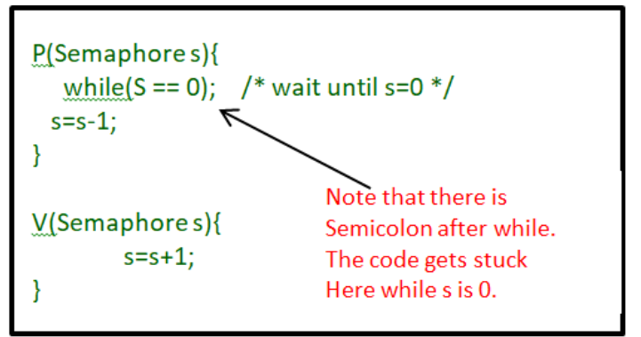
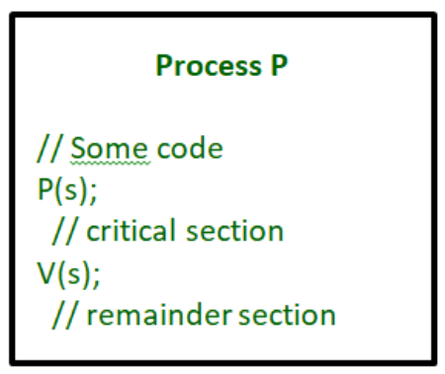
Binary Semaphore
The value of a binary semaphore can range only between 0 and 1.
Value initialized to 1

Slide 25
Semaphore Implementation
The semaphore is initialized to the number of resources available.
Each process that wishes to use a resource performs a wait() operation on the semaphore (thereby decrementing the count) (V operation)
When a process releases a resource performs a signal () operation (incrementing the count), (P operation)

Slide 26
Example
P1 , P2 → Concurrently running process
P1 with a statement S1 and P2 with a statement S2.
Suppose we require that S2 be executed only
after S1 has completed.
We can implement this scheme readily by letting P1 and P2 share a common semaphore synch, initialized to 0

Slide 27
Continued…
P1:
S1; Signal(synch);
Signal(Semaphore *S)
{
S->value++;
if (S->value <= 0) {
remove a process P from S->list;
wakeup(P);
}
}
P2:
Wait(synch);
S2;
Wait(semaphore *S)
{
S->value—;
if (S->value < 0) {
add this process to S->list;
block();
}
}

Slide 28
Producer Consumer Problem
Also known as bounded buffer problem
Two process share a common fixed size buffer – Producer & Consumer
Producer → puts information in to the buffer
Consumer → takes information from the buffer
They have to be synchronized for proper functioning

Slide 29
Continued…
N=100 ; Count=0;
Mutex=1; empty=N;full=0;
Producer()
{
int item;
while(true)
{
item=produce_item();
down(empty);
down(mutex);
insert_item(item);
up(mutex)
up(full)
} }

Slide 30
Continued…
Consumer()
{
int item;
while (TRUE)
{
down(full);
down(mutex);
item=remove_item;
up(mutex)
up(empty)
consume_item(item);
}
}

Slide 31
Semaphore Policy Selection
To implement semaphores without busy waiting, an operating system associates a process list with each semaphore.
Only the current process can choose to wait on a semaphore.
When a process waits on semaphore s, the system decrements the count associated with s.

Slide 32
Continued…
If multiple processes are waiting, which one should signal select? Several policies have been used:
Highest scheduling priority
Longest waiting time
Random
First-come-first-served

Slide 33
Static And Dynamic Semaphore Allocation
Static allocation: a programmer defines a fixed set of semaphores at compile time; the set does not change as the system runs
Dynamic allocation: the system includes functions that allow semaphores to be created on demand and de-allocated when they are no longer needed

Slide 34
Continued…
The advantage of static allocation lies in saving space and reducing CPU overhead
The system only contains memory for the needed semaphores, and the system does not require functions to allocate or de-allocate semaphores.
The chief advantage of dynamic allocation arises from the ability to accommodate new uses at run time.

Slide 35
Semaphore Reset
It is sometimes convenient to reset the count of a semaphore without incurring the overhead of deleting an old semaphore and acquiring a new one.

Slide 36
Monitors
Semaphore Solution
All processes share a semaphore variable mutex, which is initialized to 1.
Each process must execute wait (mutex) before entering the critical section and signal (mutex) afterward.
If this sequence is not observed, two processes may be in their critical sections simultaneously.

Slide 37
Continued..
To deal with these errors → High level language construct → Monitor

Slide 38
Classical synchronisation problems
Dining Philosopher’s Problem
Readers-Writers Problem

Slide 39
Multiprocessor and Locking
Locks help us write correct code for multiprocessors.
Acquire lock then perform the function that may affect a shared variable
Locks acquire and access to critical sections and release happens atomically.

Slide 40
Spinning Versus Blocking
Spin-locks are good when protecting short operations
Spin locks are not so great for code that has to wait for events that might take a long time.

Slide 41
Bakery Algorithm
Each process is given a variable which decides when the process will be allowed to execute it's critical section
It basically represents the position of the process in the queue

Slide 42
Lexicographical Timestamp order
Process(#Ticket,#Process -Id) - When comparing the processes we will first compare their ticket numbers and arrange them.
If two processes have the same ticket numbers are equal, then they will be ordered according to their process-id
The process with smaller process-id will be placed first

Slide 43
Simplified Bakery Algorithm
We have N processes, but in the simplified bakery algorithm, the processes have only one shared variable array
Basically, whenever process[i] wants to enter its critical section, we will assign number[i] to be 1 higher than the maximum of the current values of number[j] of all other processes.

Slide 44
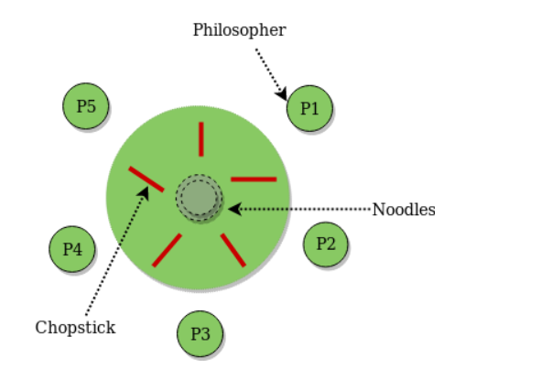
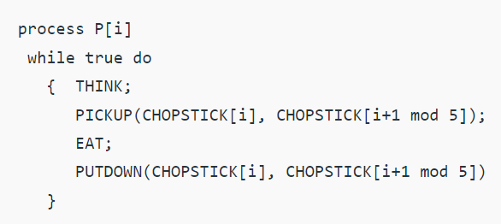
Dining Philosopher’s Problem

Slide 45
Deadlock

Slide 46
Deadlocks Handling
Deadlock Prevention
Deadlock Avoidance

Slide 47
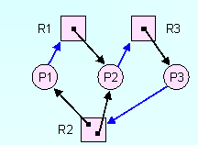
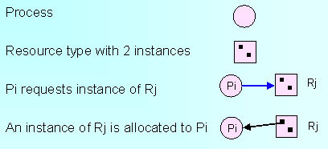
Deadlock Detection with Resource Allocation Graph

Slide 48
Deadlock Detection with Single Resource type
For each node, N in the graph, perform the following steps with N as the starting node.
Initialize L to Empty list, and designate all the arcs as unmarked.
Add the current node to end of L & check to see if the node appears in L two times. If it does, the graph contains a cycle and the algorithm terminates
From the given node, see if there are any unmarked outgoing arcs. If so go to step 5. If not go to step 6.
Pick an unmarked outgoing arc at random and mark it. Then follow it to the new current node and go to step 3.
If this node is the initial node, the graph does not contain any cycle. Otherwise we have reached dead end. Remove it and go back to previous node.

Slide 49
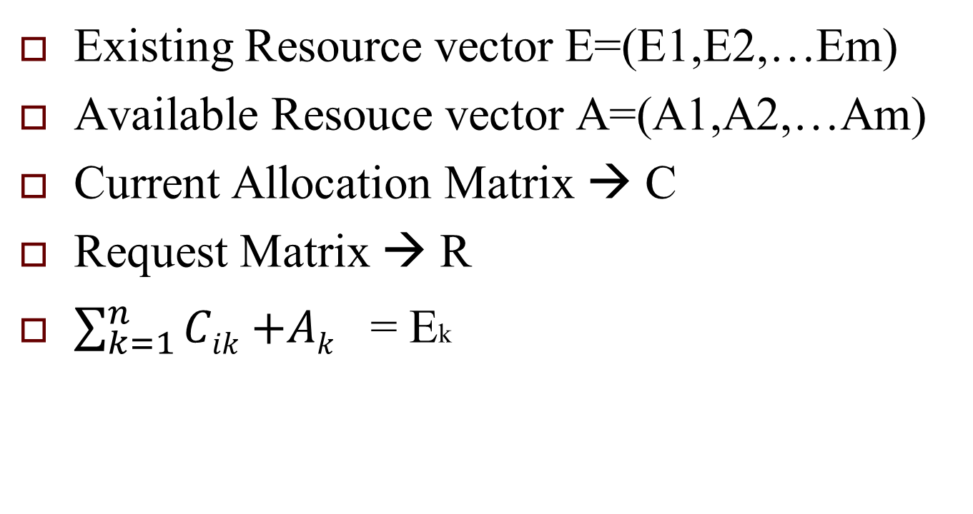
Deadlock detection for multiple resource type (Banker’s Algorithm)

Slide 50
Algorithm
Each process is initially unmarked.
As algorithm progresses, processes will be marked, indicating that they are able to complete and are thus not deadlocked.
When the algorithm terminates, any unmarked processes are known to be deadlocked.

Slide 51
Continued…
Look for an unmarked process, Pi, for which the i-th row of R is less than or equal to A
If such a process is found add the ith row of C to A, mark the process and go to step 1.
If no such process exists, the algorithm terminates.

Slide 52
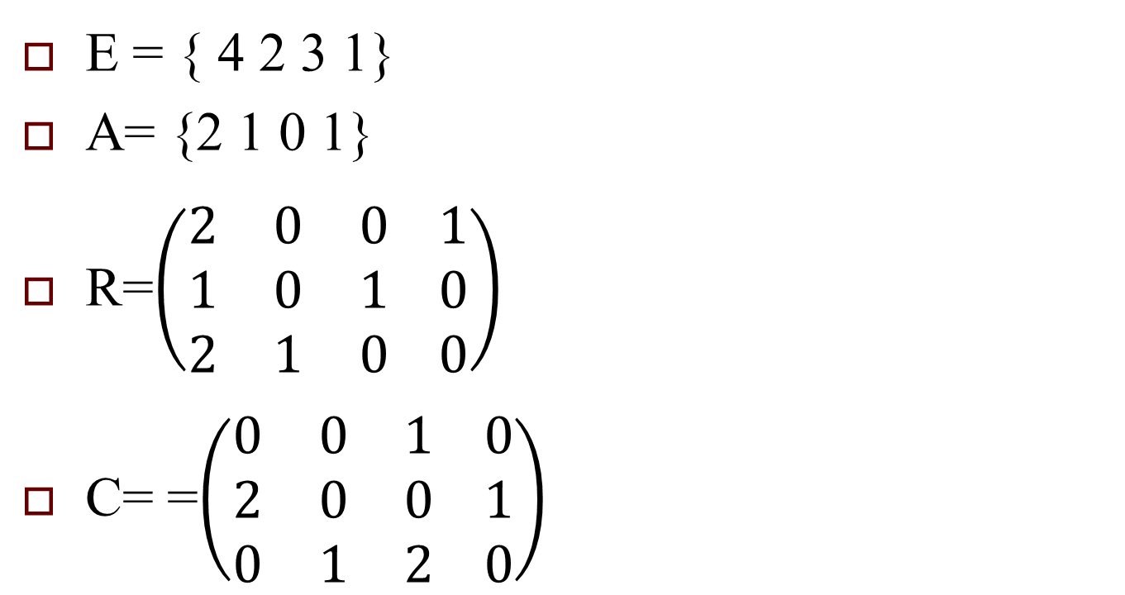
Example

Slide 53
Recovery from Deadlock
Recovery through pre-emption
Recovery through roll back
Recovery through killing procesess

Slide 54
Deadlock Avoidance
The system must be able to decide whether granting a resource is safe or not.
Is there an algorithm that can always avoid deadlock by making correct choice?

Slide 55
Resource Trajectories
Horizontal axis represents the number of instructions executed by process A.
Vertical axis→ number of instructions executed by process B

Slide 56
Safe & Unsafe States
At any instance there is a current state with E, A, C, R
A state is safe if there is some scheduling order in which every process can run to completion even if all of them suddenly request their maximum resources simultaneously. (Same example as given previously can be used)

Slide 57
Example
Has
Max
Has
Max
A | 3 | 9
B | 2 | 4
C | 2 | 7
A | 3 | 9
B | 4 | 4
C | 2 | 7
Free: 3
Free: 1
Has
Max
Has
Max
Has
Max
A | 3 | 9
B | 0 | -
C | 2 | 7
A | 3 | 9
B | 0 | -
C | 7 | 7
A | 3 | 9
B | 0 | -
C | 0 | -
Free: 5
Free: 0
Free: 7

Slide 58
Deadlock Prevention
Break one of the four must conditions of deadlock
Attacking Mutual Exclusion
Spooling printer using daemon process so deadlock problem will be converted to synchronisation problem and handled via semaphore

Slide 59
Continued….
Attacking Hold & Wait
Identifying all resources before the program execution
No optimal use of resource
Attacking no pre-emption
Resources can be virtualized to better handle deadlock with pre-emption
Not all resources can be virtualized.

Slide 60
Continued….
Attacking circular wait
Release a resource before holding another one.
Provide global numbering of all resources.
Process can request all resources but only in numerical order.

Slide 61
Inter-Process Communication

Slide 62
IPC Ports
Ports allow multiple outstanding messages
Processes accessing them are blocked until requests can be satisfied.
Each port is configured to hold up to a specified number of messages
Each message occupies a 32-bit word

Slide 63
Synchronous message passing
Both message sending and receiving are synchronous.
As long as space remains in a port, a sender can deposit a message with no delay.
Once a port becomes full, however, each sending process is blocked until a message has been removed and space becomes available.

Slide 64
Implementation of PORTS
Each port consists of a queue to hold messages and two semaphores.
One of the semaphores controls producers, blocking any process that attempts to add messages to a full port.
The other semaphore controls consumers, blocking any process that attempts to remove a message from an empty port.

Slide 65
Continued….
Because ports can be created dynamically, it is impossible to know the total count of items that will be en-queued at all ports at any given time
Although each message is small (one word), the total space required for port queues must be limited to prevent the port functions from using all the free space.

Slide 66
Continued…
To guarantee a limit on the total space used, the port functions allocate a fixed number of nodes to hold messages, and share the set among all ports
Port Table

Slide 67
IPC in Unix

Slide 68
IPC Types
Process in same host
Pipes
Half Duplex
Full Duplex
Named Full Duplex
FIFOs
Message Queues
Semaphores
Shared memory

Slide 69
IPC different hosts
Sockets
Streams

Slide 70
Pipes
Pipes are the oldest form of UNIX System IPC and are provided by all UNIX systems
Pipes can be used only between processes that have a common ancestor
Normally, a pipe is created by a process, that process calls fork, and the pipe is used between the parent and the child

Slide 71
Continued….
Every time you type a sequence of commands in a pipeline for the shell to execute, the shell creates a separate process for each command and links the standard output of one to the standard in
A pipe is created by calling the pipe function.

Slide 72
Continued…
#include <unistd.h>
int pipe(int filedes[2]);
Two file descriptors are returned through the filedes argument: filedes[0] is open for reading, and filedes[1] is open for writing. The output of filedes[1] is the input for filedes[0].

Slide 73
Continued…
When one end of a pipe is closed, the following two rules apply
If we read from a pipe whose write end has been closed, read returns 0 to indicate an end of file after all the data has been read.
If we write to a pipe whose read end has been closed, the signal SIGPIPE is generated
If we either ignore the signal or catch it and return from the signal handler, write returns 1 with errno set to EPIPE.

Slide 74
POPEN() & PCLOSE()
Creating a pipe,
Forking a child,
Closing the unused ends of the pipe,
Executing a shell to run the command, and waiting for the command to terminate

Slide 75
Sample
#include <stdio.h>
#include <unistd.h>
#include <sys/types.h>
main()
{
int fd[2];
pid_t childpid;
pipe(fd);
if((childpid = fork()) == -1)
{
perror("fork");
exit(1);
}
if(childpid == 0)
{
close(fd[0]);
write(fd[1], string, (strlen(string)+1));
}
else
{
close(fd[1]);
nbytes = read(fd[0], readbuffer, sizeof(readbuffer));
printf("Received string: %s", readbuffer);
}
}

Slide 76
FIFOs
FIFOs are sometimes called named pipes.
Pipes can be used only between related processes when a common ancestor has created the pipe.
With FIFOs, however, unrelated processes can exchange data

Slide 77
Continued…
FIFO is a type of file
Creating a FIFO is similar to creating a file.
#include <sys/stat.h>
int mkfifo(const char *pathname, mode_t mode);
Mode→ permission bits

Slide 78
Continued…
Once we have used mkfifo to create a FIFO, we can use open(), close(), read(), write()
There are two uses for FIFOs.
FIFOs are used by shell commands to pass data from one shell pipeline to another without creating intermediate temporary files.
FIFOs are used as rendezvous points in client-server applications to pass data between the clients and the servers.

Slide 79
Message Queues
A message queue is a linked list of messages stored within the kernel and identified by a message queue identifier
msgget()
A new queue is created or an existing queue opened by msgget().
include <sys/msg.h>
int msgget(key_t key, int flag);
On success, msgget returns the non-negative queue ID. This value is then used with the other three message queue functions.

Slide 80
Continued….
msgsnd()
New messages are added to the end of a queue by msgsnd
Every message has a positive long integer type field, a non-negative length, and the actual data bytes all of which are specified to msgsnd when the message is added to a queue.

Slide 81
Continued..
Each queue has the following msqid_ds structure associated with it:
struct msqid_ds
{ struct ipc_perm msg_perm;
msgqnum_t msg_qnum;
msglen_t msg_qbytes;
pid_t msg_lspid
pid_t msg_lrpid;
time_t msg_stime;
. . . };
This structure defines the current status of the queue

Slide 82
Continued…
msgctl function
Performs various operations on a queue
include <sys/msg.h>
int msgctl(int msqid, int cmd, struct msqid_ds *buf );
Msgsnd()
Data is placed onto a message queue by calling msgsnd.
include <sys/msg.h>
int msgsnd(int msqid, const void *ptr, size_t nbytes, int flag);

Slide 83
Continued…
Messages are retrieved from a queue by msgrcv.
#include <sys/msg.h>
ssize_t msgrcv(int msqid, void *ptr, size_t nbytes , long type, int flag);

Slide 84
Shared Memory
Shared memory allows two or more processes to share a given region of memory.
This is the fastest form of IPC, because the data does not need to be copied between the client and the server.
The only trick in using shared memory is synchronizing access to a given region among multiple processes

Slide 85
Continued….
The kernel maintains a structure with at least the following members for each shared memory segment:
struct shmid_ds
{ struct ipc_perm shm_perm;
size_t shm_segsz;
pid_t shm_lpid;
pid_t shm_cpid;
shmatt_t shm_nattch;
time_t shm_atime;
time_t shm_dtime;
time_t shm_ctime };

Slide 86
Continued….
#include <sys/shm.h>
int shmget(key_t key, size_t size, int flag);
int shmctl(int shmid, int cmd, struct shmid_ds
*buf);

Slide 87
Continued…
Once a shared memory segment has been created, a process attaches it to its address space by calling shmat.
void *shmat(int shmid, const void *addr, int flag);
The address in the calling process at which the segment is attached depends on the addr argument and whether the SHM_RND bit is specified in flag.

Slide 88
Continued…
If addr is 0, the segment is attached at the first available address selected by the kernel. This is the recommended technique
If addr is nonzero and SHM_RND is not specified, the segment is attached at the address given by addr
If addr is nonzero and SHM_RND is specified, the segment is attached at the address given by (addr - (addr modulus SHMLBA))

Slide 89
Continued…
The SHM_RND command stands for "round."
SHMLBA stands for "low boundary address multiple" and is always a power of 2.
What the arithmetic does is round the address down to the next multiple of SHMLBA

Slide 90
Continued…
When we're done with a shared memory segment, we call shmdt to detach it
int shmdt(void *addr);

Slide 91
Comparison of Various IPC forms
IPC Type | Connectionless? | Reliable? | Flow Control? | Records? | Message types or priorities?
message queues | no | yes | yes | yes | yes
STREAMS | no | yes | yes | yes | yes
UNIX domain stream socket | no | yes | yes | no | no
UNIX domain datagram socket | yes | yes | no | yes | no
FIFOs | no | yes | yes | no | no

Slide 92
Semaphores in Linux

Slide 93
IPC structure in linux
Each IPC(Inter Process Communication) structure (message queue, semaphore, or shared memory segment) in the kernel is referred to by a non-negative integer identifier
To send or fetch a message to or from IPC structure, all we need know is the identifier for the structures
Unlike file descriptors, IPC identifiers are not small integers

Slide 94
Continued….
The identifier is an internal name for an IPC object
Cooperating processes need an external naming scheme to be able to rendezvous using the same IPC object
For this purpose, an IPC object is associated with a key that acts as an external name.

Slide 95
Continued….
Whenever an IPC structure is being created (by calling msgget, semget, or shmget), a key must be specified
The data type of this key is the primitive system data type key_t, which is often defined as a long integer in the header <sys/types.h>
This key is converted into an identifier by the kernel.

Slide 96
Rendezvous the same IPC structure
There are various ways for a client and a server to rendezvous at the same IPC structure.
The server can create a new IPC structure by specifying a key of IPC_PRIVATE and store the returned identifier somewhere (such as a file) for the client to obtain.

Slide 97
Continued…
The client and the server can agree on a key by defining the key in a common header, for example
The client and the server can agree on a pathname and project ID (the project ID is a character value between 0 and 255) and call the function ftok to convert these two values into a key
#include <sys/ipc.h>
key_t ftok(const char *path, int id);

Slide 98
IPC_PRIVATE
The IPC_PRIVATE key is used in a parent-child relationship.
The parent creates a new IPC structure specifying IPC_PRIVATE, and the resulting identifier is then available to the child after the fork

Slide 99
Semaphores in Linux
A semaphore is a counter used to provide access to a shared data object for multiple processes.

Slide 100
A process to obtain a shared resource..
1. Test the semaphore that controls the resource.
2. If the value of the semaphore is positive, the process can use the resource. In this case, the process decrements the semaphore value by 1, indicating that it has used one unit of the resource.
3. Otherwise, if the value of the semaphore is 0, the process goes to sleep until the semaphore value is greater than 0. When the process wakes up, it returns to step 1.

Slide 101
Continued..
When a process is done with a shared resource that is controlled by a semaphore, the semaphore value is incremented by 1. If any other processes are asleep, waiting for the semaphore, they are awakened.
To implement semaphores correctly, the test of a semaphore's value and the decrementing of this value must be an atomic operation. For this reason, semaphores are normally implemented inside the kernel.

Slide 102
Header file for semaphores in linux
# include <sys/sem.h>
Each semaphore is represented by an anonymous structure containing at least the following members
Struct
{
unsigned short semval; /* semaphore value, always >= 0 */
pid_t sempid; /* pid for last operation */
unsigned short semncnt; /* # processes awaiting semval>curval */
unsigned short semzcnt; /* # processes awaiting semval==0 */
. . .
};

Slide 103
Continued….
The kernel maintains a semid_ds (semaphore id data structure)structure for each semaphore set:
struct semid_ds
{
struct ipc_perm sem_perm;
unsigned short sem_nsems;
time_t sem_otime;
time_t sem_ctime;
};

Slide 104
Functions to use Semaphores

Slide 105
Creating a semaphore
Creation of semaphore
int semget(key_t key, int nsems, int flag);
When semget() succeeds it returns semaphore id(semid)
The key argument is a access value associated with the semaphore ID.
The nsems argument specifies the number of elements in a semaphore array.

Slide 106
Continued…
The call fails when nsems is greater than the number of elements in an existing array;
When the correct count is not known, supplying 0 for this argument ensures that it will succeed.
The semflg argument specifies the initial access permissions and creation control flags.
IPC CREATE (or) IPC_PRIVATE

Slide 107
Initialization of semaphore
#include <sys/sem.h>
int semctl(int semid, int semnum, int cmd, union semun arg );
semctl() changes permissions and other characteristics of a semaphore set
It must be called with a valid semaphore ID, semid
The semnum value selects a semaphore within an array by its index
The cmd argument is one of the following control flags

Slide 108
Continued….
GETVAL-- Return the value of a single semaphore.
SETVAL-- Set the value of a single semaphore. In this case, arg is taken as arg.val, an int.
GETPID-- Return the PID of the process that performed the last operation on the semaphore or array.

Slide 109
Continued….
GETNCNT-- Return the number of processes waiting for the value of a semaphore to increase.
GETZCNT-- Return the number of processes waiting for the value of a particular semaphore to reach zero.

Slide 110
Semaphore Operations
Semop()
Performs operations on a semaphore set.
int semop(int semid, struct sembuf *sops, size_t nsops);
The semid argument is the semaphore ID returned by a previous semget() call.
The sops argument is a pointer to an array of structures, each containing the following information about a semaphore operation:

Slide 111
Continued…
The sembuf structure specifies a semaphore operation, as defined in <sys/sem.h>.
struct sembuf
{
ushort_t sem_num;
short sem_op;
short sem_flg;
};

Slide 112
Continued…
The nsops argument specifies the length of the array, the maximum size of which is determined by the SEMOPM configuration option;
This is the maximum number of operations allowed by a single semop() call, and is set to 10 by default.

Slide 113
Continued…
The operation to be performed is determined as follows:
A positive integer increments the semaphore value by that amount
A negative integer decrements the semaphore value by that amount.
An attempt to set a semaphore to a value less than zero fails or blocks, depending on whether IPC_NOWAIT is in effect.
A value of zero means to wait for the semaphore value to reach zero.

Slide 114
Control flags with semop()
IPC_NOWAIT-- Can be set for any operations in the array.
SEM_UNDO-- Allows individual operations in the array to be undone when the process exits.

Slide 115
Continued…
The semaphore number
The operation to be performed
Control flags, if any.

Slide 116
Sample code for initiallizing semaphore
#include <sys/types.h>
#include <sys/ipc.h>
#include <sys/sem.h>
……
key_t key; /* key to pass to semget() */
int semflg; /* semflg to pass tosemget() */
int nsems; /* nsems to pass to semget() */
int semid; /* return value from semget() */
...

Slide 117
Continued…
key_t key = 1234;
int semflg = IPC_CREAT | 0666;
int nsems = 1;
if ((semid = semget(key, nsems, semflg)) == -1)
{
perror("semget: semget failed");
exit(1);
}

