Slide 1
Christ Cabin Finder Real-Time Faculty Location & Availability Assistant
Student Details: Swanim Pradhan 2362373
Stephen Akash J 2362368
Riya Bajaj 23623
Guided By: Sandeep Kumar

Slide 2
Agenda
Abstract
Problem Statement and Objectives
Literature Review/ Background Study
Hardware and Software Requirements
System Architecture
Timeline
References

Slide 3
Abstract
ChristSmart Cabin Finder is a smart campus web application designed to help students quickly locate faculty cabins and check real-time faculty availability. The system provides accurate status updates such as Available, In Class, Meeting, or Away, reducing the time students spend searching across campus. It also supports intelligent search and automated schedule-based availability updates to improve communication and coordination between students and faculty. The proposed solution aims to create a more efficient, connected, and student-friendly smart campus environment.
Index Terms— Smart Campus, Real-time Tracking, Automated Scheduling, Student-Faculty Coordination, Campus Ecosystem.

Slide 4
Problem Statement
Students often spend significant time searching for faculty cabins and checking whether faculty members are available. Existing methods such as static timetables, notice boards, and manual inquiries do not provide real-time availability information and are frequently affected by schedule changes, meetings, viva sessions, and other academic activities. This leads to delays in communication, unnecessary movement across campus, and an inefficient student experience.

Slide 5
Objectives
Primary Objective
Develop a smart campus web application that provides real-time faculty cabin location and availability information.
Specific Objectives
Enable students to search for faculty members easily.
Display live faculty status (Available, In Class, Meeting, Away, etc.).
Support intelligent search for partial or misspelled faculty names.
Automate schedule-based availability updates.
Provide faculty with a simple interface to manage and approve status notices.

Slide 6
Literature Review / Background Study
Existing Systems
Static notice boards
Department timetables
Manual cabin inquiries
Basic campus chatbot systems
Limitations
No real-time faculty availability
Schedule changes are not updated instantly
Exact faculty name is often required
Notices must be updated manually
Research Gap
No single platform combines:
Real-time availability
Intelligent faculty search
Automated schedule updates
Context-aware notice suggestions

Slide 7
Literature Review / Background Study
Existing Systems
Static notice boards
Department timetables
Manual cabin inquiries
Basic campus chatbot systems
Limitations
No real-time faculty availability
Schedule changes are not updated instantly
Exact faculty name is often required
Notices must be updated manually
Research Gap
No single platform combines:
Real-time availability
Intelligent faculty search
Automated schedule updates
Context-aware notice suggestions
Project Justification
ChristSmart Cabin Finder addresses these gaps by providing a centralized smart campus platform that enables students to quickly locate faculty members and check their real-time availability while allowing faculty to manage and approve status updates efficiently.

Slide 8
Hardware and Software Requirements
Software Requirements
Frontend: React 19, Vite, CSS3
Backend: Node.js, Express.js
Database: PostgreSQL
Authentication: JWT, BcryptJS
Utilities: Multer, pdf-parse, Tesseract OCR, Helmet
Operating System: Windows / Linux / macOS
Hardware Requirements
Processor: Intel/AMD Multi-Core
RAM: Minimum 4 GB
Storage: 10 GB free space
Network: Internet connection
Client Device: Any modern laptop or desktop with a web browser

Slide 9
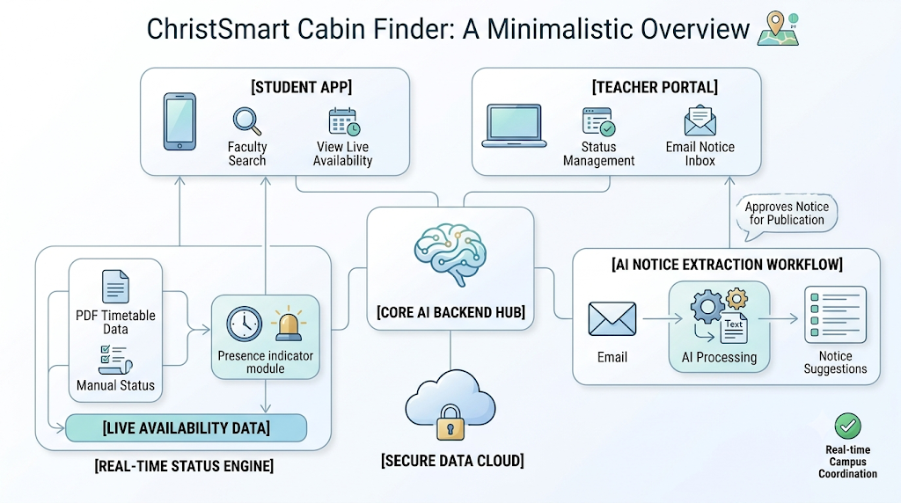
System Architecture

Slide 10
Timeline
Phase 1 (Weeks 1-2): Problem Definition, Requirement Gathering, & Database Schema Design.
Phase 2 (Weeks 3-5): Backend REST API Development, Auth Routes, & Levenshtein NLP Query Matching.
Phase 3 (Weeks 6-8): React Frontend Integration, Teacher Dashboard, & PDF Timetable Parser.
Phase 4 (Weeks 9-10): Automated Testing, UI/UX Refinement, Security Audit, & Final System Deployment.

Slide 11
References
[1] A. Rahaman, S. Das, and M. Hossain, “EduBot: An AI-Powered Chatbot for Smart Campus Assistance,” International Journal of Research and Innovation in Technology (IJRIT), vol. 11, no. 3, pp. 45–52, 2025.
[2] V. Kumar and S. Patel, “Smart Campus Bot with IoT and NLP Integration,” International Journal of Innovative Research in Technology (IJIRT), vol. 11, no. 5, pp. 210–218, 2025.
[3] V. I. Levenshtein, “Binary Codes Capable of Correcting Deletions, Insertions, and Reversals,” Soviet Physics Doklady, vol. 10, no. 8, pp. 707–710, 1966.
[4] E. Unggul, “Implementation of Levenshtein Distance Algorithm for Academic Inquiry Chatbots,” Telkom University, Bandung, Indonesia, 2024.
[5] M. Zhang, Y. Chen, and L. Wang, “Graph Retrieval for Constraint-Aware Campus Spatial Reasoning,” arXiv preprint arXiv:2403.04567, 2024.
[6] Mozilla Developer Network, “Express.js Documentation,” Available: https://expressjs.com/ . Accessed: July 2026.
[7] PostgreSQL Global Development Group, “PostgreSQL Documentation,” Available: https://www.postgresql.org/docs/ . Accessed: July 2026.
[8] Google Developers, “Gmail API Documentation,” Available: https://developers.google.com/gmail/api . Accessed: July 2026.
[9] Tesseract OCR Project, “Tesseract.js Documentation,” Available: https://tesseract.projectnaptha.com/ . Accessed: July 2026.

