Slide 1

Steganography
Guided by:-
Sapna

Slide 2
Steganogrphy
Presented By:-
Prince Kumar
Palak Singh
Sakshi Sen
Rajhanshi Singh

Slide 3
Table of content
Text Steganography encoding
Text Steganogrphy decoding
Image steganography encoding
Image steganoography decoding
Audio steganography encoding
Audio steganography decoding
Video Teganbography encoding
Video Teganbography decoding

Slide 4
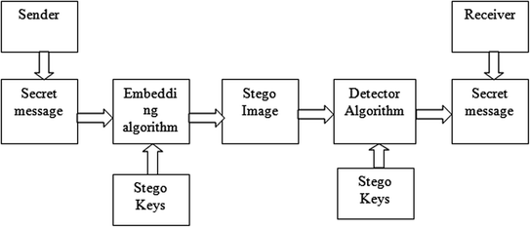
STEGANOGRAPHY

Slide 5
FOUR TYPES OF STEGANOGRAPHY
IMAGE STEGANOGRAPHY
TEXT STEGANOGRAPHY
AUDIO STEGANOGRAPHY
VIDEO STEGANOGRAPHY

Slide 6
TEXT STEGANOGRAPHY (text steganography via engaging Unicode standard encoding, 2020)

Slide 7
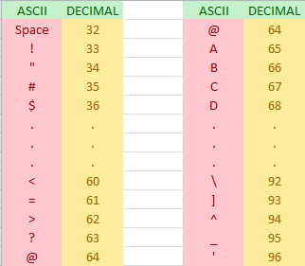
IF 32 >= P >= 64 : P = P + 32

Slide 8
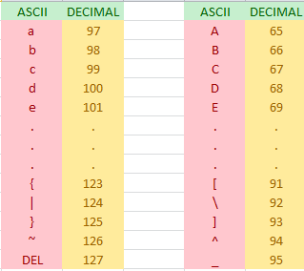
IF 64 > P >= 127 : P = P - 32

Slide 9
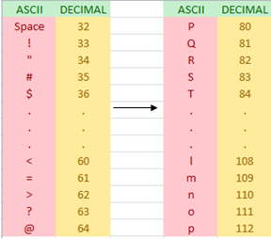
IF 32 >= P >= 64 : P = P + 48

Slide 10
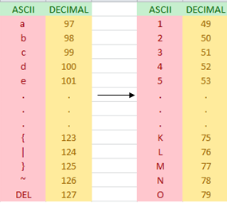
IF 64 > P >= 127 : P = P - 48

Slide 11
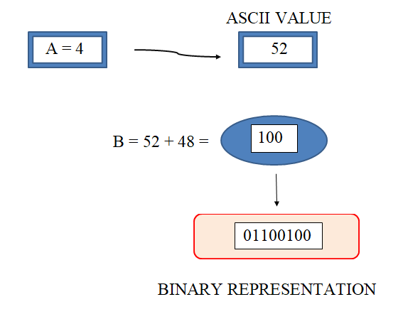
EXAMPLE 1

Slide 12
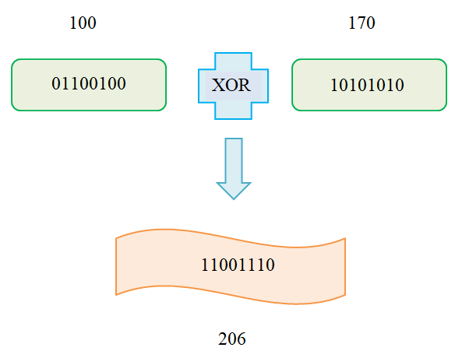

Slide 13
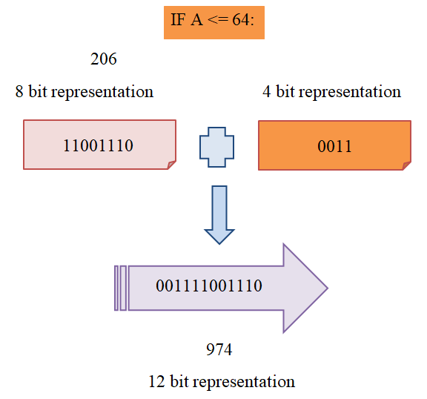

Slide 14
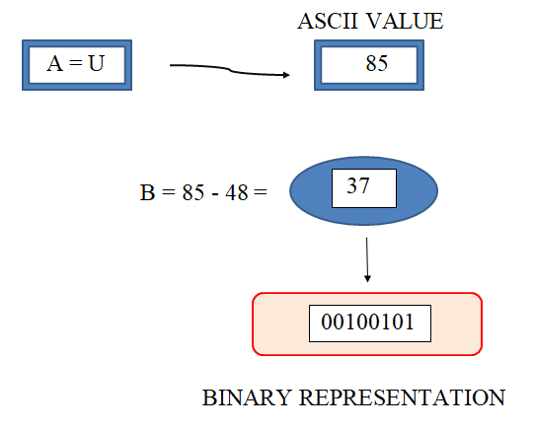
EXAMPLE 2

Slide 15
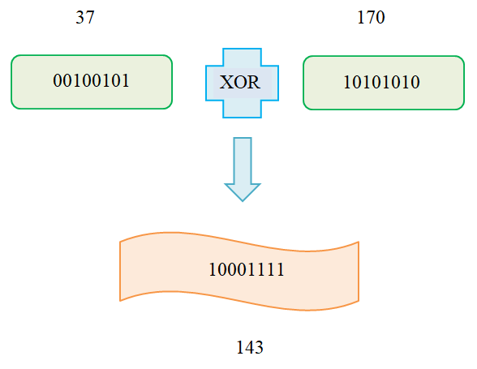

Slide 16
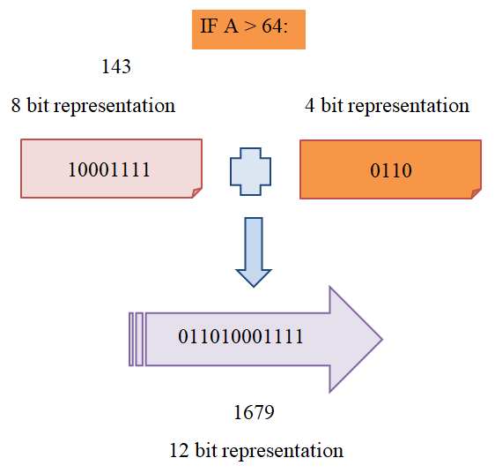

Slide 17
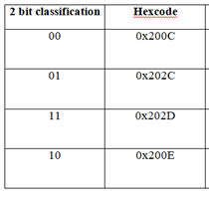
ZERO WIDTH CHARACTER

Slide 18
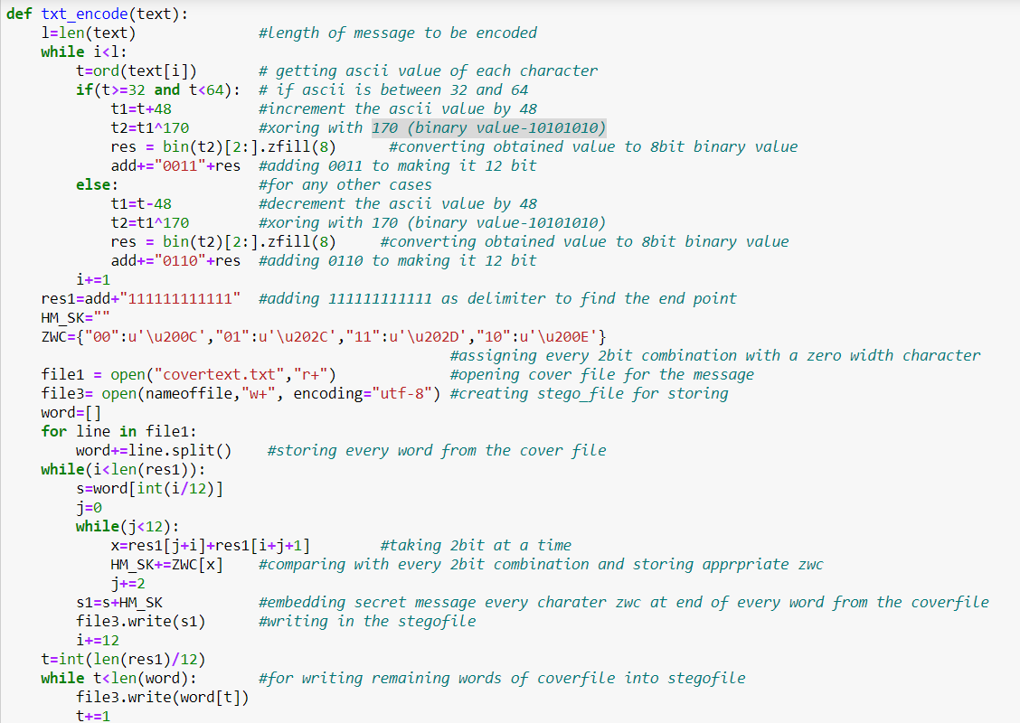
ENCODE

Slide 19
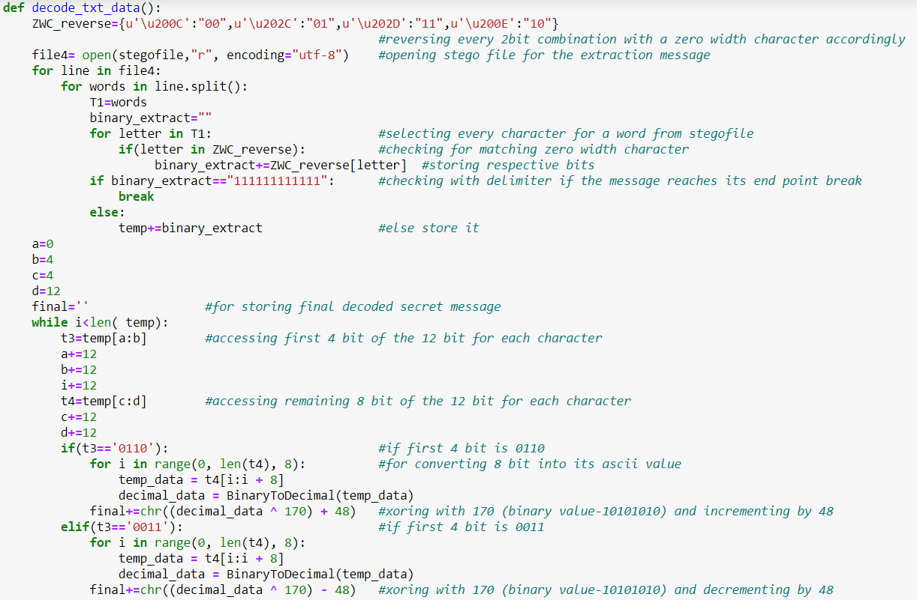
DECODE

Slide 20
IMAGE STEGANOGRAPHY (Using least significant bit algorithm, 2017)

Slide 21
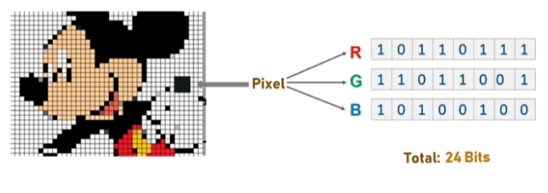
LEAST SIGNIFICANT BIT ALGORITHM
Photo credits to Edureka Steganography tutorial

Slide 22
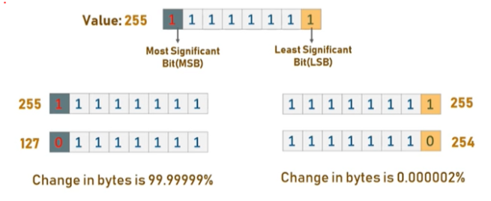

Slide 23
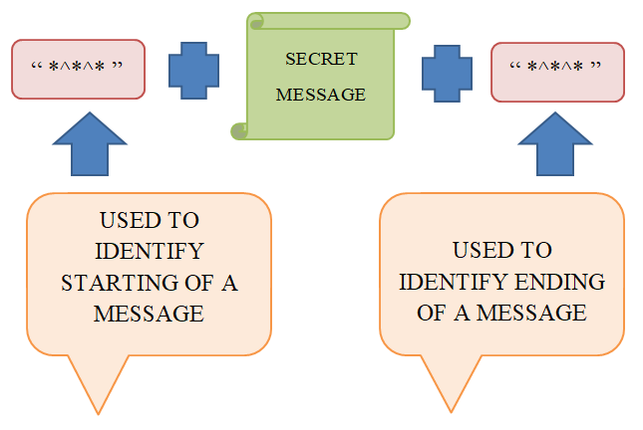
BASIC ALGORITHM

Slide 24
DISADVANTAGES
Less space available for message
Size of secret message
Distortion in image is visible

Slide 25
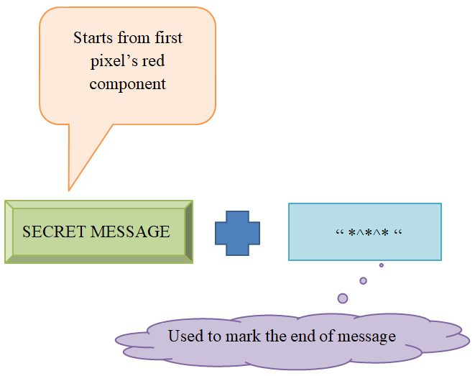
MODIFIED ALGORITHM

Slide 26
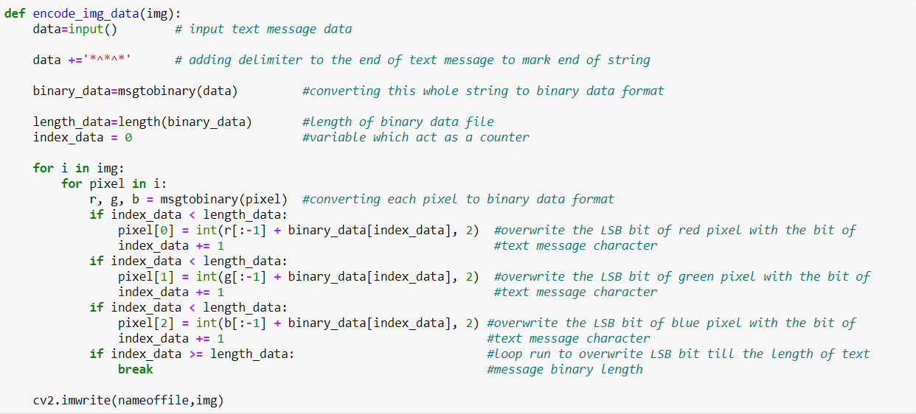
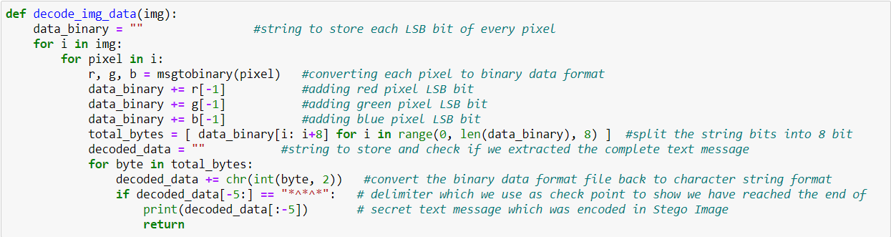
ENCODE AND DECODE

Slide 27
AUDIO STEGANOGRAPHY (LSB MODIFICATION USING ADVANCED ENCRYPTION STANDARD, 2018)

Slide 28
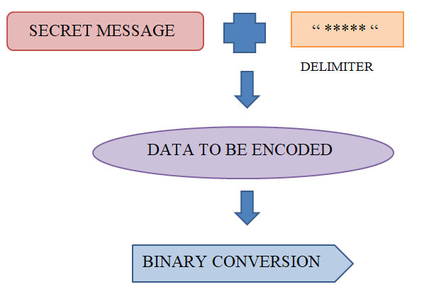

Slide 29
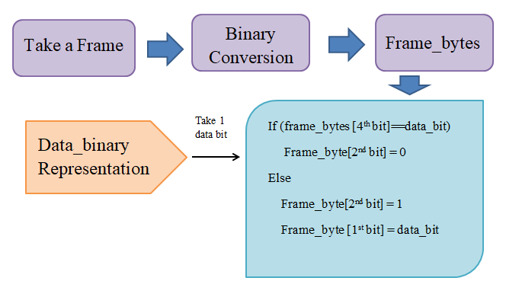

Slide 30
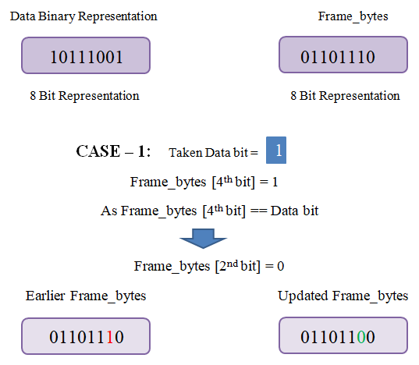

Slide 31
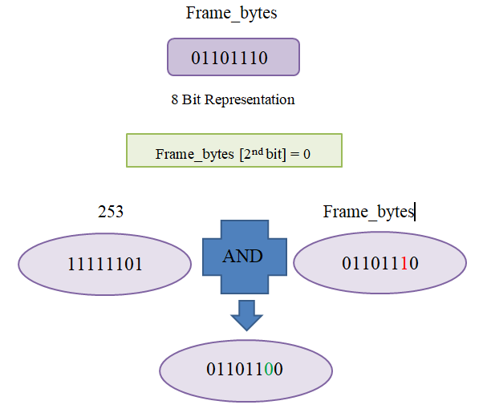

Slide 32
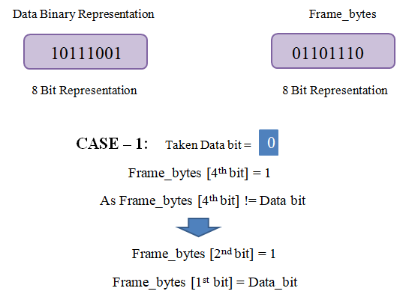

Slide 33
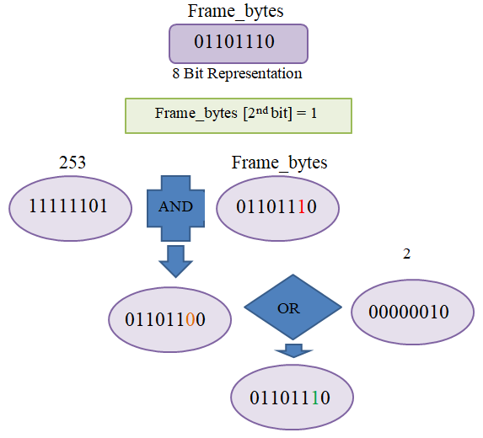

Slide 34
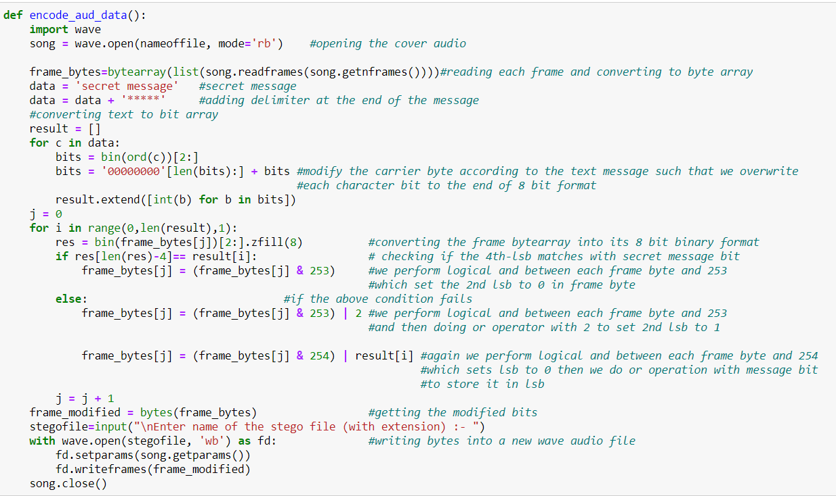
ENCODE

Slide 35
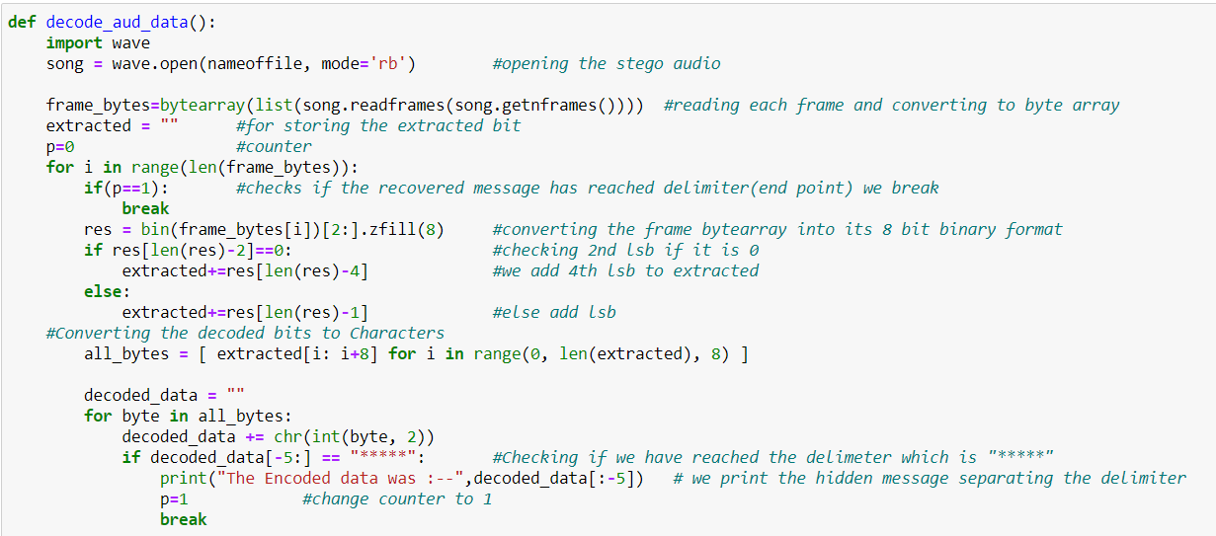
DECODE

Slide 36
VIDEO STEGANOGRAPHY (USING RC4 ALGORITHM FOR SECURITY APPLICATION, 2019)

Slide 37
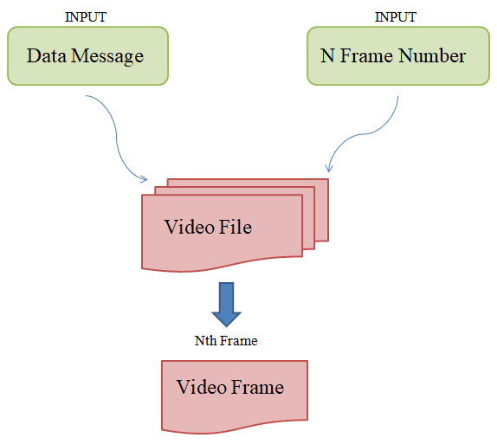

Slide 38
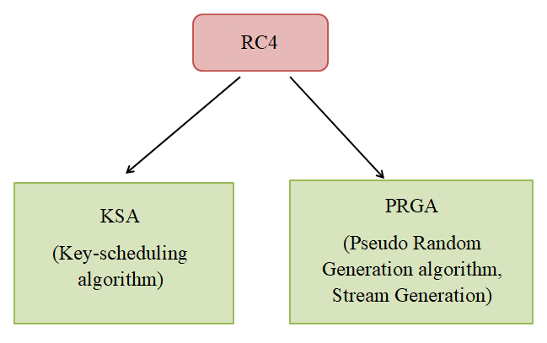

Slide 39
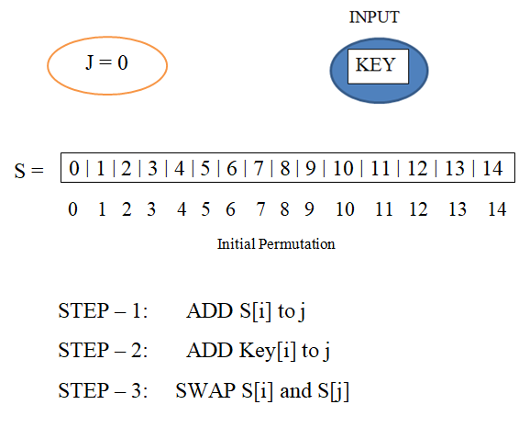
Ksa (Key-scheduling algorithm)

Slide 40
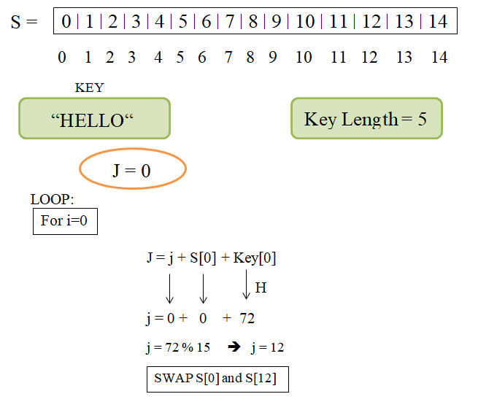

Slide 41
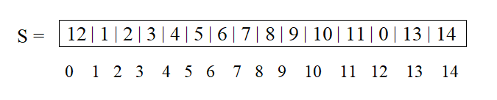
So now Permutation for next Iteration

Slide 42
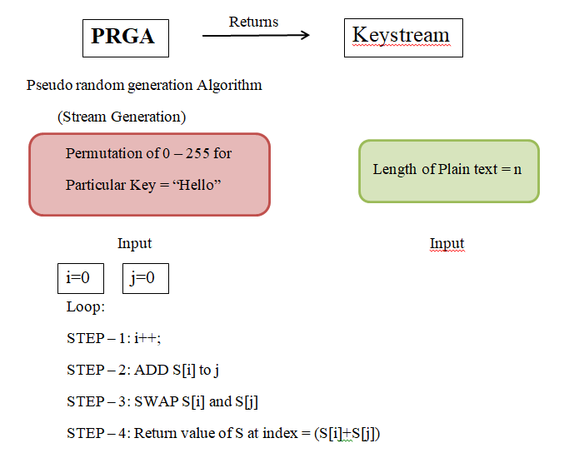
PRGA (Stream generation)

Slide 43
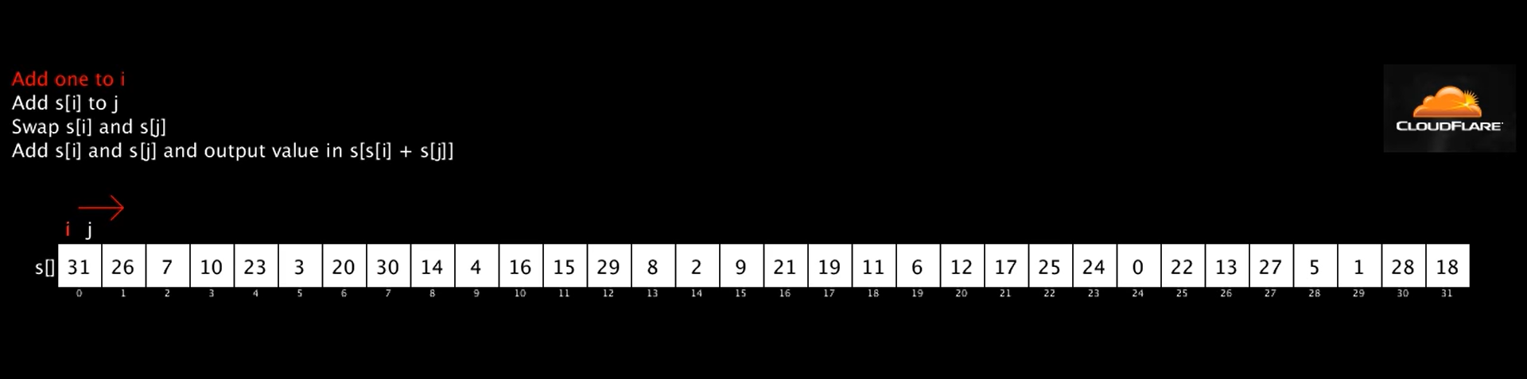

Slide 44
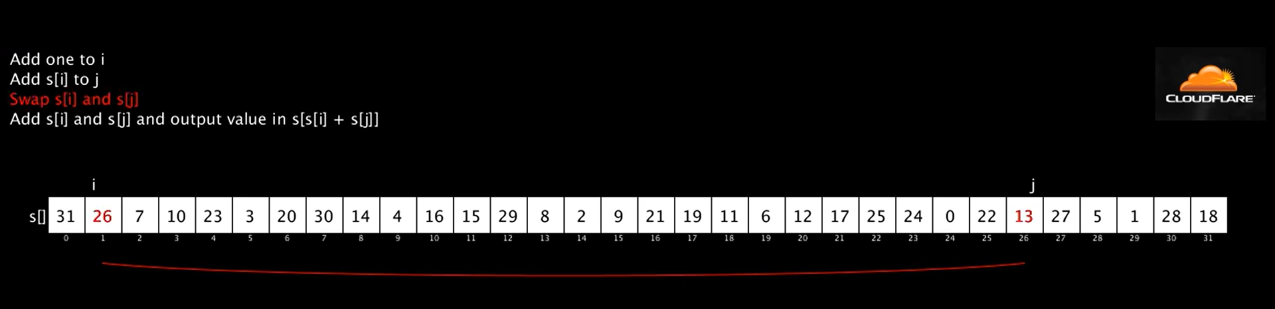

Slide 45
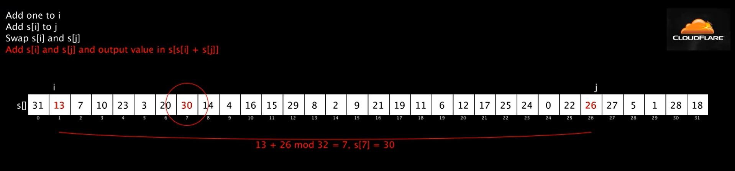

Slide 46
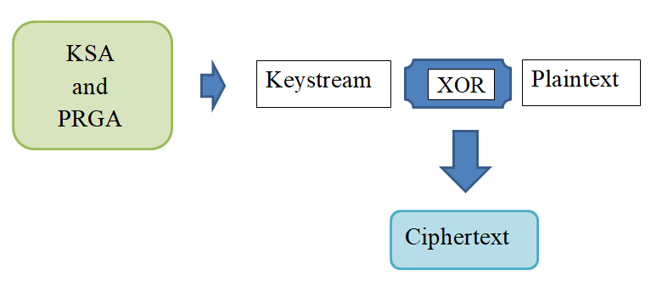
RC4 ENCRYPTION

Slide 47
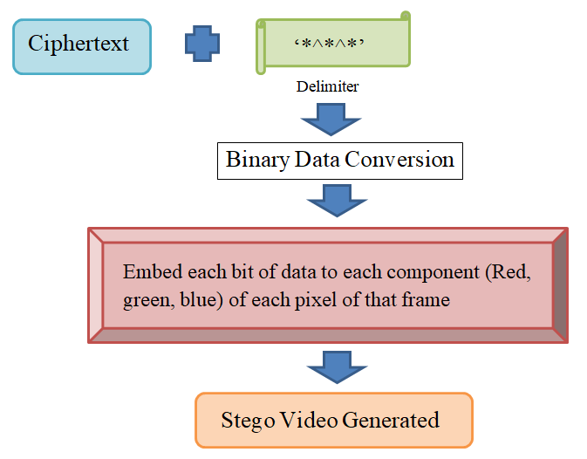

Slide 48
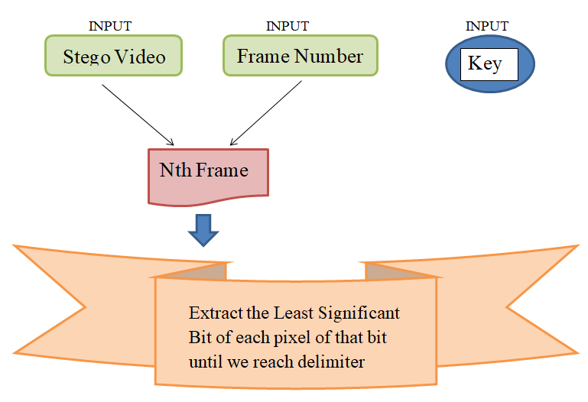
DECODE

Slide 49
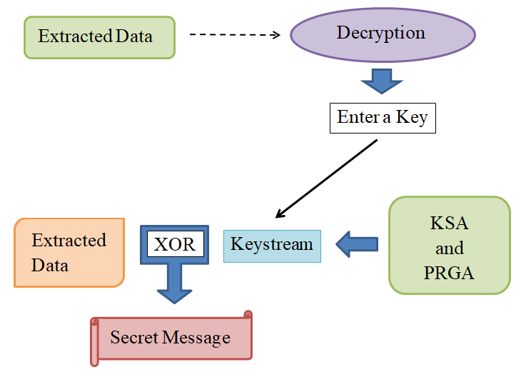

Slide 50
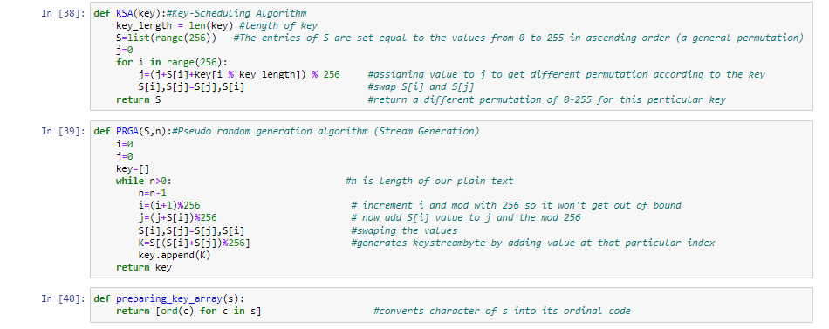
KSA AND PRGA

Slide 51
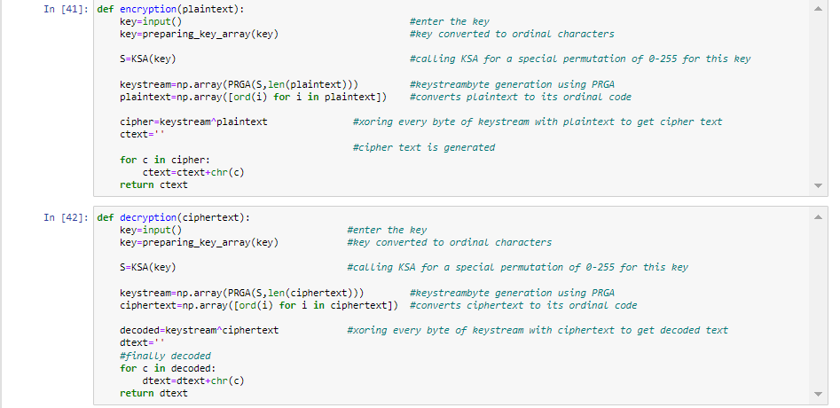
ENCRYPTION AND DECRYPTION

Slide 52
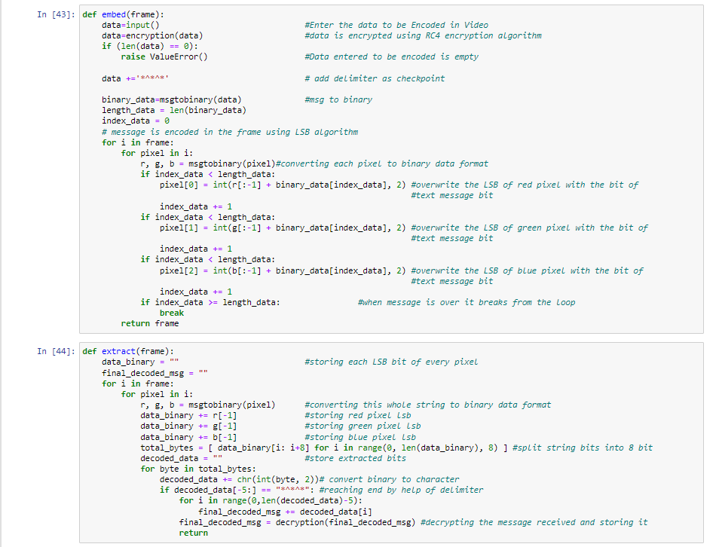
EMBED AND EXTRACT

