Slide 1

Design of Gobang Game Program Based On C Language
基于C语言的五子棋游戏程序设计
Reporter: 申卓凡 33140703

Slide 2
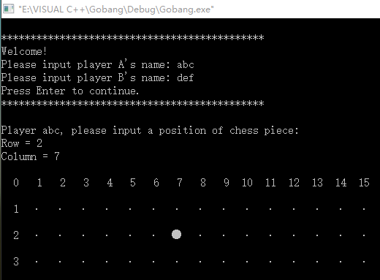
Design of Gobang Game Program Based On C Language
01
Display of final result

Slide 3
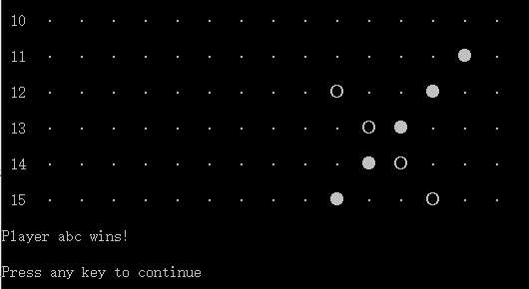
Design of Gobang Game Program Based On C Language
01
Display of final result

Slide 4
Design of Gobang Game Program Based On C Language
02
Source code
The program is composed of several parts:
function.h Header file to store global variables and declare functions;
main.c Main function;
chessboard.c A function to refresh the chessboard;
input.c A function to get coordinates of chess pieces;
judge.c A function to judge whether a player has wined the game;
print.c A function to dispaly the chessboard.

Slide 5
Header file
function.h
#define M 16
#define N 16 //size of the chessboard: 15*15
#define MAX 14 //maximum length of user name
#define NUMBER 5 // five chess pieces
struct coordinate {
int r;
int c;
}; //define a structure variable to store the location of chess piece
struct coordinate input(int round, char user1[], char user2[]);
void print(int (* chess)[N]);
int judge(int (* chess)[N], int round, char user1[], char user2[]);
void chessboard(char user1[], char user2[]); //declarations of functions

Slide 6
THANKS

