Slide 1

Design of Gobang Game Program Based On C Language
基于C语言的五子棋游戏程序设计
Man-Machine Chess Game

Slide 2
Design of Gobang Game Program Based On C Language
01
Desigh
header.h Function Declaration;
main.c Main function;
welcome.c The function to tell players how to operate this game;
set.c The function to set the game;
execute.c The function to execute the game program;
input.c The function to input the position of chess pieces;
judge.c The function to judge whether someone has won the game;
display.c The function to display the chessboard.

Slide 3
Header File
header.h
#define M 15 #define N 15 //size of the chessboard: 15*15
#define MAX 14 //maximum length of user name
#define NUMBER 5 // five chess pieces
struct coordinate {
int r;
int c;
}; //define a structure variable to store the location of chess piece
void welcome();
void display();
void input();
int judge();
void set();
void execute(); //declarations of functions

Slide 4
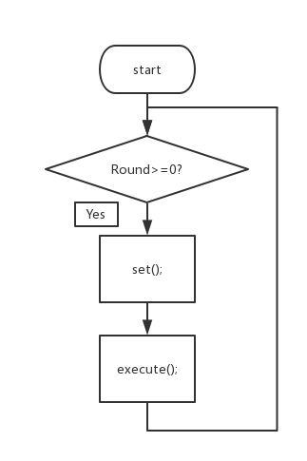
Main Function
main.c (endless loop)
char User1[MAX], User2[MAX];//user names
int Chess[M][N];//chessboard
struct coordinate Position;
//position of chess piece and cursor
char Direction;
int Turn;//whose go it is now
int Winner;//the winner
int Win1, Win2;
//each one has won how many rounds of game
int Round;
//the rounds of game that have finished

Slide 5
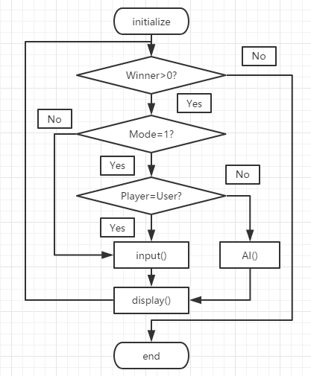
‘Execute’Function
execute.c

Slide 6
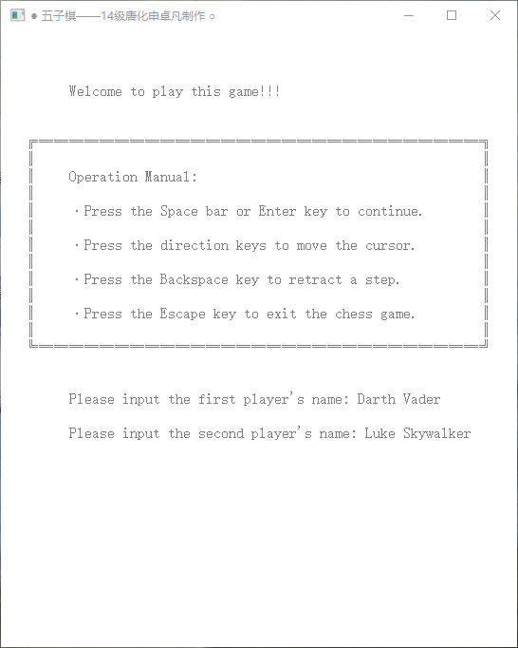
Design of Gobang Game Program Based On C Language
02
What functions does it have?

Slide 7
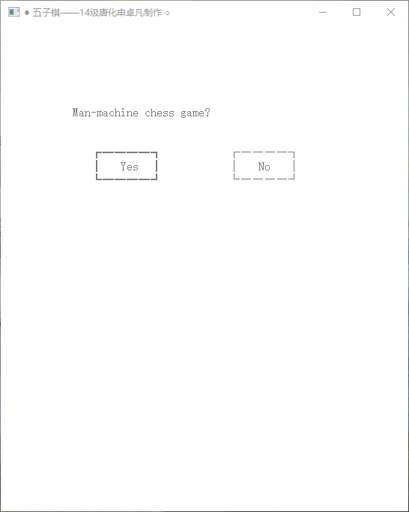

Design of Gobang Game Program Based On C Language
02
What functions does it have?

Slide 8
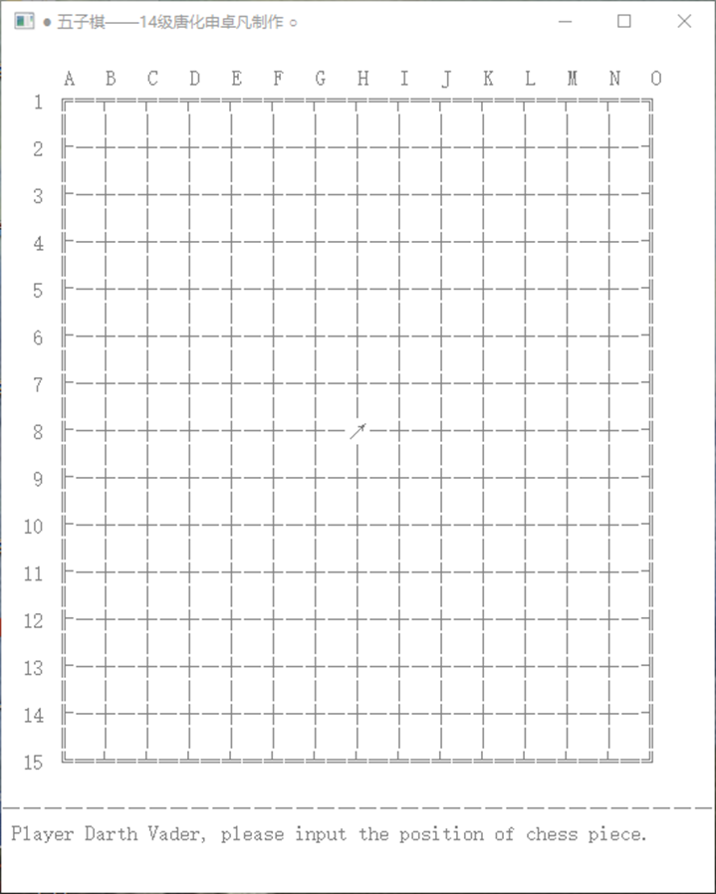
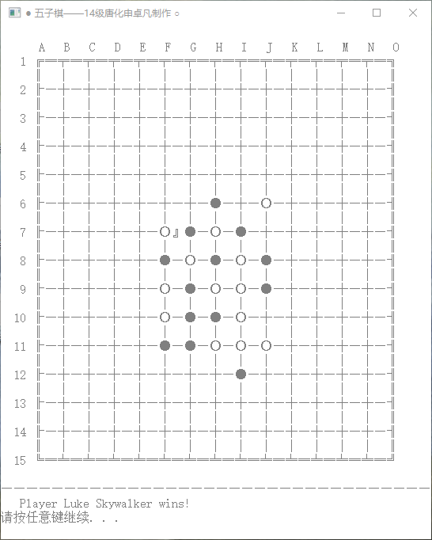
Design of Gobang Game Program Based On C Language
02
What functions does it have?

Slide 9
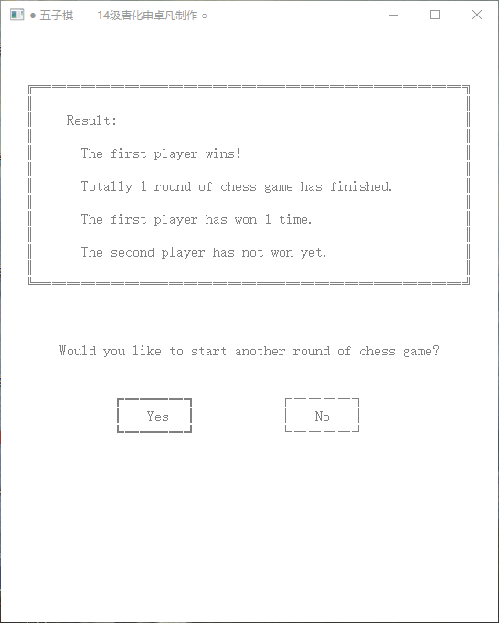
Design of Gobang Game Program Based On C Language
02
What functions does it have?

Slide 10
Design of Gobang Game Program Based On C Language
03
Highlights
User-Friendly Program Interface;
Able to Choose Who Go First;
Able to Retract a Step of Move;
Recording How Many Rounds Each One Has Won;
Artificial Intelligence to Play against Human.

Slide 11
THANKS

