Slide 1
d:
cd ffmpeg-20180325-5b31dd1-win64-static
cd bin
ffplay.exe Wildlife.wmv

Slide 2
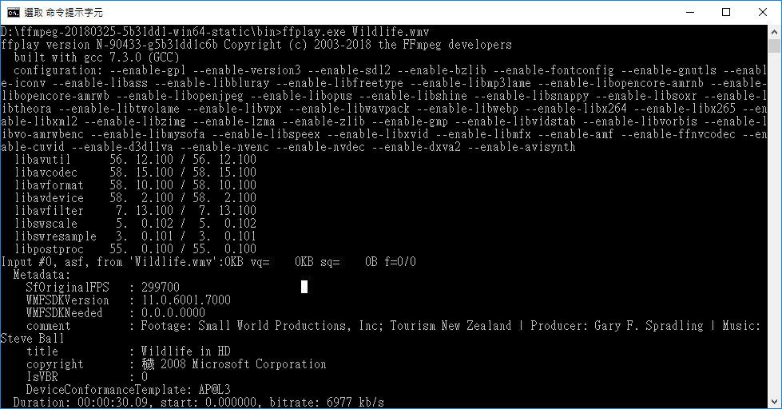

Slide 3
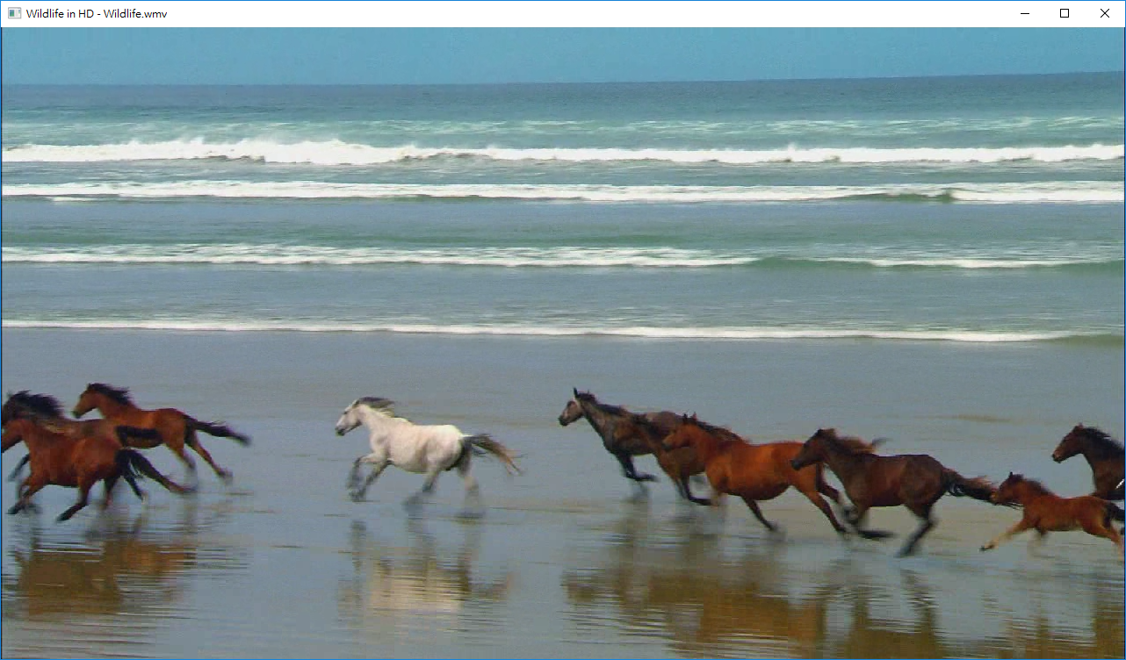

Slide 4
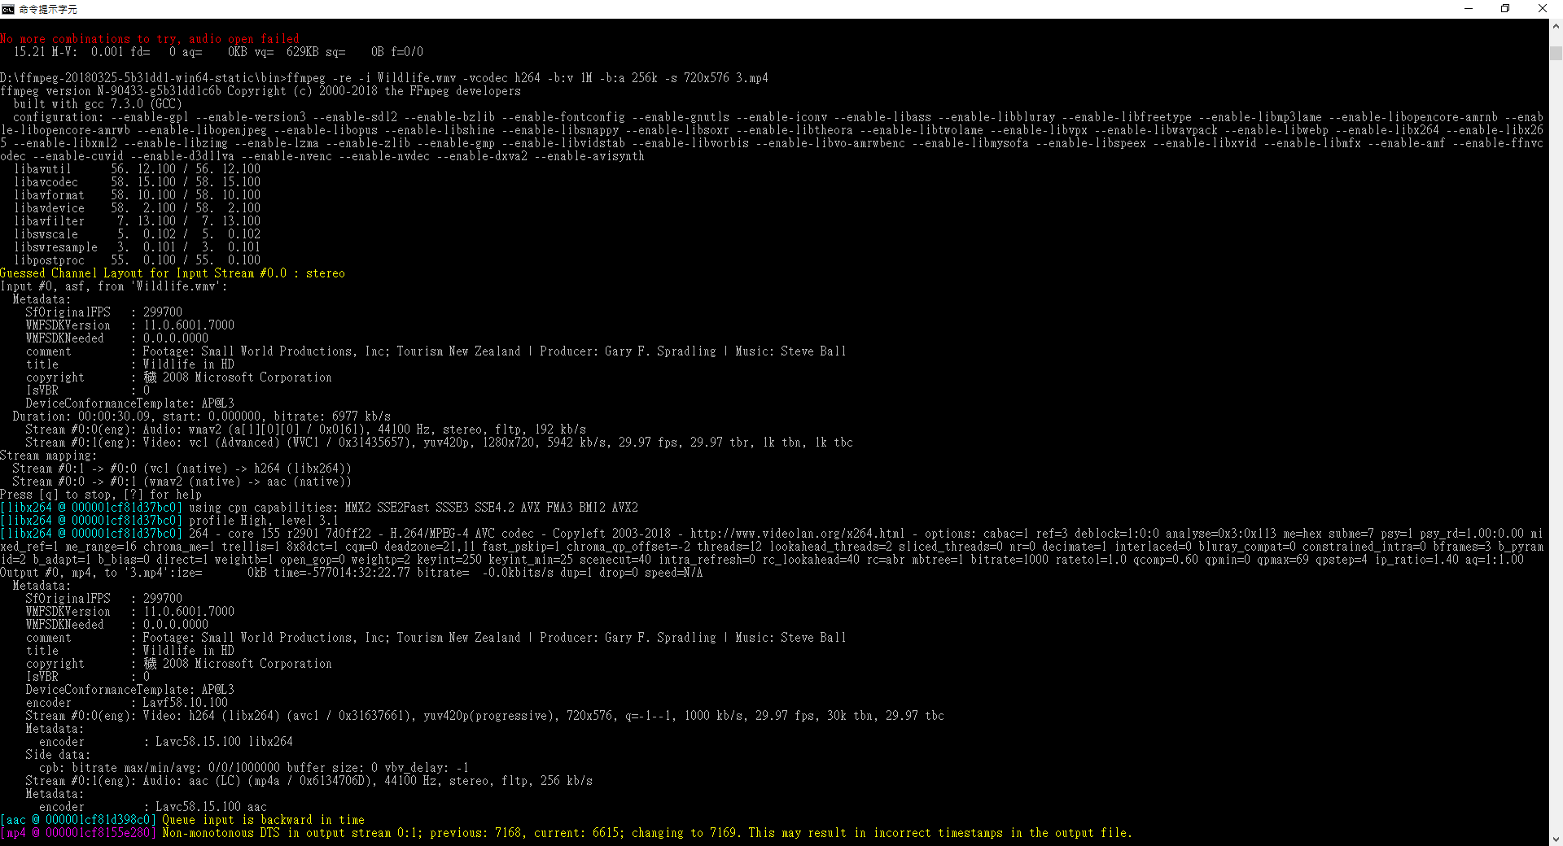
ffmpeg -re -i Wildlife.wmv -vcodec h264 -b:v 1M -b:a 256k -s 720x576 3.mp4

Slide 5
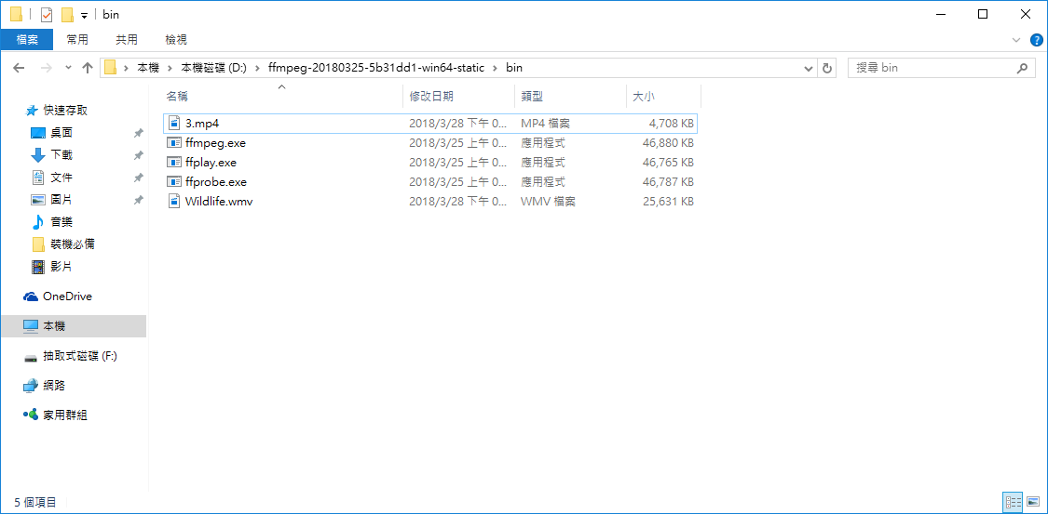

Slide 6
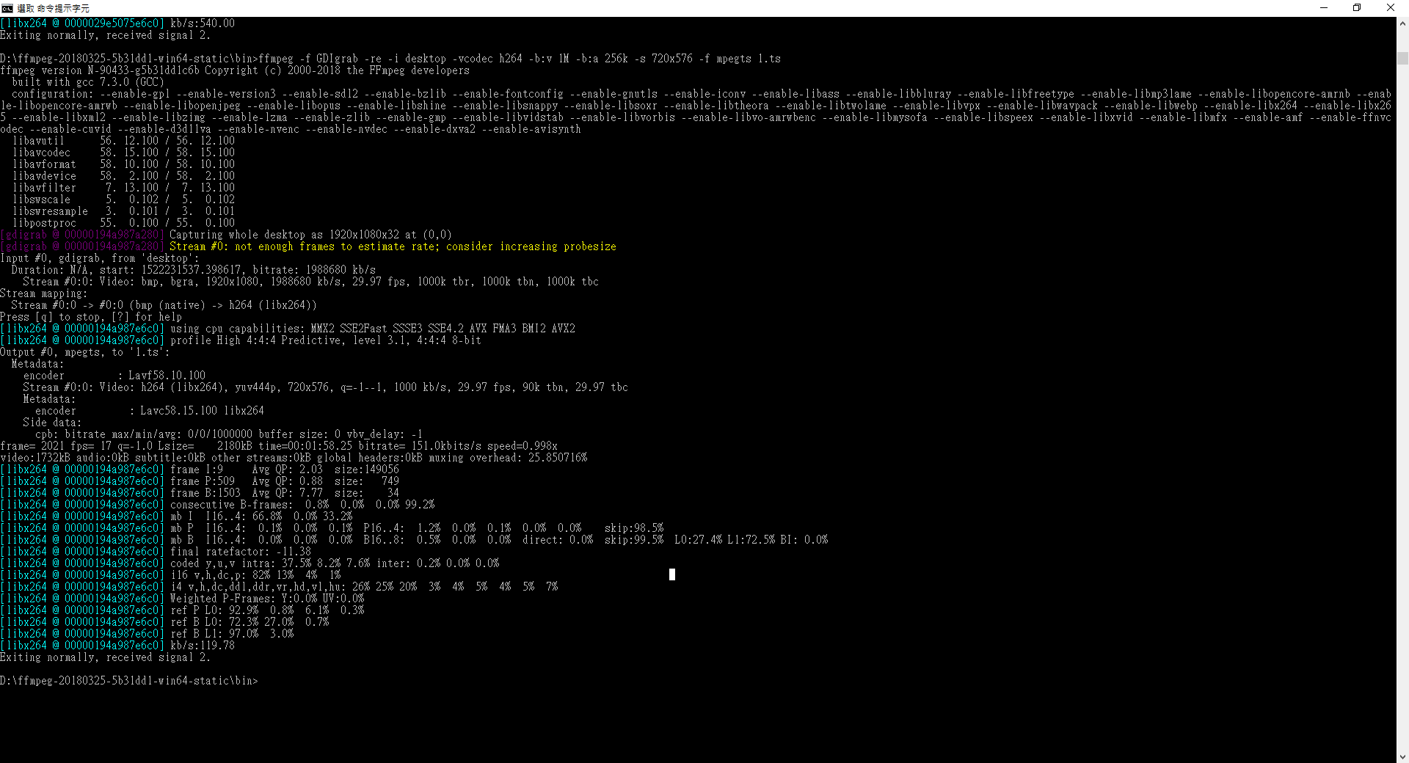
ffmpeg -f GDIgrab -re -i desktop -vcodec h264 -b:v 1M -b:a 256k -s 720x576 -f mpegts 1.ts

Slide 7
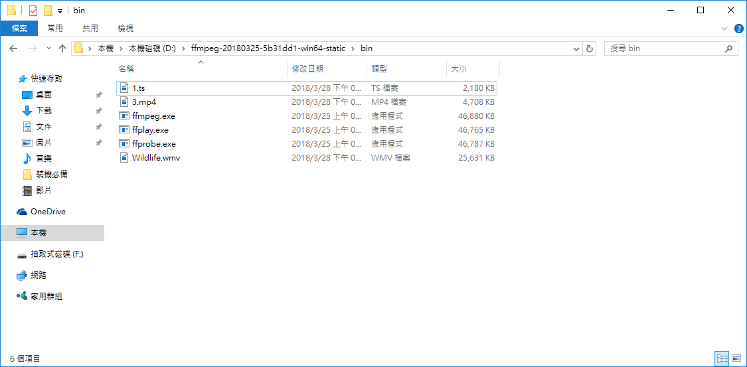

Slide 8
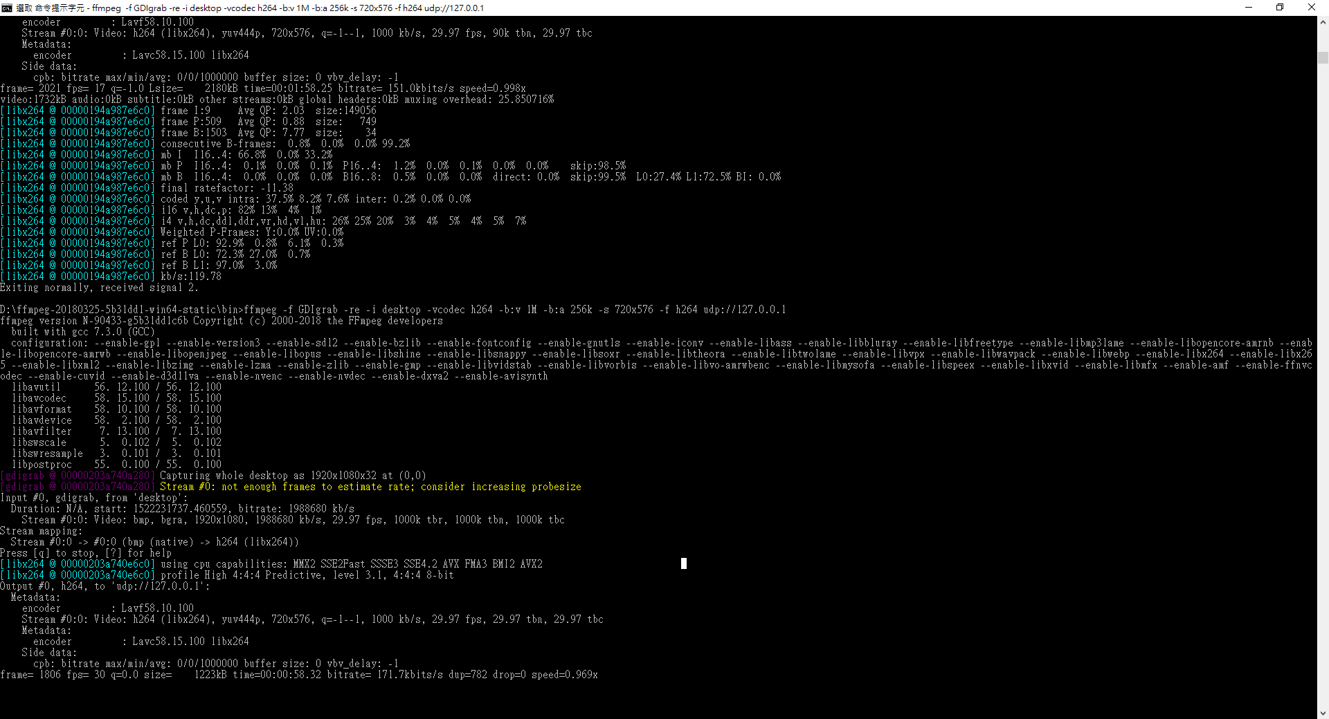
ffmpeg -f GDIgrab -re -i desktop -vcodec h264 -b:v 1M -b:a 256k -s 720x576 -f h264 udp://127.0.0.1

