Slide 1
USB Component
USB Component
USB Host
HID
Human Interface Device
CDC
Communications Device
USB Host Core
MSC
Mass Storage Class
Custom
Custom Device Class
USB Device
HID
Human Interface Device
CDC
Communications Device
USB Device Core
MSC
Mass Storage Class
Custom
Custom Device Class
ADC
Audio Device Class
CMSIS-Driver
USB Host
USB Device

Slide 2
Pipe
Transfer
Transaction
Token
Packet
Data
Packet
Status
Packet

Slide 3
Packet Structure
Sync
Data Bytes
EOP

Slide 4

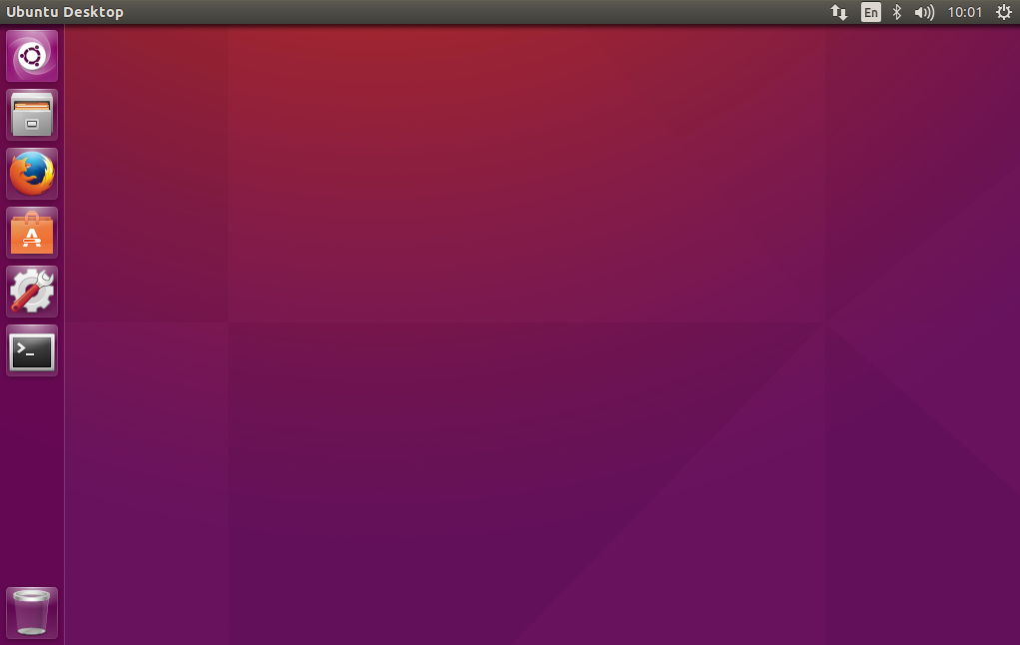

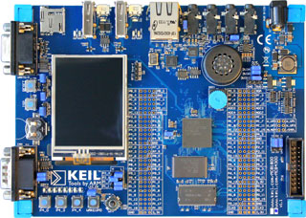
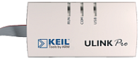
USB
To Network
USB

Slide 5

USB
To Network
USB

Slide 6
USBD_Config_HID_0.h
USBD_User_HID_0.c
USBD_User_Device_0.c
Configuration
File
User Code
Template
RTE Components
CDC 0
HID 0
HID 1
MSC 0
USB Device Class
USBD_Config_0.c
USB Device 0
USB Device 1
USB Device
RTE_Device.h
Driver_USBD0
Driver_USBD1
USB Device Driver
USB Controller 0
USB Controller 1
MCU Hardware

Slide 7
USB Controller
USB Controller
ULPI-I/F
Internal PHY
External PHY
VBUS
DP
DM
ID
VBUS
DP
DM
ID
USB Connector
USB Connector

Slide 8
USBH_Config_CDC.h
USBH_Config_MSC.h
USBH_Config_CustomClass.h
USBH_MSC.c
USBH_User_CustomClass.c
USBH_Config_HID.h
RTE Components
Supported USB Device Class
HID
CDC
MSC
Custom
Class
USBH_Config_0.c
USB Host 0
USB Host 1
USB Host
Driver_USBH0
Driver_USBH1
RTE_Device.h
USB Host Driver
USB Controller 0
USB Controller 1
MCU Hardware
Configuration
File
User Code
Template

Slide 9
USB Host
USB Device
USB Middleware
Hardware Dependent
USB Middleware
USB Host
Control Transfers
Message Pipes
Control IN Endpoint 0
USB Device
Control OUT Endpoint 0
Client
Interrupt Transfers
Stream Pipes
Interrupt IN Endpoint 1
Device Functionality 1
(e.g. HID Class)
Interrupt OUT Endpoint 1
Client
Bulk Transfers
Stream Pipes
Bulk IN Endpoint 2
Device Functionality 2
(e.g. MSC)
Bulk OUT Endpoint 2
Client
Interrupt Transfers
Stream Pipe
Interrupt IN Endpoint 3
Device Functionality 3
(e.g. CDC)
Bulk Transfers
Stream Pipes
Bulk IN Endpoint 4
Bulk OUT Endpoint 4
Client
Isochronous Transfers
Stream Pipe
Isochronous OUT Endpoint 5
Device Functionality 4
(e.g. ADC Class)
...
Client
IN Endpoint 15
Device Functionality n
Stream Pipes
OUT Endpoint 15

Slide 10
File System
File I/O functions
USB Host MSC Driver
USBH_MSC_GetDeviceStatus
USB Host
USBH_Initialize
USBH_Uninitialize
CMSIS-Driver USB Host

Slide 11
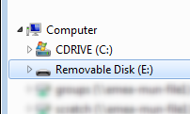
Storage Media
USB Device
File System
User Application

