Slide 1
Pandas資料分析學習報告
人工智慧與資訊安全
學生：蔡昱輝
指導老師：恩師龍大大

Slide 2
Agenda
資料科學與Pandas
Data Wrangling: Join, Combine, and Reshape（數據加工：連接,合併,整形）
Combining and Merging Datasets（合併數據集）
重塑和旋轉（整形和旋轉）
Pandas專案分析

Slide 3
資料科學與Pandas

Slide 4
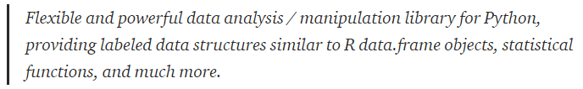
由Pandas開始的資料科學
PanDaS 取名自 pan(el)-da(ta)-s 與 Panel , DataFrame , Series 相呼應，它的GitHub repository. 是如此介紹的：
適用於Python的強大數據分析與操作庫，提供R data.frame objects，統計函數等，類似的標記數據結構。
資料來源:Datainpoint

Slide 5
資料科學 Data Science
Data Science 是一門利用資料學習知識的學科，其目標是通過從資料中提取出有價值的部分來生產資料產品。
資料科學技術可以幫助我們，如何正確的處理資料，並協助我們在生物學、社會科學、人類學等領域進行研究調研。
此外，資料科學也對商業競爭有極大的幫助。
資料來源:維基百科

Slide 6
Data Wrangling: Join, Combine, and Reshape（數據加工：連接,合併,整形）

Slide 7
Data Wrangling: Join, Combine, and Reshape（數據加工：連接, 合併, 重塑）
在很多的應用之中，通常有很多的資料分散在不同的文件或是數據庫之中，這並不方便我們進行資料的分析。
在這時可以幫助我們對數據:連接, 合併, 重塑 的工具就顯得非常重要。
資料來源:Jupyter

Slide 8
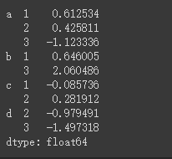
import pandas as pd
import numpy as np
data = pd . Series ( np . random . randn ( 9 ),
index = [[ 'a' , 'a' , 'a' , 'b' , 'b' , 'c' , 'c' , 'd' , 'd' ], [ 1 , 2 , 3 , 1 , 3 , 1 , 2 , 2 , 3 ]])
data

Slide 9
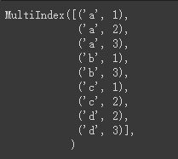
data . index

Slide 10

data [ 'b' ]

Slide 11
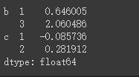
data [ 'b' : 'c' ]

Slide 12
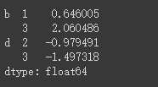
data . loc [[ 'b' , 'd' ]]

Slide 13

data . loc [:, 2 ]

Slide 14
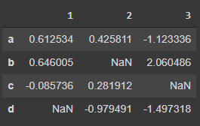
data . unstack ()

Slide 15
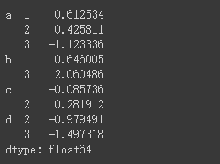
data . unstack () . stack ()

Slide 16
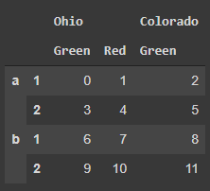
frame = pd . DataFrame ( np . arange ( 12 ) . reshape (( 4 , 3 )),
index = [[ 'a' , 'a' , 'b' , 'b' ], [ 1 , 2 , 1 , 2 ]],
columns = [[ 'Ohio' , 'Ohio' , 'Colo rado' ], [ 'Green' , 'Red' , 'Green']])
frame

Slide 17
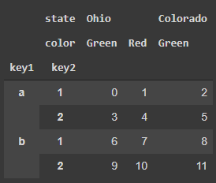
frame . index . names = [ 'key1' , 'key2' ]
frame . columns . names = [ 'state' , 'color' ]
frame

Slide 18
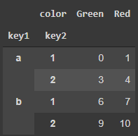
frame [ 'Ohio' ]

Slide 19

pd . MultiIndex . from_arrays ([[ 'Ohio' , 'Ohio' , 'Colorado' ], [ 'Green' , 'Red' , 'Green' ]],
names = [ 'state' , 'color' ])

Slide 20
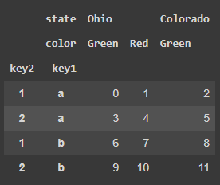
frame . swaplevel ( 'key1' , 'key2' )

Slide 21
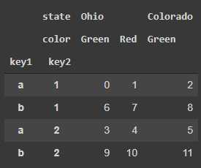
frame . sort_index ( level = 1 )

Slide 22
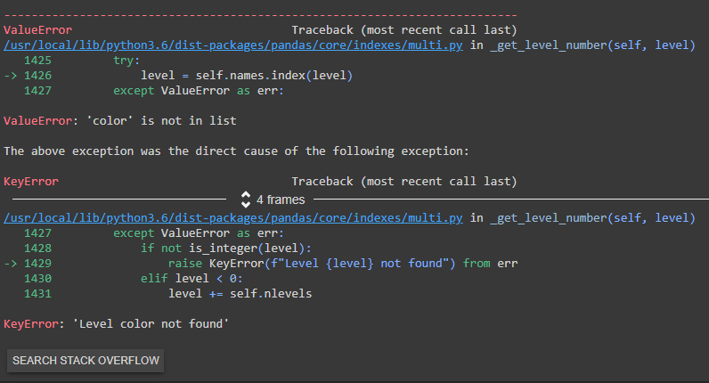
frame . sort_index ( level = 'color' )
frame . sort_index ( level = 'state' )

Slide 23
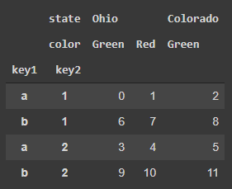
frame . sort_index ( level = 'key2' )

Slide 24
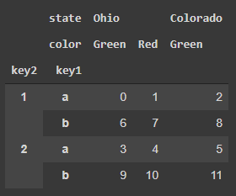
frame . swaplevel ( 0 , 1 ) . sort_index ( level = 0 )

Slide 25
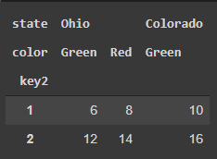
frame . sum ( level = 'key2' )

Slide 26
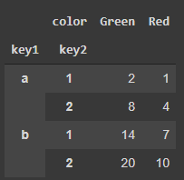
frame . sum ( level = 'color' , axis = 1 )

Slide 27
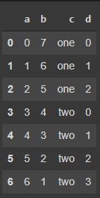
frame = pd . DataFrame ({ 'a' : range ( 7 ),
'b' : range ( 7 , 0 , -1 ),
'c' : [ 'one' , 'one' , 'one' , 'two' , 'two' ,'two' , 'two' ],
'd' : [ 0 , 1 , 2 , 0 , 1 , 2 , 3]})
frame

Slide 28
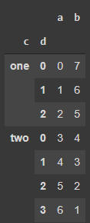
frame2 = frame . set_index ([ 'c' , 'd' ])
frame2

Slide 29
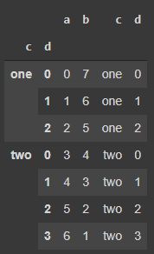
frame . set_index ([ 'c' , 'd' ], drop = False )

Slide 30
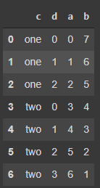
frame2 . reset_index ()

Slide 31
Combining and Merging Datasets（合併數據集）

Slide 32
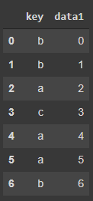
Database-Style DataFrame Joins（數據庫風格的DataFrame Joins）
df1 = pd . DataFrame ({ 'key' : [ 'b' , 'b' , 'a' , 'c' , 'a' , 'a' , 'b' ], 'data1' : range ( 7 )} ) df1

Slide 33
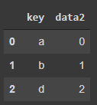
df2 = pd . DataFrame ({ 'key' : [ 'a' , 'b' , 'd' ],
'data2' : range ( 3 )})
df2

Slide 34
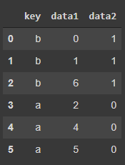
pd . merge ( df1 , df2 )

Slide 35
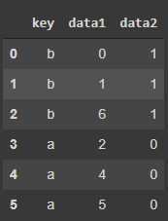
pd . merge ( df1 , df2 , on = 'key' )

Slide 36
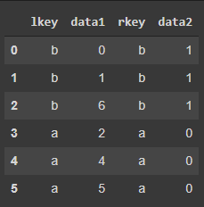
pd . merge ( df3 , df4 , left_on = 'lkey' , right_on = 'rkey' )

Slide 37
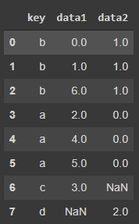
pd . merge ( df1 , df2 , how = 'outer' )

Slide 38
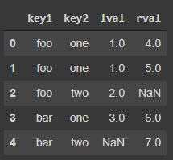
left = pd . DataFrame ({ 'key1' : [ 'foo' , 'foo' , 'bar' ],
'key2' : [ 'one' , 'two' , 'one' ],
'lval' : [ 1 , 2 , 3 ]}) right = pd . DataFrame ({ 'key1' : [ 'foo' , 'foo' , 'bar' , 'bar' ],
'key2' : [ 'one' , 'one' , 'one' , 'two' ] ,
'rval' : [ 4 , 5 , 6 , 7 ]})
pd . merge ( left , right , on = [ 'key1' , 'key2' ], how = 'outer' )

Slide 39
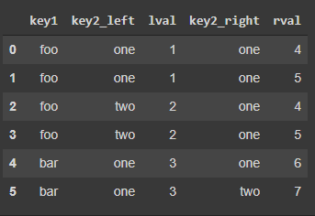
pd . merge ( left , right , on = 'key1' , suffixes = ( '_left' , '_right' ))

Slide 40
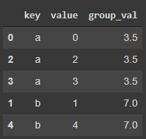
Merging on Index（在index上做歸併）
left1 = pd . DataFrame ({ 'key' : [ 'a' , 'b' , 'a' , 'a' , 'b' , 'c' ],
'value' : range ( 6 )})
right1 = pd . DataFrame ({ 'group_val' : [ 3.5 , 7 ]}, index = [ 'a' , 'b' ])
pd . merge ( left1 , right1 , left_on = 'key' , right_index = True )

Slide 41
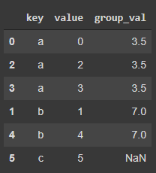
pd . merge ( left1 , right1 , left_on = 'key' , right_index = True , how = 'outer' )

Slide 42
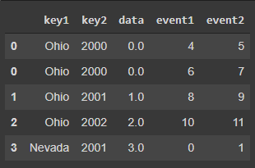
lefth = pd . DataFrame ({ 'key1' : [ 'Ohio' , 'Ohio' , 'Ohio' , 'Nevada' , 'Nevada' ], 'key2' : [ 2000 , 2001 , 2002 , 2001 , 2002 ], ' data' : np . arange ( 5. )})
righth = pd . DataFrame ( np . arange ( 12 ) . reshape (( 6 , 2 )),
index = [[ 'Nevada' , 'Nevada' , 'Ohio' , 'Ohio' , 'Ohio' , 'Ohio' ] ,
[ 2001 , 2000 , 2000 , 2000 , 2001 , 2002 ]],
columns = [ 'event1' , 'event2'])
pd . merge ( lefth , righth , left_on = [ 'key1' , 'key2' ], right_index = True )

Slide 43
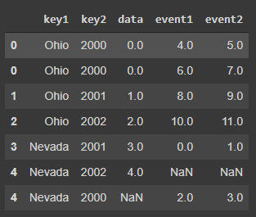
pd . merge ( lefth , righth , left_on = [ 'key1' , 'key2' ],
right_index = True , how = 'outer' )

Slide 44
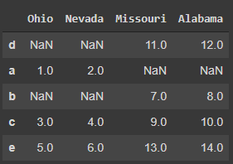
left2 = pd . DataFrame ([[ 1. , 2. ], [ 3. , 4. ], [ 5. , 6. ]],
index = [ 'a' , 'c' , 'e' ],
columns = [ 'Ohio' , 'Nevada' ])
right2 = pd . DataFrame ([[ 7. , 8. ], [ 9. , 10. ], [ 11. , 12. ], [ 13 , 14 ]],
index = [ 'b' , 'c' , ' d' , 'e' ],
columns = [ 'Missouri' , 'Alabama' ])
pd . merge ( left2 , right2 , how = 'outer' , left_index = True , right_index = True )

Slide 45
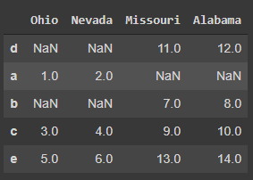
left2 . join ( right2 , how = 'outer' )

Slide 46
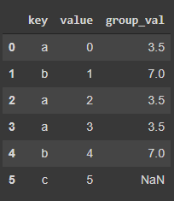
left1 . join ( right1 , on = 'key' )

Slide 47
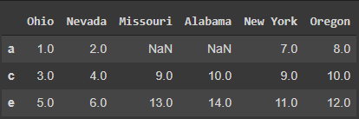
another = pd . DataFrame ([[ 7. , 8. ], [ 9. , 10. ], [ 11. , 12. ], [ 16. , 17. ]],
index = [ 'a' , 'c' , 'e' , 'f' ],
columns = [ 'New York' , 'Oregon' ])
left2 . join ([ right2 , another ])

Slide 48
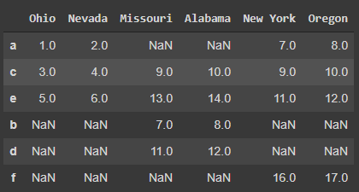
left2 . join ([ right2 , another ], how = 'outer' )

Slide 49

Concatenating Along an Axis（沿著軸串聯）
arr = np . arange ( 12. ) . reshape (( 3 , 4 ))
arr

Slide 50

np . concatenate ([ arr , arr ], axis = 1 )

Slide 51
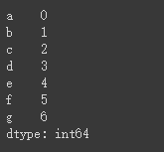
s1 = pd . Series ([ 0 , 1 ], index = [ 'a' , 'b' ]) s2 = pd . Series ([ 2 , 3 , 4 ], index = [ 'c' , 'd' , 'e' ]) s3 = pd . Series ([ 5 , 6 ], index = [ 'f' , 'g' ])
pd . concat ([ s1 , s2 , s3 ])

Slide 52
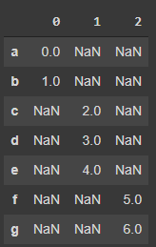
pd . concat ([ s1 , s2 , s3 ], axis = 1 )

Slide 53
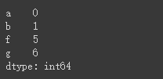
s4 = pd . concat ([ s1 , s3 ])
s4

Slide 54
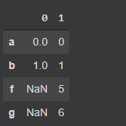
pd . concat ([ s1 , s4 ], axis = 1 )

Slide 55

pd . concat ([ s1 , s4 ], axis = 1 , join = 'inner' )

Slide 56
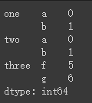
result = pd . concat ([ s1 , s1 , s3 ], keys = [ 'one' , 'two' , 'three' ])
result

Slide 57
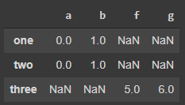
result . unstack ()

Slide 58
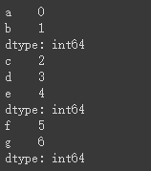
print ( s1 )
print ( s2 )
print ( s3 )

Slide 59
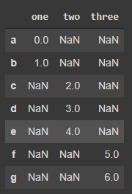
pd . concat ([ s1 , s2 , s3 ], axis = 1 , keys = [ 'one' , 'two' , 'three' ])

Slide 60
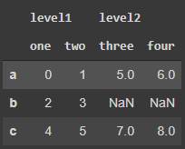
df1 = pd . DataFrame ( np . arange ( 6 ) . reshape ( 3 , 2 ), index = [ 'a' , 'b' , 'c' ],
columns = [ 'one' , 'two' ])
df2 = pd . DataFrame ( 5 + np . arange ( 4 ) . reshape ( 2 , 2 ), index = [ 'a' , 'c' ],
columns = [ 'three' , 'four' ])
pd . concat ([ df1 , df2 ], axis = 1 , keys = [ 'level1' , 'level2' ])

Slide 61
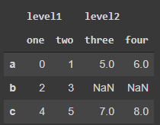
pd . concat ({ 'level1' : df1 , 'level2' : df2 }, axis = 1 )

Slide 62
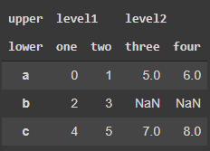
pd . concat ([ df1 , df2 ], axis = 1 , keys = [ 'level1' , 'level2' ],
names = [ 'upper' , 'lower' ])

Slide 63
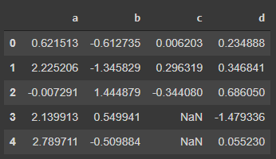
df1 = pd . DataFrame ( np . random . randn ( 3 , 4 ), columns = [ 'a' , 'b' , 'c' , 'd' ])
df2 = pd . DataFrame ( np . random . randn ( 2 , 3 ), columns = [ 'b' , 'd' , 'a' ])
pd . concat ([ df1 , df2 ], ignore_index = True )

Slide 64

Combining Data with Overlap（用重疊來合併數據）
a = pd . Series ([ np . nan , 2.5 , np . nan , 3.5 , 4.5 , np . nan ],
index = [ 'f' , 'e' , 'd' , 'c' , 'b' , ' a' ])
b = pd . Series ( np . arange ( len ( a ), dtype = np . float64 ),
index = [ 'f' , 'e' , 'd' , 'c' , 'b' , 'a' ])
np . where ( pd . isnull ( a ), b , a )

Slide 65

b [: - 2 ] . combine_first ( a [ 2 :])

Slide 66

df1 = pd . DataFrame ({ 'a' : [ 1. , np . nan , 5. , np . nan ],
'b' : [ np . nan , 2. , np . nan , 6. ],
'c' : range ( 2 , 18 , 4 )})
df2 = pd . DataFrame ({ 'a' : [ 5. , 4. , np . nan , 3. , 7. ],
'b' : [ np . nan , 3. , 4. , 6. , 8. ] })
df1 . combine_first ( df2 )

Slide 67
重塑和旋轉（整形和旋轉）

Slide 68

Reshaping with Hierarchical Indexing（對多層級索引進行整形）
data = pd.DataFrame(np.arange(6).reshape((2, 3)),
index=pd.Index(['Ohio', 'Colorado'], name='state'),
columns=pd.Index(['one', 'two', 'three'],
name='number'))
data

Slide 69

result = data.stack()

Slide 70

result.unstack()

Slide 71

result.unstack(0)

Slide 72

result.unstack('state')

Slide 73

s1 = pd.Series([0, 1, 2, 3], index=['a', 'b', 'c', 'd']) s2 = pd.Series([4, 5, 6], index=['c', 'd', 'e']) data2 = pd.concat([s1, s2], keys=['one', 'two'])

Slide 74

data2.unstack()

Slide 75

data2.unstack().stack()

Slide 76

data2.unstack().stack(dropna=False)

Slide 77

df = pd.DataFrame({'left': result, 'right': result + 5},
columns=pd.Index(['left', 'right'], name='side'))

Slide 78

df.unstack('state')

Slide 79

df.unstack('state').stack('side')

Slide 80

Pivoting “Long” to “Wide” Format （把“長”格式旋轉為“寬”格式）
data = pd.read_csv('../examples/macrodata.csv')
data.head()

Slide 81

periods = pd.PeriodIndex(year=data.year, quarter=data.quarter,
name='date')
columns = pd.Index(['realgdp', 'infl', 'unemp'], name='item')
data = data.reindex(columns=columns)
data.index = periods.to_timestamp('D', 'end')
ldata = data.stack().reset_index().rename(columns={0: 'value'})
ldata[:10]

Slide 82


pivoted = ldata.pivot('date', 'item', 'value')

Slide 83

ldata['value2'] = np.random.randn(len(ldata))

Slide 84

pivoted = ldata.pivot('date', 'item')

Slide 85

pivoted['value'][:5]

Slide 86

unstacked = ldata.set_index(['date', 'item']).unstack('item')

Slide 87

Pivoting “Wide” to “Long” Format（把“寬”格式旋轉為“長”格式）
df = pd.DataFrame({'key': ['foo', 'bar', 'baz'],
'A': [1, 2, 3],
'B': [4, 5, 6],
'C': [7, 8, 9]})
melted = pd.melt(df, ['key'])

Slide 88

reshaped = melted.pivot('key', 'variable', 'value')

Slide 89

reshaped.reset_index()

Slide 90

pd.melt(df, id_vars=['key'], value_vars=['A', 'B'])

Slide 91

pd.melt(df, value_vars=['A', 'B', 'C'])

Slide 92

pd.melt(df, value_vars=['key','A', 'B'])

Slide 93
Pandas專案分析

