Slide 1
網站漏洞分析與實務 DVWA網站安全測試報告
2020 人工智慧與資訊安全 期末平時報告
報告者:蔡昱輝
指導教授:偉大的恩師 龍大大

Slide 2
Agenda
網站的資安威脅
OWASP TOP 10
OWASP API TOP 10
DVWA測試平台
SQL Injection
Command Injection

Slide 3
網站的資安威脅

Slide 4
了解資安威脅
隨著網際網路的發達，大家也越來越依賴網站提供的便利服務，攻擊者對網站不懷好意的犯罪案例也是層出不窮，只要入侵網站後台動點手腳，大家辛苦建置的網站就會變成犯罪者的攻擊武器，訪客一旦參觀網站就會被攻擊或被感染惡意程式。
而網站裡所儲存的大量機密資訊，像個人資料、密碼、信用卡卡號等，更是攻擊者虎視眈眈的肥肉。
若建置網站時沒有意識到這些威脅，而沒有做防護措施，這些機密資料就會被網路罪犯偷走，負面新聞也會影響訪客使用網站服務的意願，更嚴重還會傷及企業形象。
http://www.cc.ntu.edu.tw/chinese/epaper/0046/20180920_4609.html

Slide 5
OWASP TOP 10

Slide 6
OWASP TOP 10 2017
A1:2017-Injection
A2:2017-Broken Authentication
A3:2017-Sensitive Data Exposure
A4:2017-XML External Entities (XXE)
A5:2017-Broken Access Control
A6:2017-Security Misconfiguration
A7:2017-Cross-Site Scripting (XSS)
A8:2017-Insecure Deserialization
A9:2017-Using Components with Known Vulnerabilities
A10:2017-Insufficient Logging & Monitoring
https://owasp.org/www-project-top-ten/2017/

Slide 7
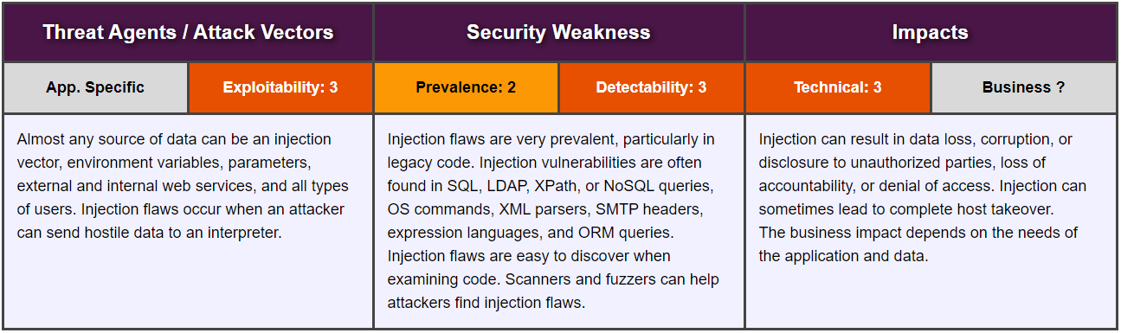
A1:2017-Injection 注入
https://owasp.org/www-project-top-ten/2017/A1_2017-Injection.html

Slide 8
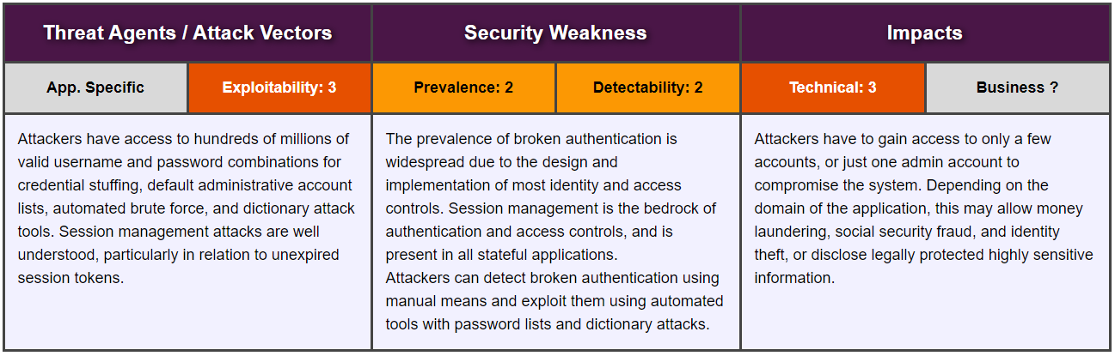
A2:2017-Broken Authentication 身份驗證失敗
https://owasp.org/www-project-top-ten/2017/A2_2017-Broken_Authentication.html

Slide 9
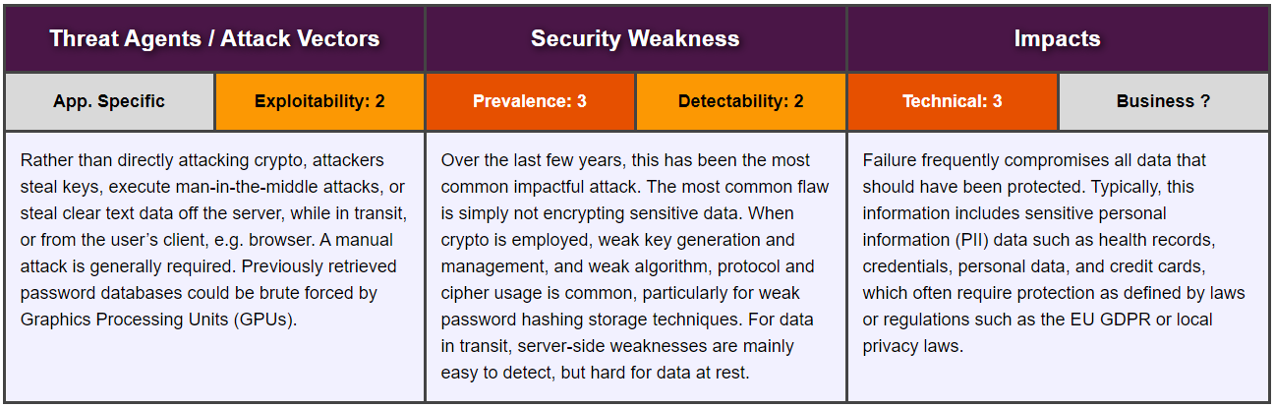
A3:2017-Sensitive Data Exposure 敏感數據公開
https://owasp.org/www-project-top-ten/2017/A3_2017-Sensitive_Data_Exposure.html

Slide 10
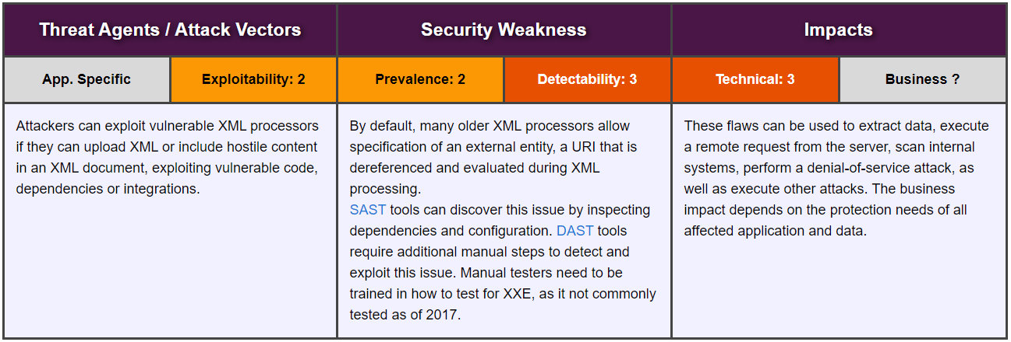
A4:2017-XML External Entities (XXE) XML外部實體 (XXE)
https://owasp.org/www-project-top-ten/2017/A4_2017-XML_External_Entities_(XXE).html

Slide 11
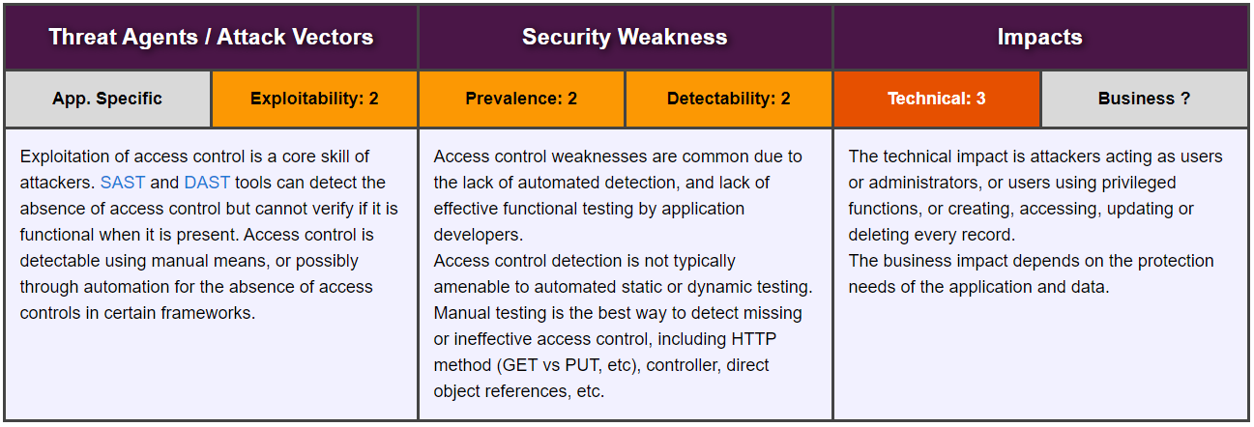
A5:2017-Broken Access Control 損壞的訪問控制
https://owasp.org/www-project-top-ten/2017/A5_2017-Broken_Access_Control.html

Slide 12
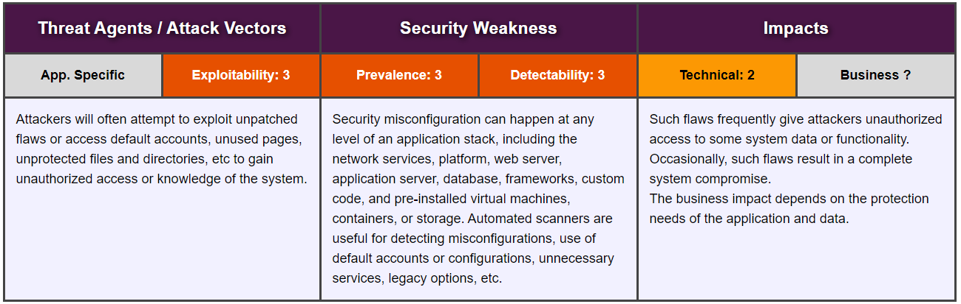
A6:2017-Security Misconfiguration 安全性錯誤配置
https://owasp.org/www-project-top-ten/2017/A6_2017-Security_Misconfiguration.html

Slide 13
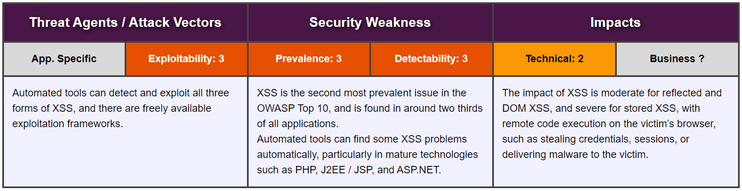
A7:2017-Cross-Site Scripting (XSS) 跨站點腳本 (XSS)
https://owasp.org/www-project-top-ten/2017/A7_2017-Cross-Site_Scripting_(XSS).html

Slide 14
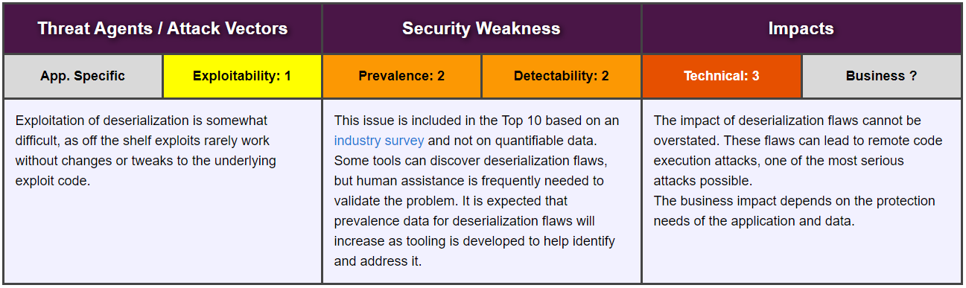
A8:2017-Insecure Deserialization 不安全反序列化
https://owasp.org/www-project-top-ten/2017/A8_2017-Insecure_Deserialization.html

Slide 15
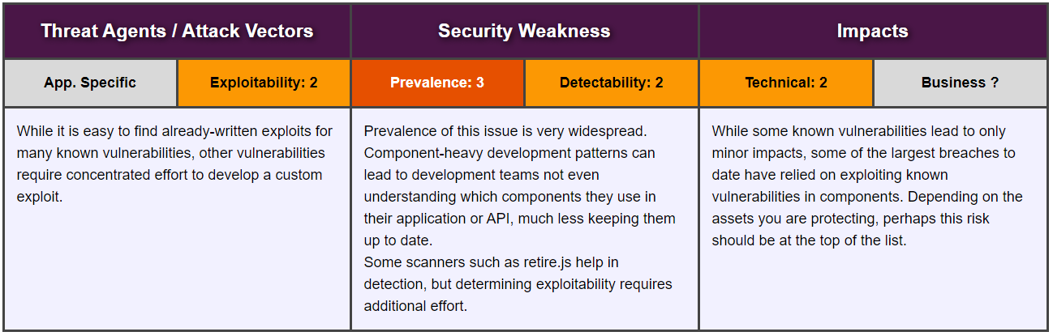
A9:2017-Using Components with Known Vulnerabilities 使用具有已知漏洞的組件
https://owasp.org/www-project-top-ten/2017/A9_2017-Using_Components_with_Known_Vulnerabilities.html

Slide 16
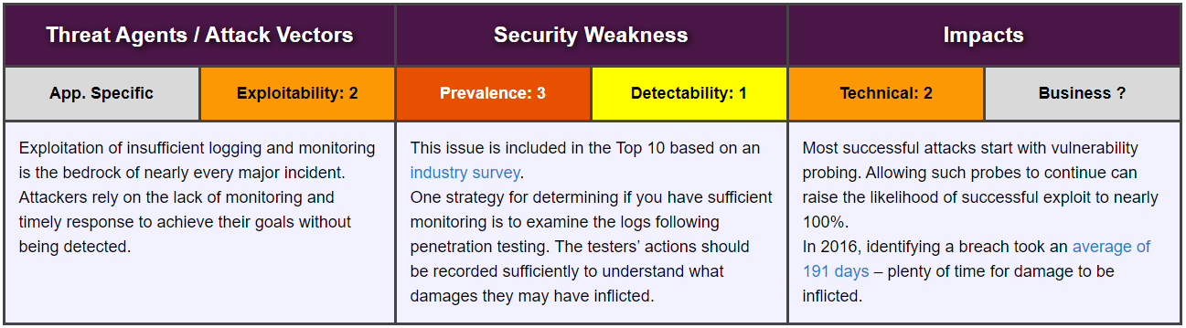
A10:2017-Insufficient Logging & Monitoring 日誌記錄和監控不足
https://owasp.org/www-project-top-ten/2017/A10_2017-Insufficient_Logging%2526Monitoring.html

Slide 17
OWASP API TOP 10

Slide 18
OWASP API TOP 10 2019
API1:2019 Broken Object Level Authorization
API2:2019 Broken User Authentication
API3:2019 Excessive Data Exposure
API4:2019 Lack of Resources & Rate Limiting
API5:2019 Broken Function Level Authorization
API6:2019 Mass Assignment
API7:2019 Security Misconfiguration
API8:2019 Injection
API9:2019 Improper Assets Management
API10:2019 Insufficient Logging & Monitoring
https://owasp.org/www-project-api-security/

Slide 19
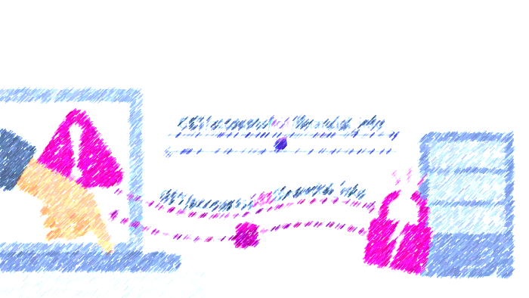
API1:2019 Broken Object Level Authorization 損壞的對象級別授權
Use case
API call parameters use the ID of the resource accessed through the API /api/shop1/financial_info.
Attackers replace the IDs of their resources with a different one which they guessed through /api/shop2/financial_info.
The API does not check permissions and lets the call through.
Problem is aggravated if IDs can be enumerated /api/123/financial_info.
https://apisecurity.io/encyclopedia/content/owasp/api1-broken-object-level-authorization

Slide 20

API2:2019 Broken User Authentication 破碎的用戶身份驗證
Use case
Unprotected APIs that are considered “internal”
Weak authentication that does not follow industry best practices
Weak API keys that are not rotated
Passwords that are weak, plain text, encrypted, poorly hashed, shared, or default passwords
Authentication susceptible to brute force attacks and credential stuffing
Credentials and keys included in URLs
Lack of access token validation (including JWT validation)
Unsigned or weakly signed non-expiring JWTs
https://apisecurity.io/encyclopedia/content/owasp/api2-broken-authentication

Slide 21
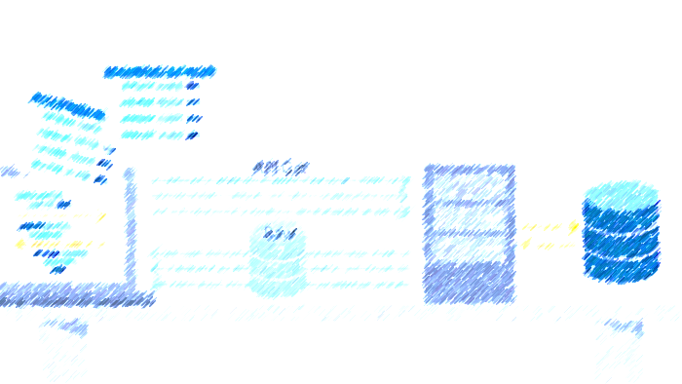
API3:2019 Excessive Data Exposure 過度的數據暴露
Use case
The API returns full data objects as they are stored in the backend database.
The client application filters the responses and only shows the data that the users really need to see.
Attackers call the API directly and get also the sensitive data that the UI would filter out.
https://apisecurity.io/encyclopedia/content/owasp/api3-excessive-data-exposure

Slide 22

API4:2019 Lack of Resources & Rate Limiting 缺乏資源和速率限制
Use case
Attackers overload the API by sending more requests than it can handle.
Attackers send requests at a rate exceeding the API's processing speed, clogging it up.
The size of the requests or some fields in them exceed what the API can process.
“Zip bombs”, archive files that have been designed so that unpacking them takes excessive amount of resources and overloads the API.
https://apisecurity.io/encyclopedia/content/owasp/api4-lack-of-resources-and-rate-limiting

Slide 23
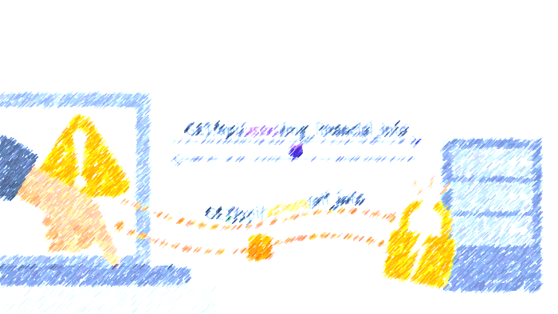
API5:2019 Broken Function Level Authorization 損壞的功能級別授權
Use case
Some administrative functions are exposed as APIs.
Non-privileged users can access these functions without authorization if they know how.
Can be a matter of knowing the URL, or using a different verb or a parameter:
/api/users/v1/user/myinfo
/api/admins/v1/users/all
https://apisecurity.io/encyclopedia/content/owasp/api5-broken-function-level-authorization

Slide 24

API6:2019 Mass Assignment 批量分配
Use case
The API works with the data structures without proper filtering.
Received payload is blindly transformed into an object and stored.
NodeJS: var user = new User(req.body); user.save();
Rails: @user = User.new(params[:user])
Attackers can guess the fields by looking at the GET request data.
https://apisecurity.io/encyclopedia/content/owasp/api6-mass-assignment

Slide 25

API7:2019 Security Misconfiguration 安全性錯誤配置
Use case
Unpatched systems
Unprotected files and directories
Unhardened images
Missing, outdated, or misconfigured TLS
Exposed storage or server management panels
Missing CORS policy or security headers
Error messages with stack traces
Unnecessary features enabled
https://apisecurity.io/encyclopedia/content/owasp/api7-security-misconfiguration

Slide 26
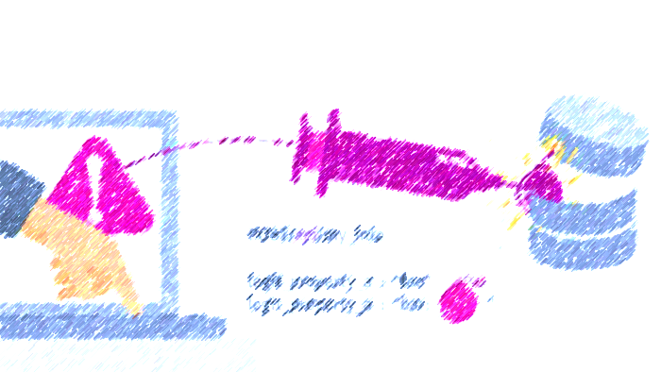
API8:2019 Injection 注射劑
Use cases
Attackers send malicious input to be forwarded to an internal interpreter:
SQL
NoSQL
LDAP
OS commands
XML parsers
Object-Relational Mapping (ORM)
https://apisecurity.io/encyclopedia/content/owasp/api8-injection

Slide 27

API9:2019 Improper Assets Management 資產管理不當
Use case
DevOps, the cloud, containers, and Kubernetes make having multiple deployments easy (for example, dev, test, branches, staging, old versions).
Desire to maintain backward compatibility forces to leave old APIs running.
Old or non-production versions are not properly maintained, but these endpoints still have access to production data.
Once authenticated with one endpoint, attackers may switch to the other, production one.
https://apisecurity.io/encyclopedia/content/owasp/api9-improper-assets-management

Slide 28

API10:2019 Insufficient Logging & Monitoring 日誌和監控不足
Use case
Logs are not protected for integrity.
Logs are not integrated into Security Information and Event Management (SIEM) systems.
Logs and alerts are poorly designed.
Companies rely on manual rather than automated systems.
https://apisecurity.io/encyclopedia/content/owasp/api10-insufficient-logging-and-monitoring

Slide 29
DVWA測試平台

Slide 30
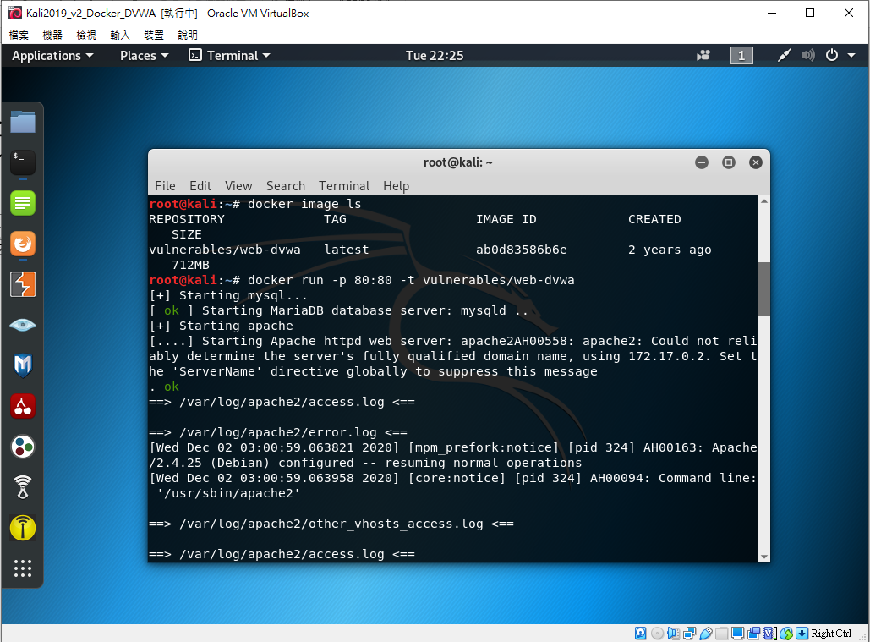
在80port啟動DVWA

Slide 31
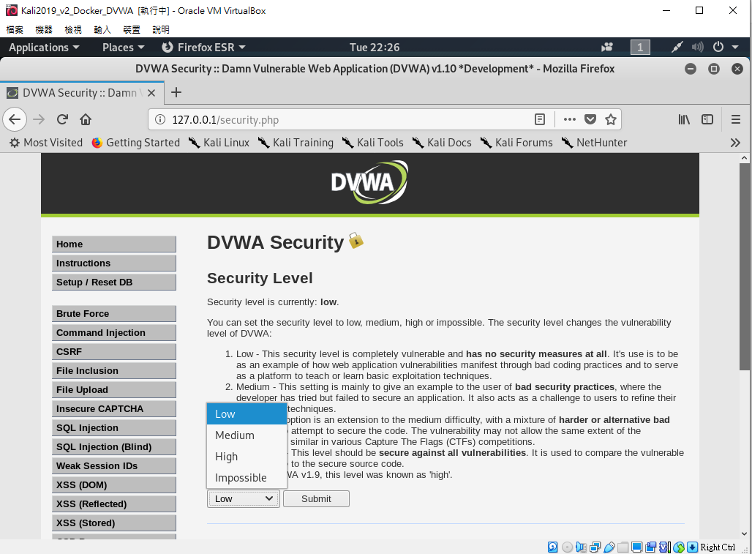
選擇DVWA的難度

Slide 32
SQL Injection

Slide 33
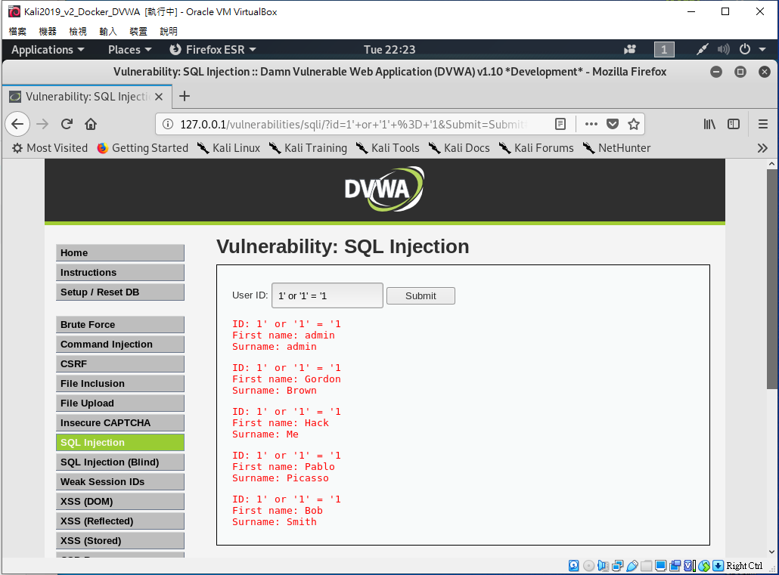
SQL 資料隱碼攻擊
SQL注入（英語：SQL injection），也稱SQL隱碼或SQL注碼，是發生於應用程式與資料庫層的安全漏洞。簡而言之，是在輸入的字串之中夾帶SQL指令，在設計不良的程式當中忽略了字元檢查，那麼這些夾帶進去的惡意指令就會被資料庫伺服器誤認為是正常的SQL指令而執行，因此遭到破壞或是入侵。

Slide 34
Command Injection

Slide 35
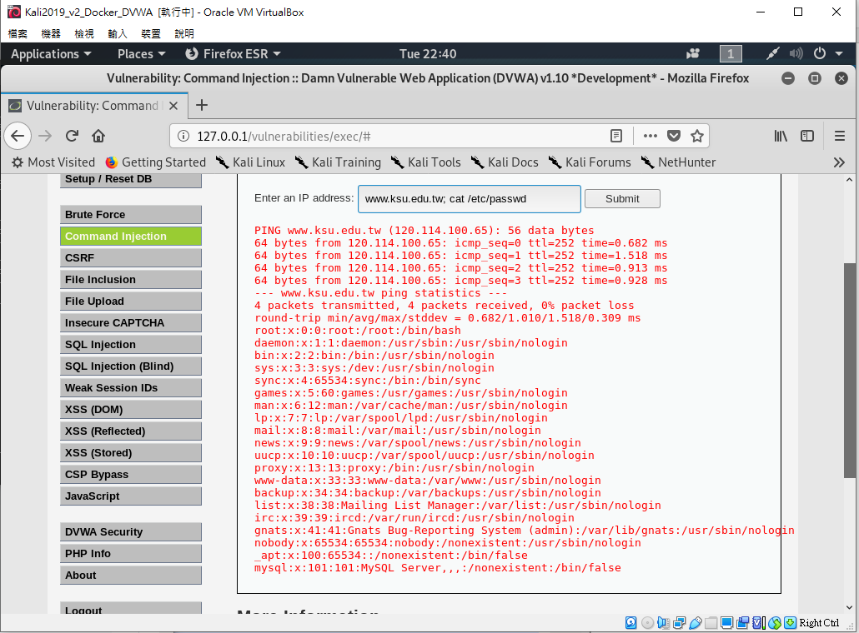
Command Injection-命令注入弱點
Command Injection（命令注入弱點）是一種常見的網頁注入攻擊行為，若管理者未在網站的輸入表單中正確過濾敏感字元，攻擊者有則可能透過這些進入點，將指令傳送至Server本機中執行後，再將執行結果透過動態網頁語言輸出，藉此獲取機敏資訊或執行未經授權的任意指令。

